Slide 1
C# Technical Sharing
Sharer: Klen
Sharing Date: 09 Jan 2020

Slide 2
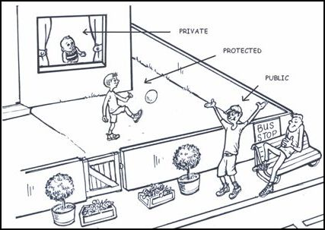
Public, Protected, Private
Public – All the project can access
Protected – Only inherited class can access
Private – Only internal of class can access
Internal – All the object in the same assembly can access

Slide 3
Encapsulation, Inheritance, Polymorphism
Encapsulation – To use access specifier to package your class
Inheritance – Subclass can inherit a base class and subclass will obtain all the setting from base class except private setting
Polymorphism – Every subclass can replace its base class. Subclass can override settings from the base class if the setting is declared to be a virtual one and it must need to override abstract settings

Slide 4
virtual v.s override v.s sealed
Virtual - To used to modify a method, property, indexer, or event declaration and allow for it to be overridden in a derived class.
Override - An override method is a new implementation of a member that is inherited from a base class. The overridden base method must be virtual, abstract, or override.
Sealed – To used to stop inheriting the particular class from other classes and we can also prevent overriding the particular properties or methods based on our requirements

Slide 5
Class v.s Struct
Class
Struct
Store in the heap memory
Can be inherited
Call by reference (reference type)
Store in the stack memory
Cannot be inherited
Call by value (value type)

Slide 6
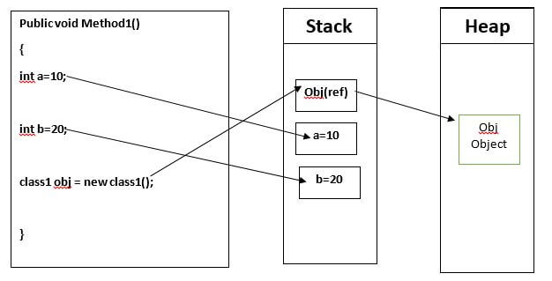
Stack v.s Heap

Slide 7
Homework
Please survey keyword - abstract
Please survey design pattern – simple factory
Do I use simple factory in my sample project? If yes, where is it?
What is difference of call by reference and call by value?

Slide 8
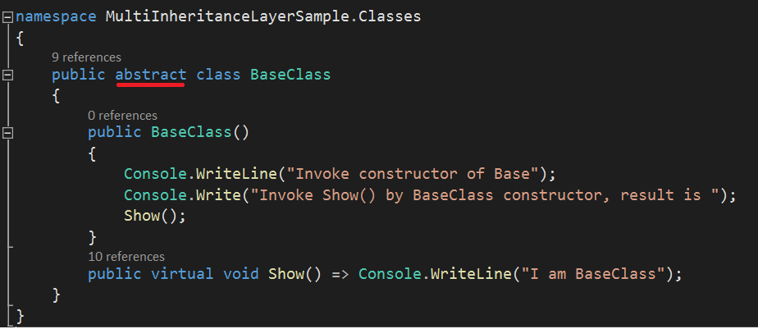
Think About This
Q1: Could project be compiled successfully if no abstract keyword?
Q2: Should we use abstract for a base class when we design a OOP project?
Q3: What is the difference when you use abstract and no use abstract keyword? Tips: abstract method

Slide 9
End

