Slide 1
SOLID
Sharer: Klen

Slide 2
What is SOLID?
Some principles to make your software designs more understandable, flexible and maintainable if you follow up them.
Here is the five principles
Single-responsibility Principle (S.R.P)
Open-closed Principle
Liskov substitution principle
Interface segregation principle
Dependency Inversion principle

Slide 3
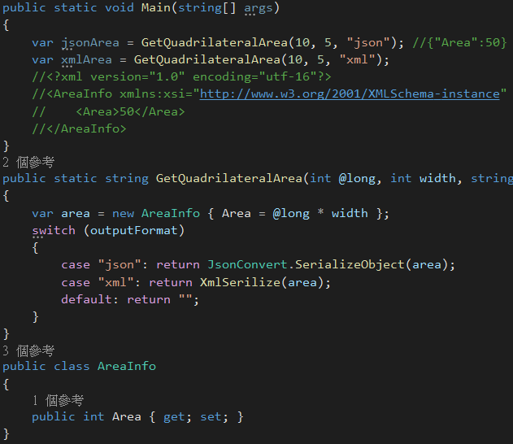
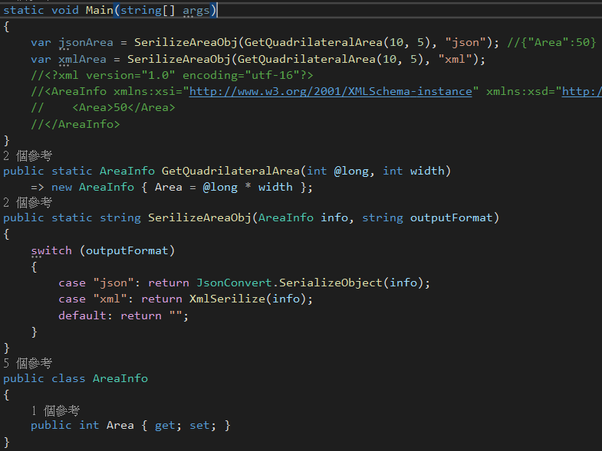
Single-responsibility Principle A object should have one and only one reason to change, meaning that a object should have only one job.
X
O
Notes:
A class or method should only have one responsibility at the same time.
Left example shows GetQuadrilateralArea method have two responsibilities calculation and serialization. It's not good.
Right example separates the responsibility to two methods GetQuadrilateralArea and SerializeAreaObj. It's good.

Slide 4
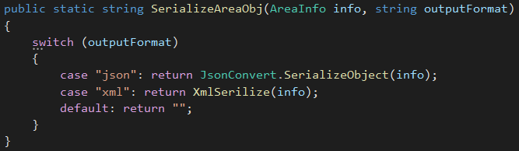
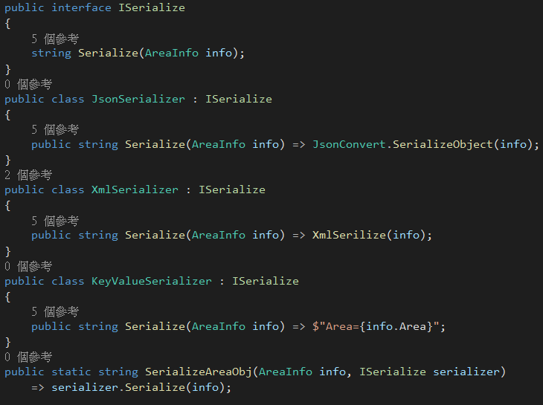
Open-closed Principle Objects or entities should be open for extension, but closed for modification.
X
O
Notes:
It's better to make objects (entities, functions...etc) to extend easily.
Don't modify the stable objects easily.
Especially, the object is used widely.
Left example, you need to add new case condition if you want to add new serialization format.
So you need to modify the stable method. It violates open-closed principle.
Right example uses interface ISerialize to define your serialization behavior.
So it's easy to add a new serialization format, such as key-value format.
You only need to add a new serializer (KeyValueSerializer) and put into SerializeAreaObj method.

Slide 5
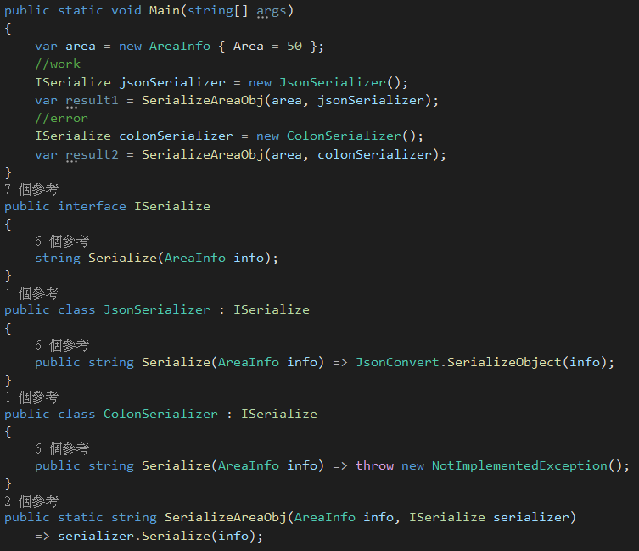
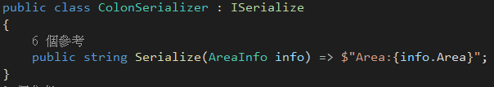
Liskov substitution principle Objects in a program should be replaceable with instances of their subtypes without altering the correctness of that program
X
O
Notes:
The base class or interface should always to be replaced with their sub class and it should not break the application flow if the sub class complies with define.
So you don't need to understand how SerializeAreaObj method works.
You just need to implement the interface and then put into the method.

Slide 6
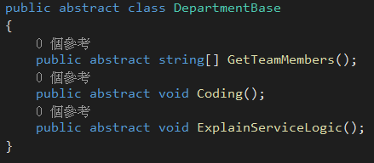
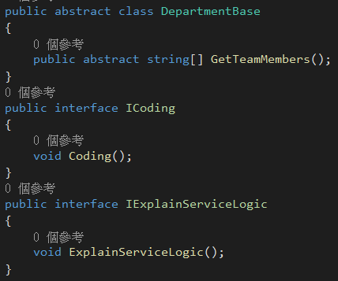
Interface segregation principle A client should never be forced to implement an interface and depend on methods that it doesn't use.
X
O
Notes:
It's not all departments need to coding and explain logic.
It's bad to define the methods Coding and ExplainServiceLogic in base class.
You should use interface to define specific methods.

Slide 7
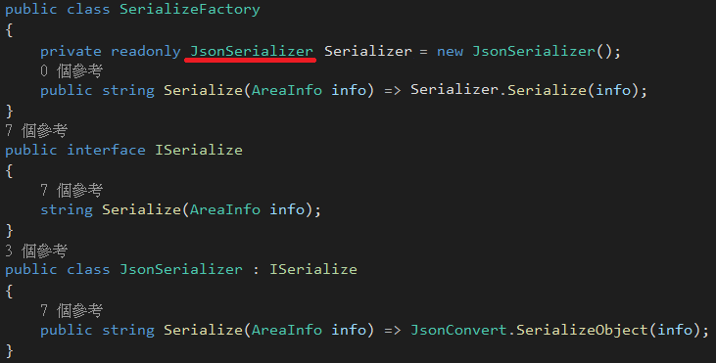
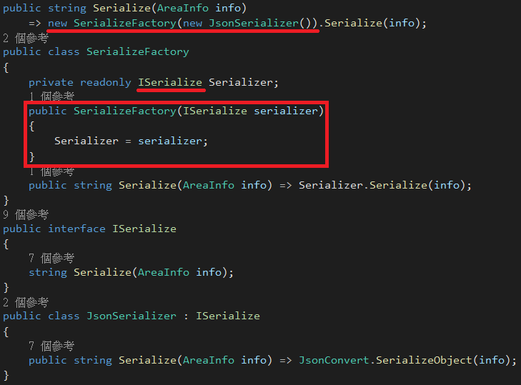
Dependency inversion principle Entities must depend on abstractions not on concretions. It states that the high level module must not depend on the low level module, but they should depend on abstractions.
X
O
Notes:
High level module and low level module should be dependent with abstraction.

Slide 8
Reference
https://scotch.io/bar-talk/s-o-l-i-d-the-first-five-principles-of-object-oriented-design#toc-interface-segregation-principle
https://en.wikipedia.org/wiki/SOLID
https://ithelp.ithome.com.tw/articles/10191553

Slide 9
Conclusion
SOLID are principles for design.
But it's not always suitable to use them.
It depends on your requirement.
For example, it's over design if your module will never have requirement to extend it.
Don't be afraid of your design is not perfect.
You always can refactor them.

Slide 10
End

