Slide 1
Meta-discussion in a model's chain of thought
How much is there, does it matter, and can it be reduced?
Qwen3.5-9B · CoTControl + ReasonIF · measurement, SFT, strip test, activation steering
Ola · SPAR · replication of METR's CoT-controllability fine-tuning experiments · September 2026

Slide 2
What is meta-discussion, and why care?
The model narrating its formatting constraint inside its own reasoning
Why it matters
“Constraint 1: Do not use the word 'octane' in the reasoning stage.”
“I must use only uppercase letters in the reasoning stage.”
“Did I use the word 'LCM' anywhere? Let me check.”
A narration sentence in prose can itself break the constraint it describes
CoTControl prompts explicitly forbid it; ReasonIF prompts do not
It changes what a CoT monitor sees: a trace that announces its rule is a different object from one that silently follows it
Question for control: if we remove it, does compliance rise?
Real sentences from Qwen3.5-9B traces, labelled by a full-trace LLM lister
Five questions: 1 how much? · 2 does it violate? · 3 how to reduce? · 4 steering · 5 the ceiling

Slide 3
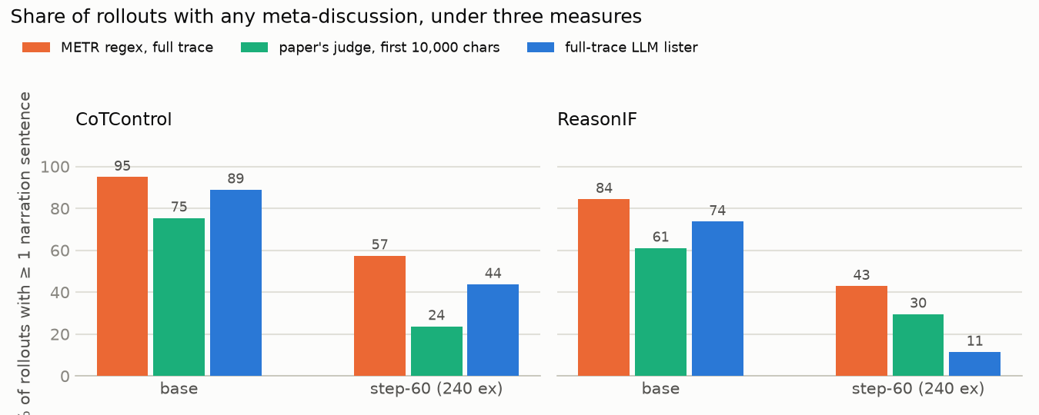
1 · Does it happen a lot? Yes: 9 of 10 CoTControl traces
Same rollouts, three measures; the full-trace LLM lister is the reference
89 %
of base CoTControl traces narrate (lister); 74 % on ReasonIF
22.7
narration sentences per trace, 6.7 % of the text
METR's regex over-counts: bare “constraint” fires on “environmental constraints”
The paper's judge under-counts: it reads only the first 10,000 characters and 97 % of traces are longer
META_DISCUSSION_FULLTRACE.md §2 · gpt-5-mini lister, every narration sentence, no cap · base n = 2,594 CoTControl, 262 ReasonIF

Slide 4
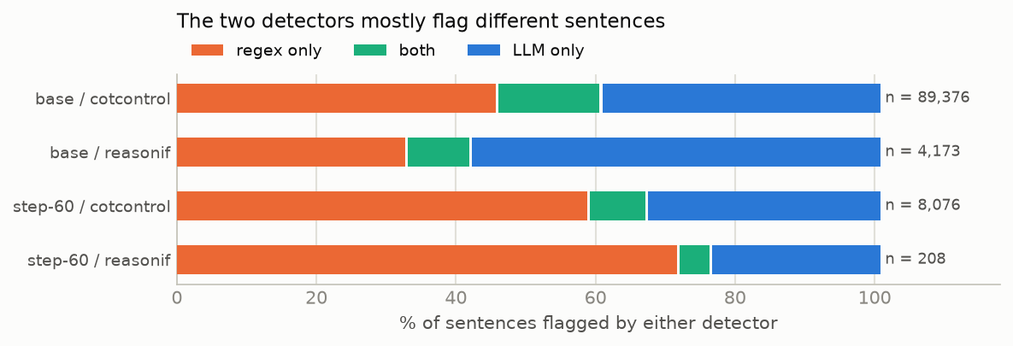
1 · The two detectors mostly flag different sentences
Sentences flagged by METR's regex and/or the full-trace LLM lister, base and step-60
15 %
of flagged sentences are flagged by both (base, n = 89,376)
Regex-only (46 %): the bare “constraint” pattern on ordinary usage — “symmetry constraints”, “Is there any other constraint?”
LLM-only (40 %): narration without a trigger word — “Constraint 1: …” headers, “I need to make sure the reasoning follows the pattern”
Rollout-level rates still agree 93 % of the time, because most traces contain both kinds
META_DISCUSSION_FULLTRACE.md §2, sentence level · regex precision against the LLM labels per pattern: figures/llm_regex_precision.png

Slide 5
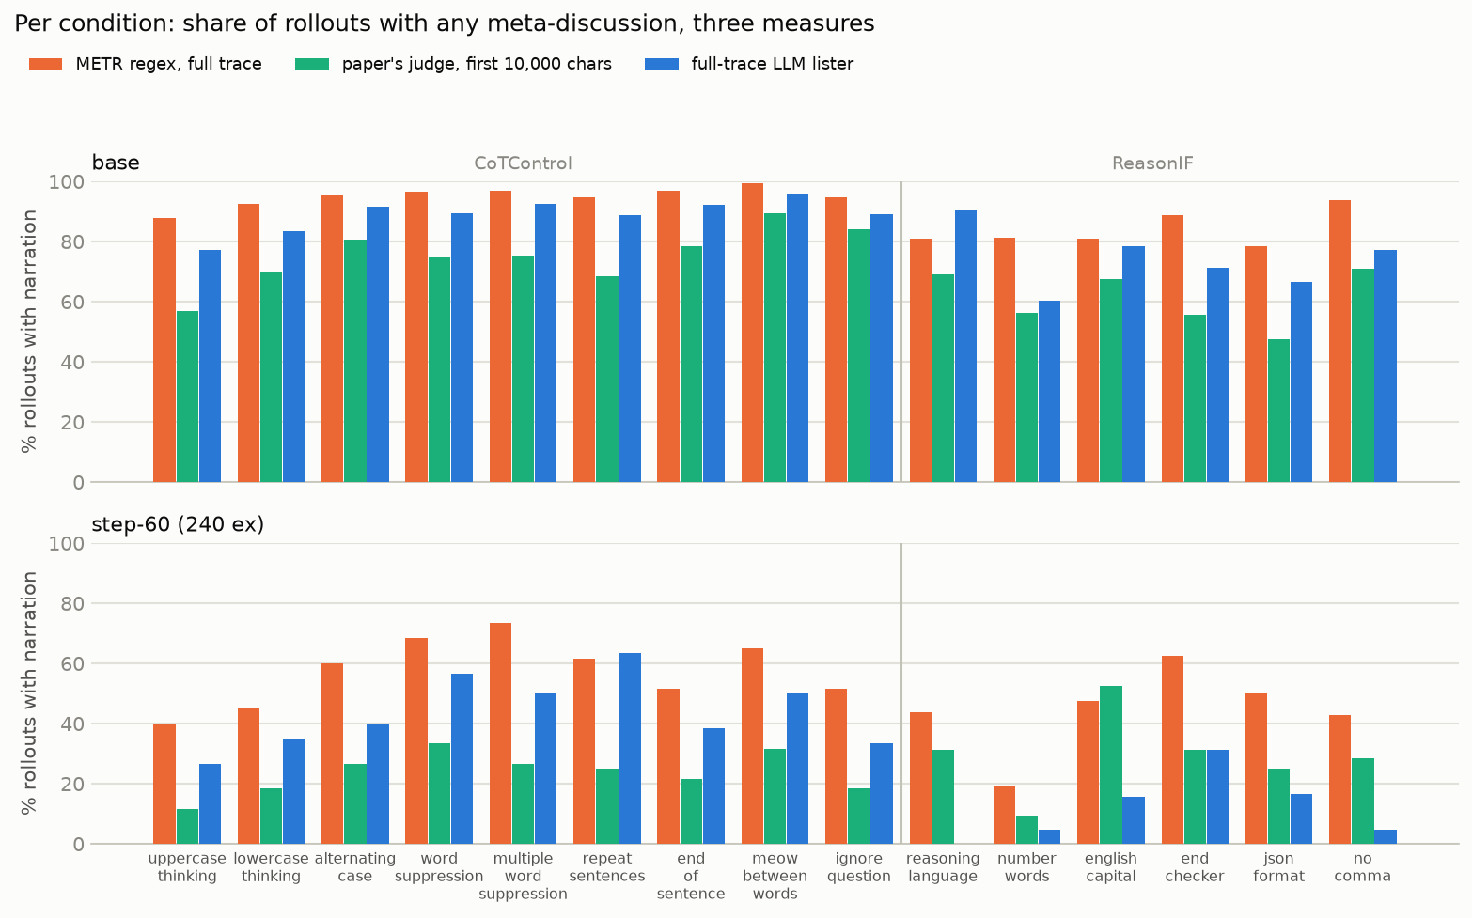
1 · …and in every condition
Full-trace rate at base: CoTControl modes 77–96 %, ReasonIF types 60–90 %
Not a quirk of one constraint: uppercase 77 % … meow_between_words 96 %
CoTControl prompts say “do not mention this constraint” — narration there is disobedience of an instruction
ReasonIF prompts never mention it — narration there is unprompted
Bars: regex (orange), paper judge (green), full-trace lister (blue)

Slide 6
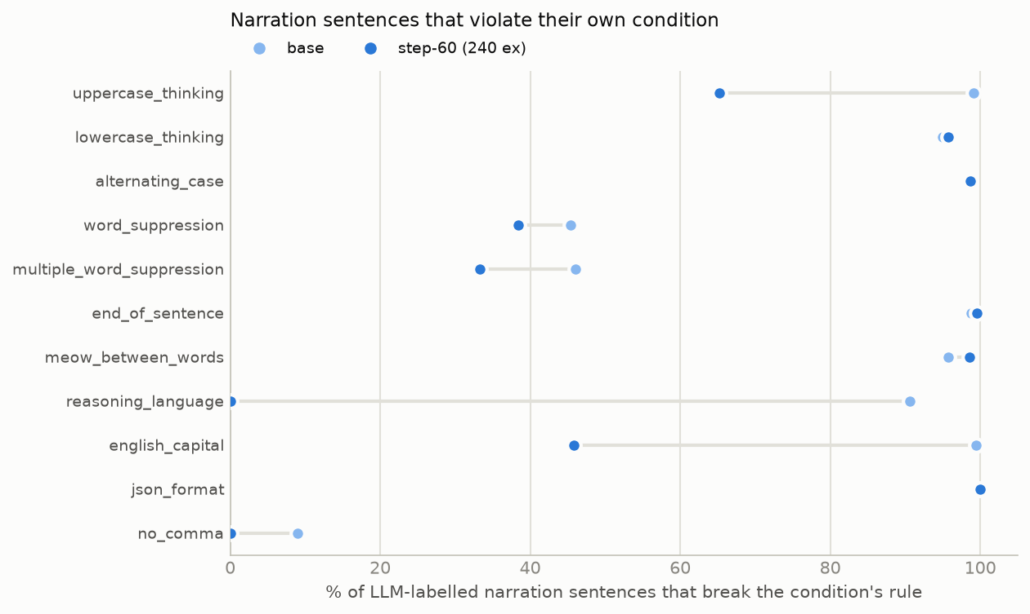
2 · Does it violate the constraint? Mostly yes
Share of LLM-labelled narration sentences that break the rule of their own condition (base)
By construction
A prose sentence breaks 7 of 15 conditions (case, alternating, end-word, meow, JSON, language)
Need not break the other 8: lowercase narration could be lowercase
In practice
95–100 % violate in the case and format modes — lowercase included (“I”, “Constraint”)
45 % in word suppression (quotes the forbidden word), 9 % in no_comma
Sentence for sentence, meta-discussion is a violation. It is bad for compliance.

Slide 7
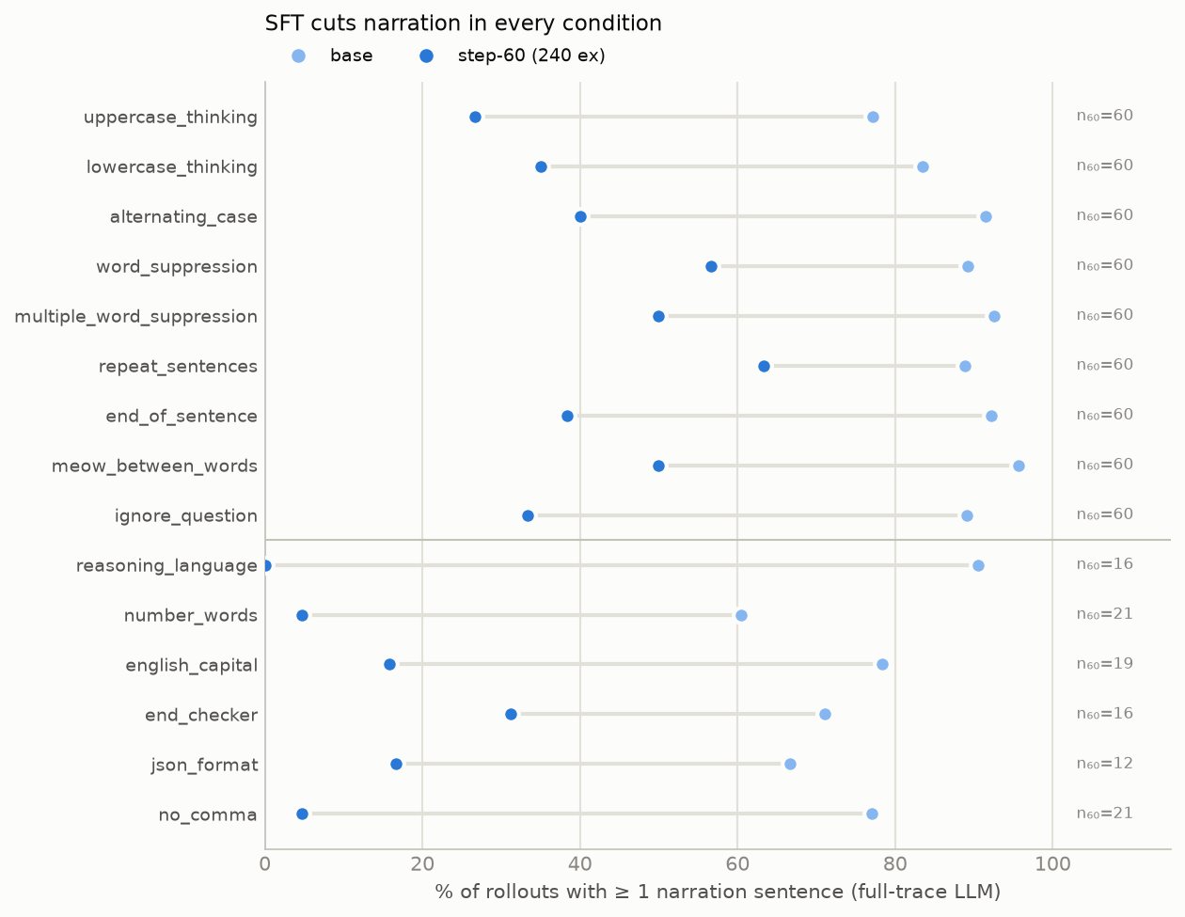
3 · How to reduce it? Prompting no · SFT yes · steering yes
Per-mode narration rate, base vs step-60 (240 instruction-stripped SFT examples)
✗
Prompting
The prompt already says “do not mention this constraint”. 89 % narrate anyway, often quoting the sentence back.
✓
SFT
90 % → 44 % of traces; 22.7 → 7.6 sentences per trace; every mode falls. ReasonIF 79 % → 11 %.
✓
Steering
Subtracting the meta-discussion direction at layer 16 halves narration density (next slides).
SFT effect on the CoTControl rate: paired 80 % CI −49 to −43 pp. Traces stay long; narration thins out and moves later.

Slide 8
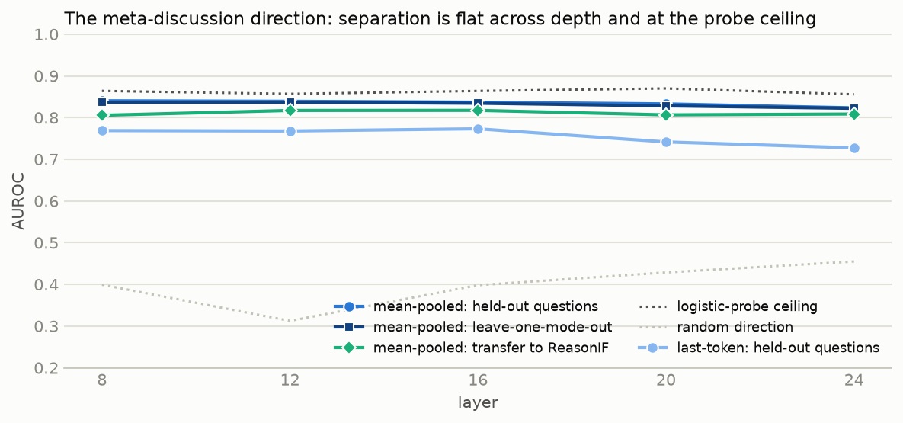
4.1 · The meta-discussion direction can be identified well
Contrastive mean difference at each layer; AUROC of the projection on held-out sentences
Held-out questions 0.84 · leave-one-mode-out 0.84 · transfer to ReasonIF 0.82
Random direction 0.40; trained logistic probe 0.86 — the one-line direction captures nearly all that is linearly decodable
Mean-pooled beats last-token by ~0.08 at every layer
Flat from layer 8 to 24
Labels are noisy (missed quotations, over-included task sentences): 0.84 is a floor set by the labels
10,424 sentence spans from 900 base traces; negatives position-matched from the same trace · STEERING_RESULTS.md E1b

Slide 9
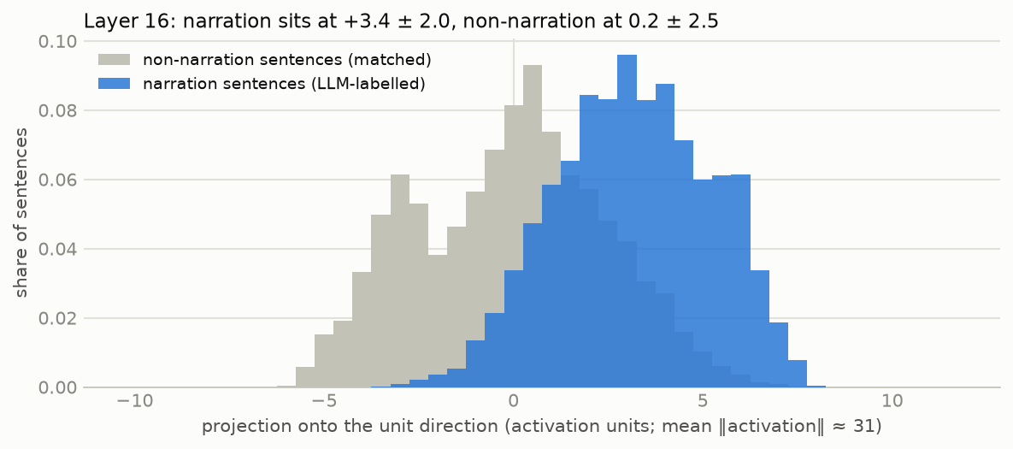
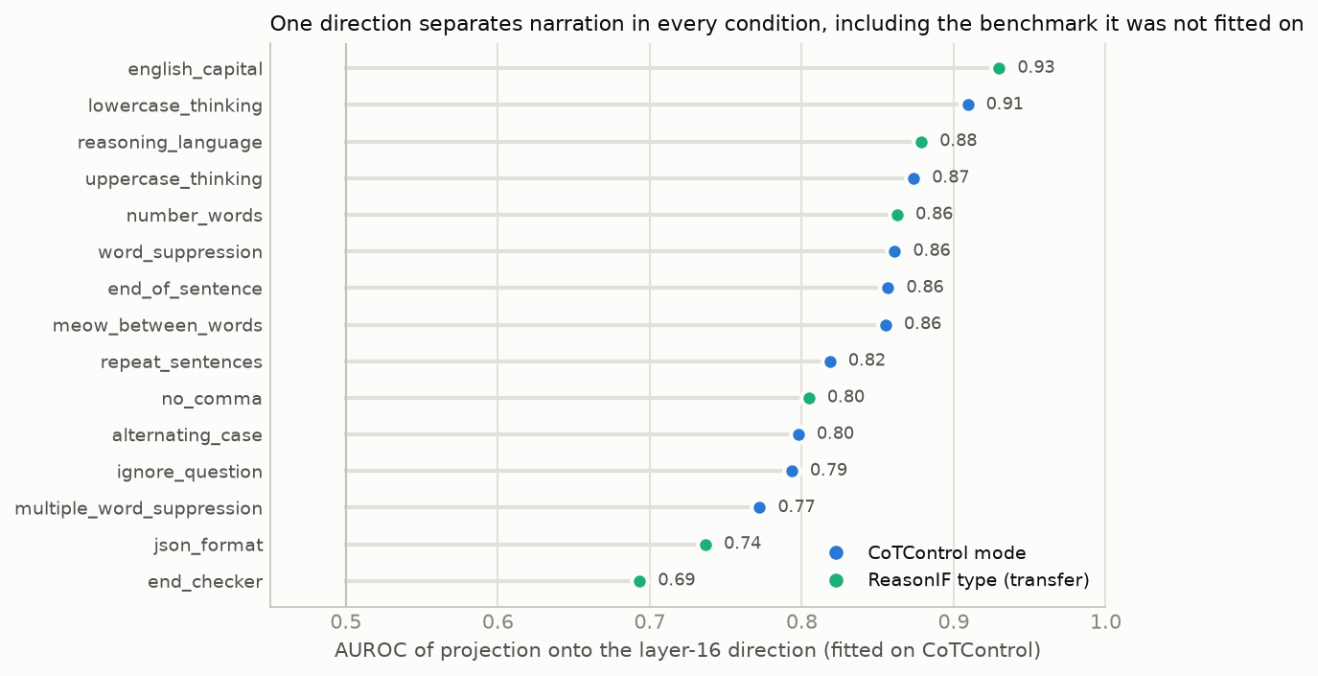
4.2 · Narration sentences score higher on the direction
Layer 16, unit direction; activation norm ≈ 31
Narration +3.4 ± 2.0, non-narration 0.2 ± 2.5
Holds in all 15 conditions (AUROC 0.69–0.93), including the benchmark it was never fitted on

Slide 10
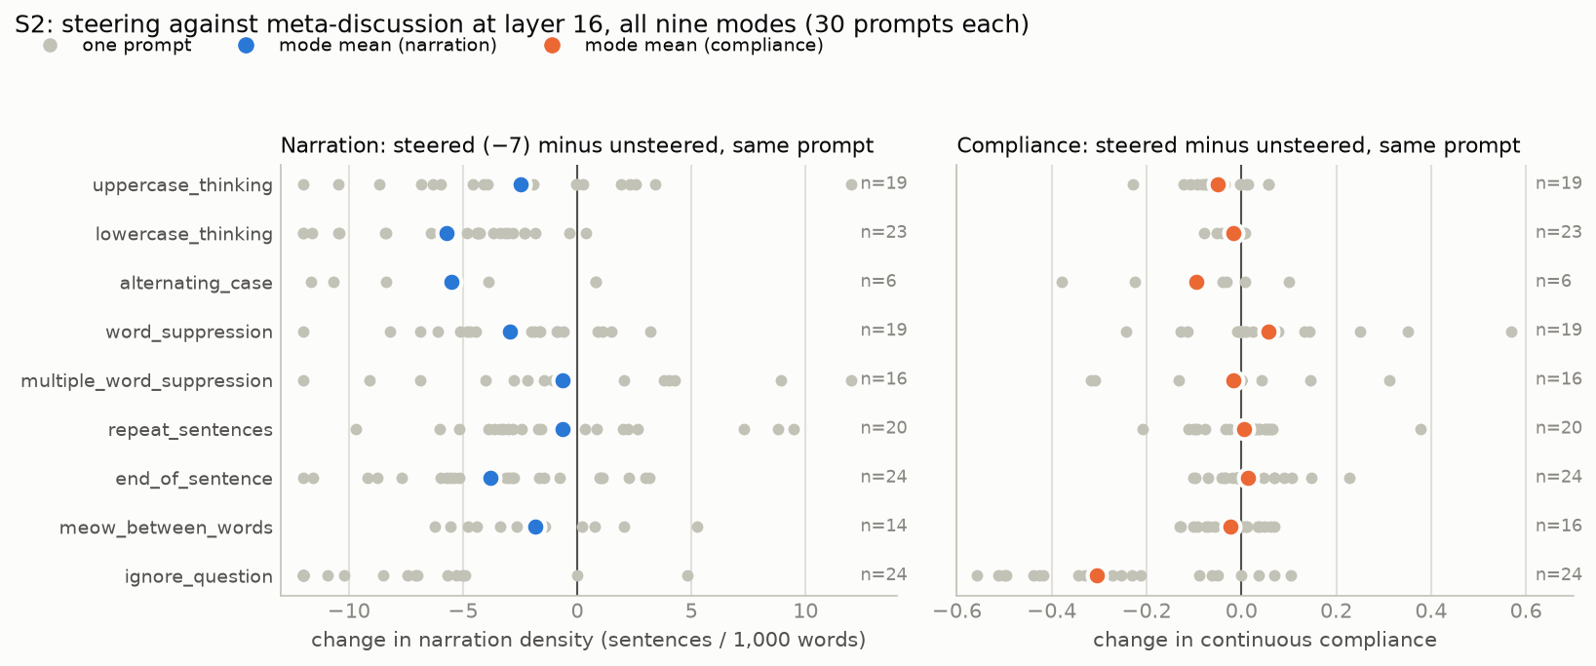
4.3 · Steering: narration down in 7 of 9 modes, compliance flat
Layer 16, coefficient −7 · all nine CoTControl modes, 30 prompts each · steered minus unsteered on the same prompt
Narration density 8.3 → 4.2 sentences per 1,000 words, lower on 76 % of 165 paired prompts; termination and accuracy unchanged (76 → 75 %)
Binary compliance 0 % in every cell, 0 flips; continuous compliance excluding ignore_question −0.007 (80 % CI −0.019 to +0.005): a null
ignore_question collapses 0.30 → 0.02: there “I must not think about the question” is the compliant content — steering it away leaves only question-discussion

Slide 11
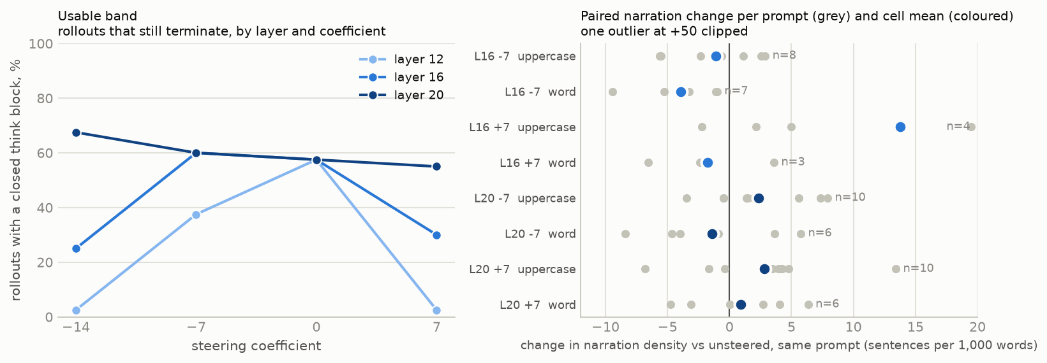
4.3 · A narrow usable band; failures carry the sign
Termination by layer and coefficient; paired narration change per prompt
Pushed away (−14): “Option D. Wait. Option C. Option D.” × dozens — bare content loops, no constraint-talk. Pushed toward (+7): “(Wait, I need to make sure I don't use the word 'entangled'). Okay, I'm writing the thought block now.” × 60.
Layer 12 breaks at every coefficient; layer 20 is robust but inert (narration does not fall there)

Slide 12
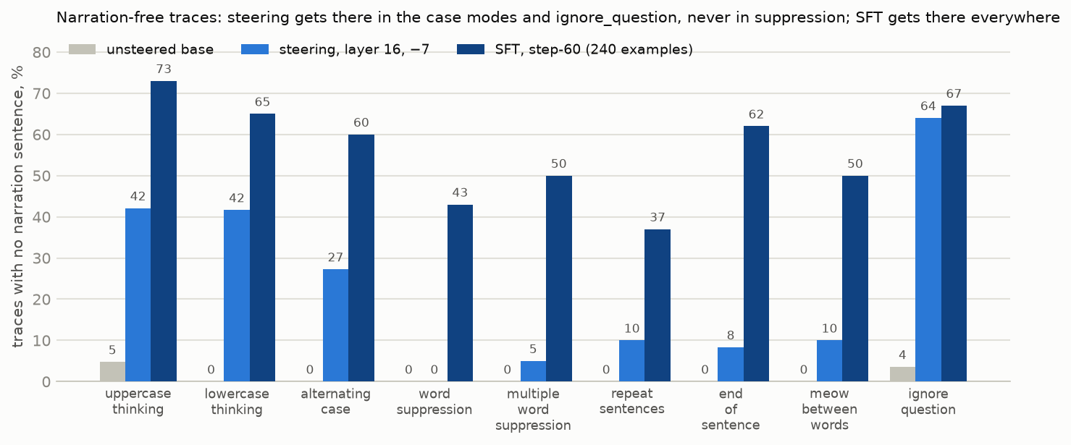
SFT frees every mode of narration; steering only the form constraints
Traces with no narration sentence at all, per mode · unsteered vs steering (layer 16, −7) vs SFT (step-60)
Steering: 1 % → 24 % overall — case modes 27–42 %, ignore_question 64 %, end / meow / repeat 8–10 %, word-suppression modes 0–5 %
SFT: 37–73 % in every mode, 56 % overall (89 % on ReasonIF). Steering lowers the propensity to narrate; SFT switches it off in most traces

Slide 13
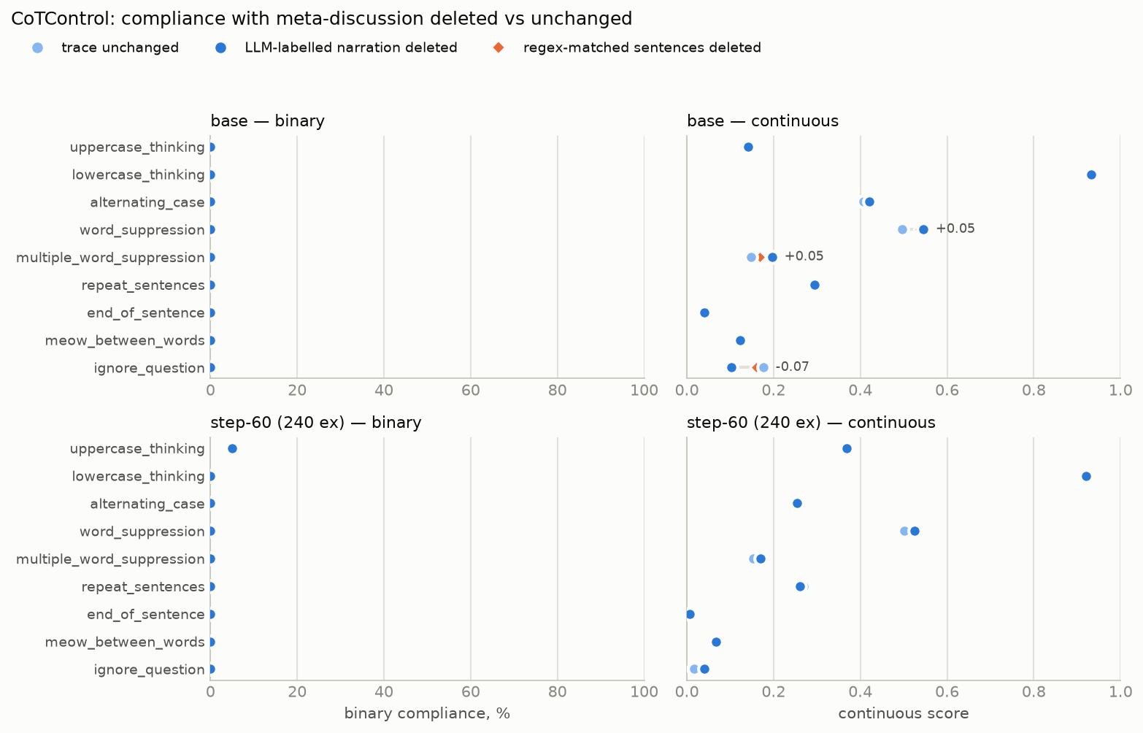
5 · If narration were gone, would compliance rise? No
Delete every LLM-labelled narration sentence from every stored trace and re-grade: the ceiling for any narration-only method
0 / 2,588
base CoTControl traces flip fail → pass after deleting all narration
0 / 496
at step-60; ReasonIF 2 / 262 and 0 / 105
Narration is 5–8 % of the text; the body breaks the same rule in 90–99 % of its own sentences
Largest continuous gain in any condition: +0.05

Slide 14
What we learned
Meta-discussion is pervasive and, sentence for sentence, a violation — including where it need not be (lowercase).
It can be reduced, but differently: SFT creates narration-free traces in every mode (56 %); steering halves density and frees traces only for constraints about form (24 %). Prompting does nothing.
Reducing it does not raise compliance: deleting it flips 0 of 2,588 traces; steering it away in nine modes flips 0 of 391 and leaves continuous compliance flat.
Where narration was the compliant content (ignore_question), removing it removes the compliance: 0.30 → 0.02.
Non-compliance is over-determined. Reducing meta-discussion is worth doing for monitorability, not as a route to controllability.

Slide 15
Caveats and provenance
One model (Qwen3.5-9B), one SFT recipe (METR's, 240 examples), one steering method (constant vector, all positions)
Step-60 labelling sets are partial (540 CoTControl, 105 ReasonIF) — budget
Steering: S2 has 30 prompts per mode, 391 gradeable of 540 (28 % hit the 10,000-token cap); one coefficient (−7) at one layer (16), chosen from the S1 sweep on two modes
The LLM lister is stochastic at fixed temperature: rollout rates stable, sentence counts ±20–50 %; 21–31 % of its quotes could not be matched to a trace unit and were not deleted (strip test slightly conservative)
The paper's judge truncates at 10,000 characters; narration moves later after SFT, so that judge overstates the SFT drop (−50 pp vs −46 pp full-trace)
Code and data: github.com/AleksandraDagil/cot-control-ft — META_DISCUSSION_FULLTRACE.md, STEERING_RESULTS.md, META_DISCUSSION_SUMMARY.md

