Slide 1
Locality / Tiling
María Jesús Garzarán
University of Illinois at Urbana-Champaign
Notes:
I am going to present the work we did to generate a library for sorting.

Slide 2
Roadmap
Locality (Tiling) for Matrix Multiplication
  Find optimal tile size assuming data are copied to consecutive locations
    Kamen Yotov et al. A Comparison of Empirical and Model-driven Optimization. In PLDI, 2003.
Locality for Non-Numerical Codes
  Structure Splitting
  Field Reordering
    Cache-conscious Structure Definition, by Trishul M. Chilimbi, Bob Davidson, and James Larus, PLDI 1999.
  Cache-conscious Structure Layout
    Cache-conscious Structure Layout, by Trishul M. Chilimbi, Mark D. Hill and James Larus, PLDI 1999.

Slide 3
Memory Hierarchy
Most programs have a high degree of locality in their accesses
  Spatial locality: accessing things nearby previous accesses
  Temporal locality: accessing an item that was previously accessed
Memory Hierarchy tries to exploit locality
processor
control
Second level cache (SRAM)
Main memory
(DRAM)
Secondary storage (Disk)
Tertiary storage
(Disk/Tape)
datapath
registers
on-chip cache
Time (Cycles): 4 23 Pentium 4 (Prescott)
3 17 AMD Athlon 64
Size (Bytes): 8-32 K 512 - 8 M 1GB-8GB 100-500GB

Slide 4
Matrix Multiplication
for (i = 0; i < SIZE; i++)
for (j = 0; j < SIZE; j++)
for (k = 0; k < SIZE; k++)
C[i][j] += A[i][k] * B[k][j];
j
C
k
A
B
j
i
i
k

Slide 5
Matrix Multiplication: Loop Invariant
for (i = 0; i < SIZE; i++)
for (j = 0; j < SIZE; j++)
for (k = 0; k < SIZE; k++)
C[i][j] += A[i][k] * B[k][j];
for (i = 0; i < SIZE; i++)
for (j = 0; j < SIZE; j++){
D =C[i][j];
for (k = 0; k < SIZE; k++)
D += A[i][k] * B[k][j];
C[i][j]=D;
}

Slide 6
Matrix Multiplication: Cache Tiling
for (i0 = 0; i0 < SIZE; i0 += block)
for (j0 = 0; j0 < SIZE; j0 += block)
for (k0 = 0; k0 < SIZE; k0 += block)
for (i = i0; i < min(i0 + block, SIZE); i++)
for (j = j0; j < min(j0 + block, SIZE); j++)
for (k = k0; k < min(k0 + block, SIZE); k++)
C[i][j] += A[i][k] * B[k][j];
j0
C
k0
A
B
j0
i0
i0
k0

Slide 7
Modeling for Tile Size (NB)
Models of increasing complexity
  3*NB² ≤ C
    Whole work-set fits in L1
  NB² + NB + 1 ≤ C
    Fully Associative
    Optimal Replacement
    Line Size: 1 word
  or
    Line Size > 1 word
  or
    LRU Replacement

Slide 8
Largest NB for no capacity/conflict misses
Tiles are copied into
contiguous memory
Condition for cold misses only:
  3*NB² <= L1Size
B
k
k
j
i
NB
NB
A
NB
NB

Slide 9
Matrix Multiplication: Cache Tiling
for (i0 = 0; i0 < SIZE; i0 += block)
for (j0 = 0; j0 < SIZE; j0 += block)
for (k0 = 0; k0 < SIZE; k0 += block)
for (i = i0; i < min(i0 + block, SIZE); i++)
for (j = j0; j < min(j0 + block, SIZE); j++)
for (k = k0; k < min(k0 + block, SIZE); k++)
C[i][j] += A[i][k] * B[k][j];
j0
C
k0
A
B
j0
i0
i0
k0

Slide 10
Largest NB for no capacity misses
MMM:
for (int j = 0; i < N; i++)
for (int i = 0; j < N; j++)
for (int k = 0; k < N; k++)
c[i][j] += a[i][k] * b[k][j]
Cache model:
  Fully associative
  Line size 1 Word
  Optimal Replacement
Bottom line:
NB²+NB+1<= L1Size
  One full matrix
  One row / column
  One element

Slide 11
Extending the Model
Line Size > 1
  Spatial locality
  Array layout in memory matters
Bottom line: depending on loop order
  either
  or
Notes:
The paper says the first one is for jik order because we are dealing with Fortran codes that store by columns. If we
are using C codes, the jik order should be the second one.

Slide 12
Extending the Model (cont.)
LRU (not optimal replacement)
MMM sample:
for (int j = 0; i < N; i++)
for (int i = 0; j < N; j++)
for (int k = 0; k < N; k++)
c[i][j] += a[i][k] * b[k][j]
Bottom line:
IJK, IKJ
JIK, JKI
KIJ
KJI

Slide 13
Matrix Multiplication: Cache and Register Tiling
for (j=0; j<=SIZE; j +=block)
for (i=0; i<=SIZE; i +=block)
for (k=0; k<=SIZE; k +=block)
// mini−MMM code
for (jj=j; jj<j+block; jj+=MU)
for (ii=i; ii<i+block; ii +=NU)
for (kk=k; kk<k+block; kk++)
// micro−MMM code
C[ii][jj]+= A[ii][kk] * B[kk][jj]
C[ii+1][jj]+= A[ii+1][kk] * B[kk][jj]
C[ii+2][jj]+= A[ii+2][kk] * B[kk][jj]
C[ii][jj+1]+= A[ii][kk] * B[kk][jj+1]
C[ii+1][jj+1]+= A[ii+1][kk] * B[kk][jj+1]
C[ii+2][jj+1]+= A[ii+2][kk] * B[kk][jj+1]
MU = 2 and NU = 3

Slide 14
Locality for Non-Numerical Codes
Cache-conscious Structure Definition, by Trishul M. Chilimbi, Bob Davidson, and James Larus, PLDI 1999.
  Structure Splitting
  Field Reordering
Cache-conscious Structure Layout, by Trishul M. Chilimbi, Mark D. Hill and James Larus, PLDI 1999.

Slide 15
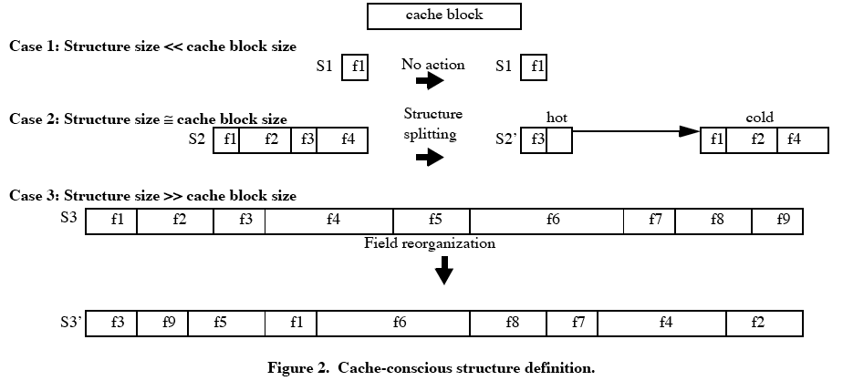
Cache Conscious Structure Definition
group them based
on temporal affinity

Slide 16
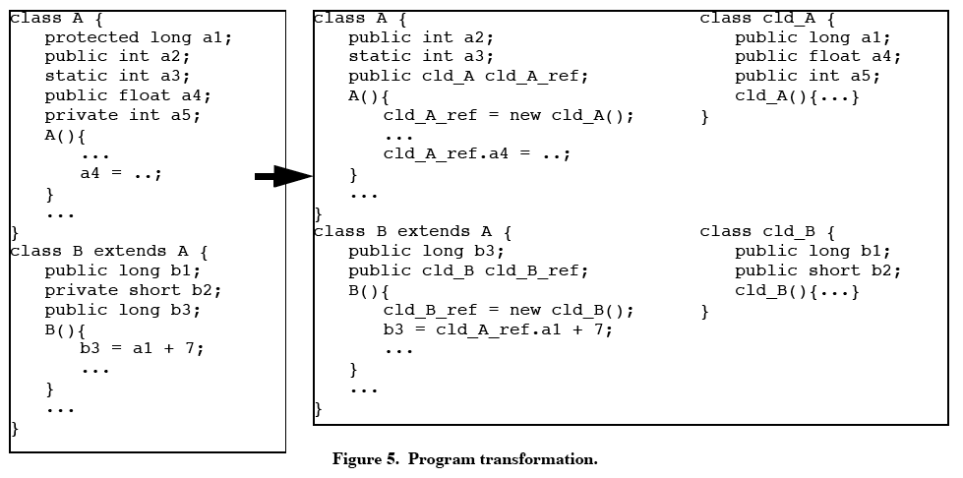
Program Transformation. Example
new cold class instance
assigned to the cold
class reference field
reference to the
new cold class
cold fields are labelled
with public
acces to cold fields require an extra indirection

Slide 17
Cache Conscious Layout
Locality can be improved by:
  changing program’s data access pattern
    Applied to scientific programs that manipulate dense matrices:
      uniform, random accesses of elements
      static analysis of data dependences
  changing data organization and layout
    They have locational transparency: elements in a structure can be placed at different memory (and cache) locations without chaging a program’s semantics.
    Two placement techniques:
      coloring
      clustsering
Notes:
in numerical codes it takes the same time to access any elements.
IN pointer-based codes, you have to traverse a linked list of some short.

Slide 18
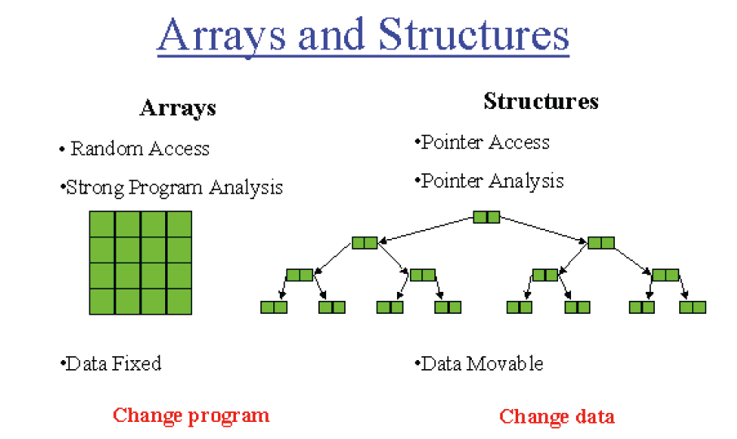

Slide 19
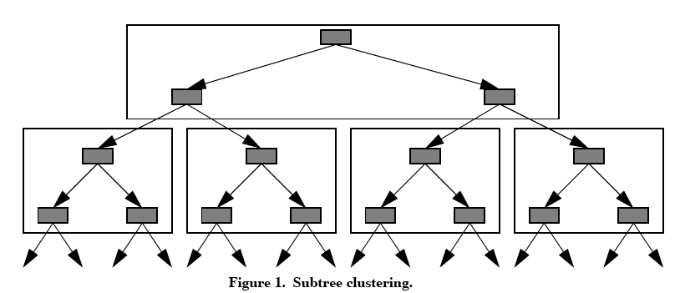
Clustering
Packs data structure elements likely to be accessed contemporaneously into a cache block.
Improves spatial and temporal locality and provides implicit prefetch.
One way to cluster a tree is to pack subrees into a cache block.

Slide 20
Clustering
Why is this clustering for binary tree good?
  Assuming random tree search, the probability of accesing either child of a node is 1/2.
  With K nodes of a subtree clustered in a cache block, the expected number of accesses to the block is the height of the subtree, log₂(k+1), which is greater than 2 when K >3.
With a depht-first clustering, the expeted number of accesses to the block is smaller.
  Of course this is only true for a random acces pattern.

Slide 21
Coloring
Coloring maps contemporaneously-accessed elements to non-conflicting regions of the cache.
p
Frequently access data
structure elements
Remaining data
structure elements
C-p
2-way cache
p
C-p
p
C-p
p
C-p

Slide 22
