Slide 1
Memory Hierarchies and Optimizations:
Case Study in Matrix Multiplication
Kathy Yelick
yelick@cs.berkeley.edu
www.cs.berkeley.edu/~yelick/cs194f07

Slide 2
Naïve Matrix Multiply
{implements C = C + A*B}
for i = 1 to n
for j = 1 to n
for k = 1 to n
C(i,j) = C(i,j) + A(i,k) * B(k,j)
Algorithm has 2*n³ = O(n³) Flops and operates on 3*n² words of memory
Reuse quotient (q = flops/word) in the algorithm is potentially as large as
2*n³ / 3*n² = O(n)
C(i,j)
C(i,j)
A(i,:)
=
+
*
B(:,j)

Slide 3
Naïve Matrix Multiply
{implements C = C + A*B}
for i = 1 to n
{read row i of A into fast memory}
for j = 1 to n
{read C(i,j) into fast memory}
{read column j of B into fast memory}
for k = 1 to n
C(i,j) = C(i,j) + A(i,k) * B(k,j)
{write C(i,j) back to slow memory}
C(i,j)
C(i,j)
A(i,:)
=
+
*
B(:,j)
C
C
A
B

Slide 4
Naïve Matrix Multiply
Number of slow memory references on unblocked matrix multiply
m = n³ to read each column of B n times
+ n² to read each row of A once
+ 2n² to read and write each element of C once
= n³ + 3n²
So the re-use quotient, q = f / m = 2n³ / (n³ + 3n²)
~= 2 for large n
This is no better than matrix-vector multiply
And is far from the “best possible” which is 2/3*n for large n
And this doesn’t take into account cache lines
C(i,j)
C(i,j)
A(i,:)
=
+
*
B(:,j)

Slide 5
Blocked (Tiled) Matrix Multiply
Consider A,B,C to be N-by-N matrices of b-by-b subblocks where b=n / N is called the block size
for i = 1 to N
for j = 1 to N
{read block C(i,j) into fast memory}
for k = 1 to N
{read block A(i,k) into fast memory}
{read block B(k,j) into fast memory}
C(i,j) = C(i,j) + A(i,k) * B(k,j) {do a matrix multiply on blocks}
{write block C(i,j) back to slow memory}
C(i,j)
C(i,j)
A(i,k)
=
+
*
B(k,j)

Slide 6
Blocked (Tiled) Matrix Multiply
Recall:
m is amount memory traffic between slow and fast memory
matrix has nxn elements, also NxN blocks each of size bxb (N=n/b)
f is number of floating point operations, 2n³ for this problem
q = f / m is our measure of algorithm efficiency in the memory system
m = N*n² read each block of B N³ times (N³ * b² = N³ * (n/N)² ⁼ N*n²)
+ N*n² read each block of A N³ times
+ 2n² read and write each block of C once
= (2N + 2) * n²
Re-use quotient is: q = f / m = 2n³ / ((2N + 2) * n²)
~= n / N = b for large n
We can improve performance by increasing the blocksize b
Can be much faster than matrix-vector multiply (q=2)

Slide 7
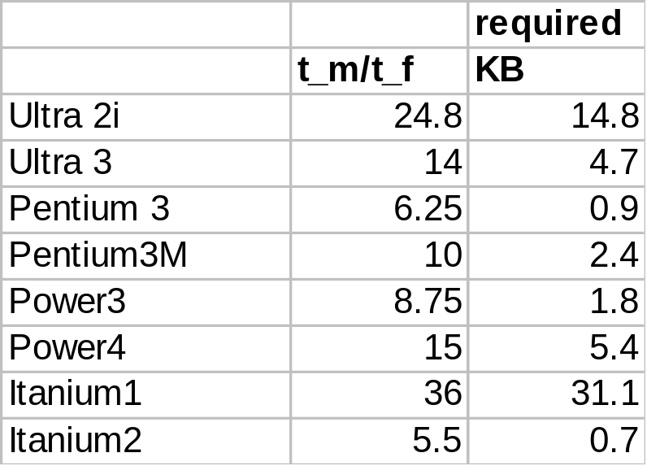
Using Analysis to Understand Machines
The blocked algorithm has computational intensity q ~= b
The larger the block size, the more efficient our algorithm will be
Limit: All three blocks from A,B,C must fit in fast memory (cache), so we cannot make these blocks arbitrarily large
Assume your fast memory has size M_{fast}
3b² <= M_{fast}, so q ~= b <= sqrt(M_{fast}/3)
To build a machine to run matrix multiply at 1/2 peak arithmetic speed of the machine, we need a fast memory of size
M_{fast} >= 3b² ~= 3q² = 3(t_{m}/t_{f})²
This size is reasonable for L1 cache, but not for register sets
Note: analysis assumes it is possible to schedule the instructions perfectly

Slide 8
Limits to Optimizing Matrix Multiply
The blocked algorithm changes the order in which values are accumulated into each C[i,j] by applying associativity
  Get slightly different answers from naïve code, because of roundoff - OK
The previous analysis showed that the blocked algorithm has computational intensity:
q ~= b <= sqrt(M_{fast}/3)
Aside (for those who have taken CS170 or equivalent)
There is a lower bound result that says we cannot do any better than this (using only associativity)
Theorem (Hong & Kung, 1981): Any reorganization of this algorithm (that uses only associativity) is limited to q = O(sqrt(M_{fast}))
What if more levels of memory hierarchy?

Slide 9
Tiling for Multiple Levels
Multiple levels: pages, caches, registers in machines
Each level could have it’s only 3-nested loops:
for i, for j, for k {matul blocks that fit in L2 cache}
for ii, for jj, for kk {matmul blocks that fit in L1}
for iii, for jjj, for kkk {matmul blocks that fit in registers}
But in practice don’t use so many levels and fully unroll code for register “tiles”
  E.g., if these are 2x2 matrix multiplies, can write out all 4 statements without loops
  c[0,0] = c[0,0] + a [0,0] * b[0,0] + a[0,1]*b[1,0]
  c[1,0] =
  c[0,1] =
  c[1,1] =
Many possible code variations; see Mark’s
notes on code generators in HW page

Slide 10
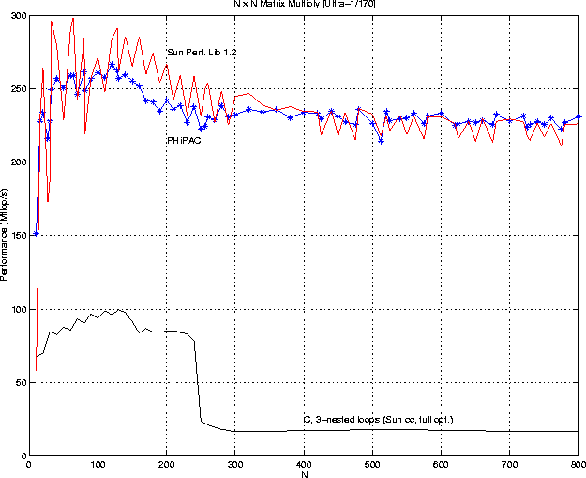
Matrix-multiply, optimized several ways
Speed of n-by-n matrix multiply on Sun Ultra-1/170, peak = 330 MFlops

Slide 11
Search Over Block Sizes
Strategies for choose block sizes:
Find out hardware parameters:
  Read vendor manual for register #, cache sizes (not part of ISA), page sizes (OS config)
  Measure yourself using memory benchmark from last time
  But in practice these don’t always work well; memory systems are complex as we saw
Manually try many variations ☹
Write “autotuner” to search over “design space” of possible implementations
  Atlas – incorporated into Matlab
  PhiPAC – original dense linear algebra tuning project from Berkeley; came from homework assignment like HW2

Slide 12
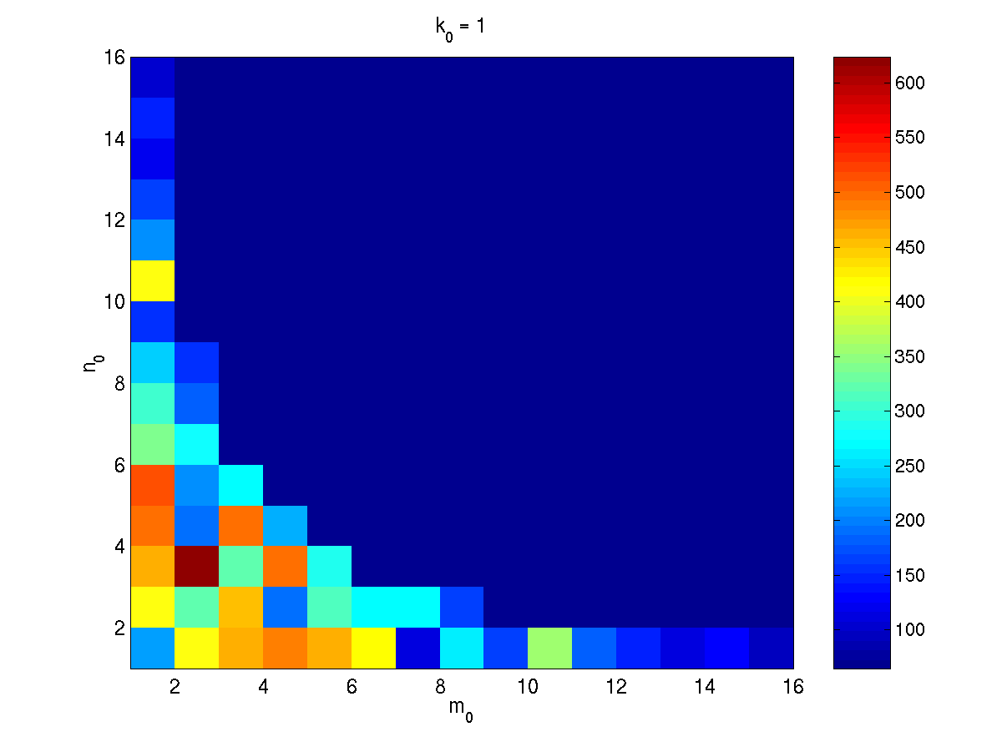
What the Search Space Looks Like
Number of columns in register block
Number of rows in register block
A 2-D slice of a 3-D register-tile search space. The dark blue region was pruned.
(Platform: Sun Ultra-IIi, 333 MHz, 667 Mflop/s peak, Sun cc v5.0 compiler)

Slide 13
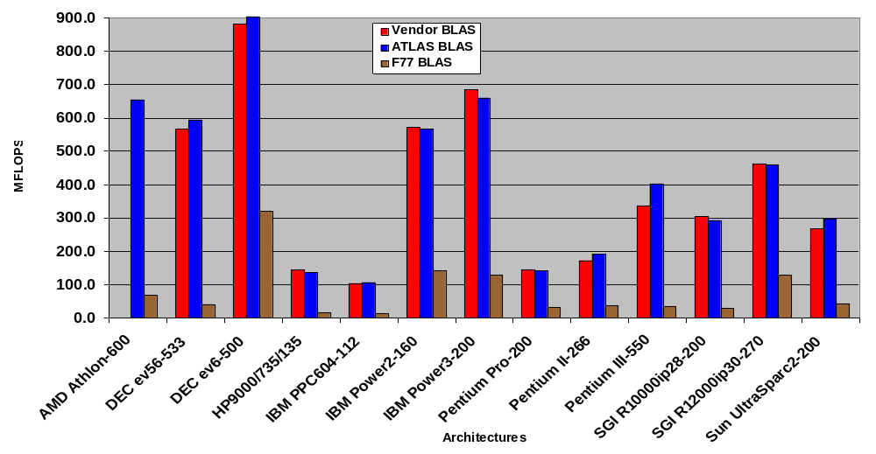
ATLAS (DGEMM n = 500)
Source: Jack Dongarra
ATLAS is faster than all other portable BLAS implementations and it is comparable with machine-specific libraries provided by the vendor.

Slide 14
Recursion: Cache Oblivious Algorithms
The tiled algorithm requires finding a good block size
Cache Oblivious Algorithms offer an alternative
  Treat nxn matrix multiply set of smaller problems
  Eventually, these will fit in cache
The idea of cache-oblivious algorithms is use for other problems than matrix multiply. The general idea is:
  Think of recursive formulation
  If the subproblems use smaller data sets and some reuse within that data set, then a recursive order may improve performance

Slide 15
Cache-Oblivious Algorithms
B₀₀
B₀₁
B
B₁₀
B₁₁
A₀₀
A₀₁
C₀₀
C₀₁
A₀
C₀
A₁₀
A₁₁
C₁₀
C₁₁
A₁
C₁
C₀₀ = A₀₀*B₀₀ + A₀₁*B₁₀
C₀₁ = A₀₁*B₁₁ + A₀₀*B₀₁
C₁₁ = A₁₁*B₀₁ + A₁₀*B₀₁
C₁₀ = A₁₀*B₀₀ + A₁₁*B₁₀
Divide all dimensions (AD)
8-way recursive tree down to 1x1 blocks
  Gray-code order promotes reuse
Bilardi, et al.
C₀ = A₀*B
C₁ = A₁*B
C₁₁ = A₁₁*B₀₁ + A₁₀*B₀₁
C₁₀ = A₁₀*B₀₀ + A₁₁*B₁₀
Divide largest dimension (LD)
Two-way recursive tree down to 1x1 blocks
Frigo, Leiserson, et al.
Slide source: Roeder, Yotov, Pingali at Cornell/UTexas

Slide 16
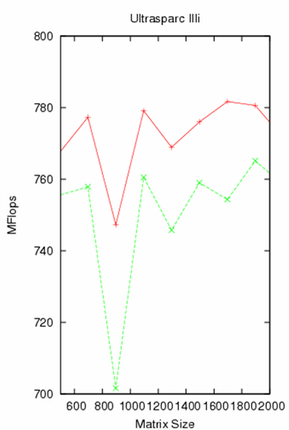
Cache-Oblivious: Discussion
Block sizes
  Generated dynamically at each level in the recursive call tree
Our experience
  Performance is similar
  Use AD for the rest of the talk
Mflop/s (up is good)
Slide source: Roeder, Yotov, Pingali at Cornell/UTexas

Slide 17
Cache-Conscious Algorithms
Usually Iterative
  Nested loops
Implementation of blocking
  Cache blocking achieved by Loop Tiling
  Register blocking also requires Loop Unrolling
Slide source: Roeder, Yotov, Pingali at Cornell/UTexas

Slide 18
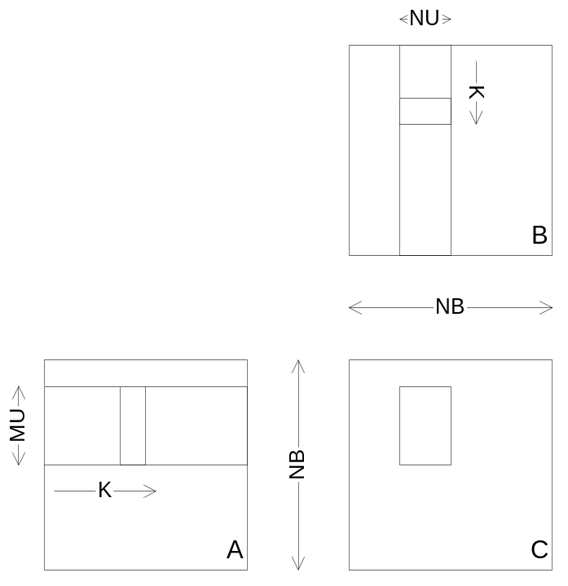
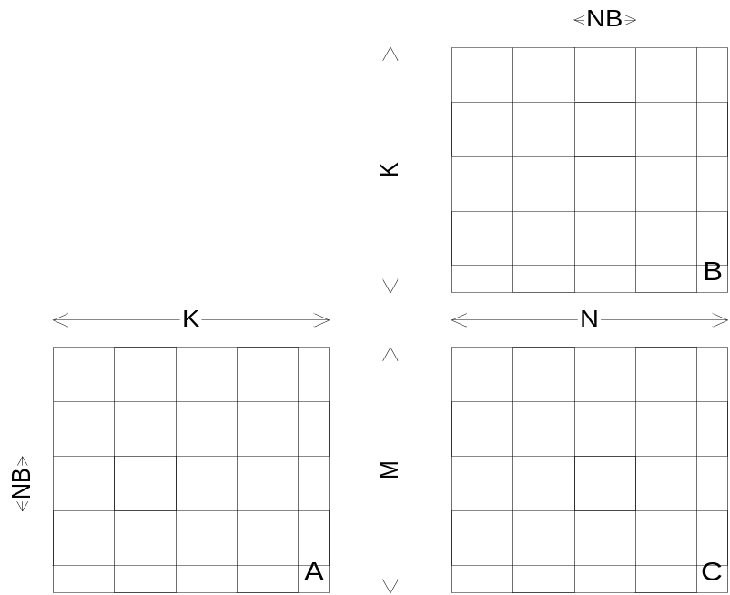
Structure of Tiled (Cache Concious) Code
Cache Blocking Register Blocking
Slide source: Roeder, Yotov, Pingali at Cornell/UTexas

Slide 19
Data Structures
Fit control structure better
Improve
  Spatial locality
  Streaming, prefecthing
Row-major
Row-Block-Row
Morton-Z
Slide source: Roeder, Yotov, Pingali at Cornell/UTexas

Slide 20
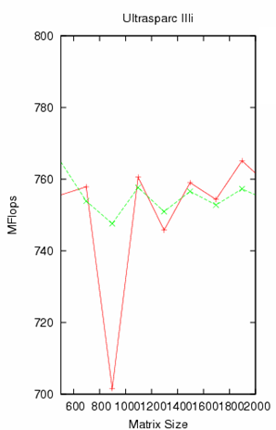

Data Structures: Discussion
Morton-Z
  Matches recursive control structure better than RBR
  Suggests better performance for CO
  More complicated to implement
  In our experience payoff is small or even negative
    Use RBR for the rest of the talk
Slide source: Roeder, Yotov, Pingali at Cornell/UTexas

Slide 21
UltraSPARC IIIi
Peak performance
  2 GFlops
Memory hierarchy
  Registers: 32
  L1 data cache: 64KB, 4-way
  L2 data cache: 1MB, 4-way
Compilers
  FORTRAN: SUN F95 7.1
  C: SUN C 5.5
Slide source: Roeder, Yotov, Pingali at Cornell/UTexas

Slide 22
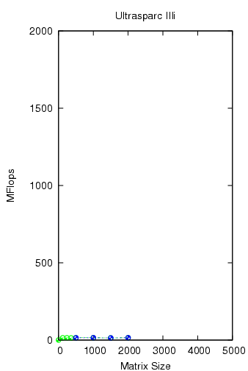
Control Structures
Iterative: triply nested loop
Recursive: down to 1 x 1 x 1
Outer Control Structure
Iterative
Recursive
Inner Control Structure
Statement
Slide source: Roeder, Yotov, Pingali at Cornell/UTexas

Slide 23
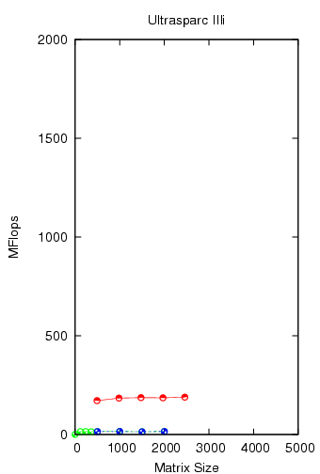

Control Structures
Recursion down to NB
  Unfold completely below NB to get a basic block
Micro-Kernel:
  The basic block compiled with native compiler
Best performance for NB =12
Compiler unable to use registers
Unfolding reduces control overhead
  limited by I-cache
Outer Control Structure
Iterative
Recursive
Inner Control Structure
Statement
Recursive
Micro-Kernel
None /
Compiler
Slide source: Roeder, Yotov, Pingali at Cornell/UTexas

Slide 24
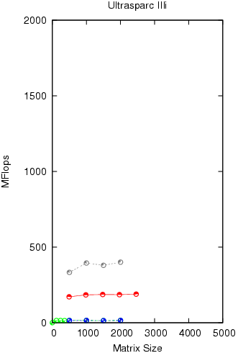

Control Structures
Outer Control Structure
Recursion down to NB
  Unfold completely below NB to get a basic block
Micro-Kernel
  Scalarize all array references in the basic block
  Compile with native compiler
Iterative
Recursive
Inner Control Structure
Statement
Recursive
Micro-Kernel
None /
Compiler
Scalarized /
Compiler
Slide source: Roeder, Yotov, Pingali at Cornell/UTexas

Slide 25
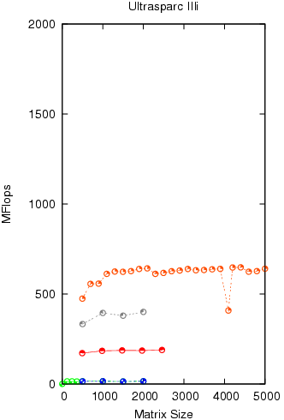

Control Structures
Outer Control Structure
Recursion down to NB
  Unfold completely below NB to get a basic block
Micro-Kernel
  Perform Belady’s register allocation on the basic block
  Schedule using BRILA compiler
Iterative
Recursive
Inner Control Structure
Statement
Recursive
Micro-Kernel
None /
Compiler
Scalarized /
Compiler
Belady /
BRILA
Slide source: Roeder, Yotov, Pingali at Cornell/UTexas

Slide 26
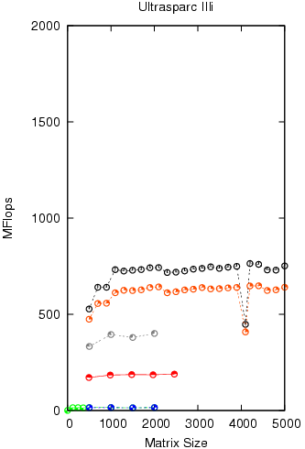

Control Structures
Outer Control Structure
Recursion down to NB
  Unfold completely below NB to get a basic block
Micro-Kernel
  Construct a preliminary schedule
  Perform Graph Coloring register allocation
  Schedule using BRILA compiler
Iterative
Recursive
Inner Control Structure
Statement
Recursive
Micro-Kernel
None /
Compiler
Scalarized /
Compiler
Belady /
BRILA
Coloring /
BRILA
Slide source: Roeder, Yotov, Pingali at Cornell/UTexas

Slide 27
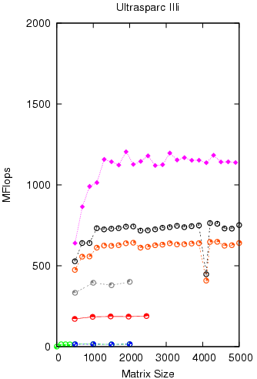
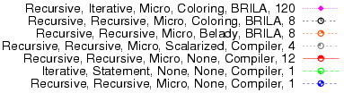
Control Structures
Outer Control Structure
Recursion down to MU x NU x KU
Micro-Kernel
  Completely unroll MU x NU x KU triply nested loop
  Construct a preliminary schedule
  Perform Graph Coloring register allocation
  Schedule using BRILA compiler
Iterative
Recursive
Inner Control Structure
Statement
Recursive
Iterative
Micro-Kernel
None /
Compiler
Scalarized /
Compiler
Belady /
BRILA
Coloring /
BRILA
Slide source: Roeder, Yotov, Pingali at Cornell/UTexas

Slide 28
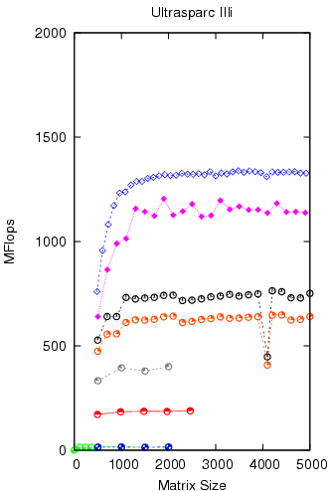
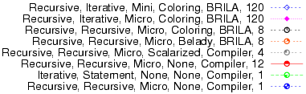
Control Structures
Outer Control Structure
Recursion down to NB
Mini-Kernel
  NB x NB x NB triply nested loop
  Tiling for L1 cache
  Body is Micro-Kernel
Iterative
Recursive
Inner Control Structure
Statement
Recursive
Iterative
Mini-Kernel
Micro-Kernel
None /
Compiler
Scalarized /
Compiler
Belady /
BRILA
Coloring /
BRILA
Slide source: Roeder, Yotov, Pingali at Cornell/UTexas

Slide 29
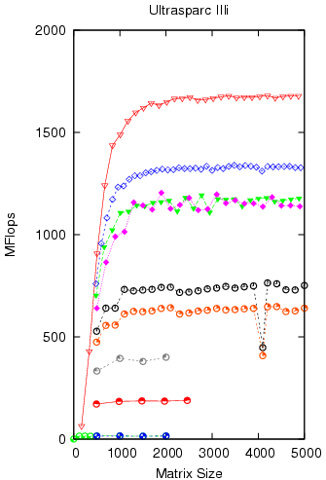
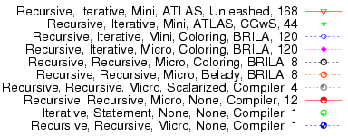
Control Structures
Outer Control Structure
Iterative
Recursive
Inner Control Structure
Statement
Recursive
Iterative
Specialized code generator with search
Mini-Kernel
Micro-Kernel
ATLAS CGw/S
ATLAS Unleashed
None /
Compiler
Scalarized /
Compiler
Belady /
BRILA
Coloring /
BRILA
Slide source: Roeder, Yotov, Pingali at Cornell/UTexas

Slide 30
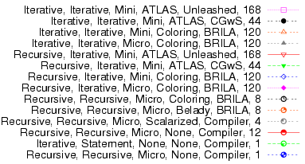
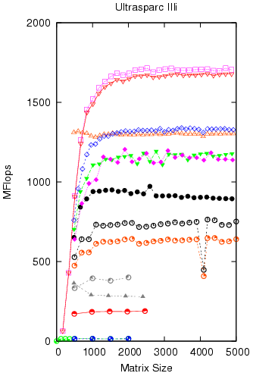
Control Structures
Outer Control Structure
Iterative
Recursive
Inner Control Structure
Statement
Recursive
Iterative
Mini-Kernel
Micro-Kernel
ATLAS CGw/S
ATLAS Unleashed
None /
Compiler
Scalarized /
Compiler
Belady /
BRILA
Coloring /
BRILA
Slide source: Roeder, Yotov, Pingali at Cornell/UTexas

Slide 31
Experience
In practice, need to cut off recursion
Implementing a high-performance Cache-Oblivious code is not easy
  Careful attention to micro-kernel and mini-kernel is needed
Using fully recursive approach with highly optimized recursive micro-kernel, Pingali et al report that they never got more than 2/3 of peak.
Issues with Cache Oblivious (recursive) approach
  Recursive Micro-Kernels yield less performance than iterative ones using same scheduling techniques
  Pre-fetching is needed to compete with best code: not well-understood in the context of CO codes

Slide 32
Basic Linear Algebra Subroutines (BLAS)
Industry standard interface (evolving)
  www.netlib.org/blas, www.netlib.org/blas/blast--forum
Vendors, others supply optimized implementations
History
  BLAS1 (1970s):
    vector operations: dot product, saxpy (y=α*x+y), etc
    m=2*n, f=2*n, q ~1 or less
  BLAS2 (mid 1980s)
    matrix-vector operations: matrix vector multiply, etc
    m=n^2, f=2*n^2, q~2, less overhead
    somewhat faster than BLAS1
  BLAS3 (late 1980s)
    matrix-matrix operations: matrix matrix multiply, etc
    m <= 3n^2, f=O(n^3), so q=f/m can possibly be as large as n, so BLAS3 is potentially much faster than BLAS2
Good algorithms used BLAS3 when possible (LAPACK & ScaLAPACK)
  See www.netlib.org/{lapack,scalapack}
  More later in course

Slide 33
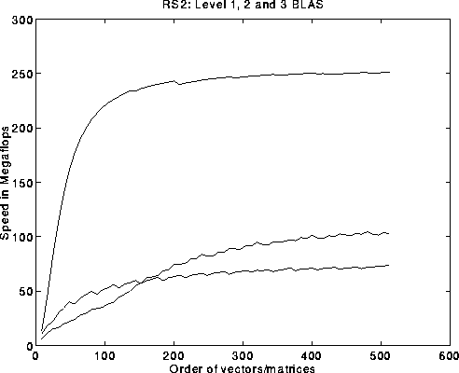
BLAS speeds on an IBM RS6000/590
Peak speed = 266 Mflops
Peak
BLAS 3
BLAS 2
BLAS 1
BLAS 3 (n-by-n matrix matrix multiply) vs BLAS 2 (n-by-n matrix vector multiply) vs BLAS 1 (saxpy of n vectors)

Slide 34
Strassen’s Matrix Multiply
The traditional algorithm (with or without tiling) has O(n^3) flops
Strassen discovered an algorithm with asymptotically lower flops
  O(n^2.81)
Consider a 2x2 matrix multiply, normally takes 8 multiplies, 4 adds
  Strassen does it with 7 multiplies and 18 adds
Let M = m11 m12 = a11 a12 b11 b12
m21 m22 = a21 a22 b21 b22
Let p1 = (a12 - a22) * (b21 + b22) p5 = a11 * (b12 - b22)
p2 = (a11 + a22) * (b11 + b22) p6 = a22 * (b21 - b11)
p3 = (a11 - a21) * (b11 + b12) p7 = (a21 + a22) * b11
p4 = (a11 + a12) * b22
Then m11 = p1 + p2 - p4 + p6
m12 = p4 + p5
m21 = p6 + p7
m22 = p2 - p3 + p5 - p7
Extends to nxn by divide&conquer

Slide 35
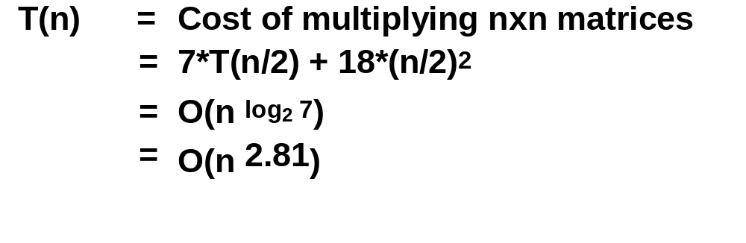
Strassen (continued)
Asymptotically faster
  Several times faster for large n in practice
  Cross-over depends on machine
  Available in several libraries
  “Tuning Strassen's Matrix Multiplication for Memory Efficiency”, M. S. Thottethodi, S. Chatterjee, and A. Lebeck, in Proceedings of Supercomputing '98
Caveats
  Needs more memory than standard algorithm
  Can be less accurate because of roundoff error
Notes:
World record due to Winograd and Copperfield
Very complicated algorithm
Needs unrealistically enormous matrices

Slide 36
Other Fast Matrix Multiplication Algorithms
Current world’s record is O(n ^{2.376...} ) (Coppersmith & Winograd)
Why does Hong/Kung theorem not apply?
Possibility of O(n^{2+ε}) algorithm! (Cohn, Umans, Kleinberg, 2003)
Fast methods (besides Strassen) may need unrealistically large n

Slide 37
Optimizing in Practice
Tiling for registers
  loop unrolling, use of named “register” variables
Tiling for multiple levels of cache and TLB
Exploiting fine-grained parallelism in processor
  superscalar; pipelining
Complicated compiler interactions
Hard to do by hand (but you’ll try)
Automatic optimization an active research area
  BeBOP: bebop.cs.berkeley.edu/
  PHiPAC: www.icsi.berkeley.edu/~bilmes/phipac
  in particular tr-98-035.ps.gz
  ATLAS: www.netlib.org/atlas

Slide 38
Removing False Dependencies
Using local variables, reorder operations to remove false dependencies
a[i] = b[i] + c;
a[i+1] = b[i+1] * d;
false read-after-write hazard
between a[i] and b[i+1]
float f1 = b[i];
float f2 = b[i+1];
a[i] = f1 + c;
a[i+1] = f2 * d;
With some compilers, you can declare a and b unaliased.
Done via “restrict pointers,” compiler flag, or pragma)

Slide 39
Exploit Multiple Registers
Reduce demands on memory bandwidth by pre-loading into local variables
while( … ) {
*res++ = filter[0]*signal[0]
+ filter[1]*signal[1]
+ filter[2]*signal[2];
signal++;
}
float f0 = filter[0];
float f1 = filter[1];
float f2 = filter[2];
while( … ) {
*res++ = f0*signal[0]
+ f1*signal[1]
+ f2*signal[2];
signal++;
}
also: register float f0 = …;
Example is a convolution

Slide 40
Minimize Pointer Updates
Replace pointer updates for strided memory addressing with constant array offsets
f0 = *r8; r8 += 4;
f1 = *r8; r8 += 4;
f2 = *r8; r8 += 4;
f0 = r8[0];
f1 = r8[4];
f2 = r8[8];
r8 += 12;
Pointer vs. array expression costs may differ.
Some compilers do a better job at analyzing one than the other

Slide 41
Loop Unrolling
Expose instruction-level parallelism
float f0 = filter[0], f1 = filter[1], f2 = filter[2];
float s0 = signal[0], s1 = signal[1], s2 = signal[2];
*res++ = f0*s0 + f1*s1 + f2*s2;
do {
signal += 3;
s0 = signal[0];
res[0] = f0*s1 + f1*s2 + f2*s0;
s1 = signal[1];
res[1] = f0*s2 + f1*s0 + f2*s1;
s2 = signal[2];
res[2] = f0*s0 + f1*s1 + f2*s2;
res += 3;
} while( … );

Slide 42
Expose Independent Operations
Hide instruction latency
  Use local variables to expose independent operations that can execute in parallel or in a pipelined fashion
  Balance the instruction mix (what functional units are available?)
f1 = f5 * f9;
f2 = f6 + f10;
f3 = f7 * f11;
f4 = f8 + f12;

Slide 43
Copy optimization
Copy input operands or blocks
  Reduce cache conflicts
  Constant array offsets for fixed size blocks
  Expose page-level locality
Original matrix
(numbers are addresses)
Reorganized into
2x2 blocks
0
4
8
12
0
2
8
10
1
5
9
13
1
3
9
11
2
6
10
14
4
6
12
13
3
7
11
15
5
7
14
15
Notes:
This is one of the optimizations that Atlas performance that PhiPAC does not.

Slide 44
Locality in Other Algorithms
The performance of any algorithm is limited by q
In matrix multiply, we increase q by changing computation order
  increased temporal locality
For other algorithms and data structures, even hand-transformations are still an open problem
  sparse matrices (reordering, blocking)
    Weekly research meetings
    Bebop.cs.berkeley.edu
    About to release OSKI – tuning for sparse-matrix-vector multiply
  trees (B-Trees are for the disk level of the hierarchy)
  linked lists (some work done here)

Slide 45
Summary
Performance programming on uniprocessors requires
  understanding of memory system
  understanding of fine-grained parallelism in processor
Simple performance models can aid in understanding
  Two ratios are key to efficiency (relative to peak)
  computational intensity of the algorithm:
    q = f/m = # floating point operations / # slow memory references
  machine balance in the memory system:
    t_{m}/t_{f} = time for slow memory reference / time for floating point operation
Want q > t_{m}/t_{f} to get half machine peak
Blocking (tiling) is a basic approach to increase q
  Techniques apply generally, but the details (e.g., block size) are architecture dependent
  Similar techniques possible on other data structures / algorithms

