Slide 1
Logistics Route Optimization
project by Denis Kleptsov

Slide 2
Table of contents
01
02
03
04
Project Introduction
The Story
Vosial Output
Resources & Deliverables

Slide 3
Logistics Route Optimization in Estonia
About the project
Timeframe | March 17–23, 2025
Team | solo project by Denis Kleptsov
High-Level Goal | Reduce delivery route distances by ≥15% using clustering and optimization methods.
Toold & Data | Tableau, Python, Excel 2 datasets (885 delivery records + 20 route logs) Geocoding via HERE API Route planning via OptimoRoute
Context & Summary
Textile delivery operations in Estonia (urban and rural)
Focused on a single transport partner with a high volume week
Evaluates delivery efficiency and route structure
Main Question
Can geographically clustering customers and optimizing routes reduce travel distance and time?
1

Slide 4
The Story – project flow
Start
1
2
3
Beginning
Middle
End
Stakeholders sought to lower operational costs and driver fatigue.
Delivery data indicated inefficiencies: long routes, inconsistent workloads.
Data cleaned
Geocoded 885 delivery locations
Clustered customers (K-means)
Built route plans using distance-minimizing heuristics
Distance can be reduced by 30%
KPI improvements: lower cost per item/kg, better workload balance

Slide 5
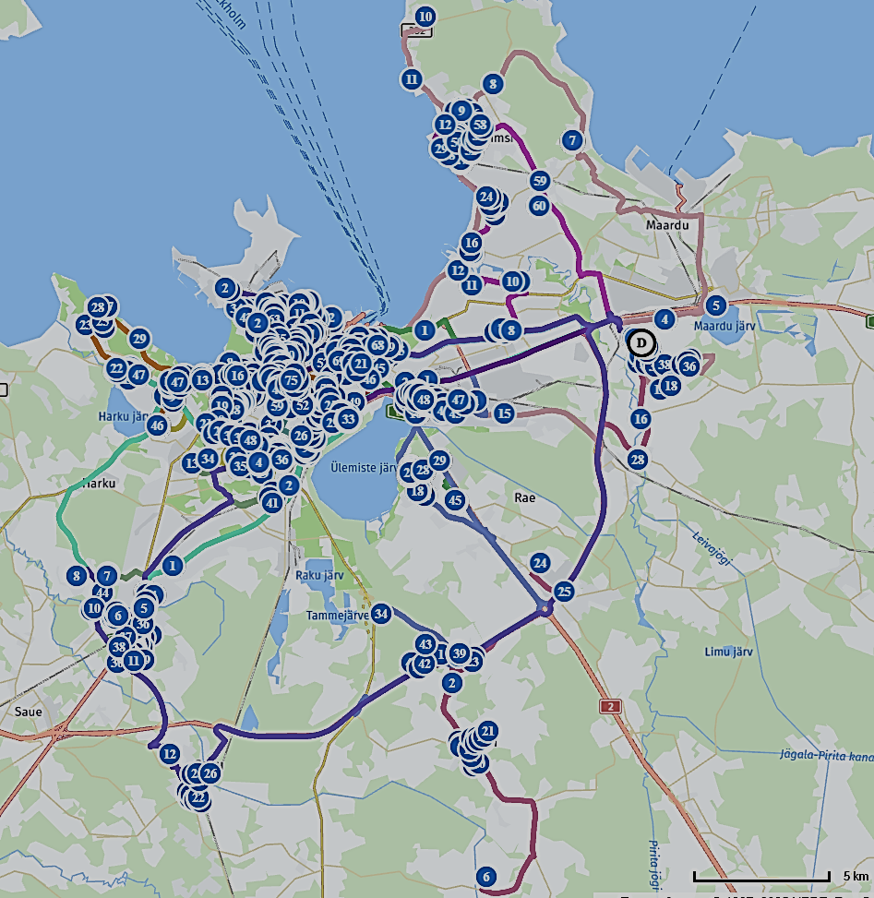
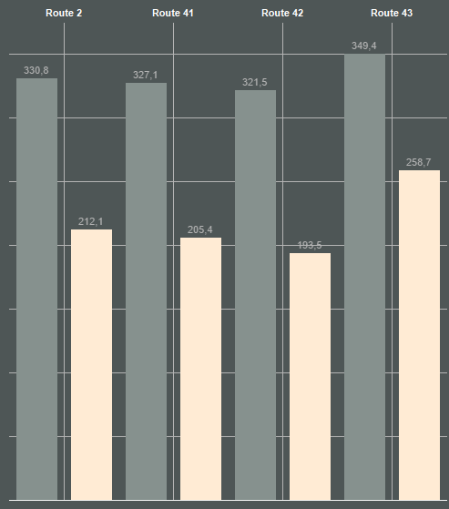
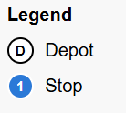
Visual Outputs & Interpretations
Legacy Routes
Optimized Routes
Optimized routes reduce the total distance from ~1300 km to ~850 km, only on 4 Routes, reducing the driving load by 33,17%.
Four geographic clusters were formed from 885 delivery points. This zoning supports logical and shorter delivery paths. For more info, click here

Slide 6




Resources & Deliverables (with links)
Presentation
Reserch Report
Cleaned & merged dataset (CSV)
Python notebooks for clustering & optimization
GitHub Repository
Tableau Public Dashboard
Local MAP file with routes

Slide 7



Thanks
If you have any questions?
denis.kleptsov @gmail.com

