Slide 1
ADD SAMPLE CHAPTERS

Slide 2
SetTimeout from Solid Doc

Slide 3
Carl Becker - LinkedIn
Hi I’m Carl. I started my adult life as a horse trainer and riding instructor. Later I automated spreadsheet models for Morgan Stanley, became a Windows developer, development manager, and then product manager. I’m now retired and focused on learning and writing. My current interest is SolidJS and SolidStart. I just published my first book, “SolidStart Routing”.

Slide 4
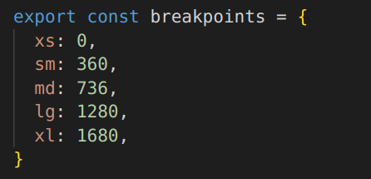
I started merging test.css and index.css. Most but not all got moved over.

Slide 5
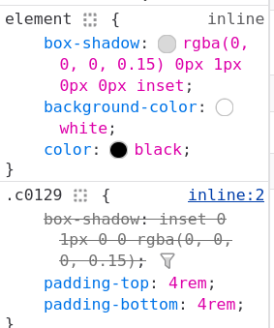
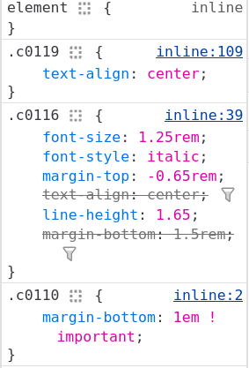

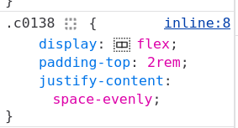

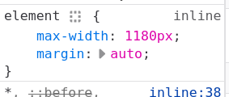
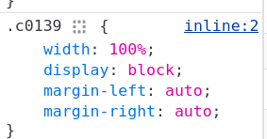
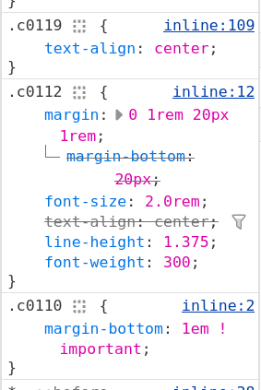


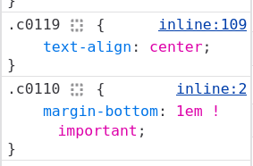
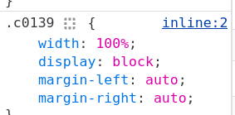
A
D
A <section>
B <div>
G
C <h2>
D <p>
H
E <div>
F <p>
B
I
G <div>
C
H <div>
I <img>
J <div>
K <img>
E
J
F
K

Slide 6
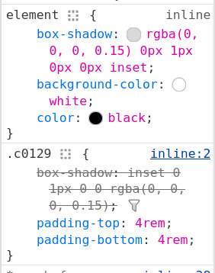
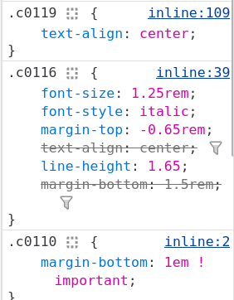
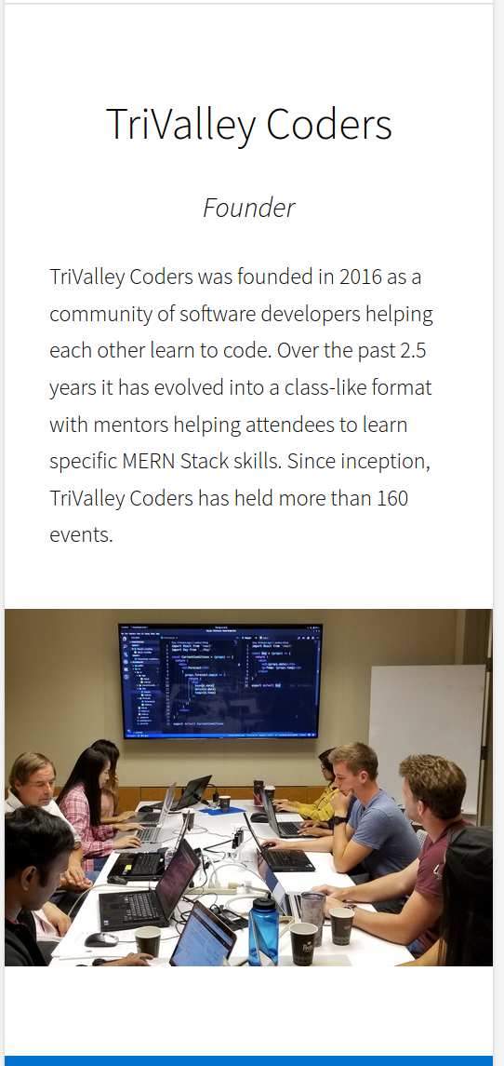
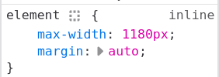
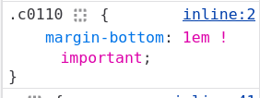
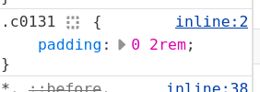
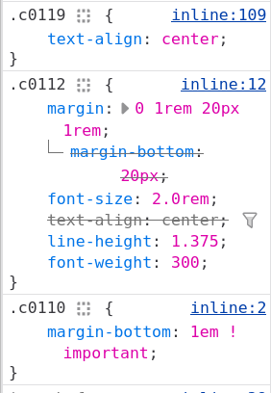
A
E
A <section>
B <div>
D h2
C <div>
E p
F p
B
B
B
F
H
H
I
I
C
J
J
K
K
D

Slide 7
YOU JUST NEED TO
ANNOUNCE IT

Slide 8
Some Text

Slide 9
Some Text

Slide 10
Some Text

