Slide 1

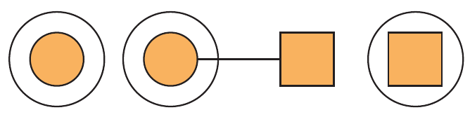
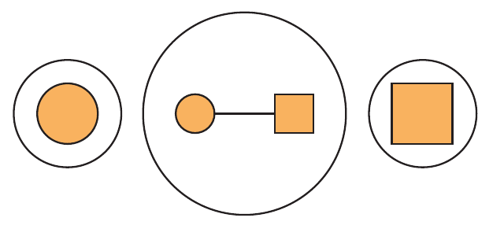
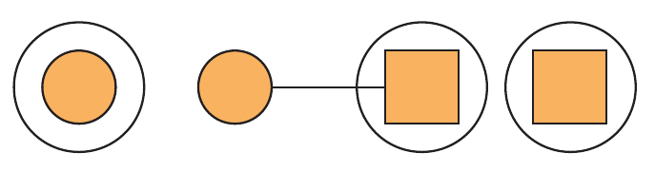
Functor
Transform types that are in context with a function that is not.
Applicative 1
Transform from one type in context to another type in context with a function that takes a value in context but outputs a value that is not.
Applicative 2
The function itself is in context
E.g., the function itself may be missing
Monad
The function itself is in context
E.g., the function itself may be missing

