Slide 1
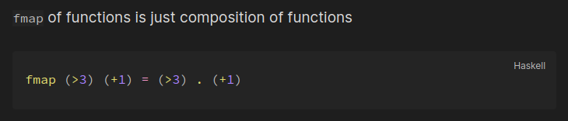
fmap

Slide 2
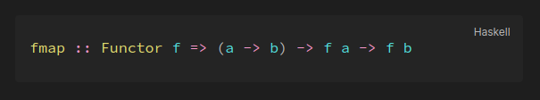
fmap
a wrapped in the context of f
b wrapped in the context of f

Slide 3
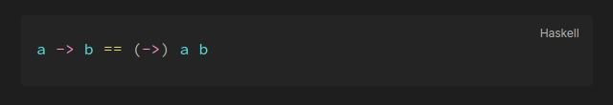
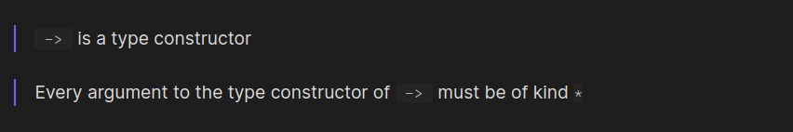
`->`

Slide 4

The kind of `f` must be `* -> *`

Slide 5
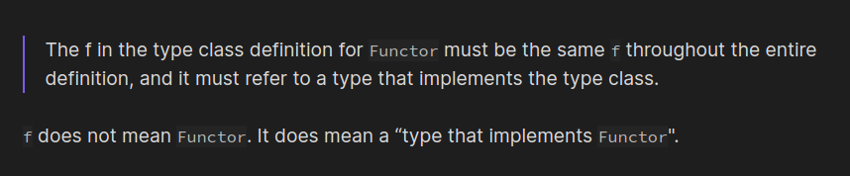
f is an instance of Functor

Slide 6
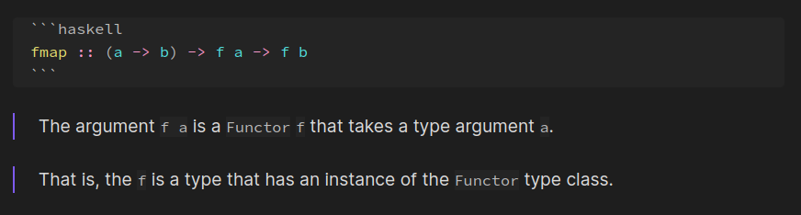
f

Slide 7
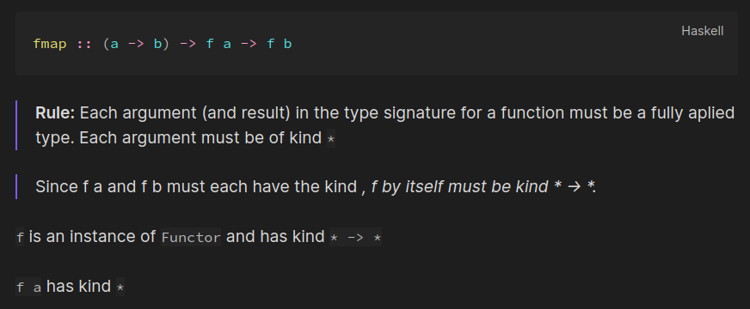
f has kind `* -> *`

Slide 8
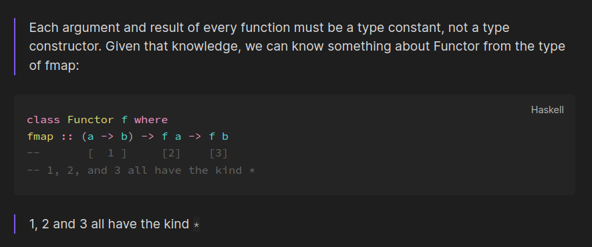
f has kind `* -> *`

Slide 9
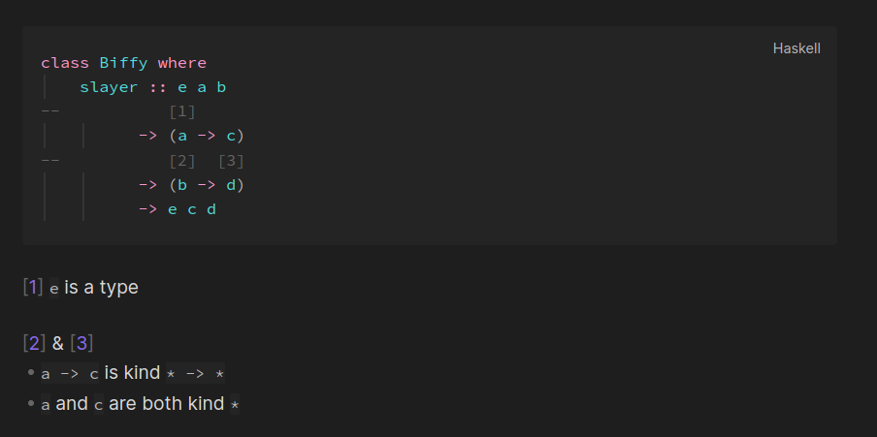
is what it says

Slide 10
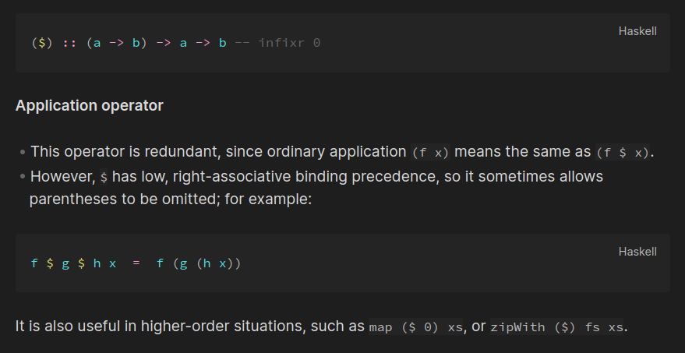
`($)` is function application

Slide 11
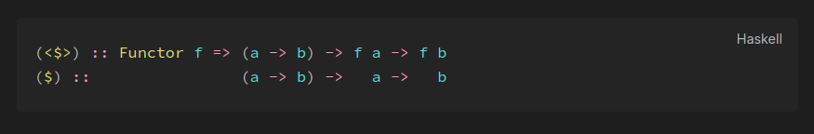
Functor is a type class for function application

