Slide 1
Events Typography

Slide 2
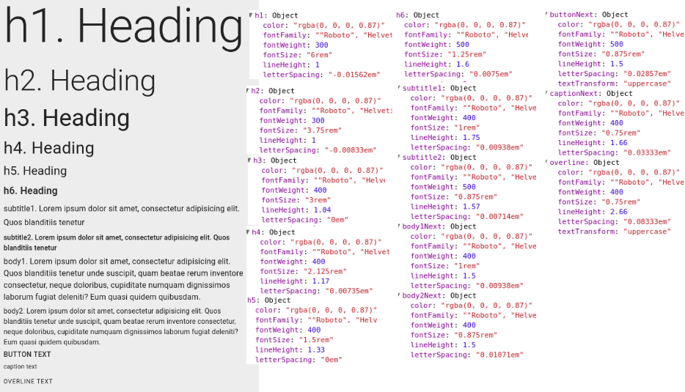

Slide 3

AppBar
1
2
1
h6
2
button

Slide 4

Card
1
1
h5
2
2
h6
3
4
3
subtitle1
4
caption

Slide 5
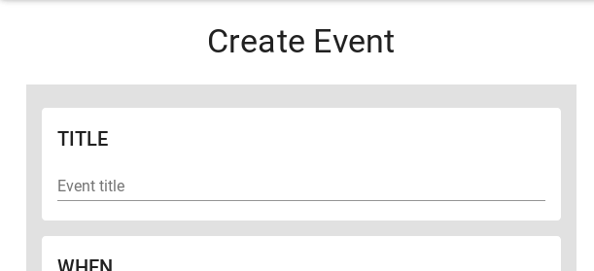
Create Event
1
<PageTitle>
h4
2
h6
1
2

Slide 6

Footer
1
1
h6
2
subtitle1
1
3
body1
2
2
2
3

Slide 7
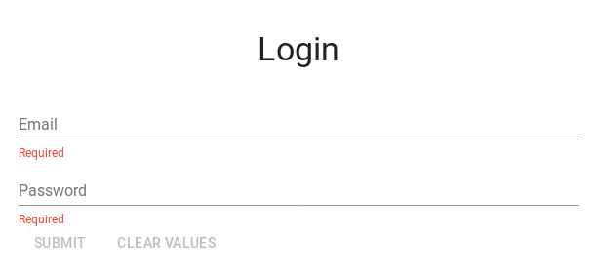
Login
1
<PageTitle>
h4
1

Slide 8
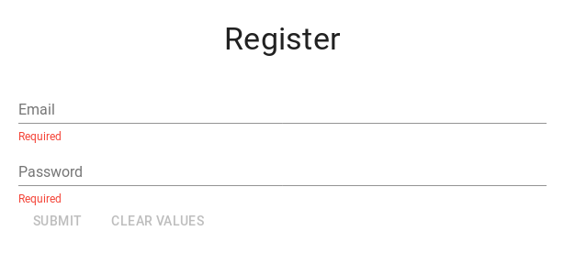
Register
1
<PageTitle>
h4
1

Slide 9
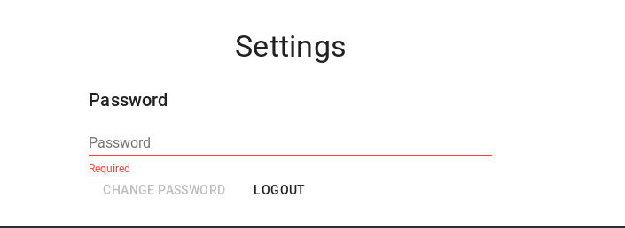
Settings
1
<PageTitle>
h4
2
h6
1
2

Slide 10
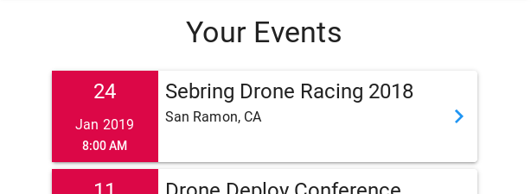
My/Your Events
1
<PageTitle>
h4
2
h5
1
3
subtitle1
2
5
4
subtitle2
3
6
5
h5
4
6
subtitle1

