Slide 1
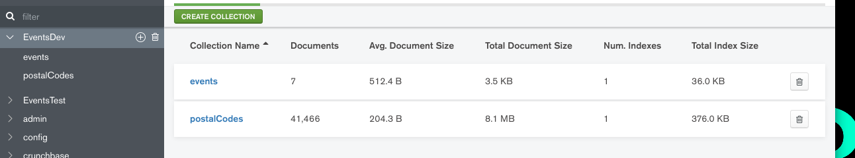
Db name is Events dev
Db name is EventsDev
Data for the collections is in doc-and-admin
Import via Compass

Slide 2
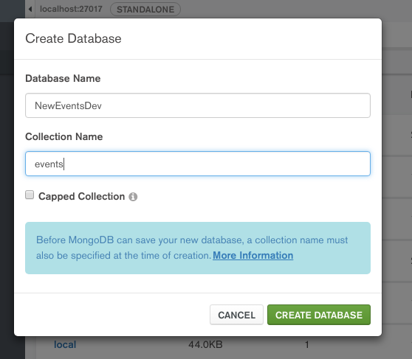
Picture has db name ‘NewEventsDev’ but yours will be ‘EventsDev’

Slide 3
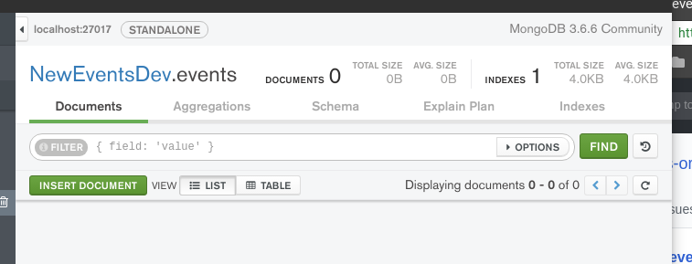
Go into the events collection which will be blank

Slide 4
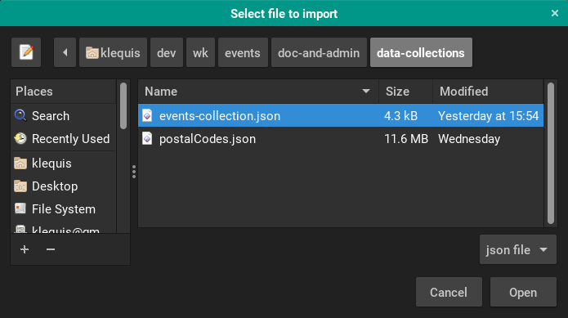
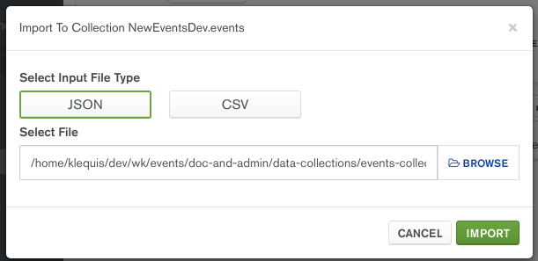
Select Collec>Import Data
Browse for the file
The collection should now have 7 documents

Slide 5
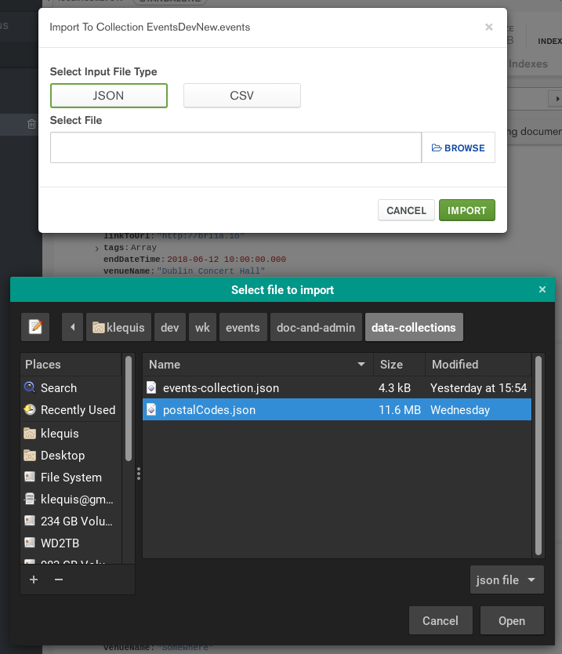
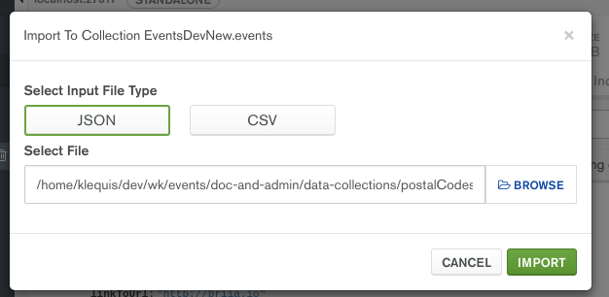
Create collection named ‘postalCodes’
Open the collection
Select Collection>Import Data
Click Import

Slide 6
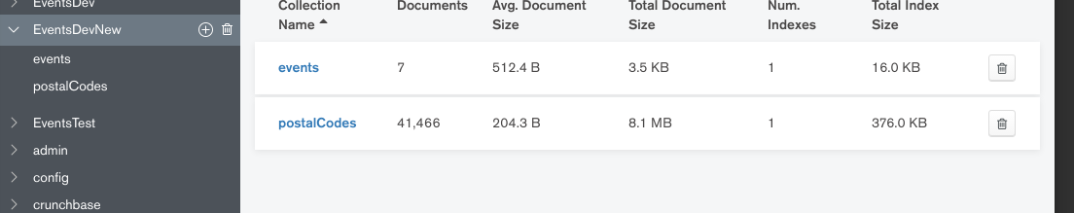
Clicking on the database on the left to show both collections you should see the number of documents as shown
It seems to take some time for the postalCodes document count to show.

Slide 7
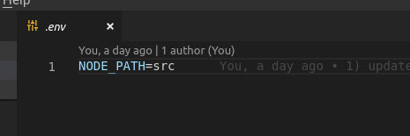
Client Setup
Get the latest dev branch from GitHub
$ rm -rf node_modules
$ rm yarn*
$ yarn
It should start now
Make sure you have the .env

Slide 8
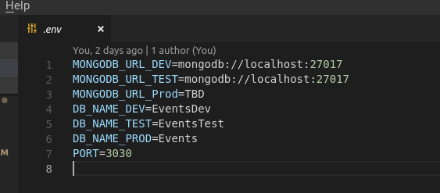
Server Setup
Get the latest dev branch from GitHub
$ rm -rf node_modules
$ rm yarn*
$ yarn
Make sure you have the .env

Slide 9
Should be working now

