Slide 1

Bellabeat Case Study: How Can a Wellness Technology Company Play it Smart?
Presented By: Kevin Leung
Last Updated: January 27, 2025

Slide 2

Background
Founded in 2013 by artist Urška Sršen and mathematician Sando Mur, Bellabeat is a health and wellness technology company that seeks to inform, inspire, and empower consumers to make health-conscious decisions.
Bellabeat manufactures smart devices that can track an individual’s activity, sleep, stress, mindfulness, and reproductive health habits.

Slide 3
Table of Contents
Business Task
General Trends
Correlation Coefficient
Relationships
Conclusion
Appendix

Slide 4
Business Task

Slide 5
Business Task
Identify trends and relationships in smart device user data that are compatible with Bellabeat consumers and deliver insights that can drive strategical innovation for Bellabeat to have a greater global presence.

Slide 6
General Trends

Slide 7
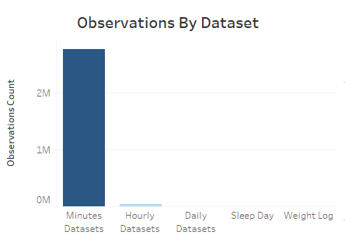

General Trends: Observations

Slide 8
General Trends: Observations
Smart devices data show a significant emphasis on tracking metrics based on number of observations that involve being active. (minute, hourly, daily)
Less emphasis placed on non-active metrics. (sleep and weight)
Notes:
Ex. Heart rate, steps, distance, calories burned, energy expenditure (METs), and intensity.
Ex. sleep and weight tracking.

Slide 9
General Trends: Center of Disease and Control (CDC) Guidelines

Slide 10
General Trends: Center of Disease and Control (CDC) Guidelines
Under CDC daily recommendations, FitBit users on average met or did not meet the target daily guidelines.
Calories Burned - ( 2000-3000 men, 1600-2400 women calories )
Active Minutes - ( >= 30 minutes )
Total Steps - ( 8000-10000 steps )
Heart Rate - ( >= 100 value )
Sleep - ( >= 7 hours )
Bmi - ( < 18.5 under, 18.5-24.9 normal, > 25 overweight bmi )
Notes:
Under CDC daily recommendations, FitBit users on average successfully met the target daily goals for calories burned (2000-3000 men, 1600-2400 women calories) and active minutes (>=30 minutes).
However, users on average fell short of meeting the total steps (8000-10000 steps), heart rate (>=100 value), sleep (>=7 hours) and weight criteria (<18.5 under, 18.5-24.9 normal, > 25 overweight bmi).

Slide 11
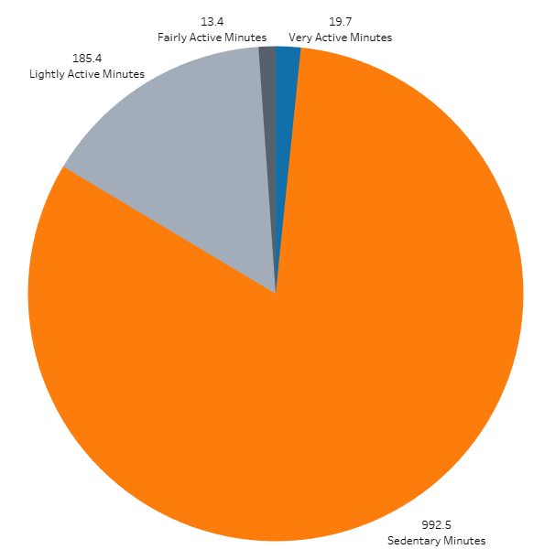
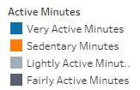
General Trends: Daily User Active Minutes

Slide 12
General Trends: Daily User Active Minutes
Users spend 18% of their daily time active and 82% sedentary.
Approximately 1/5 active, and 4/5 sedentary.

Slide 13
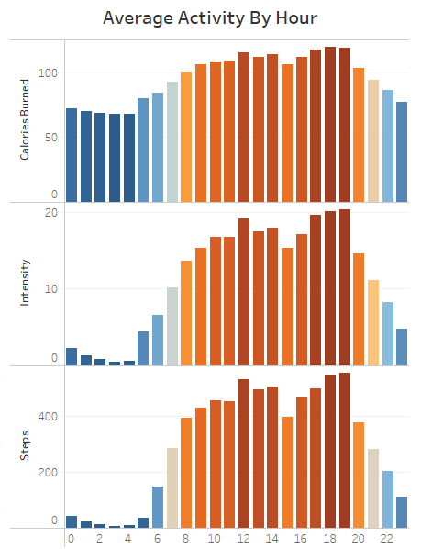
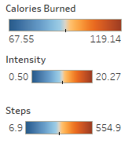
General Trends: Activity by Hour

Slide 14
General Trends: Activity by Hour
Users show the greatest total hourly input in active metrics between the hours of 12-2PM and 5-7PM.

Slide 15
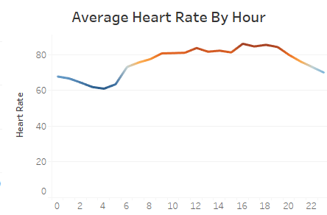

General Trends: Heart Rate by Hour

Slide 16
General Trends: Heart Rate by Hour
Users are at a daily average resting heart rate of 78.
Notes:
If we transposed the previous slide of hourly activities, then heart rate would follow a similar trend between 12-2pm and 5-7pm

Slide 17
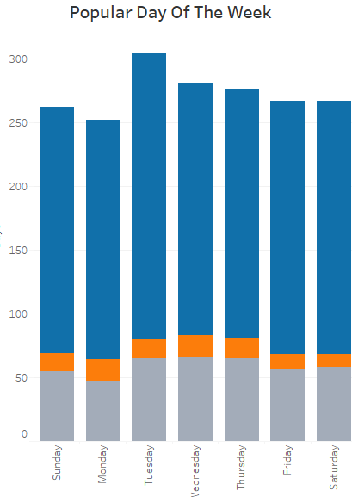
General Trends: Popular Tracking Day

Slide 18
General Trends: Popular Tracking Day
Users show the greatest overall input for active metrics on Tuesdays.
For passive metrics like sleep and weight, Wednesdays shows the most input.

Slide 19
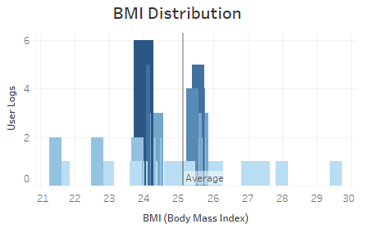
General Trends: Body Mass Index (BMI)

Slide 20
General Trends: Body Mass Index (BMI)
Users on average are overweight with a BMI of 25.37.
Notes:
Sampling 30 users, the average may not represent the sample size as that is 0.37 BMI off of being normal under CDC recommendations and contains several outliers.

Slide 21
Correlation Coefficients

Slide 22
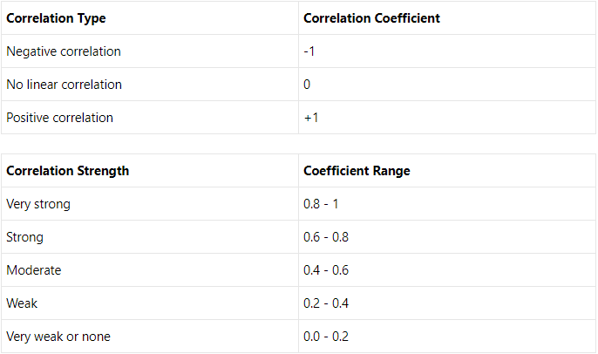
Correlation Coefficients

Slide 23
Correlation Coefficients
Correlation coefficients ρ range from -1 to +1.
The strength to which these relationships can be interpreted is as follows.

Slide 24
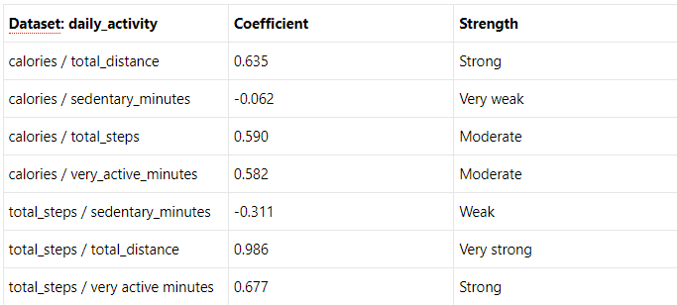
Correlation Coefficients: Daily Activity
Notes:
Over half of the dataset has correlation relationships

Slide 25
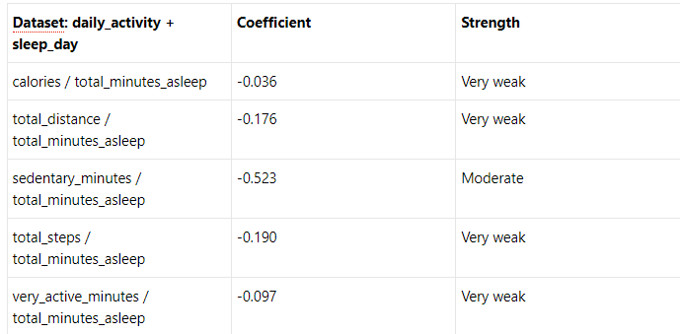
Correlation Coefficients: Daily Activity & Sleep Day
Notes:
Only 1 relationship

Slide 26
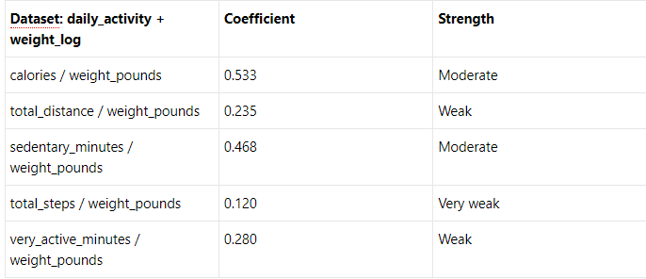
Correlation Coefficients: Daily Activity & Weight Log
Notes:
Less than half with relationships

Slide 27
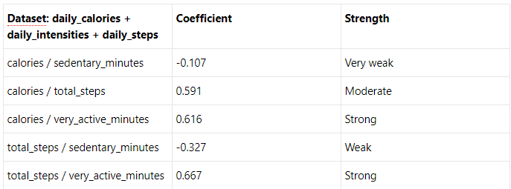
Correlation Coefficients: Daily Datasets
Notes:
More than half with relationships

Slide 28
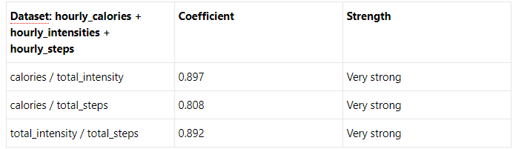
Correlation Coefficients: Hourly Datasets
Notes:
All have relationships

Slide 29
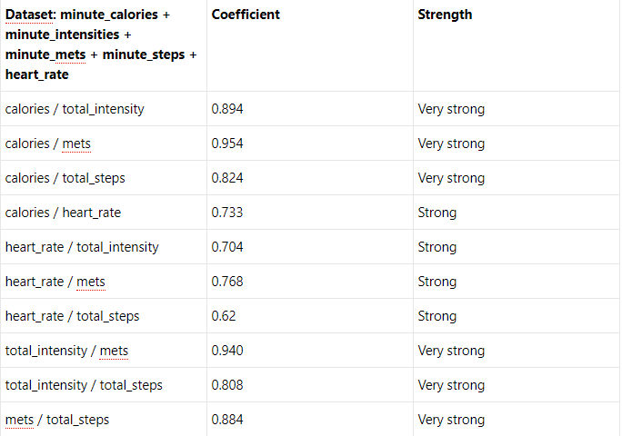
Correlation Coefficients: Minute Datasets
Notes:
All have relationships

Slide 30
Relationships

Slide 31
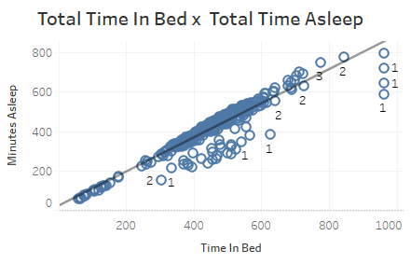
Relationships:
ρ = 0.930
Notes:
- Users spend on a daily average 7 ½ hours in bed, 6.98 hours sleeping which barely meets the minimum by CDC of at least 7 hours.
- Users on a minute average spend more time in sleep stage 1, lighter sleep.
- According to the CDC, more time should be focused in stage 3 where deep sleep and non-rapid eye movement occurs.

Slide 32
Relationships:
ρ = 0.930 - very strong
Notes:
- Users spend on a daily average 7 ½ hours in bed, 6.98 hours sleeping which barely meets the minimum by CDC of at least 7 hours.
- Users on a minute average spend more time in sleep stage 1, lighter sleep.
- According to the CDC, more time should be focused in stage 3 where deep sleep and non-rapid eye movement occurs.

Slide 33
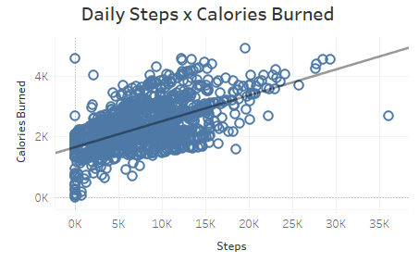
Relationships:
ρ = 0.591

Slide 34
Relationships:
ρ = 0.591 - moderate

Slide 35

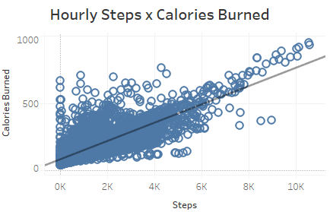
ρ = 0.808

Slide 36
ρ = 0.808 - very strong

Slide 37
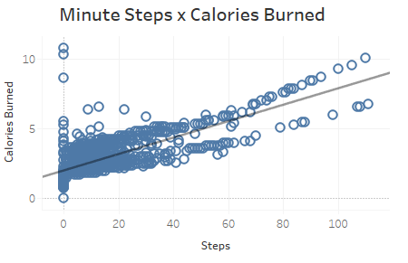
Relationships:
ρ = 0.824

Slide 38
Relationships:
ρ = 0.824 - very strong

Slide 39
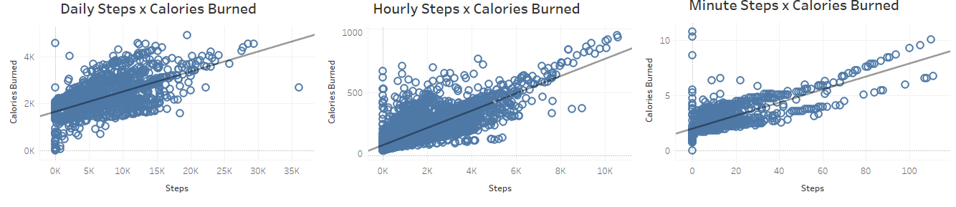
Relationships: (Daily -> Hourly -> Minute)
ρ = 0.591 - moderate
ρ = 0.808 - very strong
ρ = 0.824 - very strong

Slide 40
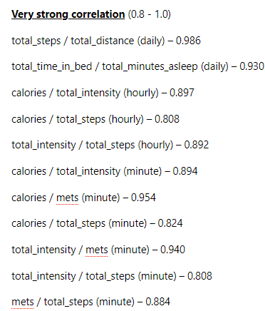
Further Exploration

Slide 41
Further Exploration
If we look at specific trends on a daily, hourly, and minute input basis to understand a user's daily activity, sleep and stress, then looking at variables that have correlation coefficients with a very strong relationship would be most recommended.
Notes:
Tracking these specific fields on smart devices would be to the immediate benefit of Bellabeat users and can be reliably explored further.

Slide 42
Review
Business Task
General Trends
Correlation Coefficient
Relationships
-> Recommendations
Notes:
Identify trends and relationships in smart device user data that are compatible with Bellabeat consumers and deliver insights that can drive strategical innovation for Bellabeat to have a greater global presence.

Slide 43
Conclusions

Slide 44
Conclusions
Campaign with a health organization like the CDC for educating users on what daily metrics can contribute to a healthy, active lifestyle and encourage them to set goals on the Bellabeat app.
Smart device active metrics are passively tracked on a frequent basis. Non-active metrics like sleep and weight could have a notification on a user's device or an incentive on the Bellabeat app for users to manually input data more frequently.
Target middle of the week (Tuesday/Wednesday) and the hours between 12-2pm, 5-7pm for user notifications and incentives on the Bellabeat app.
Users should be able to see a more complete daily end of the day total that is a passive sum of hourly or minute metrics.
Daily active metrics on the Bellabeat app need to be tracked more consistently on top of existing hourly and minute metrics to establish a better understanding of the relationship between daily active metrics and daily passive metrics such as sleep and weight.

Slide 45
Appendix
Deliverables:
https://www.github.com/kleung157/Bellabeat_Case_Study_Google_Data_Analytics
References:
https://www.cdc.gov/
https://www.kaggle.com/code/hannashuraieva/bellabeat-case-study#4.-Analyze
https://www.github.com/emily1618/Google-Data-Analytics-Bellabeat-Case-Study

Slide 46
Thank You

