Slide 1
Patient Management System

Slide 2
The Patient Management System is a web-based application designed to streamline and centralize healthcare-related operations within a medical facility. The system will enable administrative staff, doctors, and nurses to efficiently manage patient information, appointments, and medical records, while providing patients with secure access to their health data and upcoming appointments.
Key features include:
Patient registration and profile management
Appointment scheduling and rescheduling
Doctor and nurse dashboards with access to patient records
Prescription management and report uploads
Notifications and reminders for appointments and tests
Secure login and role-based access for different user types (admin, doctor, nurse, patient)
This system will help reduce paperwork, improve communication between departments, and ensure a smoother experience for both staff and patients.

Slide 3
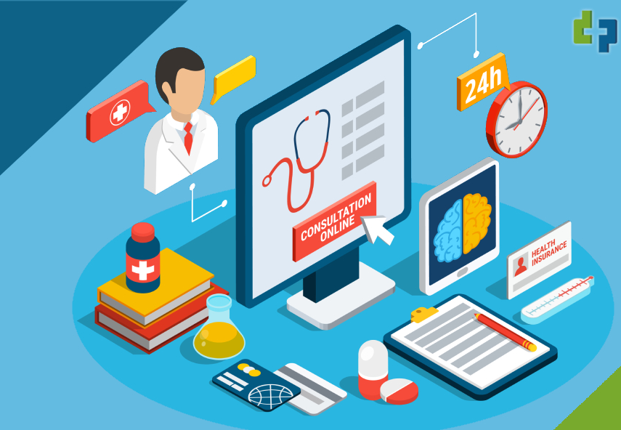
Why This App is Useful
The Patient Management System improves the efficiency and accuracy of healthcare services by replacing manual, paper-based processes with a streamlined digital solution. It reduces administrative workload, minimizes errors in patient data handling, and allows doctors and staff to access critical information quickly. For patients, it offers a convenient way to manage appointments and view medical records—enhancing overall communication, reducing wait times, and improving the quality of care.

Slide 4
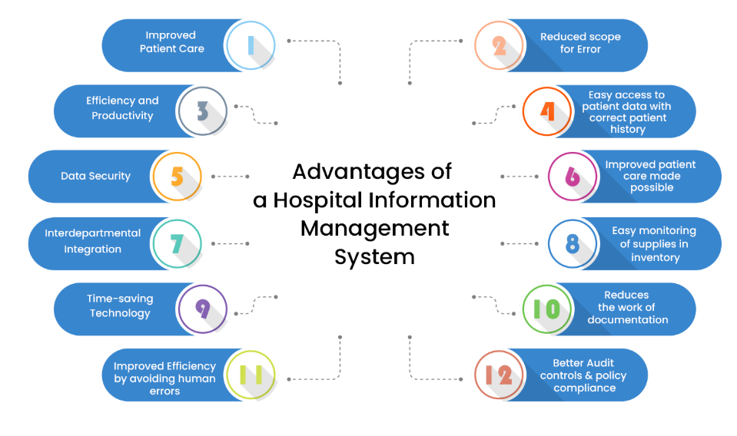
Advantages

Slide 5
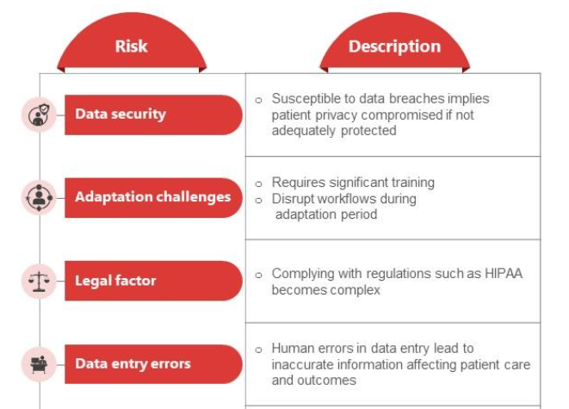
Drawbacks

Slide 6
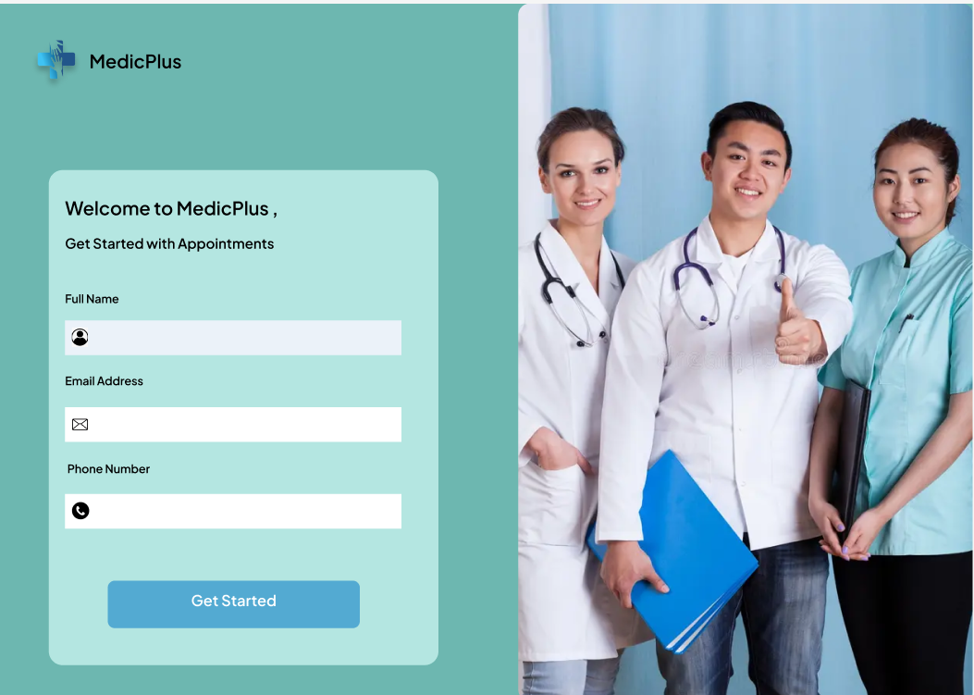
Log in page

Slide 7
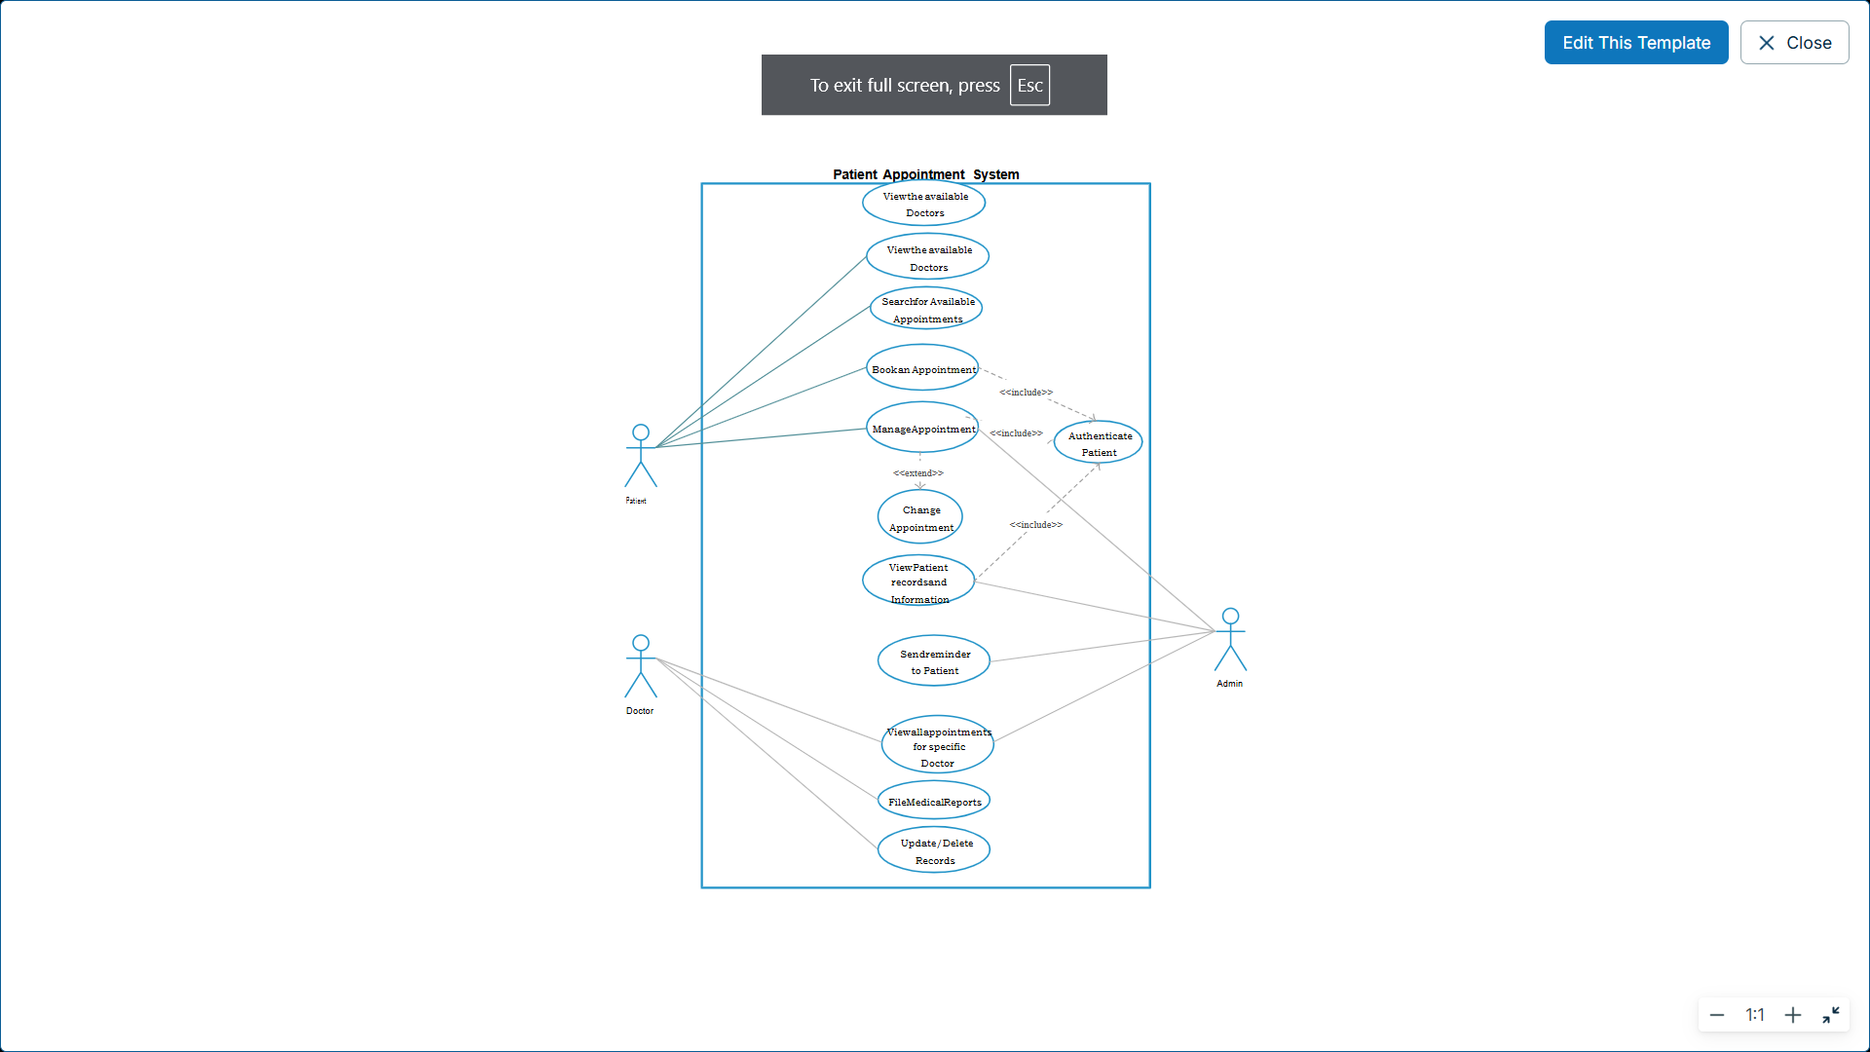
Use Case Diagram

Slide 8
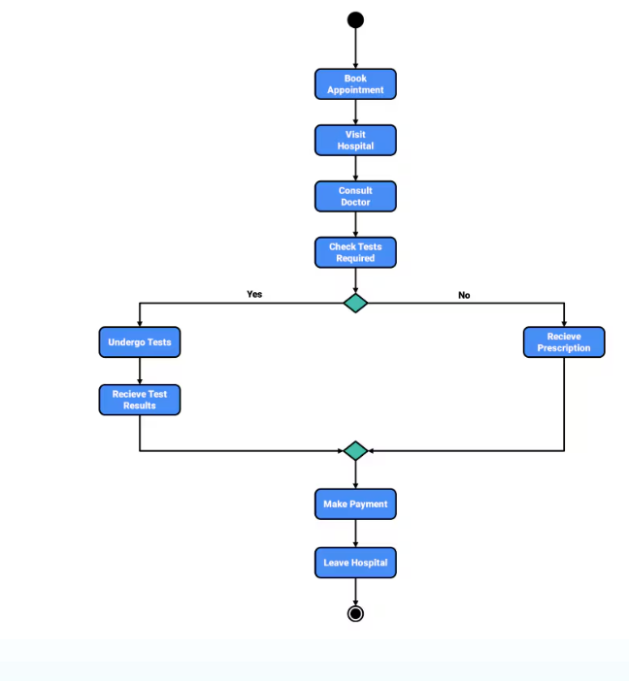
Activity Diagram

Slide 9
Roles:
- Juela Kadriu: Captain, Editor, Client Representative.
- Klevis Kadriu: Researcher, Tester, Repo master.
Team Process Guidelines:
- Team Name: SmartCare Devs

Slide 10
Thank you

