Slide 1

Getting Your Prayers Answered

Slide 2
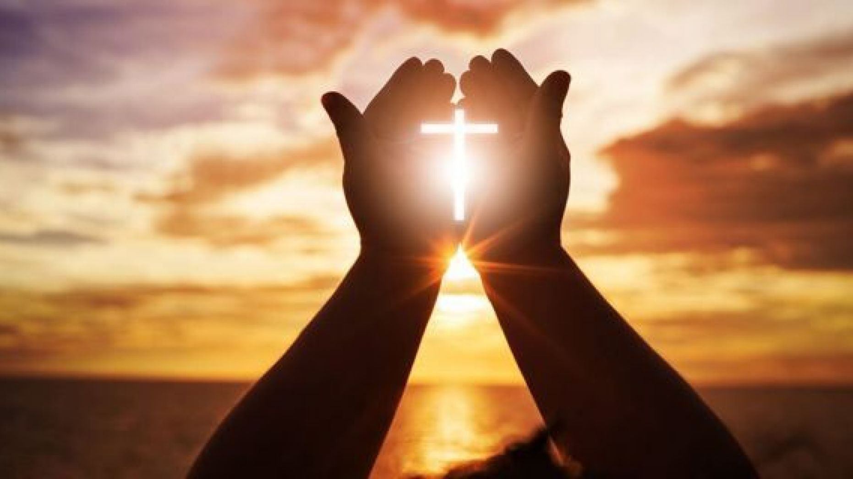
What is Prayer?
Prayer is talking with God
Prayer is our direct line with heaven
Prayer is the opening of the heart to God as to a friend. Not that it is necessary in order to make known to God what we are, but in order to enable us to receive Him. Prayer does not bring God down to us, but brings us up to Him (SC 93.1).

Slide 3
Our Need of Prayer
Jesus Himself, while He dwelt among men, was often in prayer. Our Saviour identified Himself with our needs and weakness, in that He became a suppliant, a petitioner, seeking from His Father fresh supplies of strength, that He might come forth braced for duty and trial. He is our example in all things. He is a brother in our infirmities, “in all points tempted like as we are;” but as the sinless one His nature recoiled from evil; He endured struggles and torture of soul in a world of sin. His humanity made prayer a necessity and a privilege. He found comfort and joy in communion with His Father. And if the Saviour of men, the Son of God, felt the need of prayer, how much more should feeble, sinful mortals feel the necessity of fervent, constant prayer.

Slide 4
How to get your prayers answered
God doesn’t so much hear the words of my prayer, as He sees the desire of my heart. What does He have to see in my heart for my prayers to be answered?
There are certain conditions upon which we may expect that God will hear and answer our prayers. One of the first of these is that we feel our need of help from Him. He has promised, “I will pour water on him who is thirsty, and floods on the dry ground” (Isaiah 44:3). Those who hunger and thirst after righteousness, who long after God, may be sure that they will be filled. The heart must be open to the Spirit’s influence, or God’s blessing cannot be received. (SC 95.1)
“Ask, and it will be given to you.” And “He who did not spare His own Son, but delivered Him up for us all, how shall He not with Him also freely give us all things” (Matthew 7:7; Romans 8:32).

Slide 5
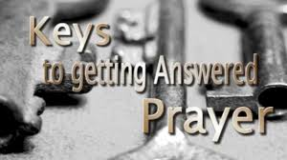
How to get your prayers answered
Another element is faith. “He who comes to God must believe that He is, and that He is a rewarder of those who diligently seek Him” (Hebrews 11:6). Jesus said to His disciples, “Whatever things you ask when you pray, believe that you receive them, and you will have them” (Mark 11:24). Do we take Him at His word?
Why should the sons and daughters of God be reluctant to pray, when prayer is the key in the hand of faith to unlock heaven’s storehouse, where are treasured the boundless resources of Omnipotence? (SC 94)

Slide 6
What are some hindrances to a potent prayer life?
Unconfessed sins
“But your iniquities have separated you from your God; your sins have hidden his face from you, so that he will not hear” (Isaiah 59:2). David concurred, knowing from experience that God is far from those who try to hide their sin: “If I had cherished sin in my heart, the Lord would not have listened” (Psalm 66:18).
Living according to the flesh
The flesh can gain control of our actions, attitudes, and motives unless we are diligent to “put to death the deeds of the body” (Romans 8:13) and be led by the Spirit in a right relationship with God. Only then will we be able to pray in close communion with Him.

Slide 7
What are some hindrances to a potent prayer life?
3. Selfishness
When our prayers are selfishly motivated, when we ask God for what we want rather than for what He wants, our motives hinder our prayers. “This is the confidence we have in approaching God: that if we ask anything according to his will, he hears us” (1 John 5:14). As in all things, Jesus is to be our example in prayer. He always prayed in the will of His Father: “Yet not my will, but yours be done” (Luke 22:42). Selfish prayers are always those that are intended to gratify our own selfish desires/hardness of heart towards others,. “When you ask, you do not receive, because you ask with wrong motives, that you may spend what you get on your pleasures” (James 4:3).

Slide 8
What are some hindrances to a potent prayer life?
4. Unforgiveness
How can we expect God to pour out His blessings upon us undeserving sinners if we harbour hatred and bitterness toward others? This principle is beautifully illustrated in the parable of the unforgiving servant in Matthew 18:23-35. This story teaches that God has forgiven us a debt that is beyond measure (our sin), and He expects us to forgive others as we have been forgiven. To refuse to do so will hinder our prayers.
5. Unbelief and Doubt
“And without faith it is impossible to please God, because anyone who comes to him must believe that he exists and that he rewards those who earnestly seek him” (Hebrews 11:6.

Slide 9
What are some hindrances to a potent prayer life?
“But when he asks, he must believe and not doubt, because he who doubts is like a wave of the sea, blown and tossed by the wind. That man should not think he will receive anything from the Lord; he is a double-minded man, unstable in all he does” (James 1:6-7).
6. Discord
In the home is a definite obstacle to prayer. Peter specifically mentions this as a hindrance to the prayers of a husband whose attitude toward his wife is less than godly. “Husbands, in the same way be considerate as you live with your wives, and treat them with respect as the weaker partner and as heirs with you of the gracious gift of life, so that nothing will hinder your prayers” (1 Peter 3:7).
Likewise, wives are to follow the biblical principles of submission to their husbands’ headship if their own prayers are not to be hindered (Ephesians 5:22-24).

Slide 10

The power of prayer
We Do Not Value the Power of Prayer as We Should—We do not value the power and efficacy of prayer as we should. Prayer and faith will do what no power on earth can accomplish (MOH 509).

Slide 11
The power of prayer
What does the Bible say?
¹⁹ Again I say to you, if two of you agree on earth about anything they ask, it will be done for them by my Father in heaven (Mat 18:19).
²² And whatever you ask in prayer, you will receive, if you have faith.” will be done for them by my Father in heaven (Mat 21:22).
²⁴ Therefore I tell you, whatever you ask in prayer, believe that you have received it, and it will be yours. (Mark 11:24).
⁷ If you abide in me, and my words abide in you, ask whatever you wish, and it will be done for you (John 15:7).

Slide 12
The power of prayer
What does the Bible say?
And whatever we ask we receive from him, because we keep his commandments and do what pleases him (1John 3:22).
And this is the confidence that we have toward him, that if we ask anything according to his will, he hears us. 15 And if we know that he hears us in whatever we ask, we know that we have the requests that we asked of him (1John 5:14-15).

Slide 13
God’s answer to prayer is
Yes or No.

