Slide 1
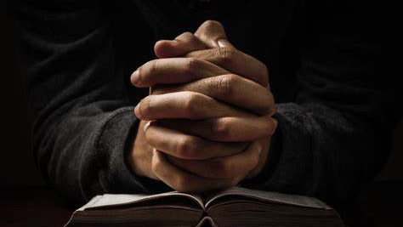

Teach Me How To Pray
By: Pastor Kiwayne Ferron

Slide 2
Did you know that prayer can be thought?

Slide 3

When Jesus was upon the earth, He taught His disciples how to pray. He directed them to present their daily needs before God, and to cast all their care upon Him. And the assurance He gave them that their petitions should be heard, is assurance also to us.
One day Jesus was praying in a certain place. When he finished, one of his disciples said to him, “Lord, teach us to pray, just as John taught his disciples” (Luke 11:1).

Slide 4
Jesus Gave A Prayer Module
2 And he said unto them, when ye pray, say, Our Father which art in heaven, Hallowed be thy name. Thy kingdom come. Thy will be done, as in heaven, so in earth.3 Give us day by day our daily bread.4 And forgive us our sins; for we also forgive every one that is indebted to us. And lead us not into temptation; but deliver us from evil (Luke 11:2-4).

Slide 5
Elements of Prayer
A.C.T.S
Adoration/Acknowledgement – “Praise be to God!” -Psalms 68:35
Tell God how much you appreciate Him. Express your love for Him. Praise His power and majesty. This is a great way to begin your prayer time.
Confession – “If we confess our sins, He is faithful and just, and will forgive us our sins and purify us from all unrighteousness.” -1 John 1:9
Tell Him where you have fallen short. Be specific.

Slide 6
Elements of Prayer
A.C.T.S
Thanksgiving – Always “glorify him with thanksgiving” -Psalms 69:30
You have plenty of reasons to be thankful. Thank God for His love, His faithfulness, His patience and a million other things. Express gratitude for what He’s doing in your life. Thank Jesus for dying on the cross for you. Thank the Holy Spirit for indwelling in you and for never leaving. Thank Him for being your conscience, your counsellor and that “still small voice.”
Supplication – “Make your requests known to God.” -Philippians 4:6
Tell God what you want, no matter how small it seems to you. Do you really think any of your requests are big to God the Creator?

Slide 7
Supplication
Although it is a noun, supplication comes from the Latin verb supplicare, which means "to plead humbly."
It is used 60 times in the Bible), it can logically be applied to any situation in which you must entreat someone in power for help or a favour.
Chronicles-2 6:35
Then hear thou from the heavens their prayer and their supplication, and maintain their cause.
James 5:16
Confess your faults one to another, and pray one for another, that ye may be healed. The effectual fervent prayer of a righteous man availeth much.

Slide 8


Slide 9
The Module Prayer
Adoration
“Our Father which art in heaven, Hallowed be thy name. Thy kingdom come. Thy will be done in earth, as it is in heaven” (Matthew 6:9-10).
The Lord’s Prayer starts with adoration. Here we use the words “Father” and “hallowed” to show who God is to us and what his name means to us.
Confession
“And forgive us our debts, as we forgive our debtors (Matthew 6:12).”
We are then guided to ask for the forgiveness of our sins and for those who have wronged us.

Slide 10
The Module Prayer
Thanksgiving
“For thine is the kingdom, and the power, and the glory, for ever. Amen”(Matthew 6:13b).
Giving thanks expresses our faith, and faith pleases God.
Supplication
Give us this day our daily bread. And lead us not into temptation, but deliver us from evil (Matthew 6: 11,13a)
We must ask and let our request be made known.

Slide 11
The Lord’s prayer is not meant to be recited word for word. Jesus said that the Lord’s prayer is a “manner” of praying. In other words, it is meant to be a template for us to use in our prayer lives, and not a word for word recitation that we repeat multiple times throughout the week or day.

Slide 12
The Godhead and Prayer
All three persons in the Godhead take part in getting our prayers answered.

Slide 13
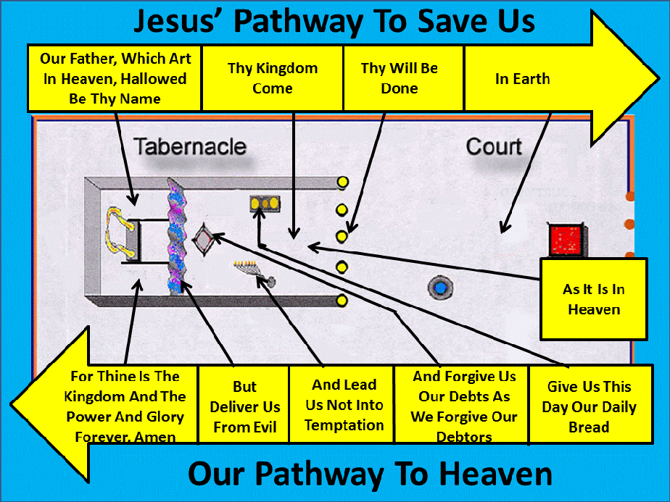
Notes:
Justification: Jesus, Sanctification: Holy Spirit, Gloration: The Father.

Slide 14
Vain Repetition
Is vain repetition calling God’s name more than once in prayer?
Is vain repetition using a given word couple times in a given prayer?
Is vain repetition asking God for the same thing over and over again (Praying the same prayer more than once).

Slide 15
Vain Repetition
Jesus said in the Sermon on the Mount, “When ye pray, use not vain repetitions, as the heathen do: for they think that they shall be heard for their much speaking” (Matthew 6:7, KJV).

Slide 16
Vain Repetition
5. “And when you pray, you shall not be like the hypocrites. For they love to pray standing in the synagogues and on the corners of the streets, that they may be seen by men. Assuredly, I say to you, they have their reward. 6 But you, when you pray, go into your room, and when you have shut your door, pray to your Father who is in the secret place; and your Father who sees in secret will reward you openly (Mat 6:5-6).
Notes:
Read verse 5 and 6 for they are connected.

Slide 17
Vain Repetition
VS 5
hypocrites - ὑποκριταί (hypokritai)
hypocrite, actor, stage player, dissembler.
ὑποκριταί- An actor under an assumed character (stage player).
Doing it as a show, to be seen by men.
Notes:
Dissembler, someone who hides their true feelings or facts. Isaiah 29:13, God says, “These people come near to me with their mouth and honor me with their lips, but their hearts are far from me.”

Slide 18
Vain Repetition
VS 6
room - ταμεῖόν (tameion)
room, closet, storeroom, inner chamber, secret room.
a place of privacy, a spot for retirement, or storage.
shut – κλείω (kleio)
to shut, close.
It is used in the New Testament to describe the act of closing a door or gate, often with the implication of preventing entry or access.

Slide 19
Vain Repetition
VS 6
secret - κρυπτῷ
hidden, concealed, secret.
That which is, private:- hid (-den), inward [-ly], secret.

Slide 20
Vain Repetition
vain repetitions: βατταλογήσητε
vain repetition, stammer.
To repeat the same thing over and over, to use idle words, to babble, to prate.
Notes:
You may also see battologeo’. Prate: talk foolishly or at tedious length about something

Slide 21
Vain Repetition
The word vain means “empty” or “useless”; so Jesus is warning us that repeating worthless phrases in our prayers will not help them be heard by God. Our Heavenly Father is not concerned with word count, flowery expressions, or mantras; He desires “truth in the inward being” (Psalm 51:6, ESV).

Slide 22
Vain Repetition
“Use not vain repetitions” is the King James translation of Matthew 6:7. Other translations say, “Do not use meaningless repetition” (NASB), “Do not heap up empty phrases” (ESV), or “Do not keep on babbling” (NIV).

Slide 23
Vain Repetition
As Jesus points out, the use of repetitious words or formulaic phrases is a “heathen” or “pagan” practice and should not be part of Christian prayer. Our prayers should be more like the short, simple prayer of Elijah on Mt. Carmel and less like the prolonged, repetitious prayers of the prophets of Baal (see 1 Kings 18:25–39).

Slide 24
Vain Repetition
Repeating things fills up time, but it does not prove our devotion or better our chances of God’s hearing us. We should teach our children at an early age to pray in a natural, conversational manner, with reverence for the One they are addressing.

Slide 25
Vain Repetition
Being persistent in prayer is not the same as using vain repetitions. There is nothing wrong with praying for the same thing more than once (see 2 Corinthians 12:8). After all, Jesus taught us that we should “always pray and not give up” (Luke 18:1). But it’s understood that our prayers are from the heart, spontaneous, and honoring to God, not the repeating of words written by someone else.
Notes:
Elijah Prayed for Rain, Jesus in gethsemane, the persistent widow and the unjust Judge (Luke 18). Luke 11: Friend at Midnight,… the friend gives him the bread because of his importunity, persistence, continual asking.

Slide 26
Vain Repetition
9 “So I say to you: Ask and it will be given to you; seek and you will find; knock and the door will be opened to you. 10 For everyone who asks receives; the one who seeks finds; and to the one who knocks, the door will be opened (Luke 11:9-10).

Slide 27

Should we only call God’s name once in prayer?
Did Ellen White say that we should address God at the beginning of our prayer and should not address him again?
Did Ellen White say it’s a sin to repeat God’s name when we pray?

Slide 28
“THOU shalt not take the name of the Lord thy God in vain; for the Lord will not hold him guiltless that taketh his name in vain.” The name of God is holy and must not be used lightly, profanely, nor vainly. Often in the Scriptures the direction is given, “Neither shalt thou profane my holy name.” The word profane means to make common. The name of God is not to be used in a way, nor with a frequency, that will make it to us as a common word or name (SITI August 11, 1887, pg. 487.1).
Notes:
Anecdote: a short, funny story. Witticism: a remark that is both clever and humorous…

Slide 29
In view of this it is certain that the practice of relating anecdotes, or of inventing or repeating witticisms, in which the name of the Lord is used, is transgression of this commandment, and therefore is sin. Whether those who do such things mean wrong by it, is not the question. It is wrong whether they mean it so or not. It is sin in itself. Its tendency is to reduce to the level of common things the name of “the high and lofty one that inhabiteth eternity, whose name is holy;” and it makes that “glorious and fearful name” to be the butt of the silly pleasantries and would-be witticisms of the profane lips of irreverent men (SITI August 11, 1887, pg. 487.2).
Notes:
Anecdote: a short, funny story. Witticism: a remark that is both clever and humorous…

Slide 30
It was Jewish tradition to substitute Adonai for the Tetragrammaton due to their ancient practice of not uttering the sacred name of God.
It was because the Jews were so concerned not to misuse the name of God that this tradition arose. The Jews wanted to be absolutely certain that they did not misuse the name of the Lord and so they read Adonai in place of YHWH.
Notes:
Tetragrammaton: The Hebrew name of God transliterated in four letters as YHWH or JHVH and articulated as Yahweh or Jehovah. Hebrew letters Yod-Heh-Vav-Heh (YHVH)

Slide 31
We have heard people pray, by whom almost every sentence was introduced with the name of the Lord. In fact, in some instances about the only use of that name in their prayers, after the first personal address, seemed to be simply as a catch-word, and was in every sense of the word taking the name of the Lord in vain. Its use, in such cases, is purposeless so far as any idea of reverence, or any just conception of the holiness of the holy name, is concerned. Such a practice is a violation of the third commandment, and such prayers are sinful. The practice is plainly forbidden by the Saviour in his instructions on the subject of prayer: “When ye pray, use not vain repetitions.” Matthew 6:7. And to use the name of the Lord at the beginning of every sentence, or of every alternate sentence, is nothing else than “vain repetition,” and is sin (SITI August 11, 1887, pg. 487.3).

Slide 32
We do not say that every repetition of the name is vain, nor that to repeat the name more than once in a prayer of considerable length and fervency would be sinful, because such a thing might be done with becoming reverence. In Jacob’s prayer when he was “greatly afraid and distressed” because of his fear of Esau, the name of God is not used at all after the address to him at the beginning. Genesis 32:6-12. It is so also in the prayer of Abraham’s servant. Genesis 24:12-14. In Solomon’s long prayer at the dedication of the temple the name of the Lord is only used ten times. 2 Chronicles 6:14-42. In the prayer of Moses which occupies the whole of the ninetieth psalm—seventeen verses—the name is used but four times.

Slide 33
In David’s deeply penitential prayer—the fifty-first psalm—he uses the holy name but seven times. In Ezra’s most sorrowful prayer the name is used but nine times. Ezra 9:6-15. In the longest prayer in the Bible the sacred name is used only seven times. Nehemiah 9:6-38. In Daniel’s prayer of thanks for the secret of Nebuchadnezzar’s dream, he used the name but twice. Daniel 2:20-23. The prayer in which that name is used the most of any in the Bible is Daniel’s of the ninth chapter, when he was earnestly pleading for an understanding of the word of the Lord—a prayer that ended in a holy vision with the angel Gabriel talking to him. There the name is used seventeen times (SITI August 11, 1887, pg. 487.4).

Slide 34
…the model which the Saviour gave does not use the holy name at all except in the form of address, “Our Father, which art in Heaven,” and then says, “hallowed be thy name.” Matthew 6:9-13. We are sure that this means something in this connection, especially as it is given immediately after the command to “use not vain repetitions.” Oh, that those who pray would heed these words, and really learn to fear “this glorious and fearful name, The Lord thy God”! Nor is this wish confined to those who pray, while they are praying. We would that these words might be heeded by those who preach as well as pray, and be heeded while they are preaching… (SITI August 11, 1887, pg. 487.5).
Notes:
Father, Lord, God, King, is not His name…

Slide 35
… Nor yet does the commandment stop with forbidding the vain use of that name itself. The commandments of God are “exceeding broad.” The commandment not only forbids the overt act of transgression, but it forbids everything which in its nature would lead to the overt act of transgression. Thus, the Saviour magnified the law of God.
Notes:
3rd commandment…

Slide 36
On the subject of this commandment, he said: “Ye have heard that it hath been said to the of old time, Thou shalt not forswear thyself, but shalt perform unto the Lord thine oaths; but I say unto you, Swear not at all; neither by heaven; for it is God’s throne; not by the earth; for it is his footstool; neither by Jerusalem; for it is the city of the great King. Neither shal thou swear by thy head, because thou canst not make one hair white or black. But let your communication be, Yea, yea; Nay, nay; for whatsoever is more than these cometh of evil.” Matthew 5:33-37 (SITI August 11, 1887, pg. 487.6).
Notes:
3rd commandment…

