Slide 1
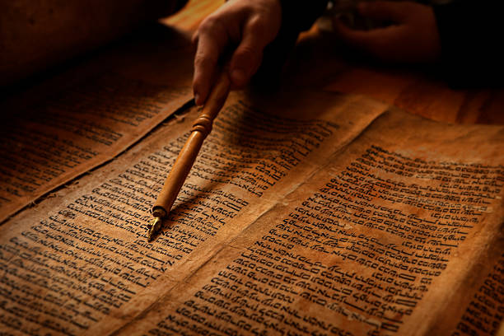
Hebrew 6:19-20
Hebrews 10: 19-20
Notes:
Christ went withing the veil and several scriptures mentions that after His ascension he sat on the right hand of God (AD 31).

Slide 2
Hebrews 6:19-20
19 Which hope we have as an anchor of the soul, both sure and stedfast, and which entereth into that within the veil;
20 Whither the forerunner is for us entered, even Jesus, made an high priest for ever after the order of Melchisedec.
Hebrews 10:19-20
19 Therefore, brethren, having boldness[a] to enter the Holiest by the blood of Jesus,
20 by a new and living way which He consecrated for us, through the veil, that is, His flesh.

Slide 3
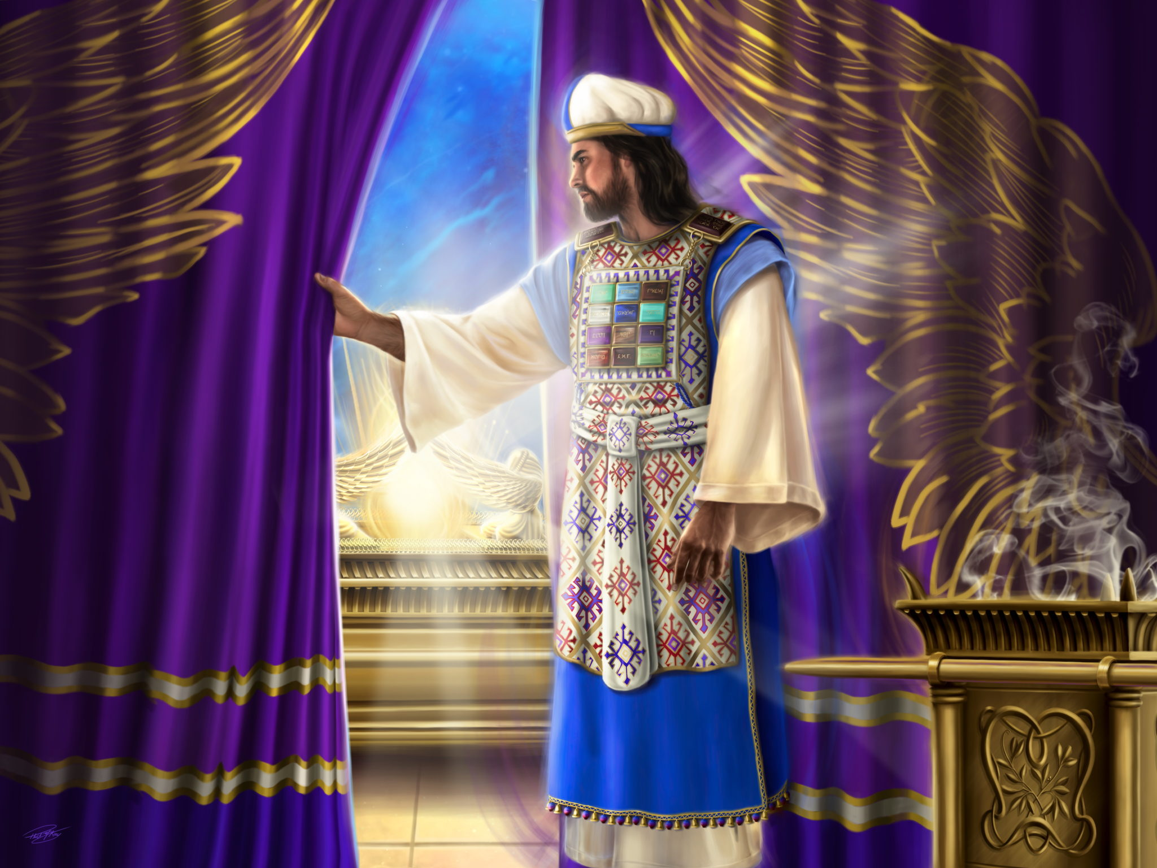
CHRIST PRIESTLY MINISTRY INAUGURATION
BY: KIWAYNE FERRON

Slide 4
"The earthly sanctuary was only "a miniature representation of the heavenly temple," "a dim reflection of the glories of the temple of God in heaven, the great center of the work for man's redemption."—Patriarchs and Prophets, pp. 343, 349.

Slide 5
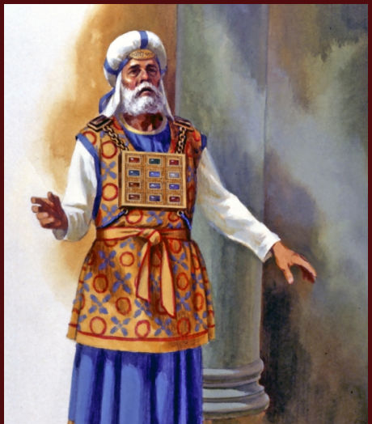
^{Hebrews 4:14}
¹⁴ Seeing then that we have a great high priest, that is passed into the heavens, Jesus the Son of God, let us hold fast our profession.

Slide 6
^{HEB 9:12} Neither by the blood of goats and calves, but by his own blood he entered in once into the holy place, having obtained eternal redemption for us. ^{KJV,}

Slide 7
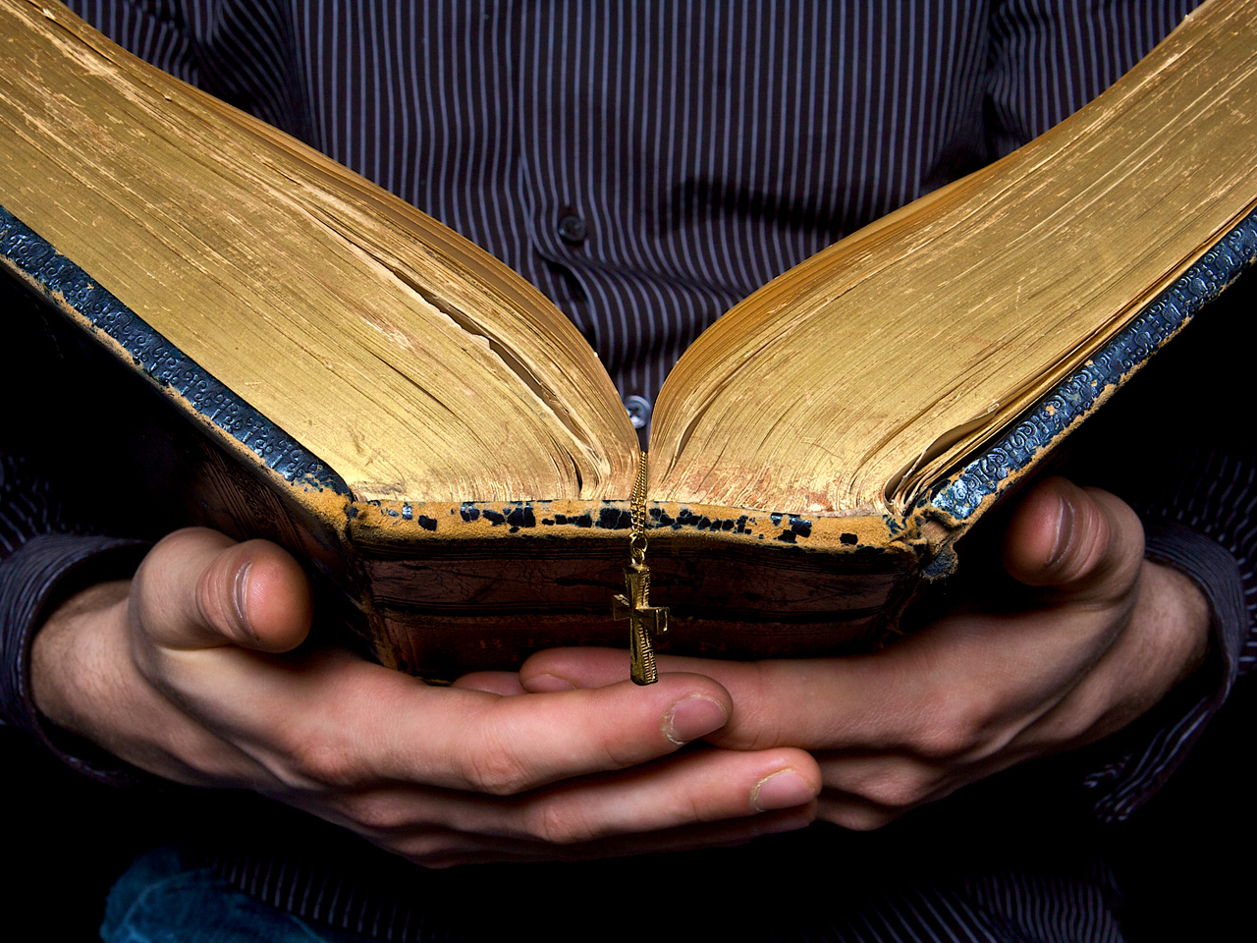
We know its length from the book of Acts. After Christ ascended to heaven (Acts 1:9), His disciples gathered and earnestly prayed for guidance and help in carrying forward the awesome task before them: telling all the world about salvation through their Lord and Saviour, Jesus Christ. They had been told to "wait" for the promised Holy Spirit (Acts 1:4, 8).

Slide 8
This prayer session was interspersed with daily witnessing in Jerusalem (Luke 24:50-53).
⁵⁰ And he led them out as far as to Bethany, and he lifted up his hands, and blessed them.
⁵¹ And it came to pass, while he blessed them, he was parted from them, and carried up into heaven.
⁵² And they worshipped him, and returned to Jerusalem with great joy:
⁵³ And were continually in the temple, praising and blessing God. Amen.

Slide 9
We are specifically told that ten days after the ascension, there occurred a dramatic outpouring of the Holy Spirit.

Slide 10
While instruction was being given to Moses regarding the erection of the sanctuary when he was in the mount with God during the forty days and forty nights, he was commanded to prepare a special anointing oil with which the tabernacle was to be anointed and the priests consecrated, before the ministry in the sanctuary was undertaken.

Slide 11
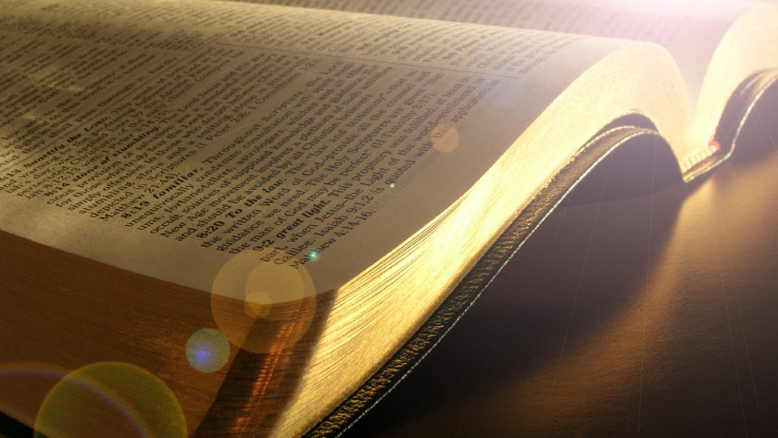
Exodus 24:1-2 King James Version (KJV)
24 And he said unto Moses, Come up unto the Lord, thou, and Aaron, Nadab, and Abihu, and seventy of the elders of Israel; and worship ye afar off.
² And Moses alone shall come near the Lord: but they shall not come nigh; neither shall the people go up with him.
Exodus 24:18 And Moses went into the midst of the cloud, and gat him up into the mount: and Moses was in the mount forty days and forty nights.
Exodus 30:25-26
²⁵ And thou shalt make it an oil of holy ointment, an ointment compound after the art of the apothecary: it shall be an holy anointing oil.
²⁶ And thou shalt anoint the tabernacle of the congregation therewith, and the ark of the testimony
Notes:
A-POTH-E-CURY… A person who prepares and sells drugs or compounds for medical purposes.

Slide 12

In regard to the consecration of the high priest and his associate priests, it is written:
"Thou shalt anoint Aaron and his sons, and con­secrate them, that they may minister unto Me in the priest's office. And thou shalt speak unto the children of Israel, saying, This shall be a holy anointing oil unto Me throughout your generations. 'Upon man's flesh shall it not be poured, neither shall ye make any other like it, after the composition of it: it is holy, and it shall be holy unto you." Ex. 30:30-32.

Slide 13
When the sanctuary was made and its parts were all put together, the following command came to Moses:
"Take Aaron and his sons with him, and the gar­ments, and the anointing oil, and a bullock for the sin offering; ... and gather thou all the congregation together unto the door of the tabernacle of the con­gregation.... And Moses said unto the congregation, This is the thing which the Lord commanded to be done." Lev. 8:2-5.

Slide 14
Moses then brought his brother Aaron and his sons, and washed them in the laver. He clothed them with the sacred robes in which they were to minister in the sanctuary. Fol­lowing this part of the ceremony—
"Moses took the anointing oil, and anointed the tabernacle and all that was therein, and sanctified them. And he sprinkled thereof upon the altar seven times, and anointed the altar and all his vessels, . . . to sanctify them. And he poured of the anointing oil upon Aaron's head, and anointed him, to sanctify him.” Leviticus 8:10-12.

Slide 15
Aaron's sons also were to be anointed with this holy oil. The Scripture says:
"Thou shalt put upon Aaron the holy garments, and anoint him, and sanctify him ; that he may min­ister unto Me in the priest's office. And thou shalt bring his sons and clothe them with coats : and thou shalt anoint them, as thou didst anoint their father, that they may minister unto Me in the priest's office: for their anointing shall surely be an everlasting priesthood throughout their generations." Ex. 40: 13-15.

Slide 16
The Scripture says regarding the thorough­ness with which this anointing with the holy oil was actually performed: "Behold, how good and how pleasant it is for brethren to dwell together in unity ! It is like the precious oint­ment upon the head, that ran down upon the beard, even Aaron's beard: that went down to the skirts of his garments." Ps, 133:2.

Slide 17
It was a most complete service which Moses performed upon his brother when he anointed him with 'the holy oil, in order that Aaron might be consecrated to the sacred and solemn work which was committed to him as the high priest of the earthly sanctuary. This holy oil was used for the purpose of dedicating the sanctuary and its vessels of service, as well as for the consecration of the priests to their ministry.

Slide 18
This inaugural and consecration service lasted seven days, as will be seen from the following scripture: "Ye shall not go out of the door of the tabernacle of the congregation in seven days, until the days of your consecra­tion be at an end: for seven days shall he consecrate you." Lev. 8:33.

Slide 19
None who were to take part in the service of the sanctuary were permitted to perform any labour during this time of inauguration and consecration; for we are told in Leviticus 8, therefore shall ye abide at the door of the tabernacle of the congregation day and night seven days, and keep the charge of the Lord, that ye die not: for so I am commanded (Lev 8:35).
Notes:
What a solemn and sacred service this must have been! To question or to mini­mize its value meant certain death. The sanctuary ministry was thus inaugurated, and the priests consecrated to this most sacred office, is clearly set forth.

Slide 20
When the week's dedication and consecra­tion service ended, the ministry of the sanc­tuary by the priesthood was officially inau­gurated. Says the Scripture:
"It came to pass on the eighth day, that Moses called Aaron and his sons, and the elders of Israel; and he said unto Aaron, Take thee a young calf for a sin offering, and a ram for a burnt offering, without blemish, and offer them before the Lord." Lev. 9:1, 2.

Slide 21
The people responded to this command of Moses. When Aaron had offered the sacri­fices, and had blessed the people for carrying out this divine instruction, then "there came a fire out from before the Lord, and consumed upon the altar the burnt offering and the fat: which when all the people saw, they shouted, and fell on their faces." Verse 24. The sanctuary service could now be entered upon according to the will and command of God.

Slide 22
Christ's Anointing as High Priest
Before the Saviour could begin His minis­try as our high priest, the heavenly sanctuary must be dedicated and anointed. and our Lord must be consecrated to His high priesthood. That this was to take place is foretold by the word of God.

Slide 23
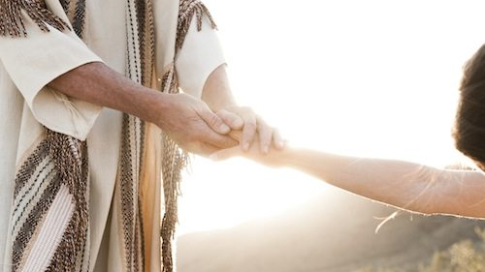
When the angel Gabriel explained to Daniel the significance of the first part of the twenty­ three-hundred-day prophecy by telling him that seventy weeks were determined upon his people and upon the Holy City, the celestial messenger said that the last thing to occur be­fore the end of the seventy-times-seven period was the anointing of the "most holy." These words, "most holy," in the Hebrew are Ko-desh Ko-do-shim Dan. 9:24. The words Ko-desh Ko-do-shim are not applied to people. They are invariably applied to objects, and particu­larly to the inner apartment of the sanctuary. ( Ex. 26:33, 34.)
Notes:
The word Messiah means “anointed” (Acts 4:25, 26, compared with PS. 2:1,2, and John 1:41). Yet we do not find in scripture the word “Most Holy” applied to the Messiah.

Slide 24
Daniel 9: 24. The Hebrew is “קָֽדָשִֽׁים׃ קֹ֥דֶשׁ וְלִמְשֹׁ֖ח", which the literal translation can be seen as “and to anoint a Holy of Holies.” ESV, NASB, NIV, NET “and to anoint a most holy place.”
(place is supplied).
Notes:
HEBREW: Right to left. we-lim- sho-ah (וְלִמְשֹׁ֖ח to anoint) a: because we don’t have a definite article after “to anoint,” Ko-desh (֥דֶשׁ Holy) Ko-do-shim (קָֽדָשִֽׁים׃ of Holies) or “to anoint a Most Holy.”

Slide 25
Scripture teaches that when the sanctuary and the furniture were finished and ready for service, Moses was commanded to make a holy anointing oil. Ex. 30:22-25. The purpose of the holy oil was to anoint the vessels of the tabernacle, including the holy and the most holy places, and for the anointing of the priests. Verses 26-30.
Strict command was given that this oil was not to go upon any human flesh, save only the priests’, and upon the vessels of the sanctuary. Verses 31-33. To violate this meant being cut off.

Slide 26
When the tabernacle was set up, Moses was exhorted:
"Thou shalt take the anointing oil, and anoint the tabernacle, and all that is therein, and shalt hallow it, and all the vessels thereof.. . . And thou shalt put upon Aaron the holy garments, and anoint him, and sanctify him; that he may minister unto Me in the priest's office. And thou shalt bring his sons, . . . and thou shalt anoint them, . . . that they may minister unto Me in the priest's office." Ex. 40:9-15.

Slide 27
When Moses had completed the setting up of the tabernacle, he was commanded to dedicate the sanctuary and to consecrate the priests be­fore- Aaron and his sons entered upon their sacred offices. The account of this dedicatory and consecration service is found in Leviticus 8.

Slide 28
Aaron and his sons were washed with water from the laver. They were then clothed with the holy garments. Verses 6-9, 13. The holy anointing oil was then applied to the sanctuary and its vessels. All parts of the tabernacle were anointed, including the furnishings in the most holy. Lev. 8:10, 11; Ex. 30:26-28. After the tabernacle and its furnishings, including the holy and the most holy, were anointed, the holy oil of anointing was poured upon the priests, upon Aaron and his sons. Lev. 8:12; Ex. 30:30.

Slide 29
The Scripture says regarding the thorough­ness with which this anointing with the holy oil was actually performed: "Behold, how good and how pleasant it is for brethren to dwell together in unity ! It is like the precious oint­ment upon the head, that ran down upon the beard, even Aaron's beard: that went down to the skirts of his garments." Ps, 133:1, 2.

Slide 30
Thus, it is clear that every part of the sanc­tuary was set apart, dedicated, consecrated with the holy anointing oil. But the ministry of the sanctuary by the priests could not begin until after the tabernacle and the priests had been set apart by this sacred service. This dedication of the sacred structure was neces­sary before the priestly service could become effective therein. At the completion of this holy service, Aaron and his sons were prepared to carry forward the ministry of reconciliation with the sacrifices in the holy place. Lev. 9:4, 6, 22, 23. God approved of the dedication of the sanctuary and the consecration of the priesthood. The sanctuary service now was inaugurated.

Slide 31
Jesus, after He completed His work on earth, was taken to heaven to appear in the presence of God as man's high priest and intercessor. He ascended to minis­ter in the sanctuary which the Lord pitched and not man. Heb. 8:2. Before He entered upon this priestly ministry in heaven, there must needs be a dedication of the heavenly sanctuary and a consecration of the priesthood of that sanctuary. Heb. 9:11-28. Jesus as­cended to heaven forty days after His resurrec­tion. Acts 1:3. According to the announce­ment of the angel Gabriel, recorded in Daniel 9:25-27, Jesus must minister three- and one-half years on earth after He became Messiah.

Slide 32
His Messianic anointing occurred at His bap­tism in October, 27 A. D. He labored among men three and one-half years following His baptism, and then died as the Lamb of God. Therefore, His ascension took place over three years before the completion of the full 490 years. It is the "most holy" of the heavenly sanctuary which Gabriel declared should be anointed during the seventy times seven years.

Slide 33
When was it consecrated/inaugurated?
Does the NT speaks of it’s consecration/inauguration?

Slide 34
^{HEB 9:12} Neither by the blood of goats and calves, but by his own blood he entered in once into the holy place, having obtained eternal redemption for us. ^{KJV,}

Slide 35
^{HEBREWS 9:12}
Hebrews 9:12 (KJV) Neither by the blood of goats and calves, but by his own blood he entered in once into the holy place, having obtained eternal redemption for us.
Hebrews 9:12 (ESV) he entered once for all into the holy places, not by means of the blood of goats and calves but by means of his own blood, thus securing an eternal redemption.
Hebrews 9:12 (NKJV) Not with the blood of goats and calves, but with His own blood He entered the Most Holy Place once for all, having obtained eternal redemption.
Hebrews 9:12 (SBLG) οὐδὲ δι’ αἵματος τράγων καὶ μόσχων διὰ δὲ τοῦ ἰδίου αἵματος, εἰσῆλθεν ἐφάπαξ εἰς τὰ ἅγια, αἰωνίαν λύτρωσιν εὑράμενος.
Notes:
τὰ ἅγια, Plural, Correct translation, Holy Places (Holy and the Most Holy) or Sanctuary (including the Apartments, Holy and Most Holy)

Slide 36
Hebrews 9:11-12
11 But Christ being come an high priest of good things to come, by a greater and more perfect tabernacle, not made with hands, that is to say, not of this building;
12 Neither by the blood of goats and calves, but by his own blood he entered in once into the holy place, having obtained eternal redemption for us.

Slide 37
Hebrews 1: 3, 9
3 Who being the brightness of his glory, and the express image of his person, and upholding all things by the word of his power, when he had by himself purged our sins, sat down on the right hand of the Majesty on high:
9 Thou hast loved righteousness, and hated iniquity; therefore God, even thy God, hath anointed thee with the oil of gladness above thy fellows.
Notes:
Jesus is anointed after His sacrifice. Jesus is not under the Aaronic priesthood; He is after a different kind (Melchizedek).

Slide 38
Hebrews 9
Now Hebrews 9 is almost written in a parable form.
Hebrews 9: 1-10 is telling us that the ministry in the earthly sanctuary system could not make the worshiper perfect.
Hebrews 9: 11 onwards, conveys the Jesus ministry in the heavenly sanctuary brings cleansing to the conscience.
So, Paul was making a comparison between the earthly and the heavenly sanctuary and service. Moreover, he was pointing heavily to the New Covenant.

