Slide 1

LLM and RL for Sentiment-Based Trading
Ayush, Kevin, Kay, Vedant

Slide 2
Introduction
Project Goal: Develop a reinforcement learning-based framework for financial news signal generation using LLMs.
Method: Combine sentiment analysis from news and volatility data to generate signals, supported by a CNN-based technical analysis agent. ESG data is also incorporated to align trading decisions with sustainable investment goals.
Approach: Use Reinforcement Learning from Market Feedback (RLMF) to continuously refine signals based on market outcomes. A dynamic reward system enhances the model’s adaptability to both immediate market shifts and longer-term trends, creating a self-improving strategy.

Slide 3
Methodology
Signal Generation Pipeline
Sentiment Score: The LLM generates sentiment scores from -10 to 10 based on news sentiment, where:
Positive values indicate bullish sentiment.
Negative values indicate bearish sentiment.
Volatility Agent:
Analyzes recent price data to assess volatility.
Scores between 0 (low volatility) and 10 (high volatility).
CNN-based Technical Analysis Agent:
Provides additional signals by identifying buy (binary outcome) opportunities from historical technical patterns (RSI, MACD, etc…)

Slide 4
Methodology
Reward Design
Sentiment-Based Reward: High positive rewards for correct, high-confidence signals (e.g., >3% return); penalties for misalignment.
Volatility-Based Adjustments: Rewards adjusted based on volatility (e.g., low volatility doubles reward).
Technical Analysis Influence: If technical analysis model disagrees with sentiment, the reward is neutralized.
ESG Data: Added ESG score bonus, simulating AI alignment with sustainable investments.
Adaptive Adjustments and Loss Calculation
Hyperparameter Dynamic Adjustments:
Automatically adjusts reward scaling based on recent portfolio trends (e.g., increases for consistent growth).
Loss Function:
Risk-Adjusted Reward: Penalizes risk using volatility scores.
Temporal Penalty: Smooths portfolio fluctuations to ensure consistent returns.
Advanced Loss Model:
Combines weighted log probabilities for sentiment and volatility.

Slide 5
Parameters
Environment Parameters
Max Steps: 248 – equivalent to a trading year minus holidays.
Threshold: 3 – defines the minimum sentiment confidence to trigger a trade action.
Lookahead: 3 days – used for projecting future price changes.
News Window: Incorporates 10 days of recent news headlines.
Reward Parameters
Return Thresholds:
Strong Positive Return: 5%
Moderate Positive Return: 2%
Weak Positive Return: 0.5%
Risk Management:
Low Risk Threshold: 4
Great Positive Reward: 2.0
Moderate Positive Reward: 1.5
Weak Positive Reward: 1.0
Passive Reward: 0.0
Moderate Negative Reward: -1.0
Strong Negative Reward: -1.5
Advanced Loss Function Parameters
Alpha Sentiment: 0.7 – weight given to sentiment score in the loss function.
Alpha Volatility: 0.3 – weight given to volatility score.
Risk Aversion: 0.5 – penalizes high volatility actions.
Temporal Smoothing Factor: 0.1 – penalizes sudden changes in portfolio performance for consistency.
Hyperparameter Adjustment Factors
Trend Days: 3 – days required for consistent portfolio trend before reward adjustments.
Increase Factor: 1.1 – increases rewards for consistent growth.
Decrease Factor: 1.1 – penalizes for consistent portfolio decline.

Slide 6
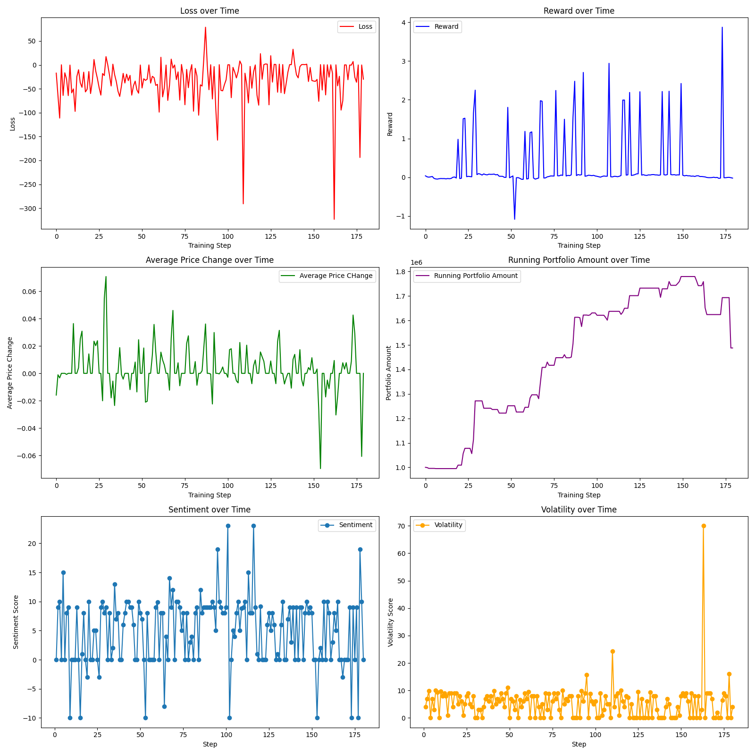
Results
AAPL stock from January 1st, 2023 to September 31st, 2023, achieving a 50% return, compared to the actual 20% return of the AAPL stock over the same period.

