Slide 1
Objects & Classes
Desmond Dadzie

Slide 2
Introduction to Classes and Objects in Python
Classes and objects are fundamental concepts in Python.
They enable us to create reusable and structured code.
Classes and objects make your code more organized, modular, and maintainable.

Slide 3
What is a class?
A class is a blueprint for creating objects.
It defines the structure and behavior of objects.
We can think of it as a template for creating objects.

Slide 4
Creating a class
To create a class, use the class keyword.
Inside a class, you can define attributes (data) and methods (functions).
Attributes store data specific to the class.
Methods are functions that operate on the data.

Slide 5
Creating and Using Objects
Objects are instances of a class.
You create objects using the class as a template.
Objects can have their own unique data, but they share methods defined in the class.

Slide 6
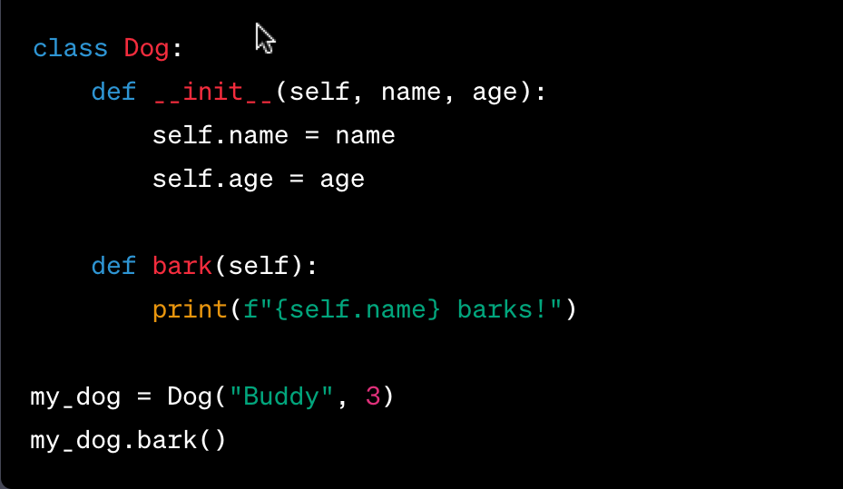
Putting everything together
Notes:
In this example, we created a Dog class with attributes and methods, and then we created an object my_dog from that class.
Takes 2 arguments - name and age
The __init__ method is a special method called a constructor.
# It initializes the attributes of the object when it is created.
When we called my_dog.bark(), it used the bark method specific to my_dog.

Slide 7
Reference
https://docs.python.org/3/glossary.html#term-class
https://docs.python.org/3/library/functions.html?highlight=object#object

