Slide 1

Title : DIGITAL MEDICAL RECORD STORAGE SYSTEM
Student Name: Komma Kavyasri
Student ID: 2520030564
Cluster: 4
Section: 14
Under the Guidance
of
Supervisor Name: xxxxxxxx
Assistant Professor
Department of CSE

Slide 2
OUTLINE
Abstract
Existing System
Proposed System
System Architecture
Project Modules
Objectives
Co’s Attainments - FWD
Co1
Co2 …….. 5. Co5
Co’s Attainments - DSA
Co1
Co2 …….. 5. Co5
Screen Shots for FWD & DSA
Conclusion
Geo-Tagged Photos

Slide 3
Abstract
The Digital Medical Record Storage System (DMRS) is a web-based application designed to manage and store patient medical records in a digital format.
Traditional healthcare systems often rely on paper-based records, which are difficult to maintain, access, and organize. This system provides a simple platform where doctors can add patient details, upload medical documents such as lab reports, prescriptions, and diagnostic files, and manage records efficiently.
The application also allows patients to access their medical records easily, improving communication between doctors and patients.
It includes features such as patient management, file uploading and downloading, a dashboard for viewing system statistics, and activity logs to track system actions.
Developed using HTML, CSS, and JavaScript, the system provides a user-friendly interface for storing and accessing healthcare data digitally.

Slide 4
Existing System
Patient medical records are mainly stored in paper-based files.
Hospitals maintain records in physical folders and documents.
Searching for patient information takes a lot of time.
There is a high risk of file loss, damage, or misplacement.
Records are not easily accessible by patients when needed.
Sharing medical reports between doctors and hospitals is difficult and slow.
Managing large volumes of patient data requires significant physical storage space.
Manual record management can lead to human errors and data duplication.

Slide 5
Proposed System
Develop a Digital Medical Record Storage System (DMRS) to store patient records digitally.
Allow doctors to add, manage, and delete patient details easily.
Enable uploading and downloading of medical files such as lab reports, prescriptions, and X-rays.
Provide secure login access for doctors and patients.
Implement a dashboard to display important statistics like total patients and total files.
Maintain activity logs to track system operations such as uploads and patient updates.
Allow patients to access their medical records anytime.
Reduce paperwork and improve efficiency, accessibility, and record management.

Slide 6
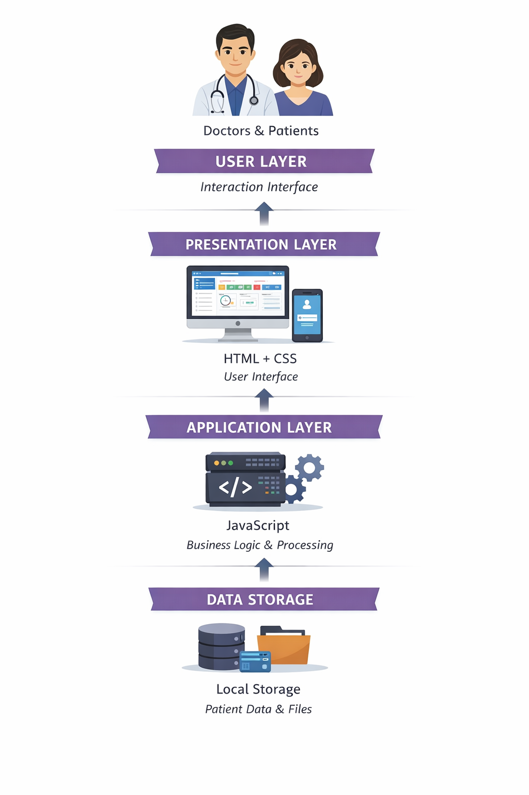
System Architecture

Slide 7
Project Modules
User Authentication Module Handles login and logout for doctors and patients with username and password verification.
Patient Management Module Allows doctors to add, view, and delete patient details such as name, age, and medical notes.
Medical File Management Module Enables doctors and patients to upload, view, and download medical files like lab reports, prescriptions, and X-rays.
Dashboard Module Displays important information such as total patients, total uploaded files, and recent uploads.
Activity Log Module Tracks all system activities such as patient creation, file uploads, and record updates.
Data Storage Module Stores patient records, uploaded files, and logs using browser Local Storage.

Slide 8
Objectives
To develop a Digital Medical Record Storage System for storing patient medical data digitally.
To provide secure access for doctors and patients through a login system.
To allow easy uploading and management of medical files such as prescriptions , lab reports, and X-rays.
To enable doctors to manage patient information efficiently.
To maintain activity logs for tracking system operations.
To reduce paper-based record keeping in hospitals and clinics.
To improve accessibility, organization, and security of medical records.

Slide 9
Co’s Attainments - FWD
CO1: HTML structure and basic CSS styling are used to design the layout and interface of the DMRS web pages such as login, dashboard, and patient management.
CO2: HTML forms, input elements, tables, and CSS layouts are used to collect patient information, upload medical files, and organize webpage content.
CO3: JavaScript fundamentals like variables, functions, conditions, loops, arrays, and objects are used to manage patient data and system functionality.
CO4: JavaScript DOM manipulation, event handling, and browser local storage are used to implement interactive features like login authentication, dynamic updates, and activity logs.
CO5: Advanced JavaScript concepts such as form validation and dynamic user input handling are used to process user actions and manage medical records efficiently.

Slide 10
Co’s Attainments - DSA
CO1: Searching and data management in the system (such as finding users during login and retrieving patient records) demonstrate algorithmic thinking and efficiency considerations similar to classical searching techniques.
CO2: Patient records and medical files are organized using structured data collections (arrays/objects), representing the concept of Abstract Data Types for storing, inserting, deleting, and traversing data.
CO3: System workflows such as managing uploaded files, activity logs, and sequential record handling reflect queue-like or stack-like processing concepts used to manage ordered data operations.
CO4: Fast access and updates of user, patient, and file data using JavaScript objects and browser storage demonstrate hash-like data access and efficient data retrieval concepts similar to hash tables and map structures.

Slide 11
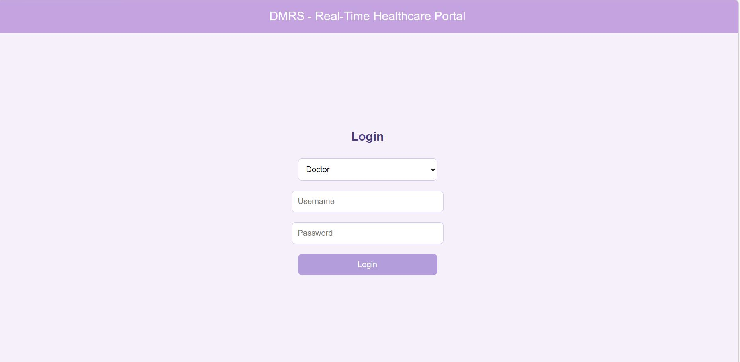
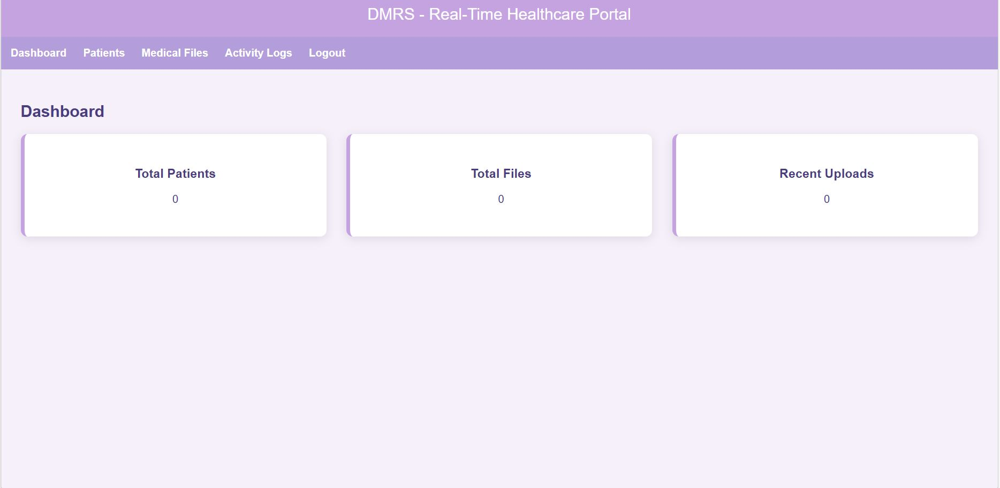
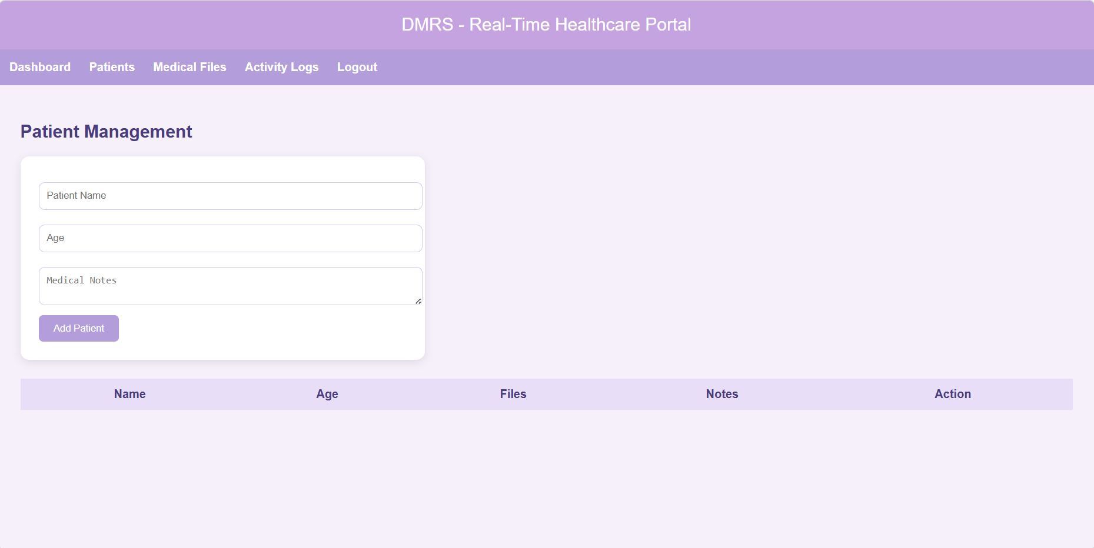
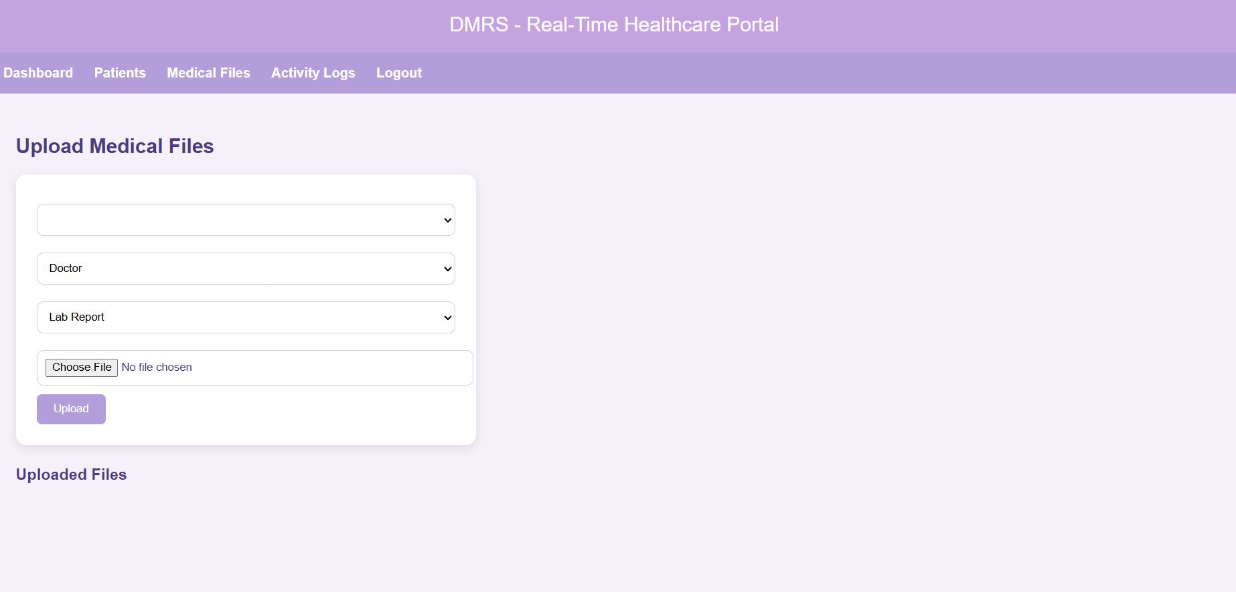
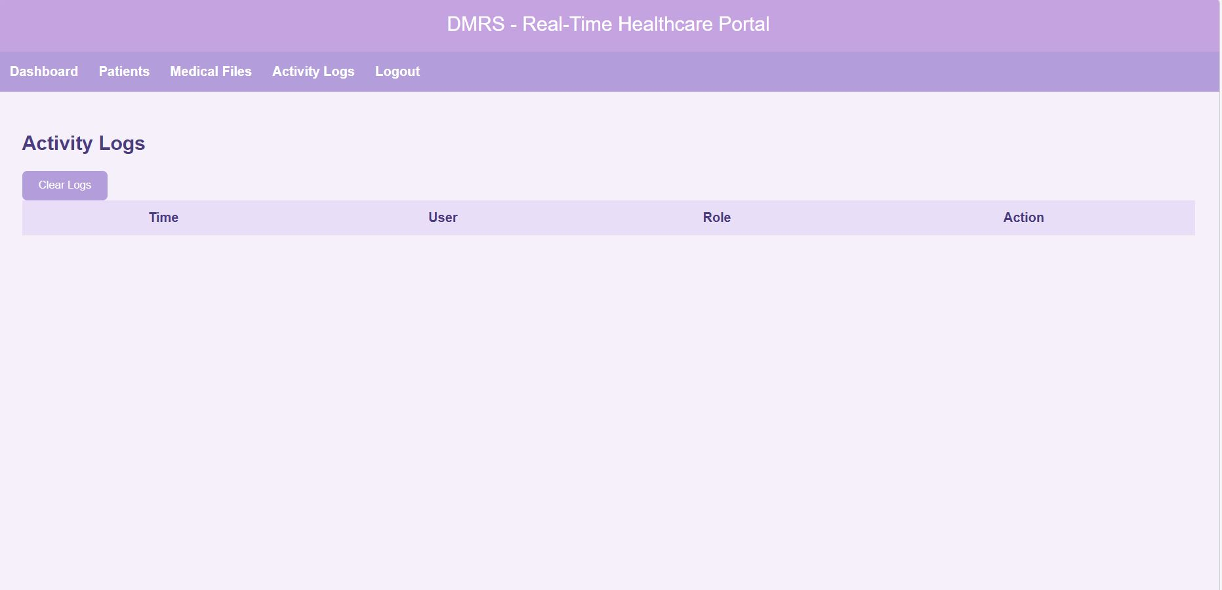
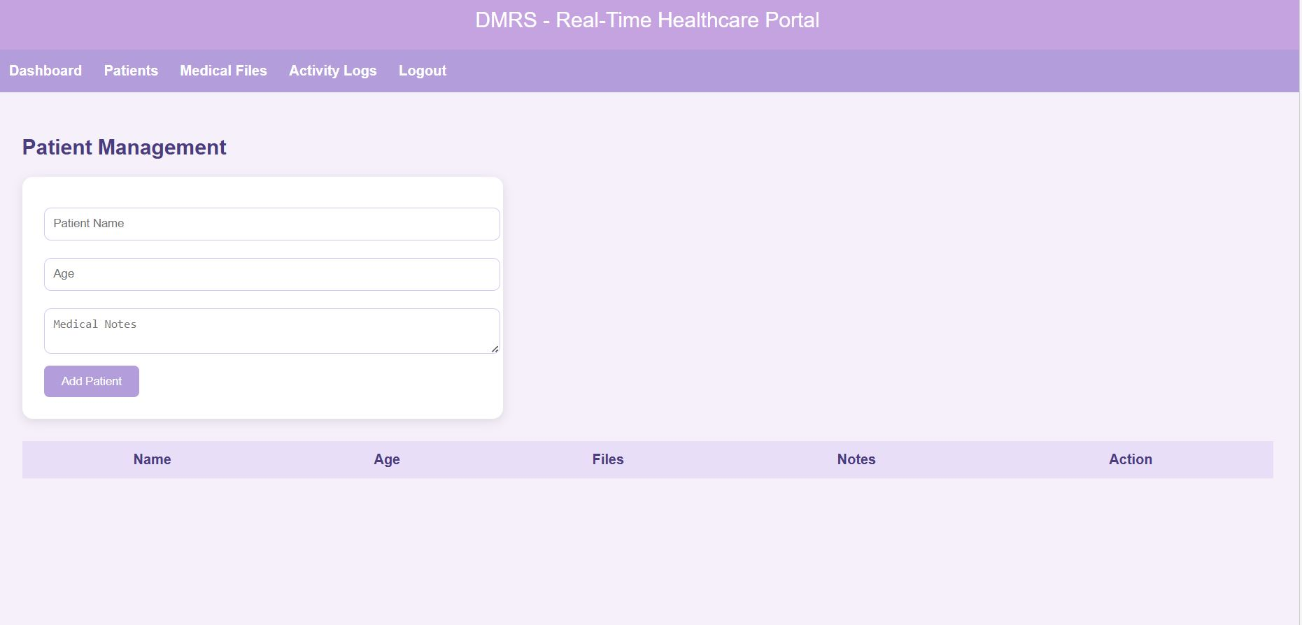
Screenshots for FWD

Slide 12
Conclusion
The Digital Medical Record Storage System provides a simple and efficient way to store and manage patient medical records digitally. The system allows doctors to add patient details, upload medical files, and maintain organized records, while patients can easily access their medical information. By replacing traditional paper-based records with a digital platform, the system improves accessibility, reduces the risk of data loss, and enhances the efficiency of healthcare record management. Overall, the project demonstrates how web technologies can be used to build practical solutions for real-world healthcare data management.

Slide 13
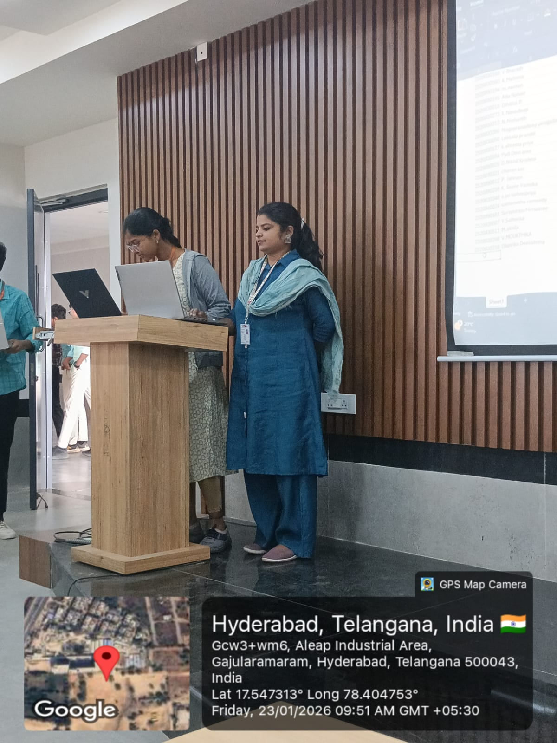
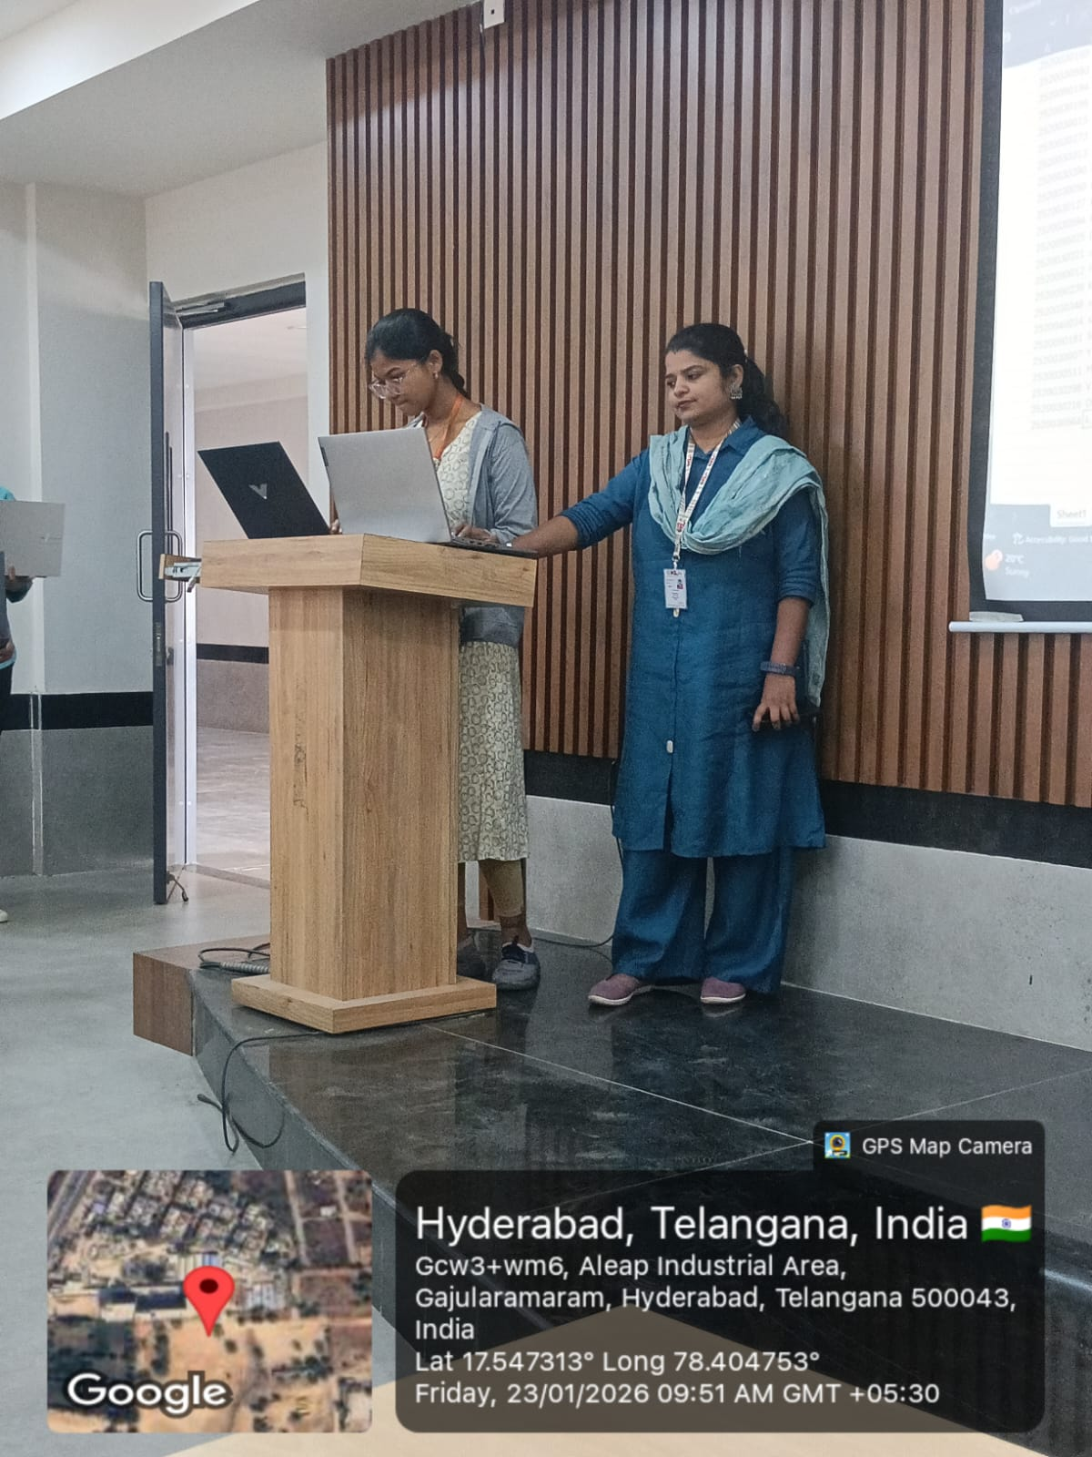
Geo- Tag Photos

Slide 14
THANK YOU

