Slide 1

Shortest Path

Slide 2
Definitions
Formal definition: Given a graph G=(V, E, W), where each edge has a weight, find a shortest path from s to v for some interesting vertices s and v.
s—source
v—destination

Slide 3

Basic Property
Suppose that a shortest path p from a source s to a vertex v can be decomposed into
s u v
for some vertex u and path p’.
Then, the weight of a shortest path from s to v is
p’
It implies that the sub-path of optimal (shortest) path is also optimal (shortest). Consider it the other way round, we could find a longer optimal path (of length n) by extending a shorter optimal path (of length n-1) with one extra edge

Slide 4

Relaxation
The process of relaxing an edge (u,v) consists of testing whether we can improve the shortest path to v found so far by going through u and,if so,updating d[v] and [v].
define RELAX(u,v,w) as…..
if d[v]>d[u]+w(u,v) { // if a shorter optimal path (d[u]) + one extra
// edge w(u,v) is shorter than current best…
d[v] = d[u]+w(u,v)
[v] = u // record the “parent”.. Needed for path tracing
}

Slide 5

Relaxation
u
v
u
v
2
2
5
9
5
6
RELAX(u,v)
RELAX(u,v)
u
v
u
v
2
2
5
7
5
6
(a)
(b)
Figure2 Relaxation of an edge (u,v).The shortest-path estimate of each vertex
is shown within the vertex. (a)Because d[v]>d[u]+w(u,v) prior to relaxation,
the value of d[v] decreases. (b)Here, d[v] d[u]+w(u,v) before the relaxation
step,so d[v] is unchanged by relaxation.

Slide 6
Single Source Shortest Path

Slide 7
Single Source Shortest Path
Single Source Shortest Path
  Only consider a fixed source s.
  To find out all shortest path to all v in V
Dijkstra’s algorithm
  Faster (for max speed, need data struct such as heap)
  All edge must be positive
Bellman-Ford algorithm
  Simple design but slower
  Can detect negative weight cycle

Slide 8
Dijkstra’s algorithm
Initialization
  For each vertex v ∈ V, d[v] denotes an upper bound on the weight of a shortest path from source s to v
  d[v] will be the weight of shortest path after the execution of algorithm
  Set d[] = Infinity at the beginning
  Set d[s] = 0

Slide 9
Dijkstra’s Pseudo code
Initialize
Q <- V[G] // Q = set of “unsolved” vertices
While (|Q| != 0) {
u <- extract-min (Q) //remove u from set Q
// Path to u is confirmed as shortest……but…why?
for each v in adj[u] { // set if there’s better path
Relax(u,v,w) // which goes through u
} // more precisely… for each v in adj[u] which is also in Q
}

Slide 10
Visual Demo
u
v
1
8
8
10
9
s
0
2
3
4
6
7
5
8
8
2
y
x
(a)

Slide 11
u
v
1
10
8
10
9
s
0
3
4
6
2
7
5
5
8
2
x
y
(b)
(s,x) is the shortest path using one edge. It is also the shortest path from s to x.

Slide 12
u
v
1
8
14
10
9
s
0
3
4
6
2
7
5
5
7
2
x
y
(c)

Slide 13
u
v
1
8
13
10
9
s
0
3
4
6
2
7
5
5
7
2
x
y
(d)

Slide 14
u
v
1
8
9
10
9
s
0
3
4
6
2
7
5
5
7
2
x
y
(e)

Slide 15
u
v
1
8
9
10
9
s
0
3
4
6
2
7
5
5
7
2
x
y
(f)

Slide 16
Consideration on Negative Weight
Negative Weight
  Edge weight may be negative!
Negative-weight cycle
  Total weight in a cycle (circuit) is negative
  If no negative-weight cycles reachable from the source s, then all shortest path weights are well defined, even if it has a negative value.
  If there is a negative-weight cycle on some path from s to v, we define it is -∞

Slide 17
Consideration on Negative Weight
B
B
10
-10
A
-3
A
3
5
5
C
C
Negative Edge but no Negative Cycle
Negative Edge with Negative Cycle

Slide 18
Bellman-Ford algorithm
Algorithm:
Initialize
for i = 1 to |V[G]|-1 // run |V[G]|-1 times = length of longest possible path
for each edge (u, v) in E[G]
Relax(u, v, w)
// checking stage…if relaxation is still possible after |V[G]|-1 times...negative cycle
for each edge (u, v) in E[G]
if d[v] > d[u] + w(u, v)
then return false
return true

Slide 19
Simple proof for Bellman-Ford
If there is a path p from some v to some u, p has at most |V[G]| - 1 edges
Each iteration of the outer loop relax all edges in E[G]
After the i iteration, d[v] stored the shortest distance from s to v for at most i edges
Therefore, after the |V[G]| - 1 pass of the loop, d[] stored the shortest from s to every v in V[G]

Slide 20
What happen if there is –ve cycle?
If there is a negative cycle reachable from s, walking every round in the cycle will make the path shorter, so there is no shortest path
Therefore after |V[G]|-1 pass of the loop, d[v] will still greater than d[u] + w(u, v), for v is any vertex in the cycle
This will make last for loop in the algorithm returns false

Slide 21
All-pair Shortest Paths

Slide 22
All-pair Shortest Paths
Problem definition:
  Given a weighted,directed graph G=(V,E), for every pair of vertices u, v ∈ V, find a shortest (least weight) path from u to v, where the weight of a path is the sum of the weights of its constituent edges.

Slide 23
Solve the problem by Single-Source shortest paths algorithm:
If all edge weights are nonnegative, we can use Dijkstra’s algorithm repeatly.
Since Dijkstra’s algorithm can compute all shortest path from a single point, it solves all-pairs shortest paths in
O(n²) × n = O(n³)
Any other method?
  Method by Matrix

Slide 24
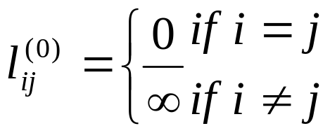
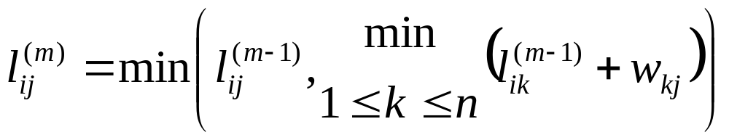
Method by Matrix
Notations:
  Let l be the minimum weight from i to j at most contain m edge
  So for m = 0 then
Premise:
  This is a recursive approach in solving this kind of problem.
  where w = the weight of the edge.
Well…what do you think?

Slide 25
Method by Matrix
2
Input Adjacency Matrix
4
3
0 | 3 | 8 | ∞ | -4
∞ | 0 | ∞ | 1 | 7
∞ | 4 | 0 | ∞ | ∞
2 | ∞ | -5 | 0 | ∞
∞ | ∞ | ∞ | 6 | 0
1
3
8
1
-4
2
-5
7
5
4
6

Slide 26
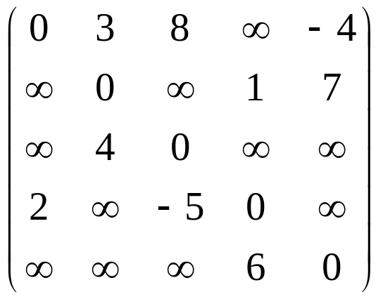
Pass 1: Input Adjacency Matrix
D⁽¹⁾=
We define:
dij(m) is the element in matrix D(m)
d_{ij}(m) --- minimum weight of any path from vertex i to vertex j that contains at most m edges

Slide 27
Pass 2 in matrix
How to get this?
0 | 3 | 8 | ∞ | -4
∞ | 0 | ∞ | 1 | 7
∞ | 4 | 0 | ∞ | ∞
2 | ∞ | -5 | 0 | ∞
∞ | ∞ | ∞ | 6 | 0
0 | 3 | 8 | -4 + 6 | -4
1 + 2 | 0 | -5+1 | 1 | 7
∞ | 4 | 0 | 4+1 | 4+7
2 | -5 + 4 | -5 | 0 | -4+2
6 + 2 | ∞ | -5+6 | 6 | 0
2
3
4
1
3
8
1
-5
-4
2
7
5
4
6

Slide 28
Pass 2 in matrix
0 | 3 | 8 | ∞ | -4
∞ | 0 | ∞ | 1 | 7
∞ | 4 | 0 | ∞ | ∞
2 | ∞ | -5 | 0 | ∞
∞ | ∞ | ∞ | 6 | 0
We try to work out this cell

Slide 29
Pass 2 in matrix
0 | 3 | 8 | ∞ | -4
∞ | 0 | ∞ | 1 | 7
∞ | 4 | 0 | ∞ | ∞
2 | ∞ | -5 | 0 | ∞
∞ | ∞ | ∞ | 6 | 0
1. Who can connect to this cell?
ANS: The corresponding column tell us
Remarks: we can ignore infinity (∞) and zero

Slide 30
Pass 2 in matrix
0 | 3 | 8 | ∞ | -4
∞ | 0 | ∞ | 1 | 7
∞ | 4 | 0 | ∞ | ∞
2 | ∞ | -5 | 0 | ∞
∞ | ∞ | ∞ | 6 | 0
2. Which path is the smallest?
ANS: The corresponding row tell us
Path 1->2->4 = 3+1 = 4 units
Path 1->5->4 = -4+6 = 2 units

Slide 31
Pass 2 in matrix
0 | 3 | 8 | 2 | -4
∞ | 0 | ∞ | 1 | 7
∞ | 4 | 0 | ∞ | ∞
2 | ∞ | -5 | 0 | ∞
∞ | ∞ | ∞ | 6 | 0
We can see:
Path 1->5->4 is the smallest
We update the cell now

Slide 32
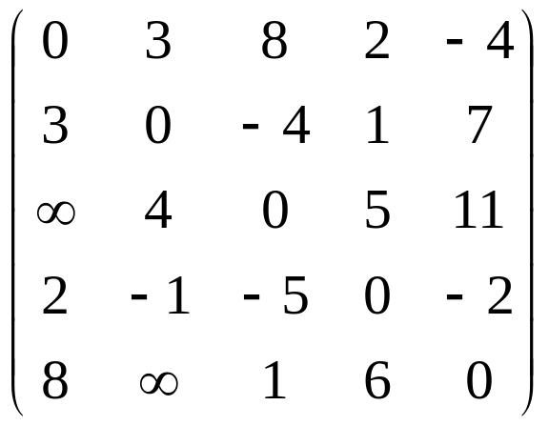
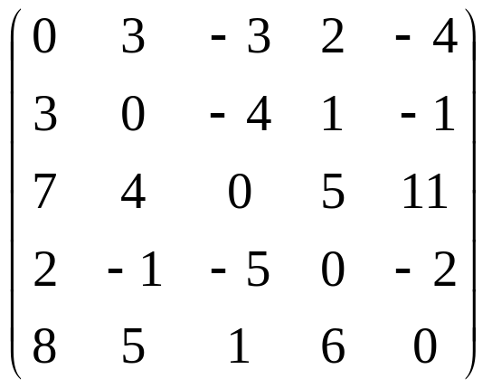
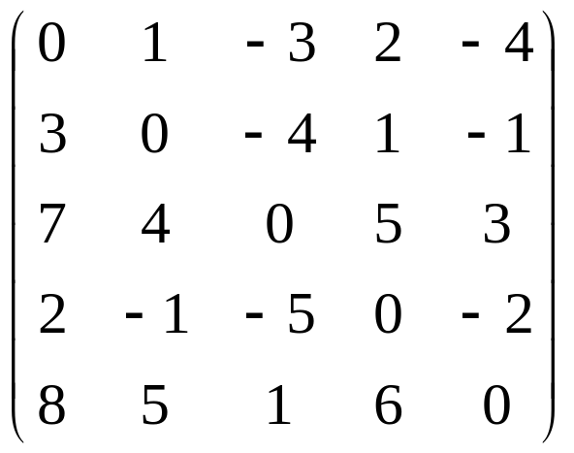
The whole process
D⁽¹⁾=
D⁽²⁾=
D⁽³⁾=
D⁽⁴⁾=

Slide 33
Consideration on All-Pair shortest path
Matrix Method is easy to understand, but the performance is not very outstanding
Optimization/shortcut may be needed to make it faster (e.g. stop if no improvement, reconsidering formula)
Depending on situation, running Dijkstra n times is not necessary a bad choice
There are other better methods, such as Floyd-Warshall algorithm, which make use of Dynamic Programming
(http://en.wikipedia.org/wiki/Floyd-Warshall_algorithm)

Slide 34
Exercises

Slide 35
Exercises
10171
http://acm.uva.es/p/v101/10171.html
10356
http://acm.uva.es/p/v103/10356.html
10285
http://acm.uva.es/p/v102/10285.html
523
http://acm.uva.es/p/v5/523.html

