Slide 1
Recursion
By Dr. Cong WANG
CS Department
City Univ. of Hong Kong

Slide 2
Quick Facts
Problem = sub-problem + simple problem
Solve by Divide-and-Conquer
  Recurrence relation (problem size < n)
  Base case

Slide 3
Discussion –Factorial (n!)
Input size: n
Recurrence relation:
f(n) = n*f(n -1)
Base Case:
Definition: 0! = 1
∴ f(0) = 1
Base case is missing!
long factorial (long n){
return (n * factorial(n-1));
}
Correct version:
long factorial (long n){
if (n == 0)
return (1);
else
return (n *factorial(n-1));
}

Slide 4
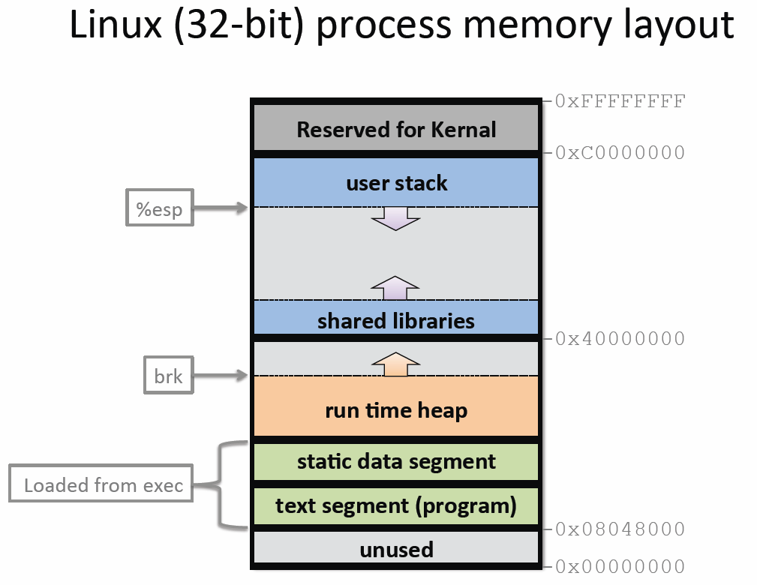
structure that grows downwards
and keeps track of the activated
method calls, their arguments
and local variables
Newly allocated variables
will stay below the previous
(existing) variables in stack.
e.g. libc
data dynamically generated
during the execution of a
process. e.g., malloc()
static program variables
initialized in the source code
prior to execution.
machine code of the program,
compiled from the source code
CS4293/CS5293 Topics Comp/Info Security
Notes:
Heap grows up

Slide 5
Stack Frame
Every time a function call is executed, a new frame is pushed onto the stack.
high
arguments
Arguments from the
function being called
The address control flow is supposed to return, when the function terminates.
return address
stack frame pointer
exception handlers
e.g.: Try-catch block
local variables
Stack
Growth
callee saved registers
SP
low

Slide 6
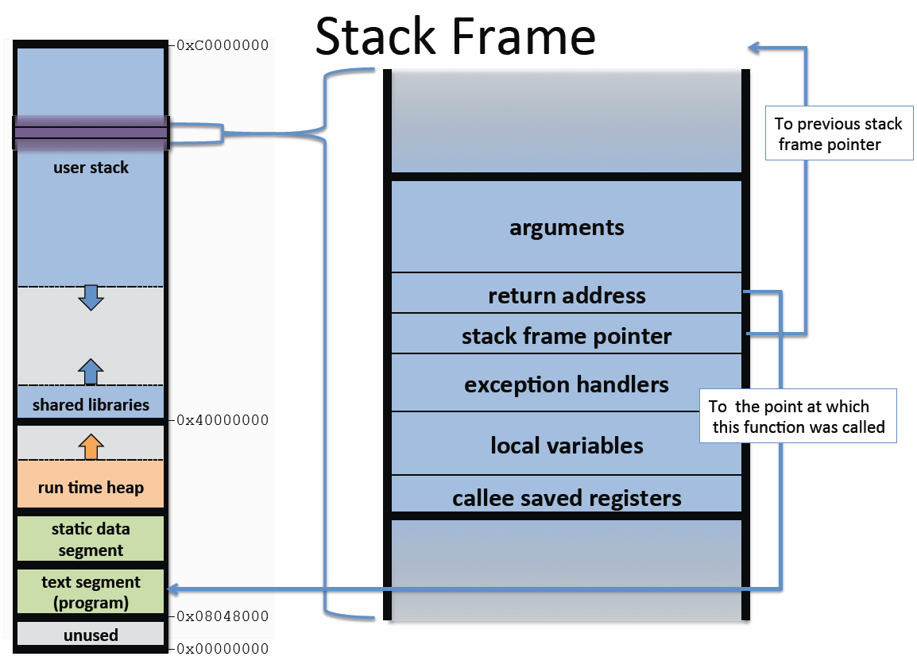
CS4293/CS5293 Topics Comp/Info Security

Slide 7
Discussion –Factorial (n!)
What if the function has to be called for many times?
  e.g. List the factorial of 1 to 10?
  What if we need get (50!) ?
n | n!
0 | 1
1 | 1
2 | 2
3 | 6
i | i*i–1 th row

Slide 8
Hands-on: nCr
Given: n characters – a,b,c,d,…
Want to choose r characters and display in order:
  e.g. choose 3 characters from “abcde”
abc abd abe acd ace ade
bcd bce bde
cde

Slide 9
Solution: nCr
We have r positions.
Select one char from n chars for position i.
Select one char from n-1 chars for position i+1.
Once each position has char, then output.
combination(set, subset, r) {
if (r == 0) {// the subset contains enough elements
print elements in subset; return;
}
while (set is not empty) {
move the first element from set to subset;
combination(set, subset, r-1);
remove the last element in subset;
}
}

Slide 10
Dataflow
set | → | subset | → | r | output
abcde |  | - |  | 3
bcde | a | a |  | 2
cde | b | ab |  | 1
de | c | abc |  | 0 | abc
de |  | ab | c | 1
e | d | abd |  | 0 | abd
e |  | ab | d | 1
- | e | abe |  | 0 | abe
- |  | ab | e | 1
cde |  | a | b | 2
de | c | ac |  | 1
e | d | acd |  | 0 | acd
e |  | ac | d | 1
- | e | ace |  | 0 | ace

Slide 11
Dataflow cont.
set | → | subset | → | r | output
- |  | ac | e | 1
de |  | a | c | 2
e | d | ad |  | 1
- | e | ade |  | 0 | ade
- |  | ad | e | 1
e |  | a | d | 2
- | e | ae |  | 1
- |  | a | e | 2
bcde |  | - | a | 3
cde | b | b |  | 2
de | c | bc |  | 1
e | d | bcd |  | 0 | bcd
e |  | bc | d | 1

Slide 12
Dataflow cont.
set | → | subset | → | r | output
- | e | bce |  | 0 | bce
- |  | bc | e | 1
de |  | b | c | 2
e | d | bd |  | 1
- | e | bde |  | 0 | bde
- |  | bd | e | 1
e |  | b | d | 2
- | e | be |  | 1
- |  | b | e | 2
cde |  | - | b | 3
de | c | c |  | 2
e | d | cd |  | 1
- | e | cde |  | 0 | cde

Slide 13
Dataflow cont.
set | → | subset | → | r | output
- |  | cd | e | 1
e |  | c | d | 2
- | e | ce |  | 1
- |  | c | e | 2
de |  | - | c | 3
e | d | d |  | 2
- | e | de |  | 1
- |  | d | e | 2
e |  | - | d | 3
- | e | e |  | 2
- |  | - | e | 3

Slide 14
Solution: nCr
Consider we have r positions.
Select one character from n characters for each position.
combination(set, subset, r) {
if (r == 0) { // when the subset contains enough elements
print elements in subset;
return;
}
if (set is empty) {
return;
}
move the first element from set to subset;
combination(set, subset, r-1);
remove the last element in subset;
combination(set, subset, r);
}

Slide 15
Dataflow
set | → | subset | → | r | output
abcde |  | - |  | 3
bcde | a | a |  | 2
cde | b | ab |  | 1
de | c | abc |  | 0 | abc
de |  | ab | c | 1
e | d | abd |  | 0 | abd
e |  | ab | d | 1
- | e | abe |  | 0 | abe
cde |  | a | b | 2
de | c | ac |  | 1
e | d | acd |  | 0 | acd
e |  | ac | d | 1
- | e | ace |  | 0 | ace
de |  | a | c | 2
e | d | ad |  | 1
- | e | ade |  | 0 | ade

Slide 16
Dataflow cont.
set | → | subset | → | r | output
bcde |  | - |  | 3
cde | b | b |  | 2
de | c | bc |  | 1
e | d | bcd |  | 0 | bcd
e |  | bc | d | 1
- | e | bce |  | 0 | bce
de |  | b | c | 2
e | d | bd |  | 1
- | e | bde |  | 0 | bde
cde |  | - |  | 3
de | c | c |  | 2
e | d | cd |  | 1
- | e | cde |  | 0 | cde

Slide 17
Explanation
char set[5]={'a','b','c','d','e'};
We use the index number to represent each character.
0
--1
--2
--3
--4
--2
--3
--4
--3
--4
1
--2
--3
--4
--3
--4
2
--3
--4
a | b | c | d | e
0 | 1 | 2 | 3 | 4
Output:
abc abd abe acd ace ade
bcd bce bde
cde

Slide 18
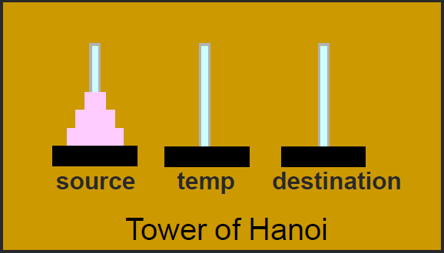
Hands-on
Objective
  Move n disks from the source pole to the destination pole (Problem size: n)
Steps:
  Move the smaller n-1 disks from source to temp (Problem size:n-1)
  Move the largest disk from source to destination (single step)
  Move the smaller n-1 disks from temp to destination (Problem size:n-1)

Slide 19
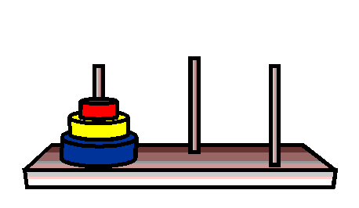

Implementation
3 poles: A (source), B, C (destination)
Input: number of disks (1..n)
Output: the sequence of movement for all disks
  move disk 1 from pole A to pole C
  move disk 2 from pole A to pole B
  move disk 1 from pole C to pole B
  move disk 3 from pole A to pole C
  move disk 1 from pole B to pole A
  move disk 2 from pole B to pole C
  move disk 1 from pole A to pole C
Moving 3 disks from A to C

Slide 20
Pros & Cons
Pros
  Once recurrence relation and base case are identified, implementation is straight forward.
  Easy to handle.
Cons
  Debugging can be an issue.
  Need to consider performance (many duplicated cases, large input).

