Slide 1
KAKO© GBS
Designed By
Nathan Goodman
Kate Hutchinson
Jesse Oberstein

Slide 2
Use Cases
User is a teacher
Upload assignments
Add grades
Display grades
View assignment and student statistics

Slide 3
Requirements
Create a new gradebook:
  Construct an empty gradebook
  Initialize gradebook from a file
  Create new gradebook in console
Add to the gradebook:
  Add Students
  Add Assignments
Grades:
  Change a students grade
  Get a student's current grade
  Store grades for the course

Slide 4
Requirements (Continued)
Get Statistics:
  Mean, Median, Minimum, Maximum, Range,
  Standard Deviation, Variance
Print Gradebook:
  Print Student Information
  Print Assignment Information
  Print Entire Gradebook
Determine if two Gradebooks are equivalent
Preform all of these functions from the console and from a file

Slide 5
Design

Slide 6
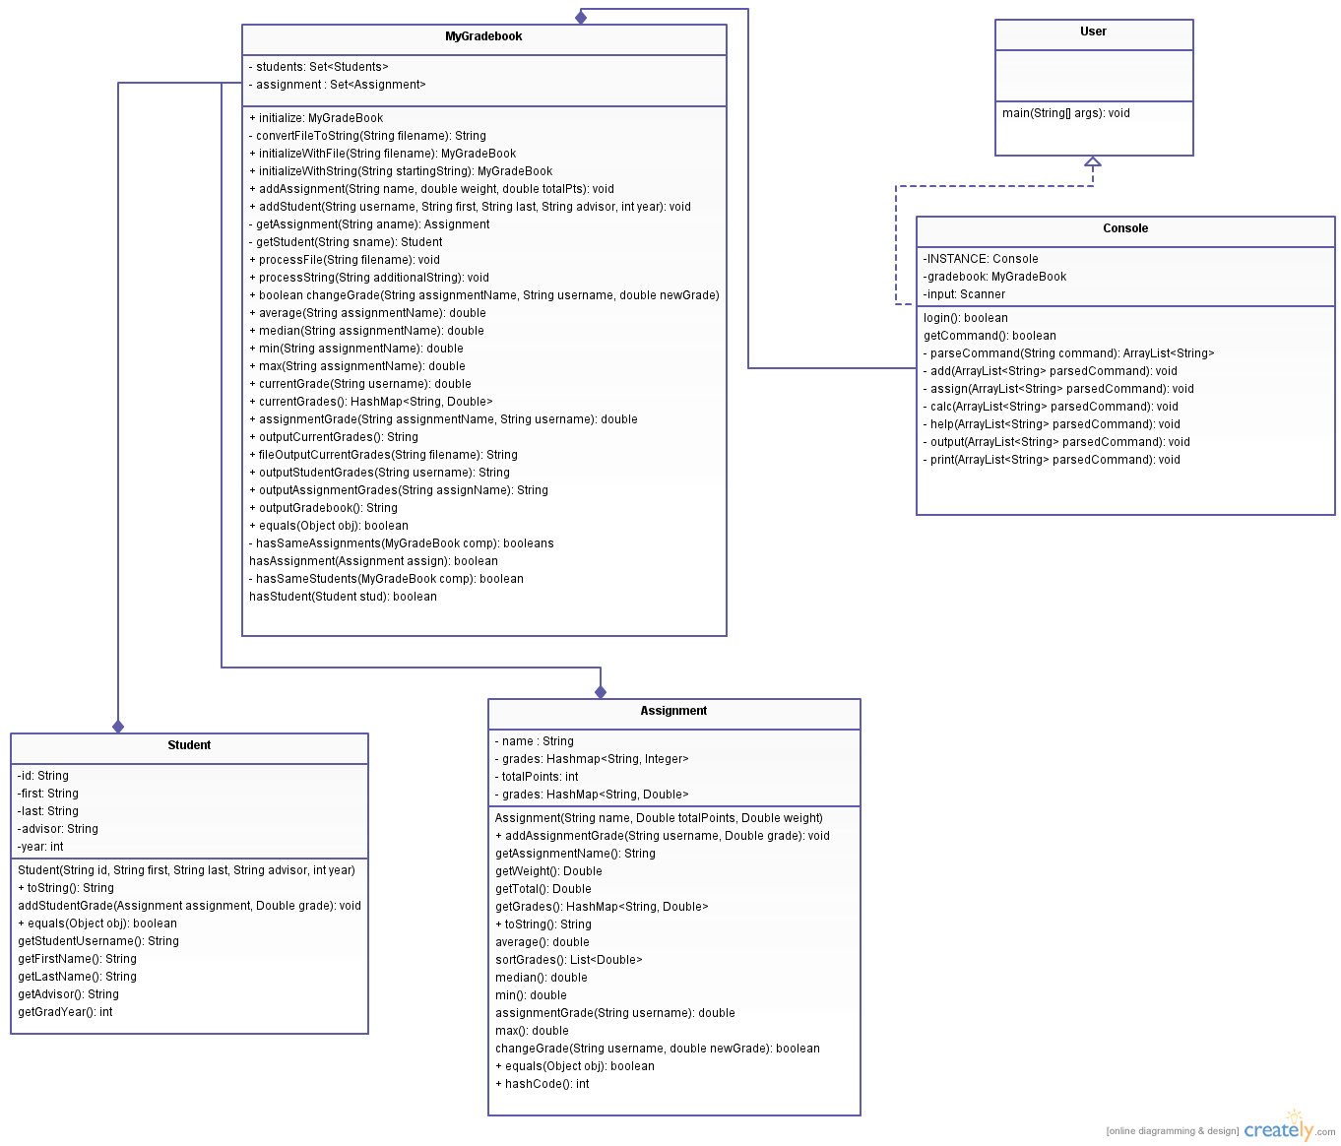

Slide 7
Assignment
Fields:
  String name
  Double totalPoints
  Double weight
  HashMap<String, Double> grades
Main Functionality:
  Stores basic information about each assignment
  Stores grades for each Student

Slide 8
Student
Fields:
  String studentId
  String firstName
  String lastName
  String advisor
  int year
Main Functionality:
  Stores information about the student

Slide 9
MyGradebook
Fields:
  Set<Student> students
  Set<Assignment> assignments
Main Functionality:
  Performs general functions for the
  gradebook
  Bridge between User and
  Assignment/Student classes

Slide 10
User
Fields: (none)
Main Functionality:
  Contains main method
  Initiates console

Slide 11
Console
Fields:
  MyGradeBook gradebook
  Scanner input
Main Functionality:
  Singleton class that handles console I/O
  Parses input to implement CLI

Slide 12
KAKO© GBS v2.0
GUI in addition to CLI
Keep track of multiple gradebooks
Different classes of users
Store Grade Book data in a database

Slide 13
License Agreement
Should this software give you a virus, cause your computer to crash, hack into your online bank accounts, post your social security number on Facebook, make your monitor blow up in your face, electrocute you, burn your house down, make your boy/girlfriend dump you, start WWIII, or cause aliens to come down to Earth and commit genocide on the human race, YOU SHALL NOT BLAME KAKO© GBS!

