Slide 1
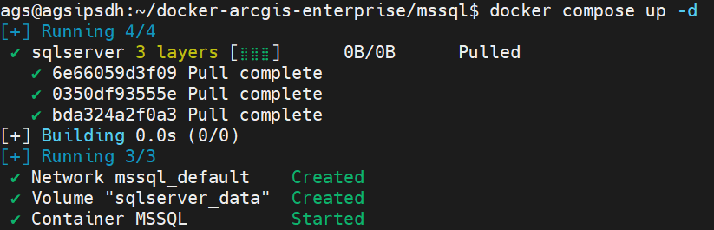
Docker-compose.yaml
version: '3.8'
volumes:
db_data:
name: sqlserver_data
services:
sqlserver:
hostname: agsipsdh.ddns.net
container_name: MSSQL
image: mcr.microsoft.com/mssql/server:2019-latest
env_file: .env
environment:
ACCEPT_EULA: "Y"
SA_PASSWORD: ${SA_PASSWORD}
TZ: ${TIMEZONE}
volumes:
- db_data:/var/opt/mssql
ports:
- 1433:1433
.env
SA_PASSWORD=ipsdh#2023
TIMEZONE="Asia/Jakarta"
MSSQL_PID=<TDKQD-PKV44-PJT4N-TCJG2-3YJ6B | Enterprise>

Slide 2

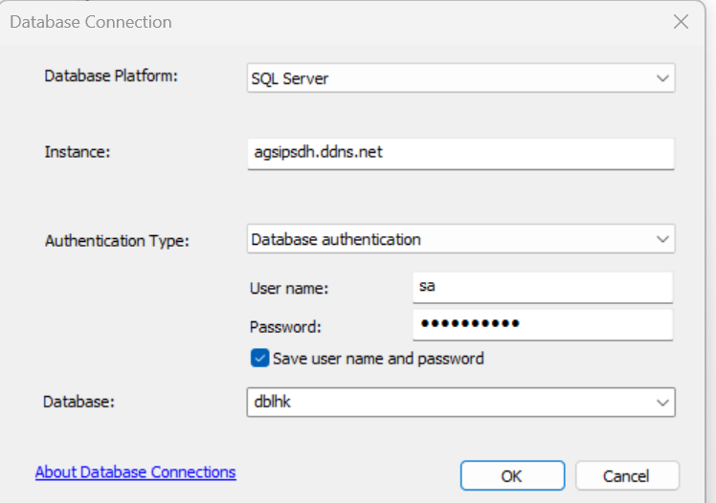
Buatdb.sql
CREATE DATABASE [dblhk]
ON
PRIMARY
(
NAME = N'dblhk',
FILENAME = N'/var/opt/mssql/data\dblhk.ndf',
SIZE = 8MB,
MAXSIZE = UNLIMITED,
FILEGROWTH = 64MB
)
LOG ON
(
NAME = N'dblhk_log',
FILENAME = N'/var/opt/mssql/data\dblhk_log.ldf',
SIZE = 8MB,
MAXSIZE = UNLIMITED,
FILEGROWTH = 64MB
)

Slide 3
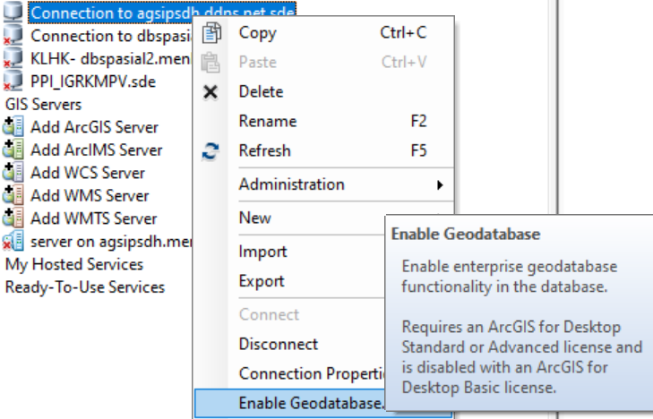
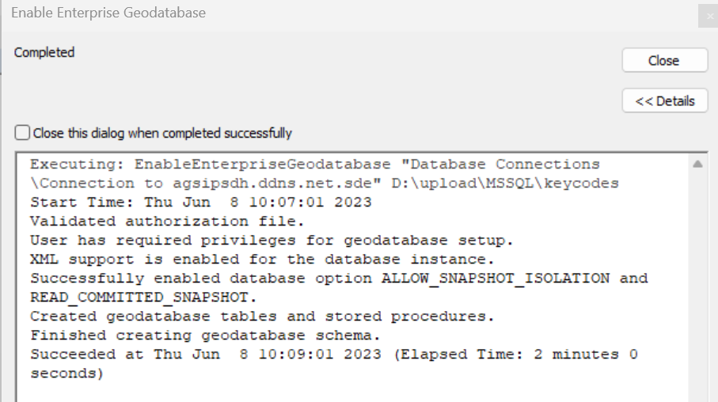
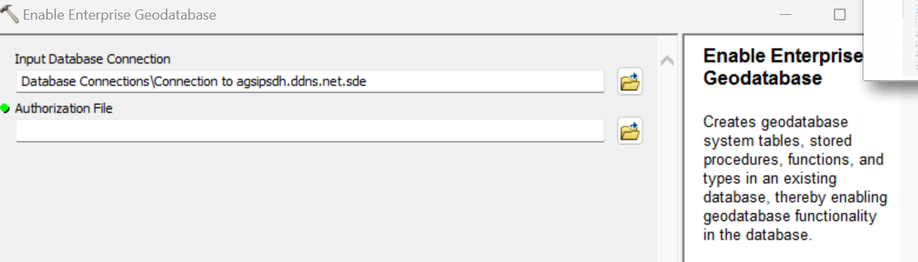

Slide 4
