Slide 1
SUPERMARKET MARKETING STRATEGY
Applied Statistics
Prof.Weijia Peng
Kotla Likitha Reddy
Sacred Heart University

Slide 2
INTRODUCTION
The objective of this analysis is to provide insights to supermarket owner, which customer is spending more money on shopping at that supermarket based on information Annual_Income , Age and Gender collected through membership card .
This will help owner to do better marketing based on customer who is having better spending_Score, which will further help them to improve sales.

Slide 3
About The DataSet
This dataset has four numeric variables
Customer_Id
Age
Annual_Income
Spending_Score
One categorical variable
Gender

Slide 4
DATA INSPECTION :
Dataset has five columns and Two-Hundred rows with zero missing values.
In this dataset two attributes Annual Income (k$), Spending Score (1-100) are renamed as Annual_Income, Spending_Score
There are Zero Null values in the data set

Slide 5
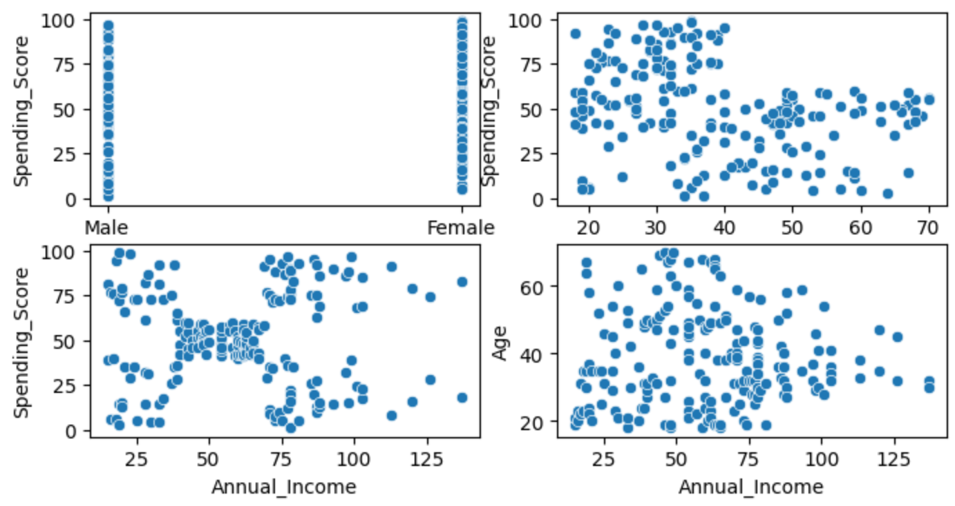
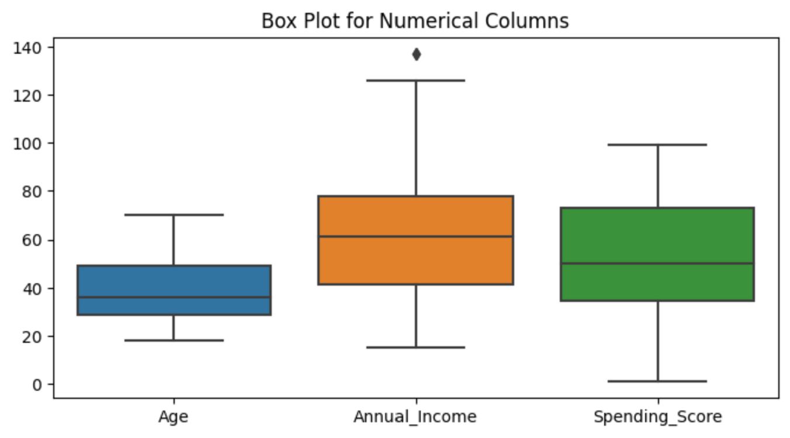
DATA VISUALISATION

Slide 6
DATA MODELING
Ordinary Least Square Regression
R-squared: 0.000
coef std err t P>|t| [0.025 0.975]
const 49.6104 4.610 10.761 0.000 40.519 58.702
Annual_Income 0.0097 0.070 0.139 0.889 -0.128 0.148
The low R-squared and high p-value suggest that the model does not provide a good fit to the data.

Slide 7
RANDOM FOREST REGRESSOR
Mean Squared Error: 478.8813484029798
R-squared : 0.029110882323047926
The Random Forest Regressor trained on the given features (Age and Annual Income) has a relatively high mean squared error (MSE) of 478.88, indicating a considerable variance between predicted and actual Spending Scores. Additionally, the low R-squared value of 0.03 suggests that the model explains only a small proportion of the variability in the target variable.

Slide 8
A/B TESTING
T-Statistic: -14.7698
P-Value: 0.0000
Statistically significant difference detected. The marketing campaign may have an impact.

Slide 9
Conclusion
Modeling efforts, including OLS regression and Random Forest, indicated challenges in predicting Spending Scores.
The Random Forest Regressor exhibited a high MSE and low Rsquared, suggesting room for improvement.
Single variable Annual_Income is not helping much in predicting Spending_score.
A/B testing results, however, highlighted a significant impact of a marketing campaign on spending behavior.
In conclusion, while predictive models may need refinement, the marketing initiative appears to have positively influenced customer spending.

Slide 10
THANK YOU

