Slide 1
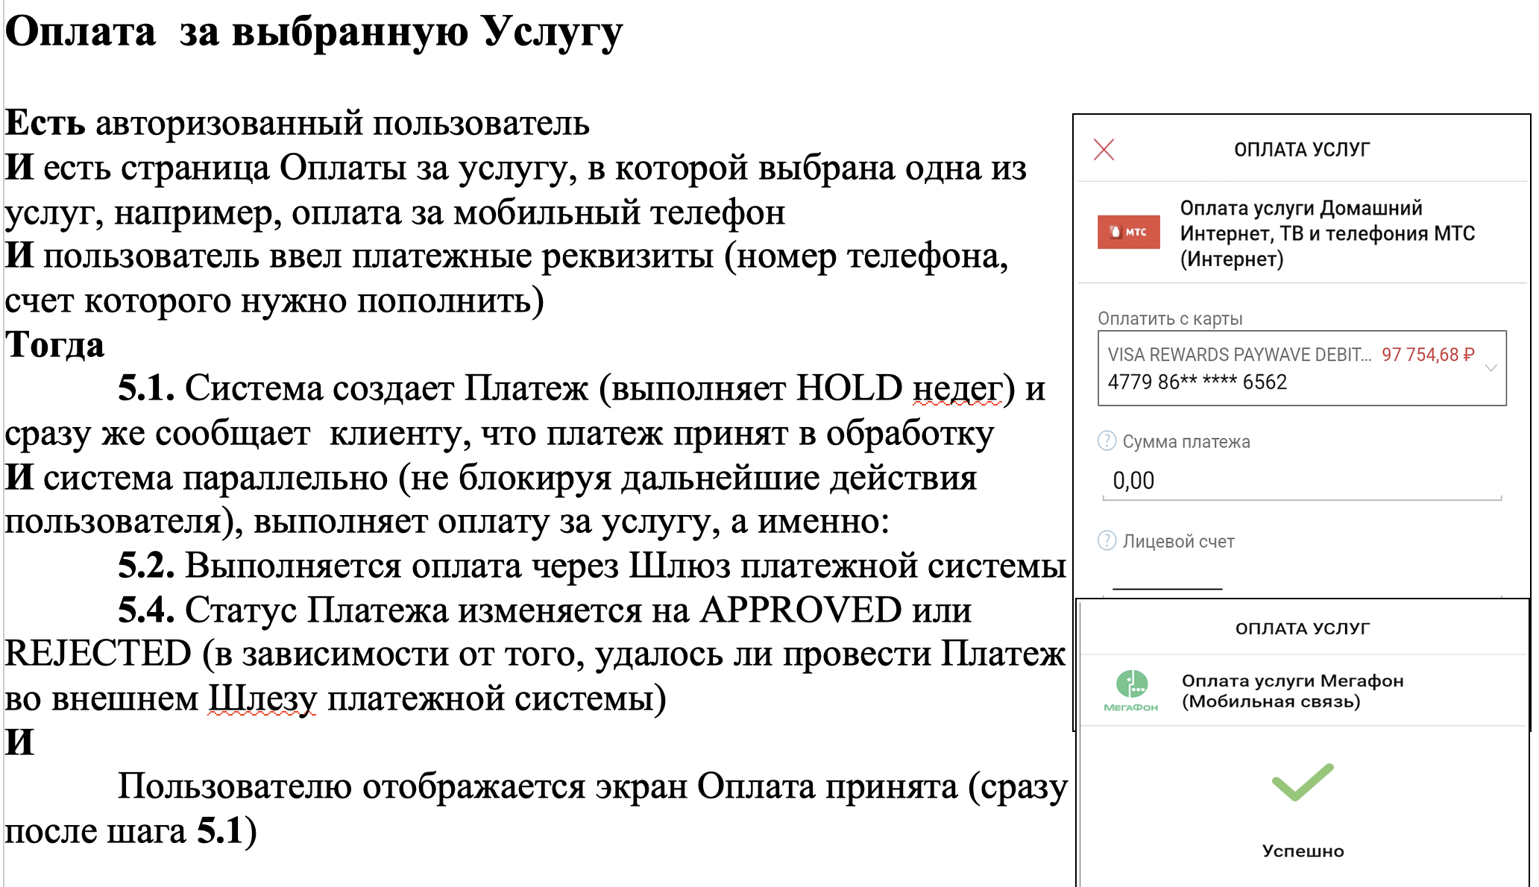
Сценарий использования

Slide 2
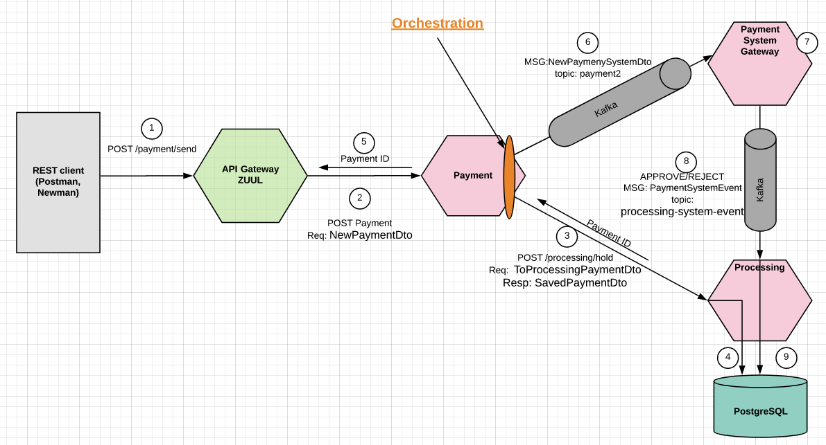
SAGA call sequence

Slide 3
SAGA
Step | Service | Transaction | Compensation Transaction | Transport
1-2 | <Client call> | Client call first microservice Payment to send new Payment request (via Zuul) | - | Sync HTTP REST
3 | Payment | Orchestration design pattern— Payment sends call to Processing to HOLD money | - | Sync HTTP REST
4 | Processing | Local transaction 1) persiste new payment in DB with status=CREATED 2) HOLD money (stub, not implemented here) | - | Local transaction in DB
5 | Response to Client | Not waiting for the end of other steps — send out Payment ID | - | HTTP Response { «transactionId»: ...}
6 | Payment | Continue ORCHESTRATION: send new payment event for processing to external payment system | - | Kafka topic «payment2»
7 | Payment System Gateway | REJECTED payment status on fail to send to external payment system | rejectPayment() | Stub to external payment system with APPROVED/REJECTED status as outcome
 |  | APPROVED — on sucess to send to external payment system | approvePayment()
8 | Processing | Idempotent: 1) Process monyey transfer (from HOLD) 2) Change payment status in DB to APPROVED or REJECTED | - | Local transaction in DB
Compensatable
transactions
Pivot
transaction
Pivot
transaction
Retriable
transaction

