Slide 1
UNCLASSIFIED
Foreign opinion is not one audience.
US policy should not treat it as one.
A capability that shows which publics exist inside foreign-opinion surveys, how large each is, and where they are, so US engagement can aim at real audiences.
Kevin Linares · MS Survey and Data Science, JPSM · 22 September 2026
UNCLASSIFIED
Notes:
Fifteen minutes, eight slides. The message in one line: foreign opinion is several publics, not one, and this shows which, how big, and where. Leave with a pilot country chosen. Backup holds the methods; open it only if asked.

Slide 2
UNCLASSIFIED
Sized foreign publics let US engagement aim instead of guess
BOTTOM LINE
Surveys of foreign populations usually report one number per question.
This capability shows the distinct publics behind those numbers, and how many people are in each.
WHAT YOU LEARN
WHAT IT LETS US POLICYMAKERS DO
Which publics exist
Aim messages at audiences that actually exist, not at an average that describes no one.
How big each one is
Weigh how much of a country a policy option or message would reach.
Where each is concentrated
Focus programs by region, age, or any group already tracked.
How sure we can be
Brief decision-makers without overstating what a survey can show.
Demonstrated on Ecuador's 2023 national survey (LAPOP AmericasBarometer). Works on any national survey released with its sample-design information.
The opportunity: engagement built on the publics that are really there.
UNCLASSIFIED
2
Notes:
Read the four rows left to right: what you learn, then what it lets policymakers do. Do not explain the statistics. If asked how, say: it groups people by how they answer a whole set of questions, and puts a margin of error on the size of each group.

Slide 3
UNCLASSIFIED
Averages can hide publics that need opposite US approaches
THE PROBLEM
What the topline says
Person A
Person B
4.0 of 7
TRUSTS
TRUSTS
Courts, the auditor, elections
The president, the military, the police
Average trust in six institutions, identical for both people
DISTRUSTS
DISTRUSTS
The president and the military
Courts and the auditor
A US message built on security partnership lands with Person B and alienates Person A. A rule-of-law message does the reverse.
The average points to neither.
Illustration: two hypothetical respondents, not survey data. The real survey comes next.
UNCLASSIFIED
3
Notes:
Say plainly that these two people are invented to make the point. Same average, opposite views, opposite messages. The real survey is next.

Slide 4
UNCLASSIFIED
Five publics in Ecuador, and each may need a different channel
WHAT THE SURVEY SHOWS
PUBLIC
SHARE OF ADULTS
WHAT IT SUGGESTS FOR ENGAGEMENT
Trust nearly everything
11% about 1 in 10
Receptive to official and partner-government voices
Generally trusting
21% about 1 in 5
Receptive, though cooler toward parties and police
Moderate middle
33% about 1 in 3
The largest group; lukewarm toward every institution
Leader-and-military loyal
24% about 1 in 4
Trust runs through the president and armed forces, little else
Distrust everything
11% about 1 in 10
Hard to reach through any official channel
Source: LAPOP AmericasBarometer, Ecuador 2023; 1,618 adults; 13 questions on trust in institutions. Shares are rounded population estimates with margins of 2 to 4 points (full estimates in backup). The right-hand column is a reading of each group's answers, not a survey finding.
UNCLASSIFIED
4
Notes:
Real data from Ecuador, 2023. Read down the right-hand column; that is the part managers need. The shares are rounded from the model; check them against the report before presenting. The right-hand column is our reading of each group's answers, so present it as what the groups suggest, not as tested fact.

Slide 5
UNCLASSIFIED
Opposing a leader is not the same as rejecting the system
A FINDING WITH POLICY WEIGHT
Share who distrust every institution, among people who rate the president's performance as:
Very bad
About 1 in 2
Very good
Under 1 in 10
Half of the harshest critics do not reject every institution, so they may still be reachable through courts, elections or local government.
The other half reject every institution. No official channel, including a partner government, is likely to reach them.
Source: LAPOP AmericasBarometer, Ecuador 2023. Rounded; the margin for the 'very bad' group is wide (roughly 35 to 68 percent) but clearly above the 'very good' group. Trust in the president is one of the 13 questions, so part of this link is built in; the point is how far the distrust spreads. Full chart in backup.
UNCLASSIFIED
5
Notes:
The slide to land. Among people who rate the president's performance very bad, about half distrust every institution; among those rating it very good, fewer than one in ten. The implication: some critics are reachable through courts, elections or local government, and some are not reachable through any official voice. If pressed: the margin for the very-bad group is wide, and trust in the president is one of the questions, so part of the link is built in. Confirm both numbers from the report CSV.

Slide 6
UNCLASSIFIED
Four ways this sharpens US engagement with foreign publics
OPPORTUNITIES
Match message and messenger
Size before you spend
Route a message through the institutions each public actually trusts: the military for one, courts or local government for another.
Know whether a receptive public is 1 in 10 or 1 in 3 before committing program resources.
Separate critics from rejecters
Watch for shifts
Tell people unhappy with a leader apart from people who reject every institution, and plan for each.
Re-run on each new survey wave to see whether the distrustful public is growing, and where.
Illustrative uses. Each needs survey data for the country. Comparing waves or countries also needs a check that the questions mean the same thing in each (see next slide).
Same survey budget, sharper answers: the data are usually already collected.
UNCLASSIFIED
6
Notes:
These are uses, not results. Pick the one closest to the room's current priorities and give it thirty seconds. Tracking across waves or countries depends on questions meaning the same thing in each; say so if someone proposes a regional comparison.

Slide 7
UNCLASSIFIED
Built to be trusted: margins shown, people decide, limits stated
HOW FAR TO RELY ON IT
Why you can rely on it
What to watch
Every number carries a margin of error from how the survey was actually drawn.
A question can mean different things in different places. The tool does not yet test this.
People make every judgment call, and each one is on the record.
Differences between groups look more certain than they are. Every report flags this.
Results match standard statistical software when checked.
With AI on, question wording and summary tables go to an outside service. Respondent data never does.
AI only drafts wording. It never produces a number and can be switched off.
Decision to make early: whether AI drafting is allowed for these datasets.
UNCLASSIFIED
7
Notes:
Raise the limits yourself; it buys credibility for everything else. The AI decision is real: if drafting is not allowed, run with it off and nothing numerical changes. Do not claim the analyst edits AI drafts; in the current build they are previewed, not edited.

Slide 8
UNCLASSIFIED
A one-country pilot shows what this adds before scaling up
NEXT STEP
The pilot
Where it can go next
One country and one topic, such as trust in institutions or security concerns.
Neighboring countries or new survey waves, once question equivalence is checked.
A survey file already in hand, with its sample-design information.
A standing library of foreign publics for recurring briefings.
Delivers: the publics, their size, where they are, and how sure we are.
Pairing with program data to see which publics a program reaches.
Next step: choose the country and topic for the pilot.
[Add the timeline and staffing estimate before presenting]
UNCLASSIFIED
8
Notes:
Close on the next step, then stop talking. Fill in the timeline and staffing line before presenting; do not improvise a number in the room.

Slide 9
UNCLASSIFIED
Backup: One-page summary to forward
LEAVE-BEHIND
1
The point
Foreign opinion is not one audience. This shows the distinct publics inside a survey, and how big each is.
2
What it found
Ecuador 2023: five publics. About 1 in 10 adults distrust every institution.
3
Why it matters
Among the president's harshest critics, half still trust other institutions; half reject them all.
4
Why it can be trusted
Margins of error on every number, people make the calls, limits stated in every report.
5
Next step
A one-country pilot on a survey already in hand.
Forward this page to anyone who missed the briefing.
UNCLASSIFIED
9
Notes:
Leave-behind. Forward as a one-pager after the briefing.

Slide 10
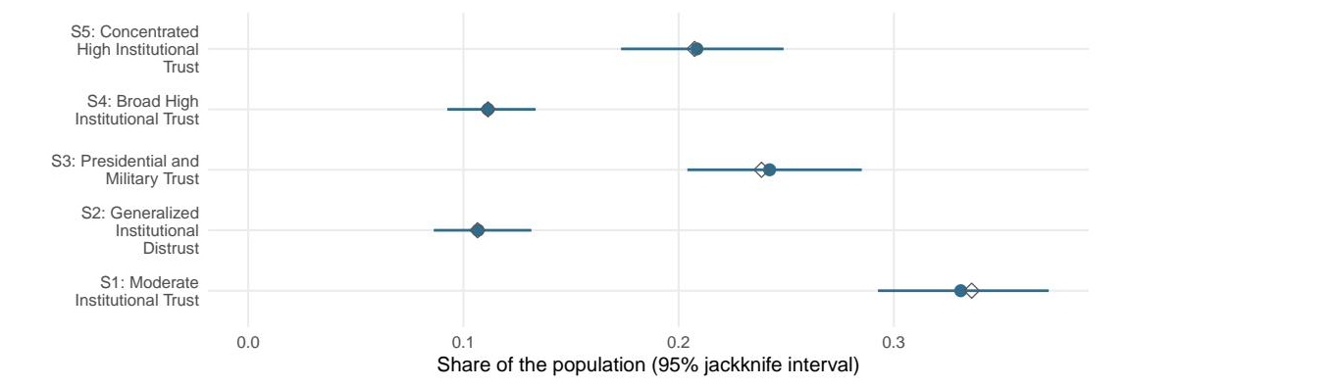
UNCLASSIFIED
Backup: Full size estimates behind the five publics
DETAIL FOR SLIDE 4
About 1 in 3
About 1 in 4
About 1 in 10
Moderate trust across the board (S1, about 33%)
Trust the president and military far more than other institutions (S3, about 24%)
Distrust every institution (S2, about 11%)
Source: LAPOP AmericasBarometer, Ecuador 2023. 13 institutional-trust questions; 1,618 of 1,622 respondents placed. Dot = design-weighted share; diamond = unweighted; bar = 95% interval from 130 jackknife replicates.
UNCLASSIFIED
10
Notes:
Detail behind slide 4: design-weighted shares with 95 percent jackknife intervals; hollow diamonds are unweighted.

Slide 11
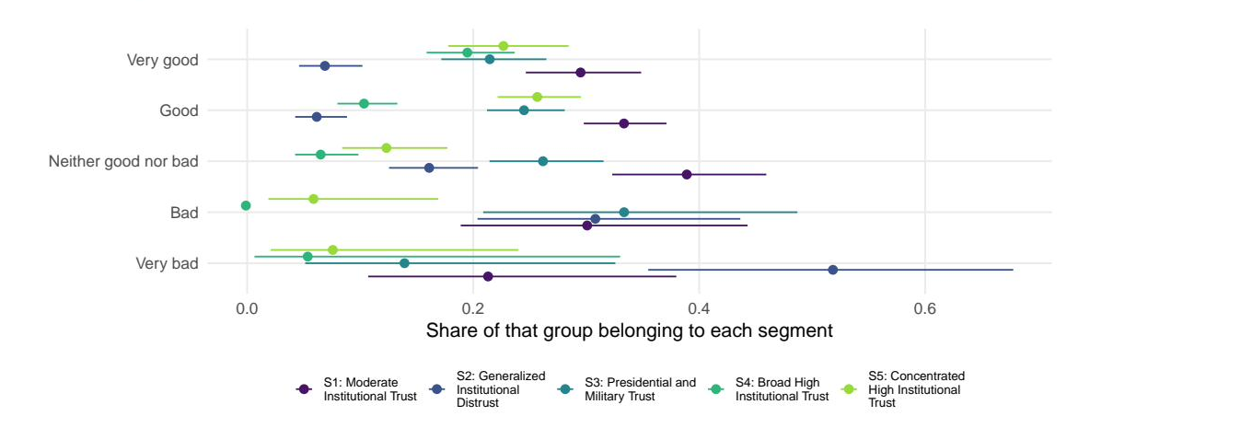
UNCLASSIFIED
Backup: Full chart behind the leader-versus-system finding
DETAIL FOR SLIDE 5
About 1 in 2
of people rating the president's performance very bad fall in the audience that distrusts every institution
Under 1 in 10
of people rating it very good
Trust in the president is one of the 13 questions, so part of this link is built in; the finding is that the distrust extends to courts, elections and parties. Shares corrected for misclassification. Source: LAPOP AmericasBarometer, Ecuador 2023.
UNCLASSIFIED
11
Notes:
Detail behind slide 5: the share of each presidential-rating group in each public, corrected for misclassification. The distrust-everything public is the dark blue series.

Slide 12
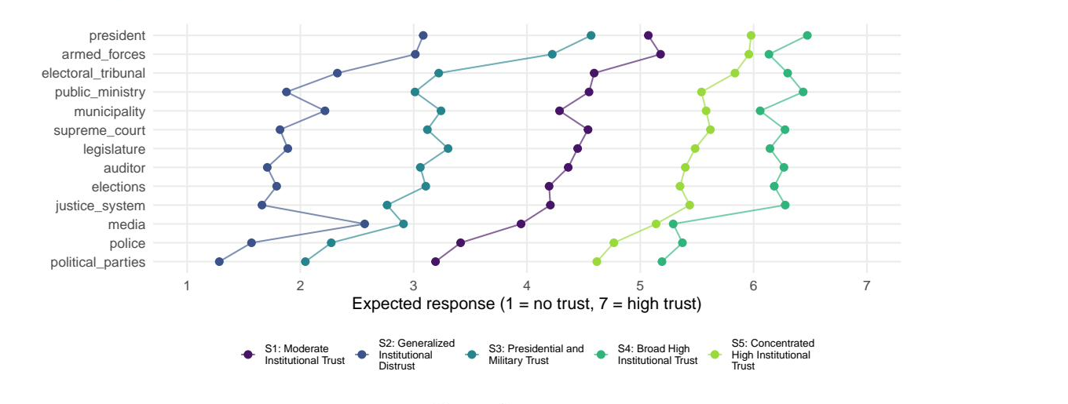
UNCLASSIFIED
Backup: Audiences differ mostly in how much they trust
RESPONSE PROFILES
Four audiences run from low to high trust with similar shapes: the difference is mostly how much, not whom. The exception is S3: low trust overall, but close to the moderate audience on the president and armed forces.
UNCLASSIFIED
12
Notes:
If asked why not just use a single trust index: agree that most of the separation is level. Segmentation adds the S3 pattern and population sizes with margins. Before presenting, look up the level-against-pattern ratio in the report and be ready to quote it.

Slide 13
UNCLASSIFIED
Backup: The illustration, answer by answer
DETAIL FOR SLIDE 3
Respondent A
Respondent B
ILLUSTRATION: two hypothetical respondents, not survey data
Courts
Auditor
4.0
Elections
shared
average
Police
President
Military
1
2
3
4
5
6
7
1 = no trust 7 = high trust
Both average 4.0, so an index calls them the same. Tables by question show every gap, but not that the gaps come from two different kinds of people. Segmentation keeps the whole pattern.
UNCLASSIFIED
13
Notes:
Detail behind slide 3, if someone wants the six answers for each hypothetical person.

Slide 14
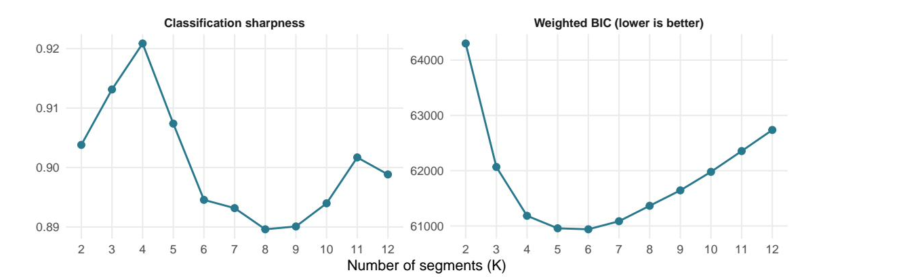
UNCLASSIFIED
Backup: How many groups is a judgment, not an output
AND WE SHOW OUR WORK
Five and six fit almost equally well. We took five. The software never picks this.
UNCLASSIFIED
14
Notes:
Forty seconds. Say plainly that an automated choice here is the first thing a reviewer attacks, and that the flat region is reported rather than hidden. The choice lives in a config file under version control, not in someone's memory.

Slide 15
UNCLASSIFIED
Backup: How this differs from a single trust score
INDEX VERSUS SEGMENTS
A single score places every person on one line, from low to high.
Segmentation asks a different question: who answers the set alike, and who answers it differently?
ONE SCORE
SEGMENTATION
Lines everyone up from low trust to high trust.
Groups people by their whole pattern of answers.
Two very different people can average to the same number.
Shows the evidence for each number of groups; the analyst chooses.
Cannot say how many kinds of people are in the data.
Gives each group a population share and a margin of error.
Where a battery really is one continuum, a single score is the simpler and better tool, and the report shows which case you are in.
UNCLASSIFIED
15
Notes:
Use if asked how this differs from an index score. The last line is the honest answer: where a battery is one continuum, an index is the better tool.

Slide 16
UNCLASSIFIED
Backup: Why this did not already exist in open tools
PRIOR ART
Latent class models date to the 1950s (Lazarsfeld); practical estimation arrived in 1974 (Goodman).
What is new here: the survey design carried through every margin, in a tool an analyst runs without code.
WITHOUT THE DESIGN
WHAT THIS TOOL ADDS
Some respondents stand in for far more of the population than others.
The design carried through fitting, sizing and comparisons.
Ignore that, and audience sizes and their margins can be wrong.
A point-and-click workflow; no coding required.
Free tools either ignore the design or stop short of these models.
Optional AI drafting of wording, reviewed by the analyst.
Commercial packages (Mplus, Latent GOLD) do much of this. The gap was an open, auditable version.
UNCLASSIFIED
16
Notes:
Use if asked why nobody has done this. Commercial tools do much of it; the gap is an open, auditable, design-based version.

Slide 17
UNCLASSIFIED
Backup: AI may draft a label; it never decides a number
A RULE, NOT A ONE-OFF
A model may draft
It never decides
Candidate names for each group
How many groups there are
Plain-language readings of results
Which items to keep or drop
From computed numbers, never raw data
Which differences are statistically real
R computes every number and runs every test. The model only drafts wording.
No number in this briefing was produced by a language model.
UNCLASSIFIED
17
Notes:
Use if asked about AI governance. Every number and every test is computed in R; the model only drafts wording. The limits slide covers what leaves the machine.

Slide 18
UNCLASSIFIED
Backup: Every person gets a probability, not a forced label
WHAT THE MODEL OUTPUTS
Segment share
Posterior
how large each group is in the population, with an interval
0.62
keeps a probability for every segment, never a hard label
one respondent
Response profile
the answer pattern that defines each group
Both are estimates of the population, so both carry uncertainty we can quantify.
UNCLASSIFIED
18
Notes:
Sixty seconds. Do not put the likelihood on screen; it is in backup if a methodologist wants it. The single point to land: nobody is relabelled. Everyone keeps a probability, which is what makes the classification-error check possible later and is exactly what a hard partition throws away.

Slide 19
UNCLASSIFIED
Backup: A partition has no interval to give you
THE PART THAT IS USUALLY SKIPPED
THE SAMPLE
THE POPULATION
icon size = survey weight
Group 1
design-weighted
latent class model
Group 2
Group 3
weights in the likelihood
strata and PSUs in the variance
Group 4
Group 5
share of the population, with its jackknife interval
The interval is the deliverable. A partition has nowhere to get one from.
UNCLASSIFIED
19
Notes:
If asked why clustering cannot give an interval. The icons are different sizes because the sample is not self-weighting, and a distance-based method treats every one of them the same. If asked how the interval is built: the whole model is refitted on 130 jackknife replicates from the real strata and clusters, because a weighted likelihood gives no usable information matrix.

Slide 20
UNCLASSIFIED
Backup: The battery's shape decides the method, not taste
HOW THE CHOICE WAS MADE
1. What are we estimating?
A partition of this file
A population parameter
k-means, medoids
factor analysis, latent class
no interval exists
2. What shape is the thing?
One continuum
Distinct types
groups differ in how high
groups differ in which items
a factor cannot hold a crossing
The battery decides question two, not taste. The diagnostic is on the profiles slide.
UNCLASSIFIED
20
Notes:
Use if asked why latent classes rather than clustering or a factor model. Concede that Pew's typology is defensible; the difference is that a partition carries no margin of error. Be candid that on the demo battery most of the separation is level, which a factor model would describe with fewer numbers.

Slide 21
UNCLASSIFIED
Backup: Four moves yield a defensible variance estimate
IF ASKED HOW IT WORKS
1. Weight the likelihood
2. Calibrate the criteria
Every respondent contributes in proportion to the population they represent.
Base weights do not sum to n, so fit statistics are rescaled before comparison to a sample-size penalty.
3. Replicate the variance
4. Correct the classification
A weighted likelihood gives no usable information matrix, so the model is refit on 130 jackknife replicates.
Assignment is imperfect. BCH removes the resulting bias before any demographic comparison.
Design: 4 strata, 130 PSUs, 126 degrees of freedom for every interval in this deck.
UNCLASSIFIED
21
Notes:
Move three is the expensive one. Move four is the one most analysts have never heard of.

Slide 22
UNCLASSIFIED
Backup: Clustering and latent class analysis differ in kind
IF ASKED ABOUT PEW
 | Distance-based partition | Latent class analysis
What it is | An algorithm that partitions this sample | A model of the population
Requires | A distance you choose | A likelihood the data imply
Number of groups | Elbow or silhouette heuristics | AIC, BIC, entropy: comparable fit
Assignment | Hard. One label per person | A probability per person
Survey weights | Can size the groups, not the variance | Enter the likelihood directly
What you report | Shares in this file | Population shares with intervals
Clustering is a fine exploratory tool. The objection is to reporting a cluster share as a population estimate.
UNCLASSIFIED
22
Notes:
The Pew answer. Concede first: their 2026 typology uses weighted clustering around medoids, it is defensible, and their sample dwarfs ours. Then the narrow claim, which comes from their own Appendix B: they say the solution moves with the algorithm, the coding, and the sort order, and they report nine group sizes with no interval. Our jackknife refits the whole model per replicate, so that instability lands in the interval. Do not widen the claim. If asked whether we could run this on their thirty items and nine groups, say no, not as specified: over a thousand parameters, an almost empty contingency table, and local independence violated by their within-battery item pairs. Their method scales where ours does not.

Slide 23
UNCLASSIFIED
Backup: The open-source gap is weighted LCA with variance
THE TOOLING GAP
Tool | Weighted likelihood | Design-based variance | Open
poLCA (R) | no | no | yes
survey (R) | no mixture models | yes | yes
Mplus, Latent GOLD | yes | linearization | no
baysc (R) | yes, Bayesian | sandwich adjustment | yes
This pipeline | yes | replicate (JKn) | yes
Mplus and Latent GOLD do this well and cost money. The gap is specific, not a claim that nobody solved segmentation.
UNCLASSIFIED
23
Notes:
Be fair to the alternatives. baysc is an excellent Bayesian counterpart.

Slide 24
UNCLASSIFIED
Backup: Four safeguards make the numbers reproducible
REPRODUCIBILITY
Validation. At equal weights this estimator and an independent published implementation agree to 0.00000 on every segment share and every response probability.
One verdict, one place. The validation result is written to disk and read by every downstream document.
Frozen decisions. The number of groups and their names live in version control, not in someone's memory.
Rendered from source. Every figure was generated from stored model objects at compile time. Nothing was pasted.
1618 of 1622 respondents received a group, including 188 who skipped items but answered enough to be scored.
UNCLASSIFIED
24
Notes:
If asked about missing data: the model is estimated on 1430 item-complete cases and scoring extends above an evidence floor. Pew imputes at their scale, which is a defensible different choice, so do not attack them on it.

Slide 25
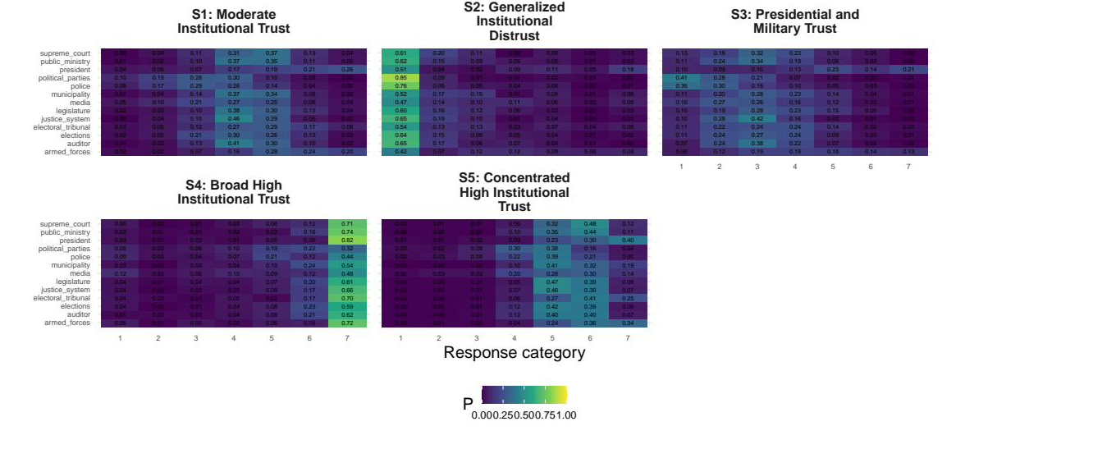
UNCLASSIFIED
Backup: The full response profile is what a label must match
IF A LABEL IS CHALLENGED
UNCLASSIFIED
25
Notes:
Full conditional response probabilities behind every label.

Slide 26
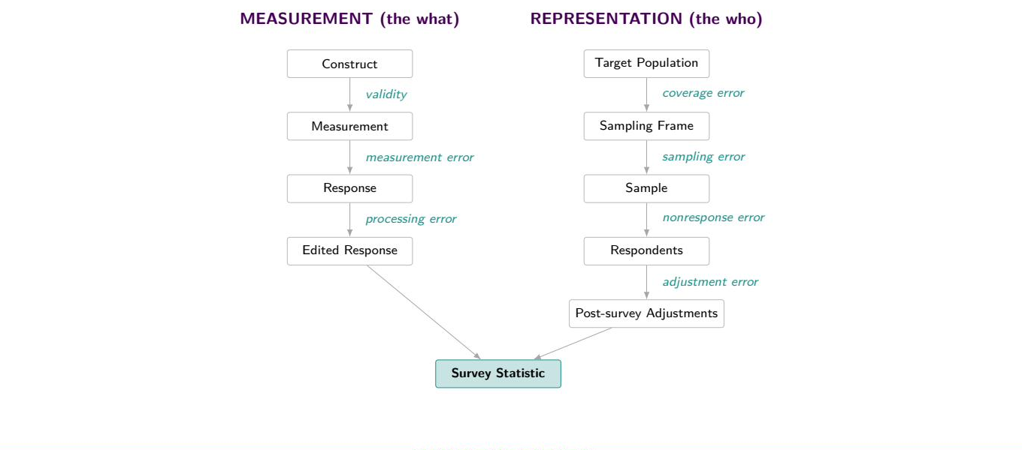
UNCLASSIFIED
Backup: Every stage of Total Survey Error is in scope
THE FRAMEWORK THIS SITS IN
This project touches validity, measurement error, processing error, sampling error, and adjustment error.
UNCLASSIFIED
26
Notes:
Groves and colleagues. Use if someone wants the framework behind the error sources.

Slide 27
UNCLASSIFIED
Backup: References
SOURCES CITED
Method
Applications in public opinion
Lazarsfeld, P. and Henry, N. (1968). Latent structure analysis. Houghton Mifflin.
Goodman, L. (1974). Exploratory latent structure analysis. Biometrika 61(2).
Patterson, Dayton and Graubard (2002). Latent class analysis of complex sample survey data. JASA 97(459), 721 to 728.
Bolck, Croon and Hagenaars (2004). Estimating latent structure models with categorical variables. Political Analysis 12(1), 3 to 27.
Vermunt, J. (2010). Latent class modeling with covariates. Political Analysis 18(4), 450 to 469.
Bakk, Oberski and Vermunt (2014). Relating latent class assignments to external variables. Political Analysis 22(4), 520 to 540.
Lumley and Scott (2015). AIC and BIC for modeling with complex survey data. JSSAM 3(1), 1 to 18.
Linzer and Lewis (2011). poLCA: polytomous variable latent class analysis. JSS 42(10).
Breen, R. (2000). Why is support for extreme parties underestimated by surveys? BJPS 30(2), 375 to 382.
Blaydes and Linzer (2008). The political economy of women's support for fundamentalist Islam. World Politics 60(4), 576 to 609.
Oser, Hooghe and Marien (2013). Is online participation distinct from offline? PRQ 66(1), 91 to 101.
Bonikowski and DiMaggio (2016). Varieties of American popular nationalism. ASR 81(5).
Alvarez, Levin and Núñez (2017). The four faces of political participation in Argentina. Journal of Politics 79(4), 1386 to 1402.
Pew Research Center (2026). Beyond Red vs. Blue: The Political Typology, 10 June 2026. Appendix B: weighted clustering around medoids.
UNCLASSIFIED
27
Notes:
Leave up during questions if the room is academic.

