Slide 1
UNCLASSIFIED
The publics
our averages hide
A capability briefing: what it finds, and what putting it to work looks like
Kevin Linares · MS Survey and Data Science, JPSM · 22 September 2026
UNCLASSIFIED
Notes:
Fifteen minutes. The goal is not to teach latent class analysis. It is to get a battery sent to you afterward.

Slide 2
UNCLASSIFIED
A capability that finds the real publics behind every average
THE CAPABILITY
Every foreign population surveyed today gets reported as one number — and that number quietly erases the real differences inside it.
This capability finds the actual publics hiding behind that number.
Finds the real groups
Counts everyone fairly
Keeps AI on a leash
Puts an analyst in charge
Replaces a guess with a map of the publics actually there.
No one's voice quietly counts for less than it should.
Drafts language. Never a number. Never a finding.
No coding or statistics background required to run it.
Built to run as a standing capability across every foreign-population account — not a one-off study.
UNCLASSIFIED
2
1
2
3
4

Slide 3
UNCLASSIFIED
The number you're relying on already hides two different people
THE COST OF ONE NUMBER
Respondent A
Respondent B
Courts
Auditor
4.0
Elections
shared
average
Police
President
Military
1
2
3
4
5
6
7
1 = no trust 7 = high trust
A single average calls these two people identical, and that average is what reaches you. Act on it, and you're aiming at neither person — with no way to know it.
UNCLASSIFIED
3
Notes:
Open here. No preamble, no credentials, no framework. Point at the crossing and let the room see it before you say anything. Then the line: everyone in this room has summed a battery, and this is what it hides. The specific values are schematic; the pattern is real and appears in the profiles later.

Slide 4
UNCLASSIFIED
What I built gives you four things a single score never could
WHAT I BUILT
It finds the real groups
It counts people fairly
Fits directly to how people actually answered. The number and kind of groups comes from the data, not a guess.
Respondents who stand in for more of the population count more, and every group's size comes with an honest confidence range.
It keeps AI on a leash
It puts an analyst in charge
A fixed, sourced list of rules the assistant can point to. It can flag something worth checking. It never decides a number — the analyst does, and signs off.
No code and no statistics background required to run it. An AI assistant helps write up what the results mean — it never touches the numbers themselves.
Each piece closes a specific way a simpler tool would get it wrong — or could not be run at all.
UNCLASSIFIED
4

Slide 5
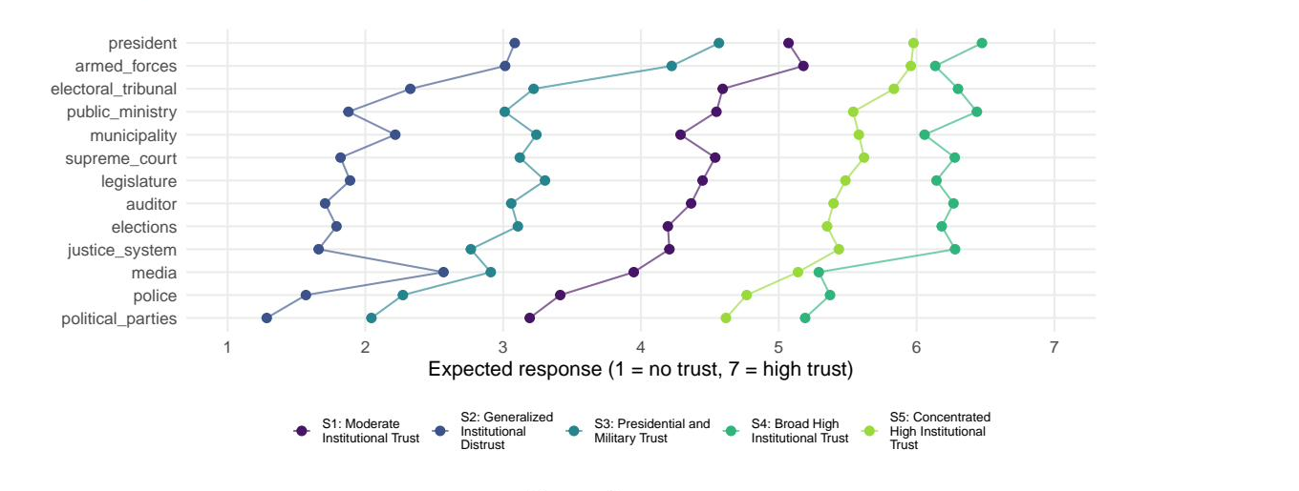
UNCLASSIFIED
Here's real data: two opposite publics scored identically
PROOF, ON REAL DATA
Two of the five segments land at nearly the same overall trust score, but trust completely different institutions. A single scale could never have told them apart.
UNCLASSIFIED
5
Notes:
This pays off the promise from slide 4. Trace the crossing with a finger. Then state the level-to-pattern diagnostic value out loud. FILL THAT NUMBER IN BEFORE PRESENTING: it is printed by the item-discrimination chunk in survey_lca_report.qmd. Without it, slide 4 made a promise this slide does not keep.

Slide 6
UNCLASSIFIED
This turns a guess about any foreign public into real intelligence
WHAT YOU GET
Instead of briefing “trust in government is at 42 percent,”
we can brief which publics make up that number, how big each is, and how sure we are.
A real audience to aim at
One method, any battery
Honesty about our uncertainty
Programs and messaging get pointed at an actual public, not a mean that describes no one.
The same pipeline segments trust, media use, or economic anxiety in any foreign population we already survey.
Every group's size comes with how confident we are, so a recommendation never claims more precision than the sample supports.
This is not one study's finding.
It's a standing capability, ready to run across every foreign-population account.
UNCLASSIFIED
6

Slide 7
UNCLASSIFIED
Here's what it takes to put this into practice
GETTING STARTED
Three ways to capture this
Questions worth settling early
A standing methods annex per account that each product links to
What must be preserved to reproduce a published number two years from now?
A shared archive: configuration, diagnostics, frozen names, citable per run
Who reviews a segment name before it reaches a briefing?
A one-pager that travels with the product itself
What is the minimum caveat that must appear in the product itself?
Send a battery of categorical items and its design variables. I'll tell you how many groups are really in there, how big they are in the population, and how sure we are — in a form a policy audience can act on.
UNCLASSIFIED
7
Notes:
Close on the offer, not the method. Then stop talking. This is where the room decides whether to send you work, and silence does more than another sentence.

Slide 8
UNCLASSIFIED
Backup: One-page summary of this briefing
LEAVE-BEHIND SUMMARY
1
What this capability is
A tool that replaces one guess about a population with a map of its real publics.
2
What it is costing us today
Every average we brief is a real difference between publics, erased before anyone sees it.
3
Why no one else has built this
The idea is old. Making it correct and self-service, without a statistician, is not.
4
What it buys us
Segment-level intelligence on any foreign population we already survey.
5
Getting started
Three things that make this how we always do it.
This is the one-pager — forward it to anyone who missed the briefing.
UNCLASSIFIED
8

Slide 9
UNCLASSIFIED
Backup: How this differs from a single trust score
THE TECHNICAL DIFFERENCE
A single score forces every person onto one line, from low to high.
This capability asks a sharper question: who answers alike, and who answers differently?
ONE SCORE (what costs us today)
THE CAPABILITY (what we built)
Lines everyone up from low trust to high trust.
Groups people by their whole pattern of answers.
Two very different people can average to the same number.
Lets the data decide how many real groups exist.
Cannot say how many kinds of people are in the data.
Gives each group a size and a confidence range.
Same capability whether the battery is institutional trust, views of a government, or a policy — and it is ready now.
UNCLASSIFIED
9
Notes:
Thirty seconds. The TSE reference is one line and you move on; the full framework diagram is in backup if anyone wants it. The third cost is the one that matters to this room: segmentation exists to target, and a mean cannot target.

Slide 10
UNCLASSIFIED
Backup: Why this didn't already exist
PRIOR ART AND TIMING
Segmentation itself is decades old — the first method dates to 1974.
What's new is a version that is correct on a real foreign-population sample, and doesn't need a statistician in the room.
WHAT IT COSTS TO GET WRONG
THE CAPABILITY WE BUILT
Some people's answers stand in for a lot more of the population than others.
The correct math, built in — no separate statistician required.
Ignore that, and the groups — and their sizes — can be quietly wrong.
A self-service tool an analyst runs without writing code.
Doing it right by hand takes a statistician days per run.
An AI assistant that helps interpret results and never touches a number.
No one had packaged the correct math as a tool ready to use. Now it exists.
UNCLASSIFIED
10

Slide 11
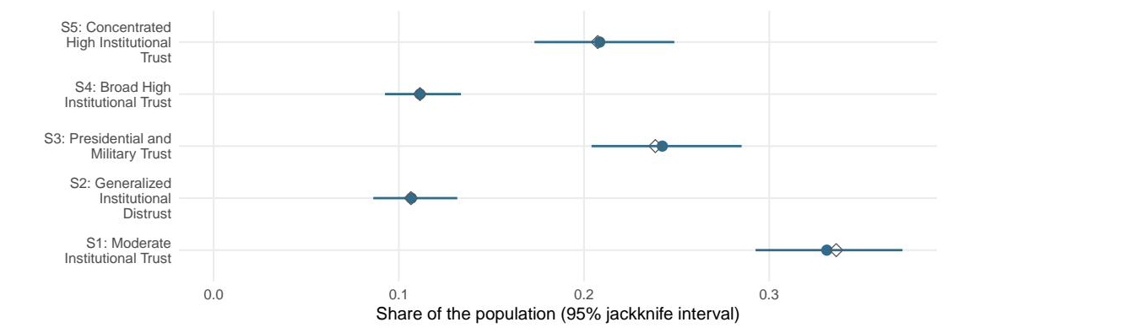
UNCLASSIFIED
Backup: How sure we are about each segment's size
UNCERTAINTY, IN DETAIL
The solid dots count people the way they were actually reached. The hollow diamonds pretend everyone counted equally. Here the two nearly agree — but we cannot know that in advance, so we check every time. Skip that check, and an ordinary-looking gap between two groups can be reported as real when it is just noise.
UNCLASSIFIED
11
Notes:
Say the weighting correction was small here before anyone asks. Then the recovery: you cannot know it is small until you compute it, and the variance correction was never small. This is also where you note that the classification-error correction was run and agreed closely, which is a robustness finding, not a reason to skip it.

Slide 12
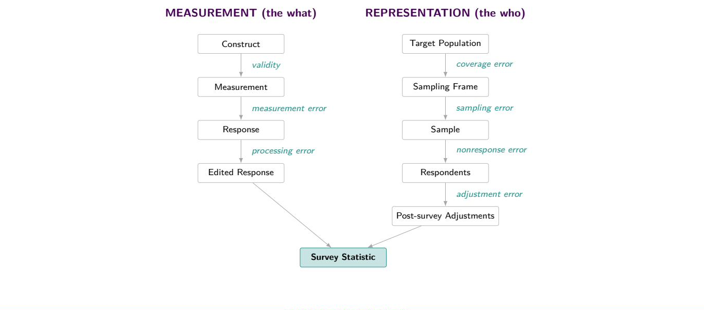
UNCLASSIFIED
Backup: Every stage of Total Survey Error is in scope
THE FRAMEWORK THIS SITS IN
This project touches validity, measurement error, processing error, sampling error, and adjustment error.
UNCLASSIFIED
12
Notes:
Groves and colleagues. Both arms converge on the survey statistic. Use if someone wants the framework rather than the one-line reference on slide 3.

Slide 13
UNCLASSIFIED
Backup: The battery's shape decides the method, not taste
HOW THE CHOICE WAS MADE
1. What are we estimating?
A partition of this file
A population parameter
k-means, medoids
factor analysis, latent class
no interval exists
2. What shape is the thing?
One continuum
Distinct types
groups differ in how high
groups differ in which items
a factor cannot hold a crossing
The battery decides question two, not taste. The diagnostic is on the profiles slide.
UNCLASSIFIED
13
Notes:
Ninety seconds and the most important slide in the deck. Question one is where clustering gets set aside: a partition has nothing to put a standard error on. If the room raises Pew's typology, concede it fully. Their method is a weighted medoid partition, it is defensible, their sample dwarfs mine. The difference is what you can say afterward. Do not widen the claim. Question two is a promise: you must pay it off at the profiles.

Slide 14
UNCLASSIFIED
Backup: A partition has no interval to give you
THE PART THAT IS USUALLY SKIPPED
THE SAMPLE
THE POPULATION
icon size = survey weight
Group 1
design-weighted
latent class model
Group 2
Group 3
weights in the likelihood
strata and PSUs in the variance
Group 4
Group 5
share of the population, with its jackknife interval
The interval is the deliverable. A partition has nowhere to get one from.
UNCLASSIFIED
14
Notes:
Sixty seconds, two beats. Left: the icons are different sizes because the sample is not self-weighting, and a distance-based method treats every one of them the same. Right: run a finger along one whisker. Geometry here is schematic; real numbers arrive in three slides. If asked how the interval is built: the whole model is refit on 130 jackknife replicates from the real strata and clusters, because a weighted likelihood gives no usable information matrix. Detail slide is in backup.

Slide 15
UNCLASSIFIED
Backup: Four moves yield a defensible variance estimate
IF ASKED HOW IT WORKS
1. Weight the likelihood
2. Calibrate the criteria
Every respondent contributes in proportion to the population they represent.
Base weights do not sum to n, so fit statistics are rescaled before comparison to a sample-size penalty.
3. Replicate the variance
4. Correct the classification
A weighted likelihood gives no usable information matrix, so the model is refit on 130 jackknife replicates.
Assignment is imperfect. BCH removes the resulting bias before any demographic comparison.
Design: 4 strata, 130 PSUs, 126 degrees of freedom for every interval in this deck.
UNCLASSIFIED
15
Notes:
Move three is the expensive one. Move four is the one most analysts have never heard of.

Slide 16
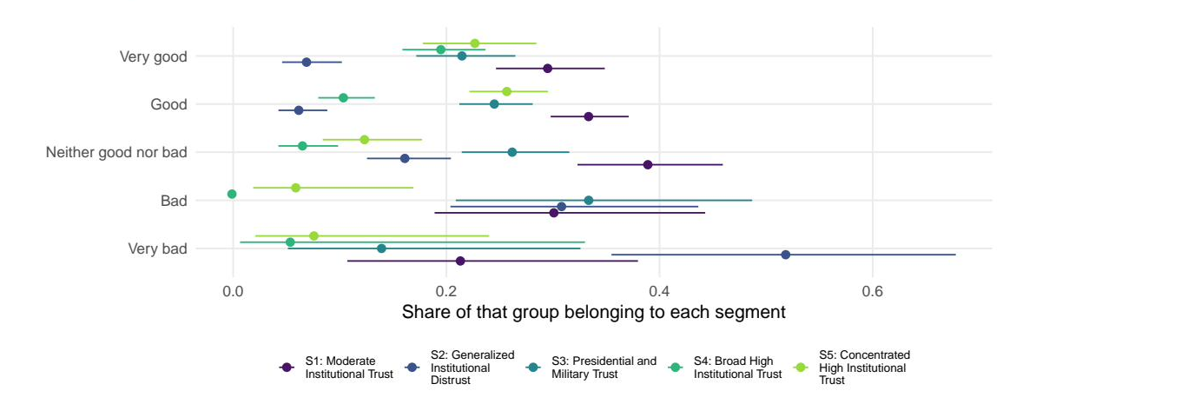
UNCLASSIFIED
Backup: Classification correction keeps contrasts honest
PROFILING, CORRECTED
Corrected for classification error, so the contrasts are not diluted by people sitting in the wrong group.
UNCLASSIFIED
16
Notes:
Composition by presidential job approval. Strongly ordered, and the intervals tell you which contrasts are real. The correction here is the BCH three-step; on this battery it agreed closely with the uncorrected estimates because separation is good. Mechanics are in backup.

Slide 17
UNCLASSIFIED
Backup: AI may draft a label; it never decides a number
A RULE, NOT A ONE-OFF
A model may draft
It never decides
A candidate name for each group
How many groups there are
From the estimated numbers only
Which items to keep or drop
Into a file the analyst owns and edits
Anything that appears as a finding
A model may draft configuration. Never a decision, never a claim about results.
Nothing in this briefing rests on anything a language model wrote.
UNCLASSIFIED
17
Notes:
Slow down here. This generalizes past the project into a policy the room can apply to their own work, which is often what they remember. The naming step, the prompt as a versioned instrument, and the certification harness are all in backup if there is appetite.

Slide 18
UNCLASSIFIED
Backup: Clustering and latent class analysis differ in kind
IF ASKED ABOUT PEW
 | Distance-based partition | Latent class analysis
What it is | An algorithm that partitions this sample | A model of the population
Requires | A distance you choose | A likelihood the data imply
Number of groups | Elbow or silhouette heuristics | AIC, BIC, entropy: comparable fit
Assignment | Hard. One label per person | A probability per person
Survey weights | Can size the groups, not the variance | Enter the likelihood directly
What you report | Shares in this file | Population shares with intervals
Clustering is a fine exploratory tool. The objection is to reporting a cluster share as a population estimate.
UNCLASSIFIED
18
Notes:
The Pew answer. Concede first: their 2026 typology uses weighted clustering around medoids, it is defensible, and their sample dwarfs ours. Then the narrow claim, which comes from their own Appendix B: they say the solution moves with the algorithm, the coding, and the sort order, and they report nine group sizes with no interval. Our jackknife refits the whole model per replicate, so that instability lands in the interval. Do not widen the claim. If asked whether we could run this on their thirty items and nine groups, say no, not as specified: over a thousand parameters, an almost empty contingency table, and local independence violated by their within-battery item pairs. Their method scales where ours does not.

Slide 19
UNCLASSIFIED
Backup: The open-source gap is weighted LCA with variance
THE TOOLING GAP
Tool | Weighted likelihood | Design-based variance | Open
poLCA (R) | no | no | yes
survey (R) | no mixture models | yes | yes
Mplus, Latent GOLD | yes | linearization | no
baysc (R) | yes, Bayesian | sandwich adjustment | yes
This pipeline | yes | replicate (JKn) | yes
Mplus and Latent GOLD do this well and cost money. The gap is specific, not a claim that nobody solved segmentation.
UNCLASSIFIED
19
Notes:
Be fair to the alternatives. baysc is an excellent Bayesian counterpart.

Slide 20
UNCLASSIFIED
Backup: Four safeguards make the numbers reproducible
REPRODUCIBILITY
Validation. At equal weights this estimator and an independent published implementation agree to 0.00000 on every segment share and every response probability.
One verdict, one place. The validation result is written to disk and read by every downstream document.
Frozen decisions. The number of groups and their names live in version control, not in someone's memory.
Rendered from source. Every figure was generated from stored model objects at compile time. Nothing was pasted.
1618 of 1622 respondents received a group, including 188 who skipped items but answered enough to be scored.
UNCLASSIFIED
20
Notes:
If asked about missing data: the model is estimated on 1430 item-complete cases and scoring extends above an evidence floor. Pew imputes at their scale, which is a defensible different choice, so do not attack them on it.

Slide 21
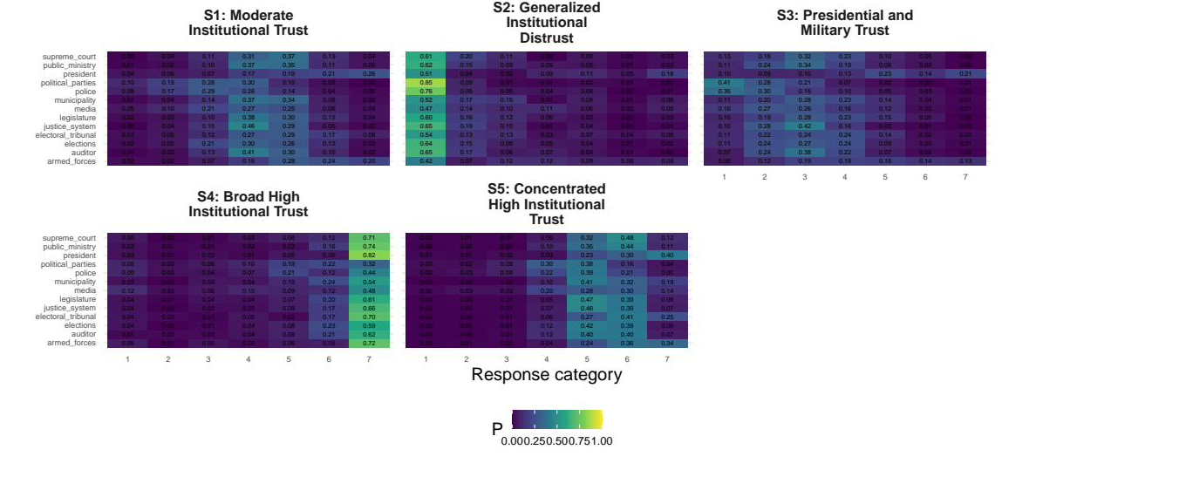
UNCLASSIFIED
Backup: The full response profile is what a label must match
IF A LABEL IS CHALLENGED
UNCLASSIFIED
21
Notes:
Full conditional response probabilities behind every label.

Slide 22
UNCLASSIFIED
Backup: Every person gets a probability, not a forced label
WHAT THE MODEL OUTPUTS
Segment share
Posterior
how large each group is in the population, with an interval
0.62
keeps a probability for every segment, never a hard label
one respondent
Response profile
the answer pattern that defines each group
Both are estimates of the population, so both carry uncertainty we can quantify.
UNCLASSIFIED
22
Notes:
Sixty seconds. Do not put the likelihood on screen; it is in backup if a methodologist wants it. The single point to land: nobody is relabelled. Everyone keeps a probability, which is what makes the classification-error check possible later and is exactly what a hard partition throws away.

Slide 23
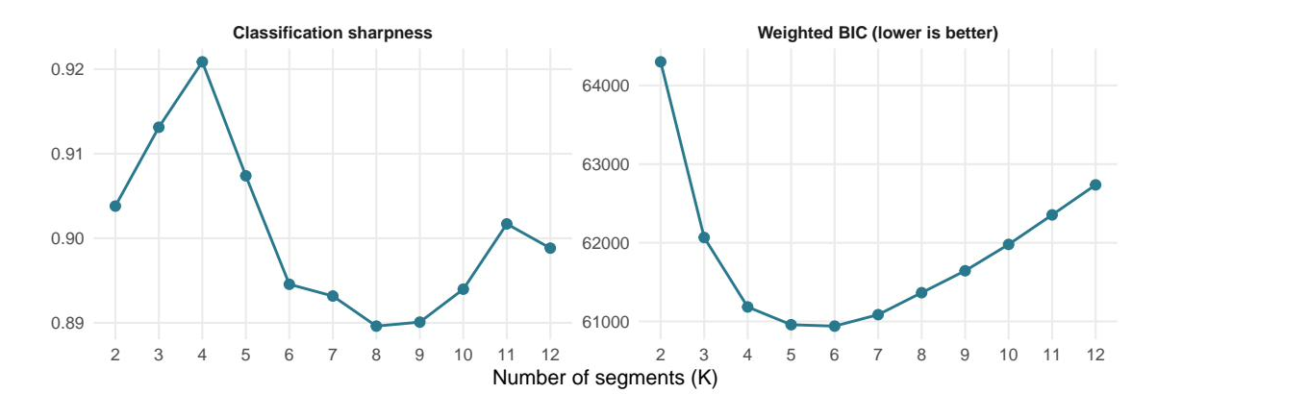
UNCLASSIFIED
Backup: How many groups is a judgment, not an output
AND WE SHOW OUR WORK
Five and six fit almost equally well. We took five. The software never picks this.
UNCLASSIFIED
23
Notes:
Forty seconds. Say plainly that an automated choice here is the first thing a reviewer attacks, and that the flat region is reported rather than hidden. The choice lives in a config file under version control, not in someone's memory.

Slide 24
UNCLASSIFIED
Backup: References
SOURCES CITED
Method
Applications in public opinion
Goodman, L. (1974). Exploratory latent structure analysis. Biometrika 61(2).
Patterson, Dayton and Graubard (2002). Latent class analysis of complex sample survey data. JASA 97(459), 721 to 728.
Bolck, Croon and Hagenaars (2004). Estimating latent structure models with categorical variables. Political Analysis 12(1), 3 to 27.
Vermunt, J. (2010). Latent class modeling with covariates. Political Analysis 18(4), 450 to 469.
Bakk, Oberski and Vermunt (2014). Relating latent class assignments to external variables. Political Analysis 22(4), 520 to 540.
Lumley and Scott (2015). AIC and BIC for modeling with complex survey data. JSSAM 3(1), 1 to 18.
Linzer and Lewis (2011). poLCA: polytomous variable latent class analysis. JSS 42(10).
Breen, R. (2000). Why is support for extreme parties underestimated by surveys? BJPS 30(2), 375 to 382.
Blaydes and Linzer (2008). The political economy of women's support for fundamentalist Islam. World Politics 60(4), 576 to 609.
Oser, Hooghe and Marien (2013). Is online participation distinct from offline? PRQ 66(1), 91 to 101.
Bonikowski and DiMaggio (2016). Varieties of American popular nationalism. ASR 81(5).
Alvarez, Levin and Núñez (2017). The four faces of political participation in Argentina. Journal of Politics 79(4), 1386 to 1402.
Pew Research Center (2026). Beyond Red vs. Blue: The Political Typology, 10 June 2026. Appendix B: weighted clustering around medoids.
UNCLASSIFIED
24
Notes:
Leave up during questions if the room is academic.

