Slide 1
UNCLASSIFIED
Segmenting survey data
without breaking the design
Finding real groups in a categorical battery, and putting an interval on them
Kevin Linares · MS Survey and Data Science, JPSM · 22 July 2026
UNCLASSIFIED
Notes:
Fifteen minutes. The goal is not to teach latent class analysis. It is to get a battery sent to you afterward.

Slide 2
UNCLASSIFIED
Same average, opposite people
THE PROBLEM
Respondent A
Respondent B
Courts
Auditor
4.0
Elections
both
means
Police
President
Military
1
2
3
4
5
6
7
1 = no trust 7 = high trust
A summed scale calls these two people identical. They are not.
UNCLASSIFIED
2
Notes:
Open here. No preamble, no credentials, no framework. Point at the crossing and let the room see it before you say anything. Then the line: everyone in this room has summed a battery, and this is what it hides. The specific values are schematic; the pattern is real and appears in the profiles later.

Slide 3
UNCLASSIFIED
A scale answers a different question
WHAT AVERAGING COSTS
The scale is not wrong. It measures how much, when the question is which kind.
A
B
1
4
7
both land here
Two different people
Real contrasts
You cannot target
collapse to one number
get diluted toward the mean
what you cannot distinguish
This is a validity problem, on the measurement side of Total Survey Error. Not a reporting choice.
UNCLASSIFIED
3
Notes:
Thirty seconds. The TSE reference is one line and you move on; the full framework diagram is in backup if anyone wants it. The third cost is the one that matters to this room: segmentation exists to target, and a mean cannot target.

Slide 4
UNCLASSIFIED
Two questions before picking a method
HOW THE CHOICE WAS MADE
1. What are we estimating?
A partition of this file
A population parameter
k-means, medoids
factor analysis, latent class
no interval exists
2. What shape is the thing?
One continuum
Distinct types
groups differ in how high
groups differ in which items
a factor cannot hold a crossing
The battery decides question two, not taste. The diagnostic is on the profiles slide.
UNCLASSIFIED
4
Notes:
Ninety seconds and the most important slide in the deck. Question one is where clustering gets set aside: a partition has nothing to put a standard error on. If the room raises Pew's typology, concede it fully. Their method is a weighted medoid partition, it is defensible, their sample dwarfs mine. The difference is what you can say afterward. Do not widen the claim. Question two is a promise: you must pay it off at the profiles.

Slide 5
UNCLASSIFIED
What comes out
THE TWO OUTPUTS
Segment share
Posterior
how large each group is in the population, with an interval
0.62
keeps a probability for every segment, never a hard label
one respondent
Response profile
the answer pattern that defines each group
Both are estimates of the population, so both carry uncertainty we can quantify.
UNCLASSIFIED
5
Notes:
Sixty seconds. Do not put the likelihood on screen; it is in backup if a methodologist wants it. The single point to land: nobody is relabelled. Everyone keeps a probability, which is what makes the classification-error check possible later and is exactly what a hard partition throws away.

Slide 6
UNCLASSIFIED
Where the sample design enters
THE PART THAT IS USUALLY SKIPPED
THE SAMPLE
THE POPULATION
icon size = survey weight
Group 1
design-weighted
latent class model
Group 2
Group 3
weights in the likelihood
strata and PSUs in the variance
Group 4
Group 5
share of the population, with its jackknife interval
The interval is the deliverable. A partition has nowhere to get one from.
UNCLASSIFIED
6
Notes:
Sixty seconds, two beats. Left: the icons are different sizes because the sample is not self-weighting, and a distance-based method treats every one of them the same. Right: run a finger along one whisker. Geometry here is schematic; real numbers arrive in three slides. If asked how the interval is built: the whole model is refit on 130 jackknife replicates from the real strata and clusters, because a weighted likelihood gives no usable information matrix. Detail slide is in backup.

Slide 7
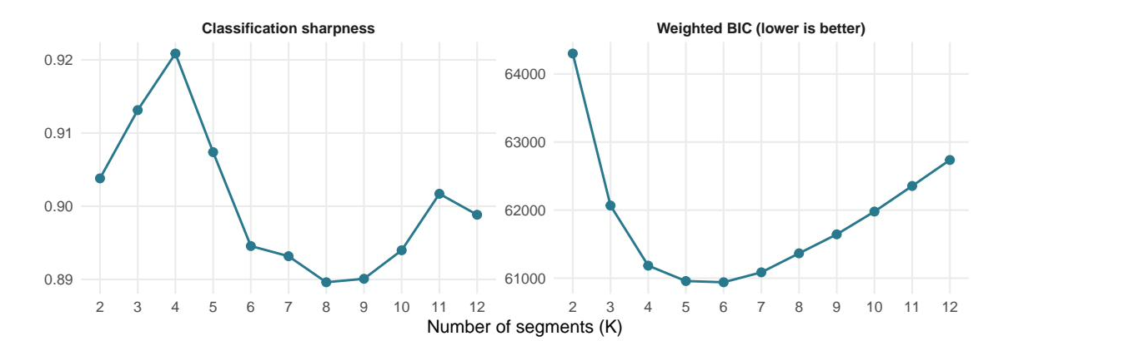
UNCLASSIFIED
How many groups is a judgment, not an output
AND WE SHOW OUR WORK
Five and six fit almost equally well. We took five. The software never picks this.
UNCLASSIFIED
7
Notes:
Forty seconds. Say plainly that an automated choice here is the first thing a reviewer attacks, and that the flat region is reported rather than hidden. The choice lives in a config file under version control, not in someone's memory.

Slide 8
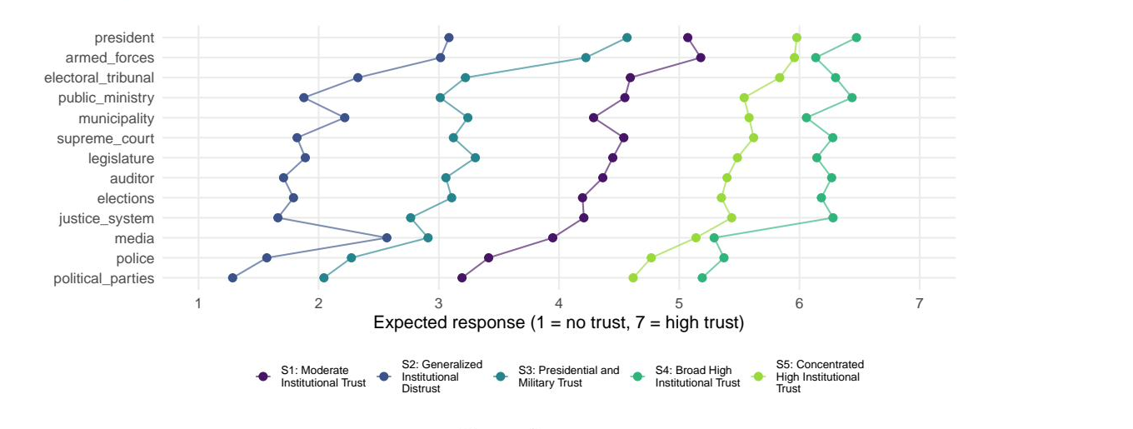
UNCLASSIFIED
Three groups differ in level. Two differ in shape.
THE PAYOFF
The two that cross have the same overall trust and opposite profiles. That is what a factor model cannot hold.
UNCLASSIFIED
8
Notes:
This pays off the promise from slide 4. Trace the crossing with a finger. Then state the level-to-pattern diagnostic value out loud. FILL THAT NUMBER IN BEFORE PRESENTING: it is printed by the item-discrimination chunk in survey_lca_report.qmd. Without it, slide 4 made a promise this slide does not keep.

Slide 9
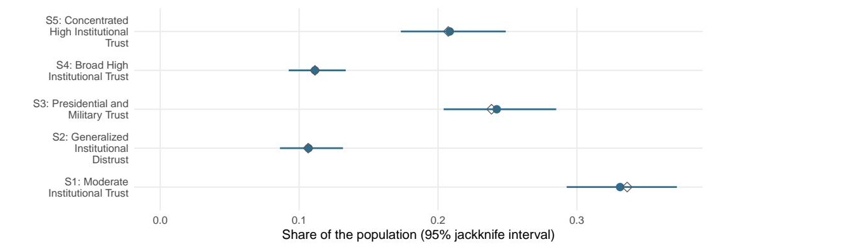
UNCLASSIFIED
How big each group is, and how sure we are
THE DELIVERABLE
Filled points use the design. Open diamonds are what an unweighted analysis reports. Here they nearly agree, and that is worth saying out loud. Without the intervals, a three point gap looks like a finding.
UNCLASSIFIED
9
Notes:
Say the weighting correction was small here before anyone asks. Then the recovery: you cannot know it is small until you compute it, and the variance correction was never small. This is also where you note that the classification-error correction was run and agreed closely, which is a robustness finding, not a reason to skip it.

Slide 10
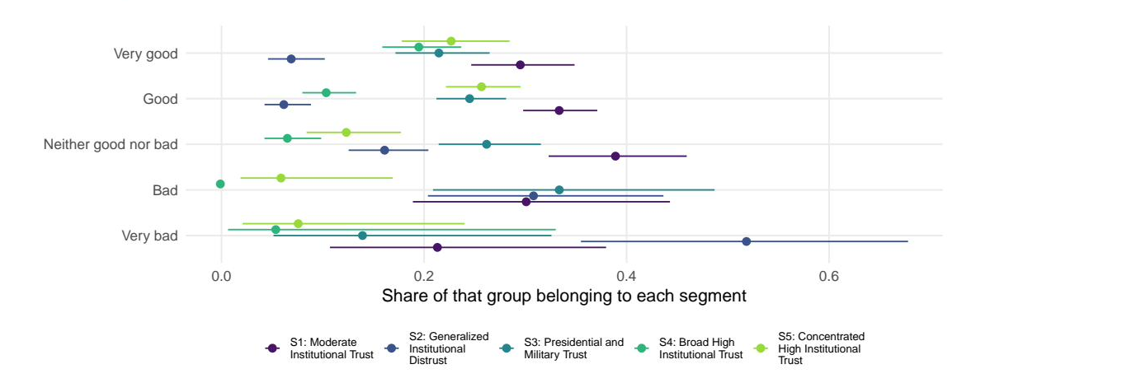
UNCLASSIFIED
Who is in each group
PROFILING, CORRECTED
Corrected for classification error, so the contrasts are not diluted by people sitting in the wrong group.
UNCLASSIFIED
10
Notes:
Composition by presidential job approval. Strongly ordered, and the intervals tell you which contrasts are real. The correction here is the BCH three-step; on this battery it agreed closely with the uncorrected estimates because separation is good. Mechanics are in backup.

Slide 11
UNCLASSIFIED
Where the line sits on AI assistance
A RULE, NOT A ONE-OFF
A model may draft
It never decides
A candidate name for each group
How many groups there are
From the estimated numbers only
Which items to keep or drop
Into a file the analyst owns and edits
Anything that appears as a finding
A model may draft configuration. Never a decision, never a claim about results.
Nothing in this briefing rests on anything a language model wrote.
UNCLASSIFIED
11
Notes:
Slow down here. This generalizes past the project into a policy the room can apply to their own work, which is often what they remember. The naming step, the prompt as a versioned instrument, and the certification harness are all in backup if there is appetite.

Slide 12
UNCLASSIFIED
What I would bring to our work
THE OFFER
Segmentation
Inference review
Reproducible pipelines
of any categorical battery, with population estimates and design-based intervals
on analyses we already publish
that render from source and can be audited a year later
Bring me a battery of categorical items and its design variables.
I will tell you how many groups are really in there, how big they are in the population, and how sure we are.
UNCLASSIFIED
12
Notes:
Close on the offer, not the method. Then stop talking. This is where the room decides whether to send you work, and silence does more than another sentence.

Slide 13
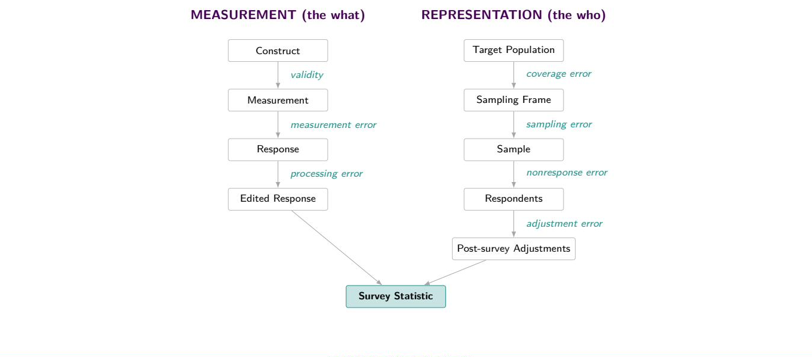
UNCLASSIFIED
Backup: Total Survey Error
THE FRAMEWORK THIS SITS IN
This project touches validity, measurement error, processing error, sampling error, and adjustment error.
UNCLASSIFIED
13
Notes:
Groves and colleagues. Both arms converge on the survey statistic. Use if someone wants the framework rather than the one-line reference on slide 3.

Slide 14
UNCLASSIFIED
Backup: The method, in four moves
IF ASKED HOW IT WORKS
1. Weight the likelihood
2. Calibrate the criteria
Every respondent contributes in proportion to the population they represent.
Base weights do not sum to n, so fit statistics are rescaled before comparison to a sample-size penalty.
3. Replicate the variance
4. Correct the classification
A weighted likelihood gives no usable information matrix, so the model is refit on 130 jackknife replicates.
Assignment is imperfect. BCH removes the resulting bias before any demographic comparison.
Design: 4 strata, 130 PSUs, 126 degrees of freedom for every interval in this deck.
UNCLASSIFIED
14
Notes:
Move three is the expensive one. Move four is the one most analysts have never heard of.

Slide 15
UNCLASSIFIED
Backup: Clustering and latent class analysis
IF ASKED ABOUT PEW
 | Distance-based partition | Latent class analysis
What it is | An algorithm that partitions this sample | A model of the population
Requires | A distance you choose | A likelihood the data imply
Number of groups | Elbow or silhouette heuristics | AIC, BIC, entropy: comparable fit
Assignment | Hard. One label per person | A probability per person
Survey weights | Can size the groups, not the variance | Enter the likelihood directly
What you report | Shares in this file | Population shares with intervals
Clustering is a fine exploratory tool. The objection is to reporting a cluster share as a population estimate.
UNCLASSIFIED
15
Notes:
The Pew answer. Concede first: their 2026 typology uses weighted clustering around medoids, it is defensible, and their sample dwarfs ours. Then the narrow claim, which comes from their own Appendix B: they say the solution moves with the algorithm, the coding, and the sort order, and they report nine group sizes with no interval. Our jackknife refits the whole model per replicate, so that instability lands in the interval. Do not widen the claim. If asked whether we could run this on their thirty items and nine groups, say no, not as specified: over a thousand parameters, an almost empty contingency table, and local independence violated by their within-battery item pairs. Their method scales where ours does not.

Slide 16
UNCLASSIFIED
Backup: Why this needed building
THE TOOLING GAP
Tool | Weighted likelihood | Design-based variance | Open
poLCA (R) | no | no | yes
survey (R) | no mixture models | yes | yes
Mplus, Latent GOLD | yes | linearization | no
baysc (R) | yes, Bayesian | sandwich adjustment | yes
This pipeline | yes | replicate (JKn) | yes
Mplus and Latent GOLD do this well and cost money. The gap is specific, not a claim that nobody solved segmentation.
UNCLASSIFIED
16
Notes:
Be fair to the alternatives. baysc is an excellent Bayesian counterpart.

Slide 17
UNCLASSIFIED
Backup: Why you can believe the numbers
REPRODUCIBILITY
Validation. At equal weights this estimator and an independent published implementation agree to 0.00000 on every segment share and every response probability.
One verdict, one place. The validation result is written to disk and read by every downstream document.
Frozen decisions. The number of groups and their names live in version control, not in someone's memory.
Rendered from source. Every figure was generated from stored model objects at compile time. Nothing was pasted.
1618 of 1622 respondents received a group, including 188 who skipped items but answered enough to be scored.
UNCLASSIFIED
17
Notes:
If asked about missing data: the model is estimated on 1430 item-complete cases and scoring extends above an evidence floor. Pew imputes at their scale, which is a defensible different choice, so do not attack them on it.

Slide 18
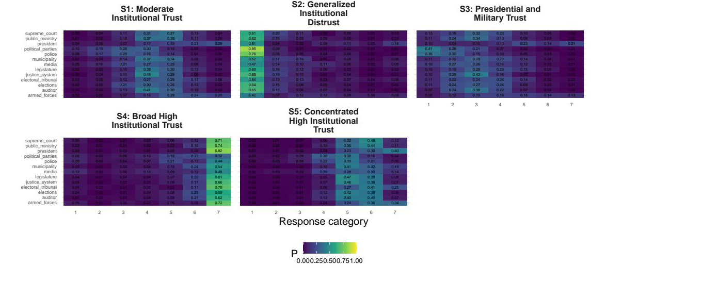
UNCLASSIFIED
Backup: Full response profiles
IF A LABEL IS CHALLENGED
UNCLASSIFIED
18
Notes:
Full conditional response probabilities behind every label.

Slide 19
UNCLASSIFIED
Backup: References
SOURCES CITED
Method
Applications in public opinion
Goodman, L. (1974). Exploratory latent structure analysis. Biometrika 61(2).
Patterson, Dayton and Graubard (2002). Latent class analysis of complex sample survey data. JASA 97(459), 721 to 728.
Bolck, Croon and Hagenaars (2004). Estimating latent structure models with categorical variables. Political Analysis 12(1), 3 to 27.
Vermunt, J. (2010). Latent class modeling with covariates. Political Analysis 18(4), 450 to 469.
Bakk, Oberski and Vermunt (2014). Relating latent class assignments to external variables. Political Analysis 22(4), 520 to 540.
Lumley and Scott (2015). AIC and BIC for modeling with complex survey data. JSSAM 3(1), 1 to 18.
Linzer and Lewis (2011). poLCA: polytomous variable latent class analysis. JSS 42(10).
Breen, R. (2000). Why is support for extreme parties underestimated by surveys? BJPS 30(2), 375 to 382.
Blaydes and Linzer (2008). The political economy of women's support for fundamentalist Islam. World Politics 60(4), 576 to 609.
Oser, Hooghe and Marien (2013). Is online participation distinct from offline? PRQ 66(1), 91 to 101.
Bonikowski and DiMaggio (2016). Varieties of American popular nationalism. ASR 81(5).
Alvarez, Levin and Núñez (2017). The four faces of political participation in Argentina. Journal of Politics 79(4), 1386 to 1402.
Pew Research Center (2026). Beyond Red vs. Blue: The Political Typology, 10 June 2026. Appendix B: weighted clustering around medoids.
UNCLASSIFIED
19
Notes:
Leave up during questions if the room is academic.

