Slide 1
Motivation
Out of curiosity, how much change is there to a stock price before and after an acquisition?

Slide 2
Data Discovery
Started with our S&P 100 list
Performed a search of recent (last 2 years) of acquisitions using data collected by PitchBook.com
Out of the initial 100, 48 public companies had a recent acquisition
From the list of 48 companies, stock data was pulled using IEX Trading’s API
Most companies had a +5/-5 percent change in stock prices 5 days before an acquisition to 5 days after
Information Technology and B2C acquisitions top the list with the highest changes
One outlier is Merck (MRK) with a 13% loss after it’s acquisition of Rigontec, a biotechnology company
What the data doesn’t show if it other events contributed to the percent changes

Slide 3
Data Cleanup
Issues with the data
Not all initial 100 companies had recent acquisitions
A few companies had acquisitions older than 2 years which was outside the scope of the stock data
Steps to fix
Used .dropna to eliminate any companies without deal dates
Used a try except statement to continue the loop if a missing deal date caused an error while converting it to a datetime object

Slide 4
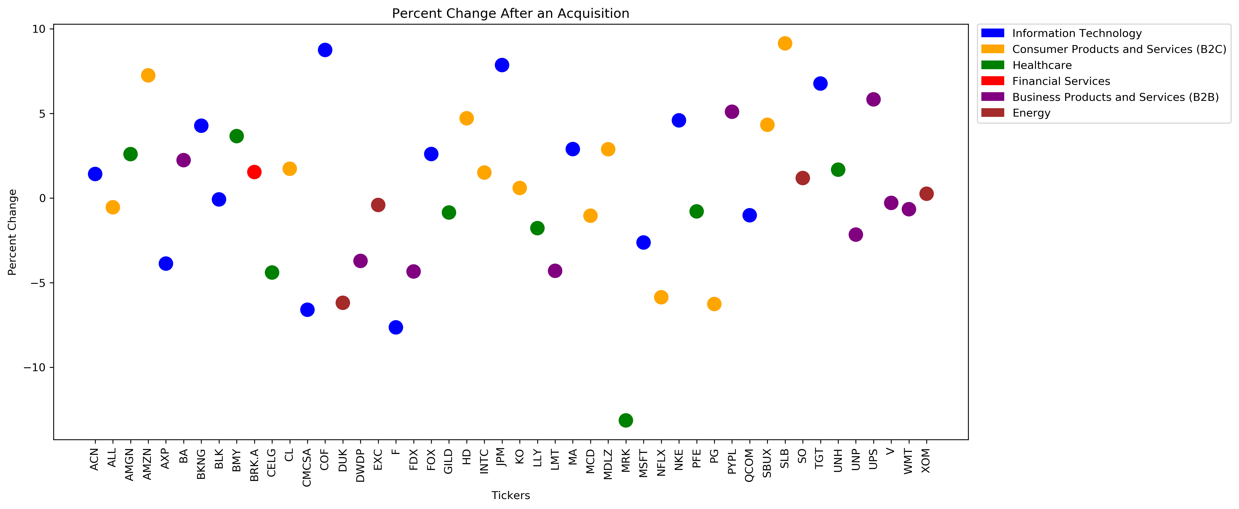
Data Analysis – Graph

