Slide 1
Motivation
I thought it would be interesting to breakdown the social media (Twitter) behavior of the S&P 100. How often they tweet, what types of tweets, who tweets the most and how they interact (if at all) with others on the platform

Slide 2
Data Discovery
Used the Tweepy api with a user_timeline search.
Looped through each twitter handle grabbing 200 tweets at a time, 11 times for a max of 2200 tweets. Used the max_id parameter to grab only unique tweets.
Gathered approximately 187,000 tweets
Used Regular Expression library to find the patterns for a retweet, URL,@ mention, hashtag.

Slide 3
Data Cleanup
Issues with the data
Some tweet text would break to new row
A few companies did not have twitter handles
Counting the difference between a retweet and a “@ mention”
A search for @Danaher Corporation would return tweets from MY timeline...
Steps to fix
Used .dropna to clear bad rows of data
Used a try except statement to continue the loop if a search would cause an error due to the twitter handle not existing
Used an if statement to not count the “@” if it was already counted as a “RT @”
Used the .drop function to remove my timeline tweets

Slide 4
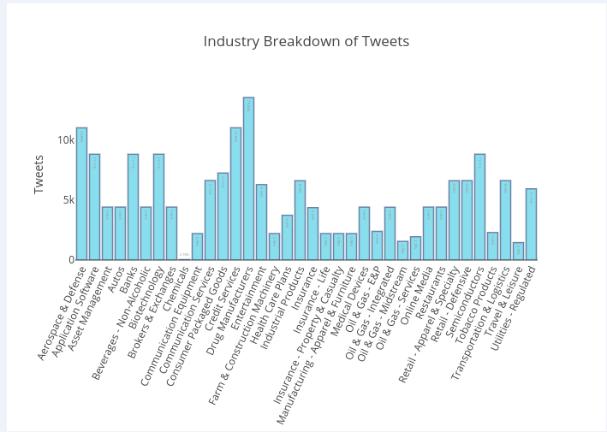
Data Analysis – Graph 1
First graph breaks down the S&P 100 by Industry showing how often these industries tweet.
Interesting data points
Drug Manufactures had the most tweets
Aerospace and Defense had a surprising amount
of tweets.
Biotechnology had a surprising amount
given only making up %11 of S&P

Slide 5
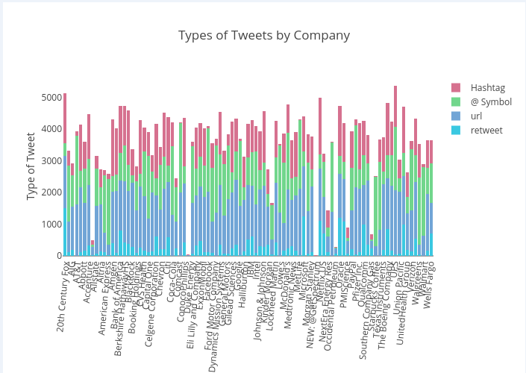
Data Analysis – Graph 2
Second graph breaks down the S&P 100 by company and how they post or interact with users
Interesting data points
NVIDIA does a lot of hash tagging
20th Century Fox does a lot of retweeting
URL’s and @ mentions are the majority

