Slide 1
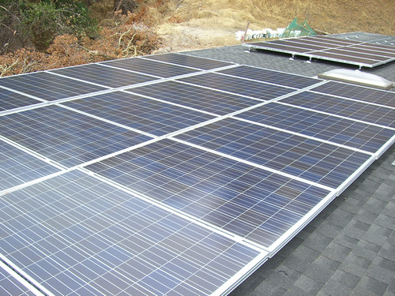
Renewable Energy in India
Powering a sustainable future
August 05, 2026
Notes:
Cover image: Joe's DIY Solar Panel Install Taken by Joe by Dave Dugdale (CC BY-SA 2.0) https://www.flickr.com/photos/37387065@N05/4160370798

Slide 2
Agenda
01 Introduction to Renewables
02 Renewable Energy Capacity
03 Solar Energy in India
04 Wind Farms in India
05 Renewable vs Non-Renewable Energy
06 Government Initiatives
07 Renewable Energy Milestones
08 Conclusion

Slide 3
Introduction to Renewables
▪ 30% of global emissions
▪ 50% of electricity from renewables by 2030
▪ India's renewable capacity: 100 GW
Renewables are crucial for a sustainable future
Renewable Energy in India
1 / 7
Notes:
Brief overview of the importance of renewables

Slide 4
Renewable Energy Capacity
150 GW
Installed capacity by 2025
Renewable Energy in India
2 / 7
Notes:
Discuss the growth of renewable energy in India

Slide 5
Solar Energy in India
▪ 50 GW installed capacity
▪ $20 billion investment by 2025
▪ Creating 1 million jobs
Solar energy is a key driver of India's renewable growth
Renewable Energy in India
3 / 7
Notes:
Highlight the significance of solar energy in India's renewable mix

Slide 6
Wind Farms in India
Wind energy is a significant contributor to India's renewable energy
Renewable Energy in India
4 / 7
Notes:
Showcase the wind farms in India and their contribution to renewable energy

Slide 7
Renewable vs Non-Renewable Energy
Renewable Energy
Non-Renewable Energy
▪ Sustainable
▪ Zero emissions
▪ Lower operational costs
▪ Finite resources
▪ High emissions
▪ Higher operational costs
Renewable Energy in India
5 / 7
Notes:
Compare the benefits of renewable energy with non-renewable energy

Slide 8
Government Initiatives
▪ National Solar Mission
▪ Wind-Solar Hybrid Policy
▪ Renewable Purchase Obligations
The government is actively promoting renewable energy in India
Renewable Energy in India
6 / 7
Notes:
Discuss the government initiatives to promote renewable energy

Slide 9
Renewable Energy Milestones
2020
2022
2025
India achieves 50 GW of installed renewable capacity
India launches the National Hydrogen Mission
India targets 150 GW of installed renewable capacity
Renewable Energy in India
7 / 7
Notes:
Highlight the key milestones in India's renewable energy journey

Slide 10
Conclusion
Renewable energy is crucial for a sustainable future
Notes:
Summarize the key points and emphasize the importance of renewable energy

Slide 11
Image credits
Joe's DIY Solar Panel Install Taken by Joe by Dave Dugdale (CC BY-SA 2.0) https://www.flickr.com/photos/37387065@N05/4160370798

Slide 12
Thank you

