Slide 1
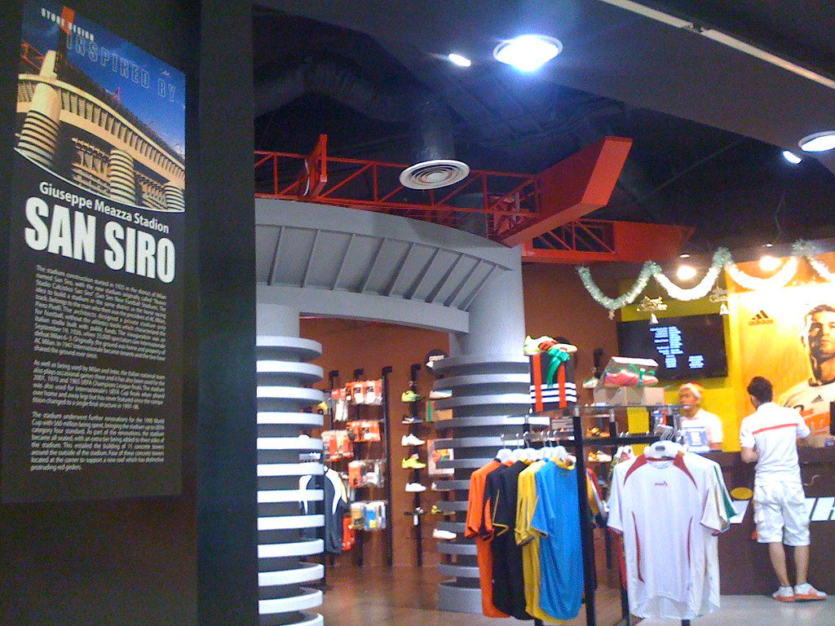
Zudio Retail Limited Overview
Transforming retail experiences through innovation
August 05, 2026
Notes:
Cover image: FISIK retail store Tunjungan Plaza by jheffryswid™ d e s i g n (CC BY 2.0) https://www.flickr.com/photos/22938698@N08/5278137532

Slide 2
Agenda
01 Introduction
02 Company History
03 Revenue Growth
04 Store Experience
05 Sustainability Initiatives
06 Market Position
07 Future Plans
08 CEO Statement

Slide 3
Introduction
Zudio Retail Limited is a leading retail company
Notes:
Brief overview of the company

Slide 4
Company History
▪ Founded in 2010
▪ First store opened in 2012
▪ Expanded to 100 stores by 2018
Zudio Retail Limited has experienced rapid growth
Zudio Retail Limited Overview
1 / 7
Notes:
Discuss the company's expansion and milestones

Slide 5
Revenue Growth
500 million
USD in annual revenue
Zudio Retail Limited Overview
2 / 7
Notes:
Highlight the company's financial performance

Slide 6
Store Experience
Zudio Retail Limited offers a unique shopping experience
Zudio Retail Limited Overview
3 / 7
Notes:
Describe the company's store design and layout

Slide 7
Sustainability Initiatives
▪ Reduced energy consumption by 20%
▪ Implemented recycling programs
▪ Sourced 50% of materials from sustainable suppliers
Zudio Retail Limited is committed to sustainability
Zudio Retail Limited Overview
4 / 7
Notes:
Discuss the company's environmental initiatives

Slide 8
Market Position
Zudio Retail Limited
Competitors
▪ Strong brand presence
▪ Wide product range
▪ Limited brand recognition
▪ Narrow product range
Zudio Retail Limited Overview
5 / 7
Notes:
Analyze the company's market standing and advantages

Slide 9
Future Plans
2023
2025
Expand to 200 stores
Enter new markets
Zudio Retail Limited Overview
6 / 7
Notes:
Outline the company's future expansion and strategies

Slide 10
“Our goal is to revolutionize the retail industry”
— CEO, Zudio Retail Limited
Zudio Retail Limited Overview
7 / 7
Notes:
Discuss the company's vision and mission

Slide 11
Image credits
FISIK retail store Tunjungan Plaza by jheffryswid™ d e s i g n (CC BY 2.0) https://www.flickr.com/photos/22938698@N08/5278137532

Slide 12
Thank you

