Slide 1
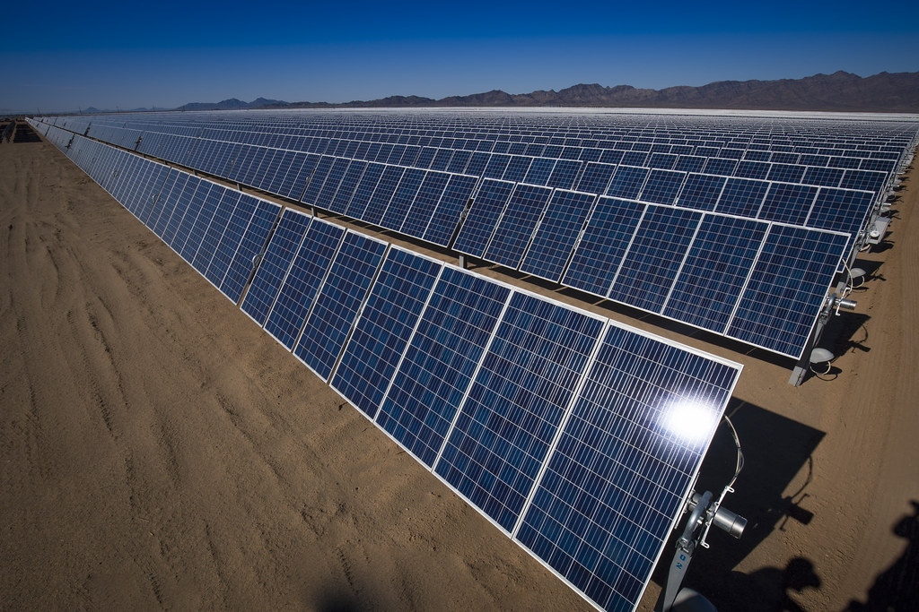
Renewable Energy: A Path Forward
Harnessing the power of nature to fuel our future
August 01, 2026
Notes:
Cover image: Renewable Energy Development in the California Desert by mypubliclands (CC BY 2.0) https://www.flickr.com/photos/91981596@N06/29730316311

Slide 2
Agenda
01 The Problem with Fossil Fuels
02 Renewable Energy Growth
03 Benefits of Renewable Energy
04 Solar Power in Action
05 Cost Comparison: Fossil Fuels vs. Renewables
06 Challenges and Opportunities
07 Conclusion

Slide 3
The Problem with Fossil Fuels
▪ Contributes to climate change
▪ Finite resource
▪ Pollutes the environment
Fossil fuels are unsustainable and harming our planet
Renewable Energy: A Path Forward
1 / 7
Notes:
We need to transition away from fossil fuels to mitigate climate change

Slide 4
Renewable Energy Growth
24%
Global renewable energy capacity growth (2020-2021)
Renewable Energy: A Path Forward
2 / 7
Notes:
Solar and wind power are leading the charge in renewable energy

Slide 5
Benefits of Renewable Energy
▪ Reduces greenhouse gas emissions
▪ Creates jobs and stimulates local economies
▪ Improves air quality
Renewable energy has numerous benefits for our health and economy
Renewable Energy: A Path Forward
3 / 7
Notes:
Investing in renewable energy can have significant social and economic returns

Slide 6
Solar Power in Action
Renewable energy is already being harnessed worldwide
Renewable Energy: A Path Forward
4 / 7
Notes:
Solar power is one of the most widely used forms of renewable energy

Slide 7
Cost Comparison: Fossil Fuels vs. Renewables
Fossil Fuels
Renewables
▪ High upfront costs
▪ Variable fuel prices
▪ Low maintenance costs
▪ Predictable energy output
Renewable Energy: A Path Forward
5 / 7
Notes:
The levelized cost of energy (LCOE) for renewables is decreasing

Slide 8
Challenges and Opportunities
▪ Grid integration
▪ Energy storage
▪ Policy and regulation
Addressing the challenges of renewable energy will unlock its full potential
Renewable Energy: A Path Forward
6 / 7
Notes:
Investing in research and development can help overcome these challenges

Slide 9
Conclusion
▪ Renewable energy is a vital component of our sustainable future
▪ We must continue to invest in its growth and development
The transition to renewable energy is underway, but we must accelerate it
Renewable Energy: A Path Forward
7 / 7
Notes:
Together, we can create a cleaner, more sustainable world

Slide 10
Image credits
Renewable Energy Development in the California Desert by mypubliclands (CC BY 2.0) https://www.flickr.com/photos/91981596@N06/29730316311

Slide 11
Thank you

