Slide 1
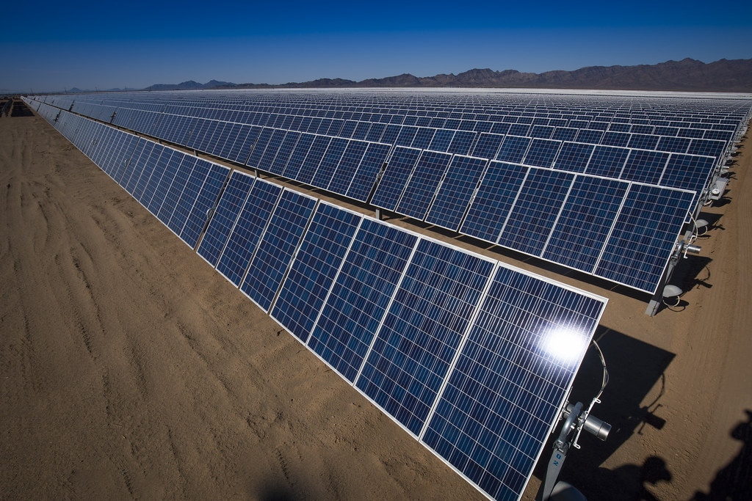
The Future of Renewable Energy
Harnessing the power of nature to fuel our world
July 31, 2026
Notes:
Cover image: Renewable Energy Development in the California Desert by mypubliclands (CC BY 2.0) https://www.flickr.com/photos/91981596@N06/29730316311

Slide 2
Agenda
01 Why Renewable Energy Matters
02 Renewable Energy Sources
03 Renewable Energy Growth
04 Challenges and Opportunities
05 Renewable Energy vs. Fossil Fuels
06 Renewable Energy Timeline
07 Conclusion and Next Steps

Slide 3
Why Renewable Energy Matters
▪ Reducing carbon emissions by 50% by 2030
▪ Creating jobs and stimulating local economies
▪ Improving air quality and public health
Renewable energy is essential for a sustainable future
The Future of Renewable Energy
1 / 8
Notes:
According to the IPCC, we must reduce greenhouse gas emissions by 45% by 2030 to meet the Paris Agreement targets.

Slide 4
Renewable Energy Sources
▪ Solar power: 1.3 million installations worldwide
▪ Wind power: 740 GW of capacity installed globally
▪ Hydroelectric power: 1,200 TWh of electricity generated annually
A variety of renewable energy sources are available and growing in popularity
The Future of Renewable Energy
2 / 8
Notes:
The cost of solar panels has decreased by 70% over the past decade, making them more competitive with fossil fuels.

Slide 5
Renewable Energy Growth
25%
Annual growth rate of renewable energy capacity
The Future of Renewable Energy
3 / 8
Notes:
According to the International Energy Agency, renewable energy accounted for 26% of global electricity generation in 2020.

Slide 6
Challenges and Opportunities
▪ Grid integration: connecting renewables to the grid
▪ Energy storage: improving battery technology
▪ Policy and regulation: supporting a transition to 100% renewables
Addressing challenges is crucial for widespread adoption of renewable energy
The Future of Renewable Energy
4 / 8
Notes:
The cost of energy storage has decreased by 80% over the past decade, making it more viable for large-scale deployment.

Slide 7
Renewable Energy vs. Fossil Fuels
Renewable Energy
Fossil Fuels
▪ Zero greenhouse gas emissions
▪ Abundant resource availability
▪ Low operating costs
▪ High greenhouse gas emissions
▪ Finite resource availability
▪ High operating costs
The Future of Renewable Energy
5 / 8
Notes:
According to the World Health Organization, air pollution from fossil fuels causes 7 million premature deaths worldwide each year.

Slide 8
Renewable Energy Timeline
2020
2030
2050
Renewable energy accounted for 26% of global electricity generation
50% reduction in greenhouse gas emissions target
100% renewable energy goal
The Future of Renewable Energy
6 / 8
Notes:
The European Union has set a target of at least 32% of its energy coming from renewables by 2030.

Slide 10
Conclusion and Next Steps
▪ Investing in renewable energy infrastructure
▪ Developing policies to support a transition to 100% renewables
▪ Educating the public about the benefits of renewable energy
A collective effort is needed to achieve a sustainable future with 100% renewable energy
The Future of Renewable Energy
8 / 8
Notes:
According to the International Renewable Energy Agency, investing in renewable energy can create up to 24 million jobs globally by 2030.

Slide 11
Image credits
Renewable Energy Development in the California Desert by mypubliclands (CC BY 2.0) https://www.flickr.com/photos/91981596@N06/29730316311

Slide 12
Thank you

