Slide 1
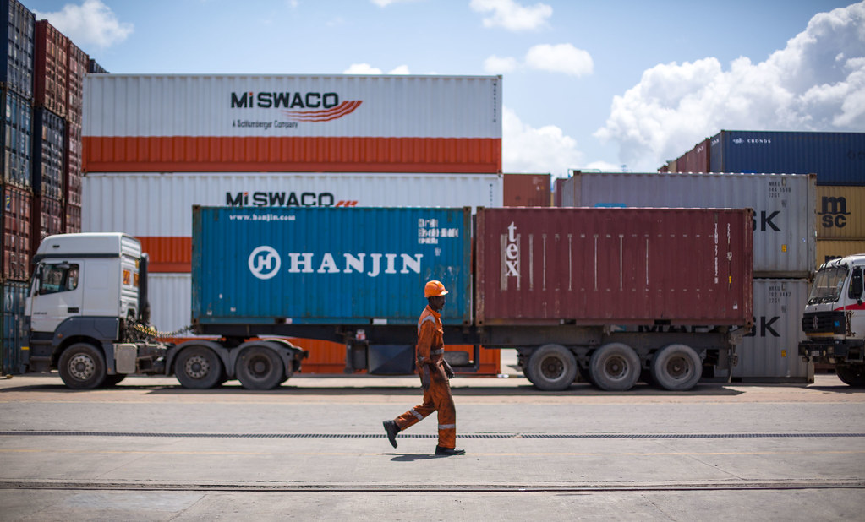
India's GDP Growth
Unlocking the Potential of the Indian Economy
August 11, 2026
Notes:
Cover image: 2015_07_31_Mombasa_Port_JPEG_RESIZED_0042 by Ministry of East African Affairs, Commerce & Touri (CC PDM 1.0) https://www.flickr.com/photos/132371669@N04/20348770861

Slide 2
Agenda
01 Introduction to India's Economy
02 GDP Growth Trends
03 Key Drivers of Growth
04 Comparison with Peer Nations
05 Challenges and Opportunities Ahead
06 Recommendations for Sustained Growth

Slide 3
Introduction to India's Economy
India's economy has experienced rapid growth in recent years
Notes:
speaker can elaborate on the factors contributing to this growth

Slide 4
GDP Growth Trends
▪ India's GDP growth rate was 8.9 percent in 2007
▪ Average annual GDP growth from 2014 to 2020 was 7.1 percent
▪ GDP growth slowed to 4.2 percent in 2020 due to the pandemic
▪ The service sector contributed 54.4 percent to GDP in 2022
Illustrative figures — not from a cited source.
India's GDP growth has been steadily increasing over the years
India's GDP Growth
1 / 5
Notes:
Emphasize the impact of the pandemic on GDP growth and the dominant role of the service sector

Slide 5
Key Drivers of Growth
▪ Service sector grew at 9.5 percent from 2015 to 2020
▪ Manufacturing output increased by 7.2 percent in 2019
▪ Foreign investment reached 73.5 billion USD in 2020
▪ Domestic investment rose by 10.3 percent in the first quarter of 2021
Diversified growth across sectors drives India's GDP
India's GDP Growth
2 / 5
Notes:
Emphasize the role of foreign and domestic investment in boosting growth

Slide 6
Comparison with Peer Nations
GDP Growth Rates
Emerging Market Comparison
▪ India: 7.3 percent in 2021
▪ China: 6.1 percent in 2021
▪ Brazil: 2.3 percent average from 2015 to 2020
▪ South Africa: 0.8 percent in 2020
▪ Indonesia: 5.2 percent average from 2015 to 2020
▪ Russia: 1.7 percent in 2020
India's GDP Growth
3 / 5
Notes:
Emphasize India's growth rate compared to other emerging markets, highlighting the service sector's contribution

Slide 7
Challenges and Opportunities Ahead
2023-2025
2025-2027
2027-2030
India's GDP growth rate is expected to average 8 percent, driven by service sector and foreign investment
The country will need to invest heavily in infrastructure development to sustain growth
The service sector is expected to drive growth, accounting for 60 percent of India's GDP
India's GDP Growth
4 / 5
Notes:
Emphasize the importance of infrastructure development and government reforms to sustain growth

Slide 8
Recommendations for Sustained Growth
8%
projected annual GDP growth rate
▪ Invest 1.4 trillion USD in infrastructure development by 2027 ▪ Increase foreign investment to 100 billion USD annually by 2025 ▪ Implement tax reforms to boost manufacturing growth by 10 percent
India's GDP Growth
5 / 5
Notes:
Emphasize the importance of infrastructure development and foreign investment in driving economic growth

Slide 9
Image credits
2015_07_31_Mombasa_Port_JPEG_RESIZED_0042 by Ministry of East African Affairs, Commerce & Touri (CC PDM 1.0) https://www.flickr.com/photos/132371669@N04/20348770861

Slide 10
Thank you

