Slide 1
Lecture 5: Stats Week!
Linear Regression

Slide 2
Regression Analysis - Terminology
Dependent variable - the variable you’re interested in understanding (y)
Independent variables or predictors - the variables you think are related to your dependent variable
Regression gives us a framework to determine the nature of the relationship between these variables

Slide 3
Visualizing Your Data
STEP 1
Always start by looking at your data. Make a histogram of your x/dependent variables. Make a histogram of your independent variables. Describe them using:
Shape
Center
Spread
Unusual Features (Gaps, Outliers, etc.)

Slide 4
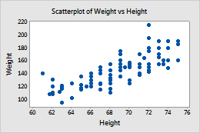
Visualizing Your Data
STEP 2
Now, let’s look at the relationship between the two variables with a scatter plot.
We plot the dependent variable (y) against the independent variable (x).

Slide 5
Visualizing Your Data
STEP 3
Now we can describe the scatterplot:
Form: linear or non-linear (curved)
Direction: positive or negative (direction of slope)
Strength: strong? moderate? weak? no relationship (cloud-like)?
Unusual Features: outliers? clusters?

Slide 6
Example #1
Describing the Scatterplot
The scatterplot of weight vs. height appears linear, moderately strong, and positive.

Slide 7
Group Work #1
In groups of 2-3, describe the scatterplots given.

Slide 8
Pearson’s Correlation Coefficient (r)
Measures the strength of the linear association between two variables
Can range from -1 to 1
1 is perfectly linear and positive
0 is no linear relationship
-1 is perfectly linear and negative
Sign always matches sign of slope
It is sensitive to outliers
Has no units

Slide 9

Linear Regression Using a Stats Package
If we think there is a linear relationship between two variables, we can model it using linear regression.
To perform a linear regression, you’ll use Ordinary Least Squares (OLS)
y = b + mx
Slope
(regression coefficient on x)
y-intercept
(constant)
error

Slide 10
Why Least Squares?
We are literally trying to minimize the sum of the areas of the squares (LINK)
The vertical distance between the point and the regression line is the residual
Residual:
e = y - y-hat

Slide 11
Four Key Assumptions for Regression
Linearity Assumption - relationship b/t the two variables is linear
Independence Assumption - errors in the true underlying model are independent
Equal Variance Assumption (Homoskedasticity) - The variability of y should be about the same for each value of x
Normal Population Assumption - the residuals/errors are normally distributed

Slide 12
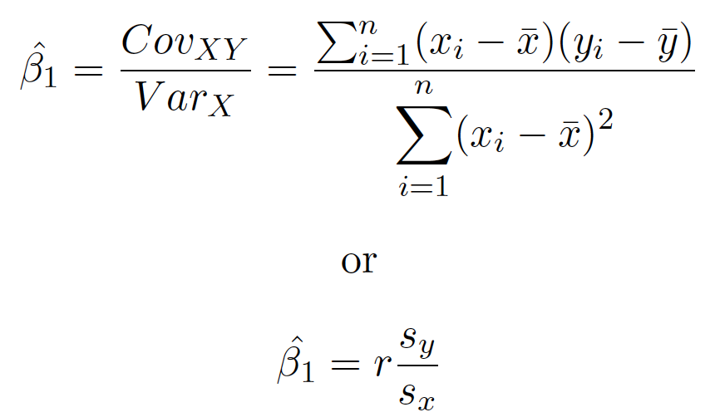
Formulas for B₁

Slide 13

Formula for B₀

Slide 14
Example #2
Colleges use SAT scores in the admissions process because they believe these scores provide some insight into how a high school student will perform at the college level. Suppose the entering freshman at a certain college have mean combined SAT scores of 1222 with a standard deviation of 83. In the first semester, these students attained a mean GPA of 2.66 with a standard deviation of 0.56. A scatterplot showed the association to be reasonably linear, and the correlation between SAT score and GPA was 0.47. What’s the equation of the regression line?

Slide 15
Group Work #2
In groups of 2-3, find the equations for the regression lines in the scenarios given.

Slide 16
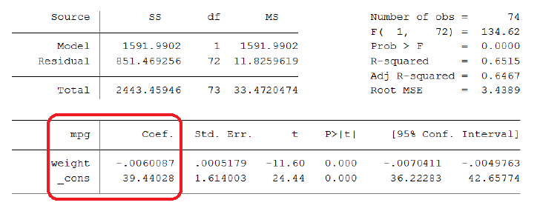
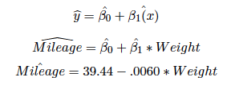
Regression Outputs, Example 3

Slide 17
Interpreting Slope & Y-Intercept, Example 3
Slope: For every one x units increase in x variable, the regression model predicts a value of slope y units (increase or decrease) in y variable.
Y-Intercept: When x variable is 0 x units, the regression model predicts y variable to be value of y-intercept y units.

Slide 18
Group Work #3
In groups of 2-3, write the equation of the regression line. Then, interpret the slope and y-intercept.

Slide 19
Predicting Values, Example 4
We can use the regression equation to predict values of y based on x.
If we were interested in the fuel economy of a car weighing 3,000lbs:
If we were interested in a car weighing 500 lbs:
500 lbs. Is outside the range of the weight values in our dataset, so this is an example of extrapolation

Slide 20
Group Work #4
In groups of 2-3, calculate predicted values for the two scenarios given.

Slide 21

Calculating Residuals, Example 5
A VW Rabbit weights 1930 lbs.
Substituting this into our regression equation, we get its predicted value.
Our dataset reveals that the VW Rabbit actually gets 25 mpg.
What does this value mean?

Slide 22
Group Work #5
In groups of 2-3, calculate the residuals in the given scenarios.

Slide 23
Coefficient of Determination, (R²)
R² and adjusted R² show what percentage of the variation in the y variable is explained by x.
R² can range from 0 to 1, 0% to 100%
We “adjust” R² when we have more than one predictor
R² = r²

Slide 24
Correlation ≠ Causation
Correlation: When X changes, Y tends to change. We observe a relationship, but we cannot prove why.
Causal: Not only do we observe a relationship, but we see that X has a consistent causal effect on Y.

