Slide 1
MbrDB V2.0
Updates to:
Navigation
Reminders
Reports

Slide 2
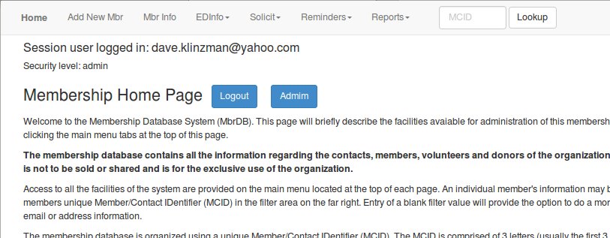
Navigation

Slide 3
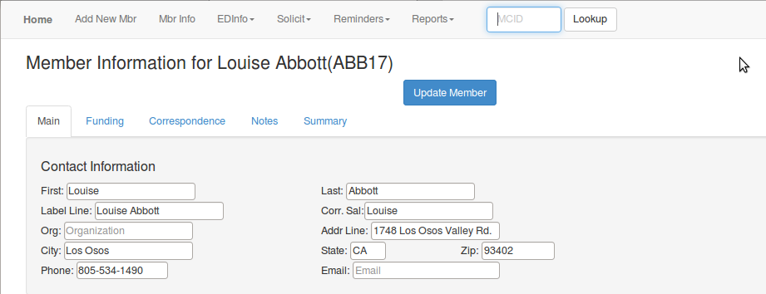
New Mbr Info Tabs

Slide 4
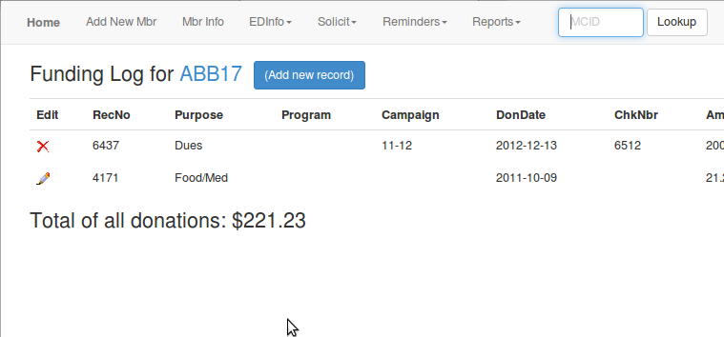
Mbr Info Funding & Corr. Tabs

Slide 5
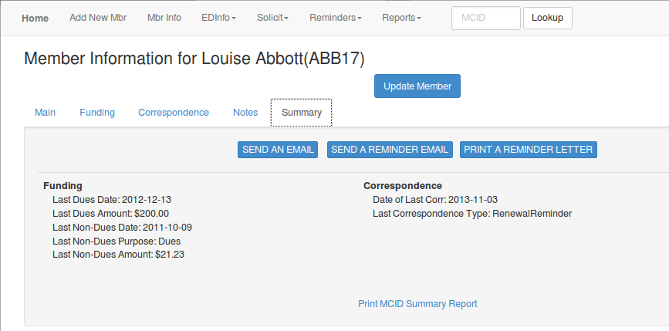
Mbr Info Summary

Slide 6
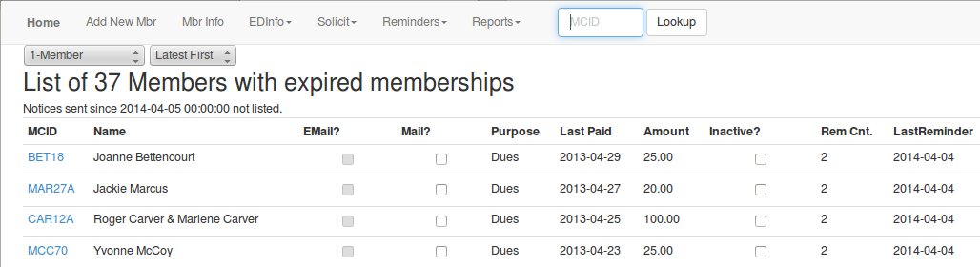
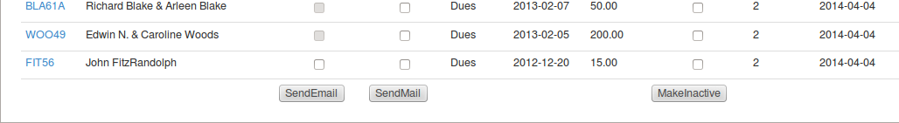
Reminders

Slide 7
Reminders
Workflow
Delete items in print queue.
List Expired, review and correct entries.
Check all entries qualified as 'Inactive' and update.
Check all entries available for email reminders and update.
Check all entries for mail labels, update, print labels and delete all items in print queue.
Check all remaining entries for form letters, update and print letters and labels.
Delete all items in print queue.

Slide 8
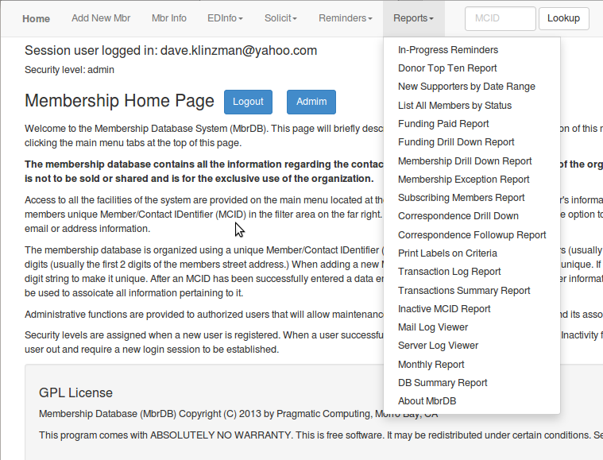
Reports

