Slide 1
Plot Dots and Add labels
IHI Decarbonization Learning Session June 2023 Kevin Little

Slide 2
IHI makes a big deal of asking you for numbers
Our ask: collect and report data on measures–-monthly or weekly time steps.
Why? Show evidence that your changes to operations drive changes in performance.
Numbers help answer Question 2 of the Model for Improvement.

Slide 3
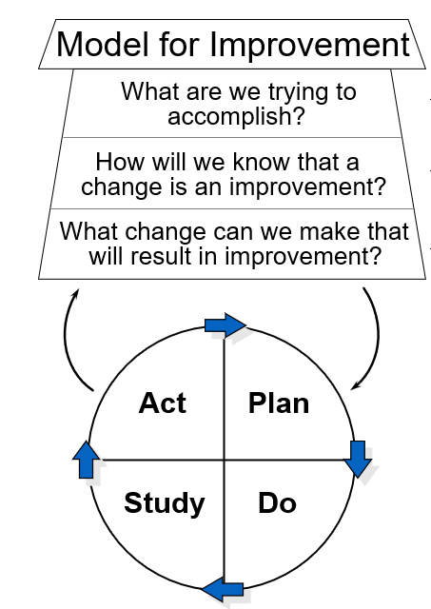
The Model for Improvement
developed by Associates in Process Improvement

Slide 4
Acknowledgement
The charts and explanation shown in this presentation are based on this paper:
Perla, R. J., Provost, L. P., Murray, S. K. The run chart: a simple analytical tool for learning from variation in healthcare processes. BMJ Quality & Safety, 2011, 20, pp. 46-51.

Slide 5
Don’t Be Fooled by Table Summaries
Hospital | Year | Total | Monthly Average | Monthly Median
A | 2021 | 864.0 | 72.0 | 71.0
A | 2022 | 453.6 | 37.8 | 36.5
B | 2021 | 864.0 | 72.0 | 71.0
B | 2022 | 453.6 | 37.8 | 36.5
C | 2021 | 864.0 | 72.0 | 71.0
C | 2022 | 453.6 | 37.8 | 36.5
The simulated situation: Hospital A, B, and C each have summarized tons of CO2e associated with their operations month by month in 2021 and 2022.
Each Hospital tested and changed operations in December 2021, with the aim of decreasing CO2e emissions.
Each of the three hospitals produce exactly the same summary table.
Does it look like our community should get excited about the impact of December 2021’s change?
Yearly Summary Report: MT CO2e impact, three hospitals

Slide 6
Plot Dots

Slide 7
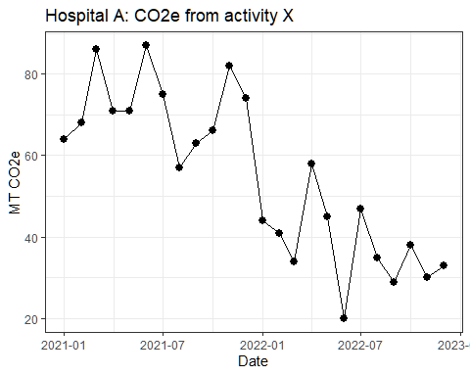
Case A What do you see in the data display?
The time series graph for Hospital A shows the monthly values summarized in the table on the previous slide.
Does the graph support the belief that the change in December 2021 improved performance, 2022 vs 2021?

Slide 8
Add Labels

Slide 9
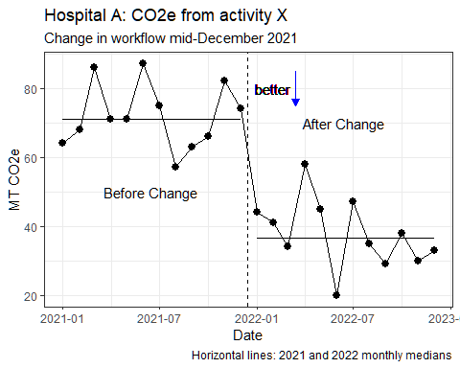
Case A Make it easier to see the story in the numbers!
Does the graph support the belief that the change in December 2021 improved performance, 2022 vs 2021?
Adding words, the line to mark the change in workflow, and the “better” direction arrow helps you think!

Slide 10
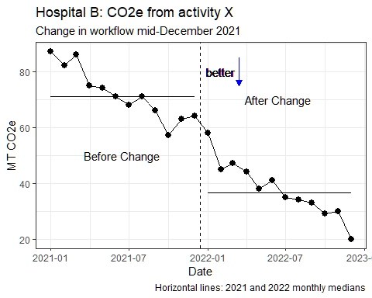
Case B What do you see in the data display?
Does the graph support the belief that the change in December 2021 improved performance, 2022 vs 2021?
How does the pattern in this graph differ from the graph of Hospital A’s data?

Slide 11
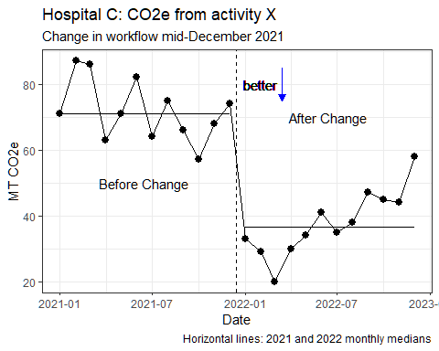
Case C What do you see in the data display?
–Does the graph support the belief that the change in December 2021 improved performance, 2022 vs 2021?
–How does the pattern in this graph differ from the graphs of data from Hospitals A and B?

Slide 12
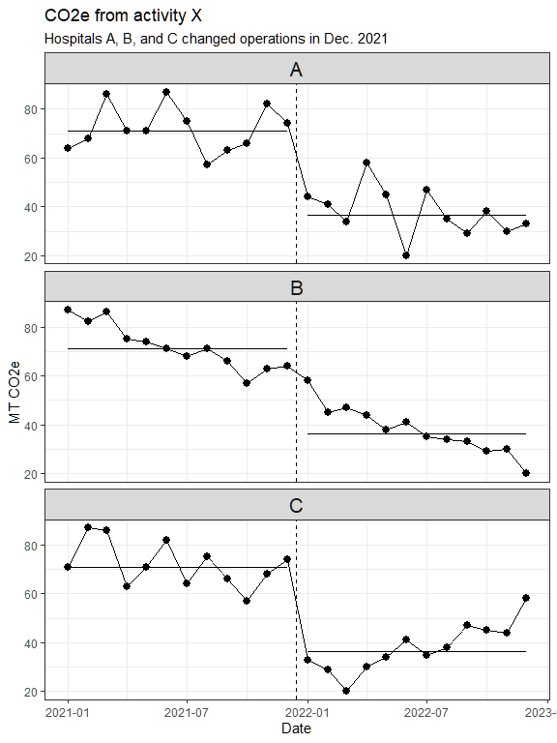
In our collab work, we often show all the Hospitals in one display
You can shrink graphs to show several in one display; it helps if the scales are all aligned.
You can quickly compare patterns and look for differences.
Here’s a stack of the graphs from Hospitals A, B, C.

Slide 13
Appendix: Background details

Slide 14
What is the median of a set of values?
The median divides the set of values into two equal batches: one batch has values all less than or equal to the median; the other batch has all values greater than or equal to the median. In other words, the median is the 50% value when you rank order the values from smallest to largest.
You can calculate the median using Excel if you have a lot of numbers. For example if the values are in cells B2 through B25, choose an empty cell on the same worksheet and type =median(B2:B25).

Slide 15
Why do we use medians in our improvement project graphs?
The median isn’t affected by a few whacky values.
You can calculate the median GRAPHICALLY–it’s easy to estimate if it is missing from a time series graph.
Once you know the median, you can learn to apply a few simple statistical rules. The rules help you find patterns that are not likely to arise just by chance. These “low chance” patterns are clues that your operations may have changed–either by something you did on purpose or from some other cause.
Notes:
We can show the graphical approach to finding the median on the graph from Hospital A. Grab a rectangle shape from the insert menu and stretch the top of the box until we get to between the 6th and 7th values in 2021.
The paper by Perla, Provost and Murray introduce four rules. The trend and shift rules should only be applied to short series (n <= 20) as the probability of seeing the trend or shift signal given by the authors is an increasing function of the length of the series. For longer series, the number of runs rule will still apply. Alternatively, you should consider constructing an appropriate control chart.

Slide 16
Are you a fan of tables? Add graphs to see patterns over time.
You can enhance tables of numbers with small charts embedded in table cells. Formalized by information graphic designer Edward Tufte in 1983 and named by him as “sparkline” in 2006, sparklines are available in Excel, Tableau, PowerBI, table functions in R, etc.

Slide 17
The Kelleher Rule: Choose the right time step of your measurement series
Notes:
My colleague Kevin Kelleher taught me a rule of thumb 30 years ago

Slide 18
What is the appropriate time step for your data series?
Kelleher’s Rule: Collect and display data on key system properties at least “one step” faster than your capacity to make decisions and interventions using those data.
Why? Build understanding of system variation; patterns in the data give you clues for adjustments and insight.

Slide 19
EXAMPLE
If you can propose changes to work and analyze performance weekly then the time step of your data should be at least daily.
Time Steps: years, quarters, months, weeks, days, 8-hour shifts, hours, … decrease by a median factor of 4.
click here for more discussion of the Kelleher Rule
Notes:
When you track numbers in a table or add dots to a plot, a daily value gives you a sense of trends or shifts within the week, especially if you have past weeks for reference. This is the logic behind use of specific rules for run charts.
It’s also usually a good idea not to react to a single data point unless the single point is very unusual. Control charts are one class of tools to judge whether an individual point is unusual enough to justify a rational response through detective work and action.
Prospectively, if you make a change to the system or process, you’d like to have evidence relatively quickly that the change is working or not. Quickness again is relative to your management capacity. If you have a weekly management stand-up review meeting and make a change on Monday, Kelleher’s rule guides you to get data daily to assess impact of your change to inform next week’s review.

