Slide 1




Slide 2




Security
Principles
Risk Management
Process
Security
Concepts
Governance
and Process
Elements
Security
Controls

Slide 3
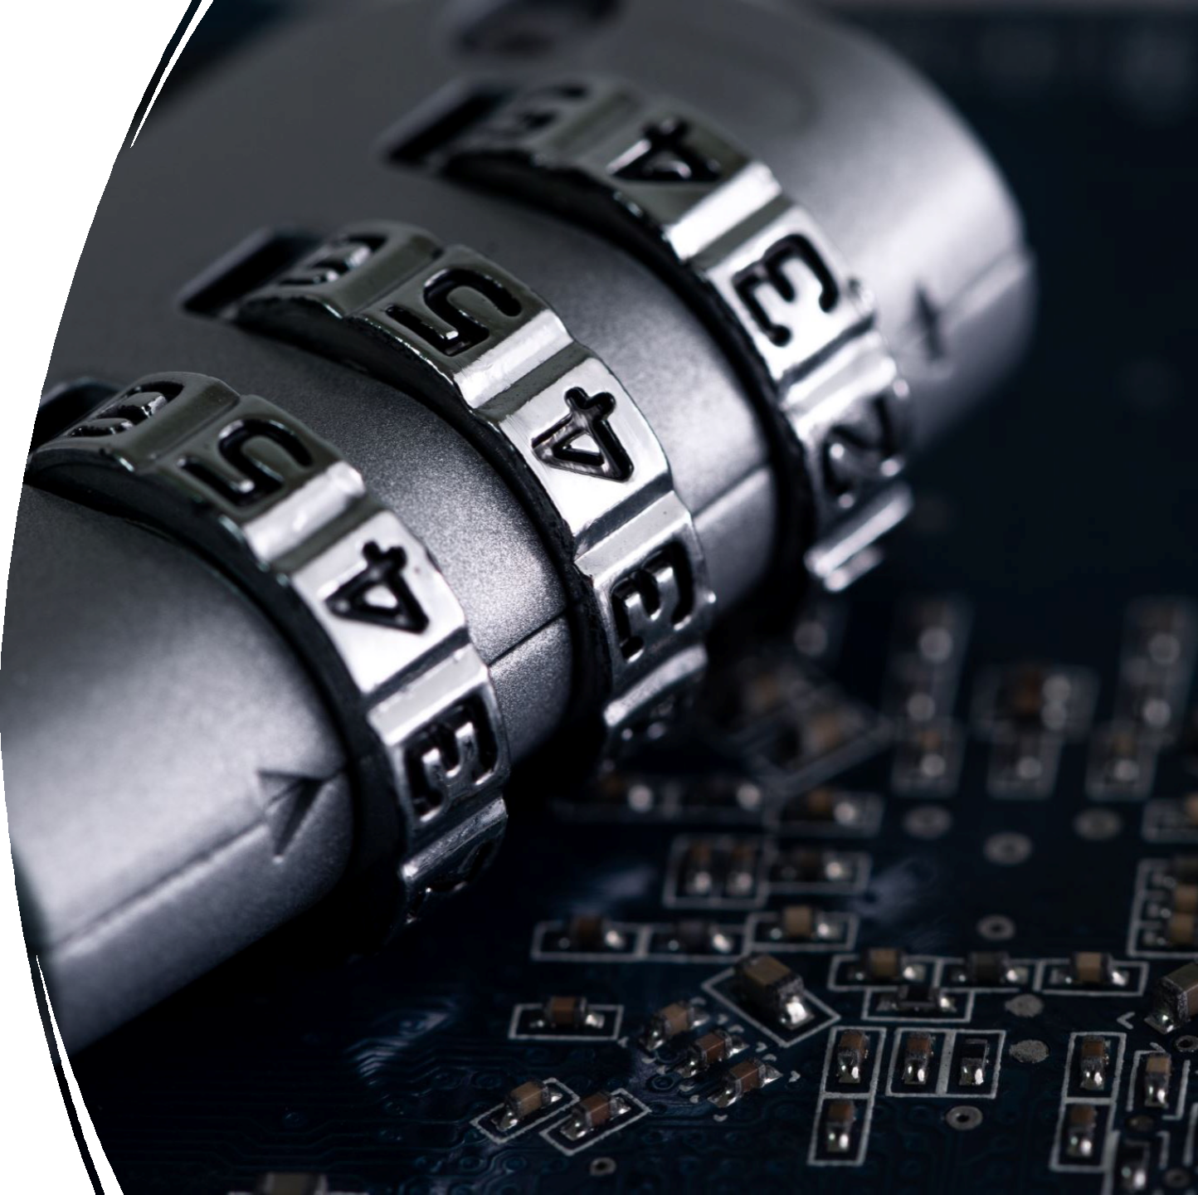
Security
Concepts
•
•
•
•
•
•
The CIA Triad
CIA Triad Deep Dive
Authentication
Methods of Authentication
Non-repudiation
Privacy

Slide 4
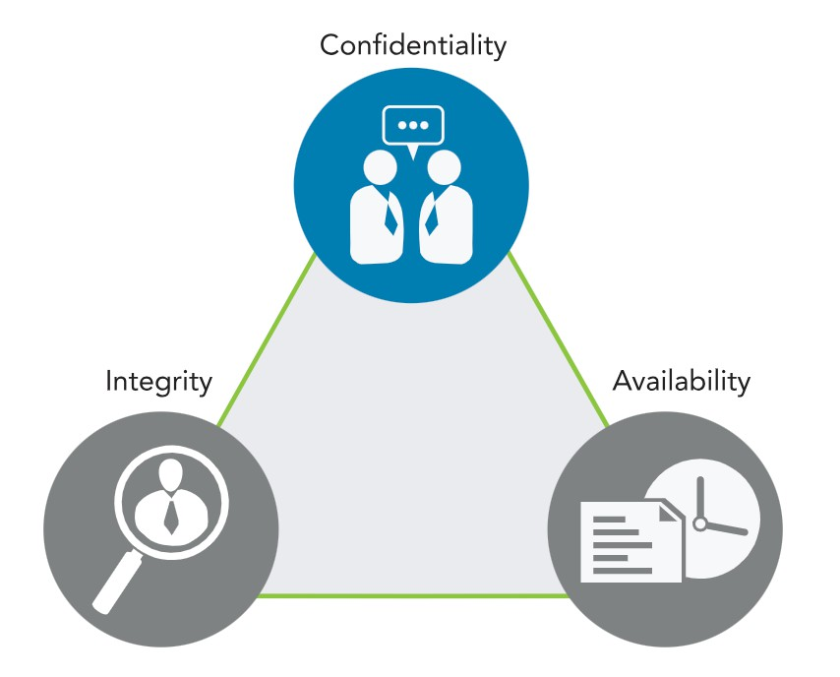
Security
Concepts
:
The
CIA
Triad

Slide 5



Security
Concepts
:
CIA
Triad
Deep
Dive
Confidentiality
Confidentiality relates to permitting
authorized access to information, while at
the same time protecting information from improper disclosure.
Integrity
Integrity is the property of information
whereby it is recorded, used and
maintained in a way that ensures its
completeness, accuracy, internal
consistency and usefulness for a stated
purpose.
information or data
systems and processes for business operations
organizations
people and their actions
Data Integrity
System Integrity (state & baseline)
Availability
Availability means that systems and data
are accessible at the time users need
them.
Personally Identifiable Information (PII)
protected health information (PHI)
classified or sensitive information sensitivity
criticality

Slide 6
This process of verifying or
proving the user’s identification is
known as authentication. Simply put,
authentication is a process to prove
the
identity
of
the
requestor.
Security
Concepts :
Authentication
There are three common methods of authentication:
Something you
know: Passwords
or passphrases
Something you
have: Tokens,
memory cards,
smart cards
Something you
measurable
are: Biometrics ,
characteristics

Slide 7

Security Concepts : Methods of
Authentication
•
•
•
Single-factor authentication
Multi-factor authentication
Common best practice is to implement at least
two of the three common techniques for
authentication:
o Knowledge-based
o Token-based
o Characteristic-based

Slide 8


Security
Concepts
:
Non-repudiation
Protection against an individual falsely denying
having performed a particular action.
Non-repudiation methodologies ensure that
people are held responsible for transactions they conducted.

Slide 9
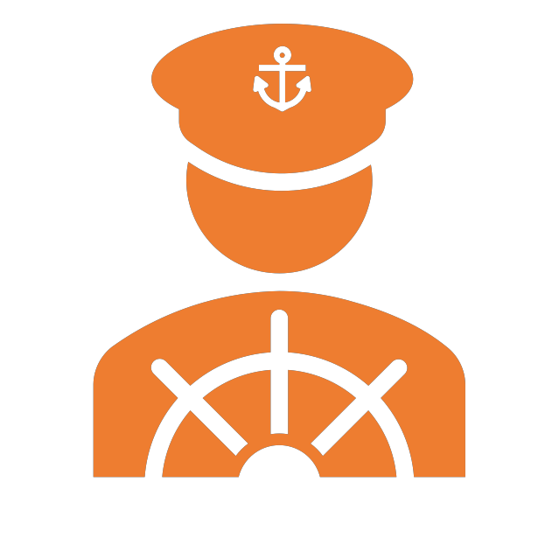

Security
Concepts
:
Privacy
The right of an individual to control the
distribution of information about themselves.
General Data Protection Regulation (GDPR)

Slide 10
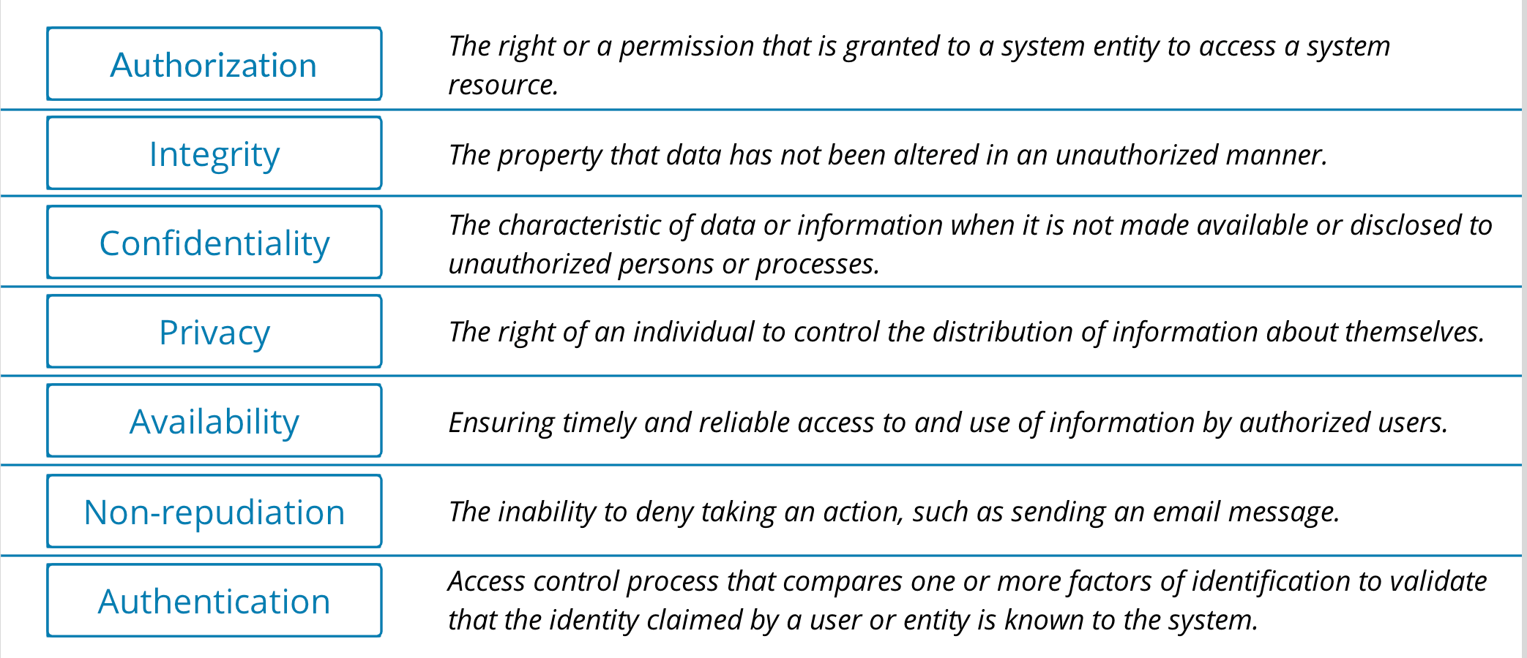
Security Concepts : Summary

Slide 11



Risk
Management
Asset : something in
protection.
need of
Process
Risk
:
Management
Terminology
Vulnerability : a gap
or weakness
in those protection efforts.
Threat : something or someone
that aims to exploit a vulnerability
to thwart protection efforts.

Slide 12


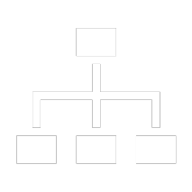

a recurring process of identifying different possible
risks, characterizing them and then estimating their potential for disrupting the organization.
RISK
MANAGEMENT
PROCESS :
RISK
IDENTIFICATION
Identify risk to communicate it clearly.
Employees at all levels of the organization are
responsible for identifying risk.
Identify risk to protect against it.

Slide 13



RISK MANAGEMENT PROCESS
RISK ASSESSMENT
:
• The process of identifying, estimating
and prioritizing risks to an
organization’s operations (including its
mission, functions, image and
reputation), assets, individuals, other
organizations and even the nation.

Slide 14

RISK MANAGEMENT PROCESS
RISK TREATMENT
:
•
Risk avoidance is the decision to attempt to
eliminate the risk entirely.
Risk mitigation is taking actions to prevent or reduce the possibility of a risk event or its impact.
Risk transference is the practice of passing the
risk to another party, who will accept the
financial impact of the harm resulting from a
risk being realized in exchange for payment.
Risk acceptance is taking no action to reduce the likelihood of a risk occurring.
•
•
•

Slide 15

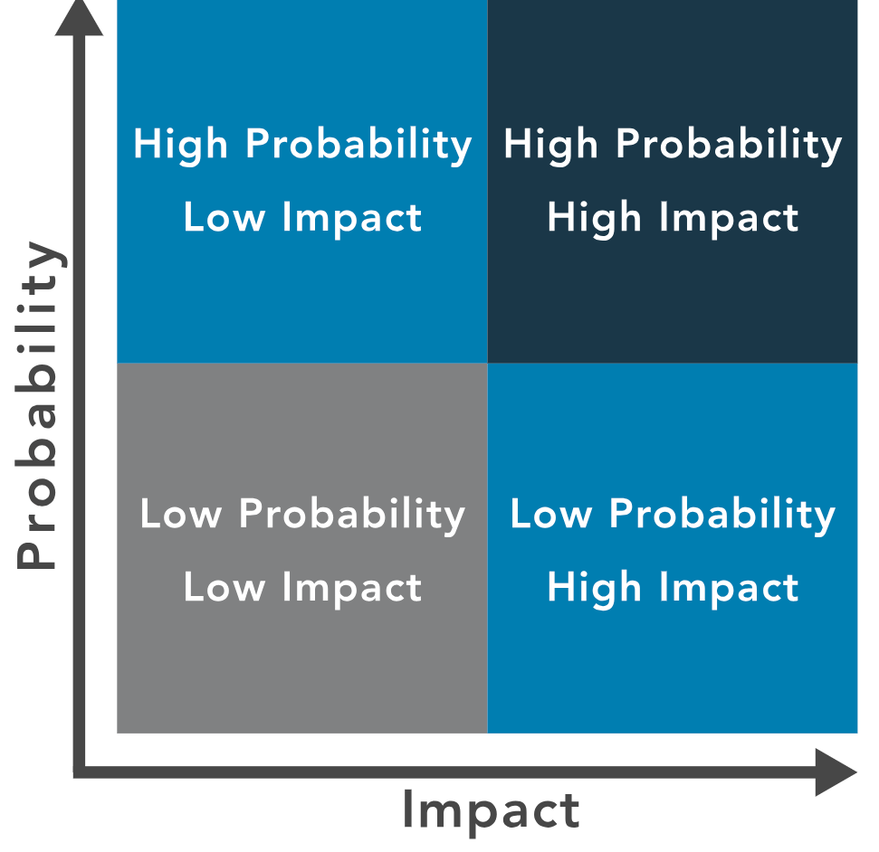
RISK
RISK
MANAGEMENT
PRIORITIES
PROCESS
:
• Qualitative risk analysis
• Quantitative risk analysis

Slide 16
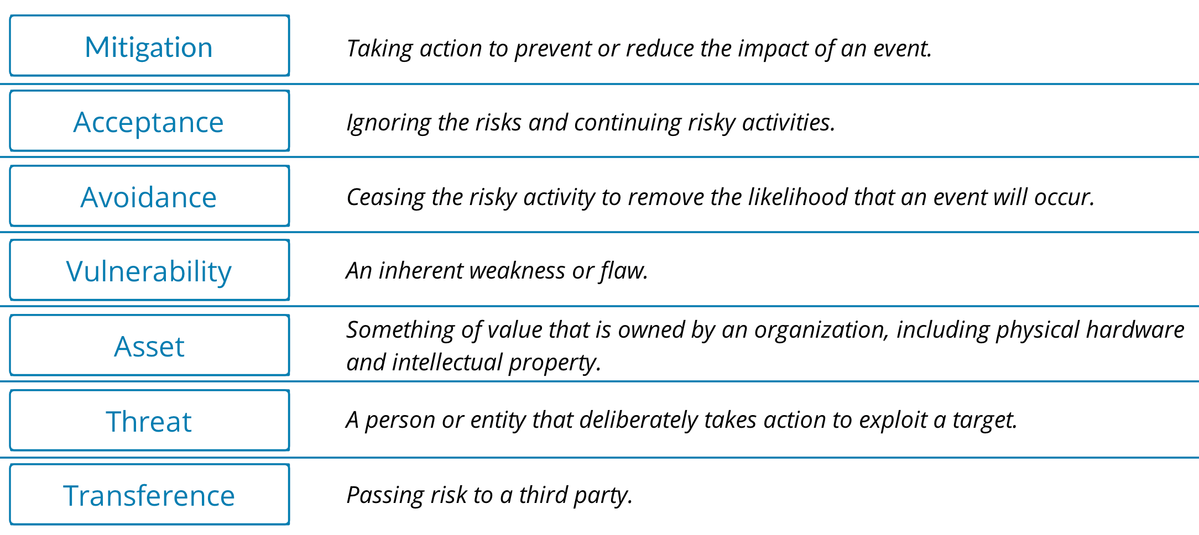
Risk Term Review

Slide 17
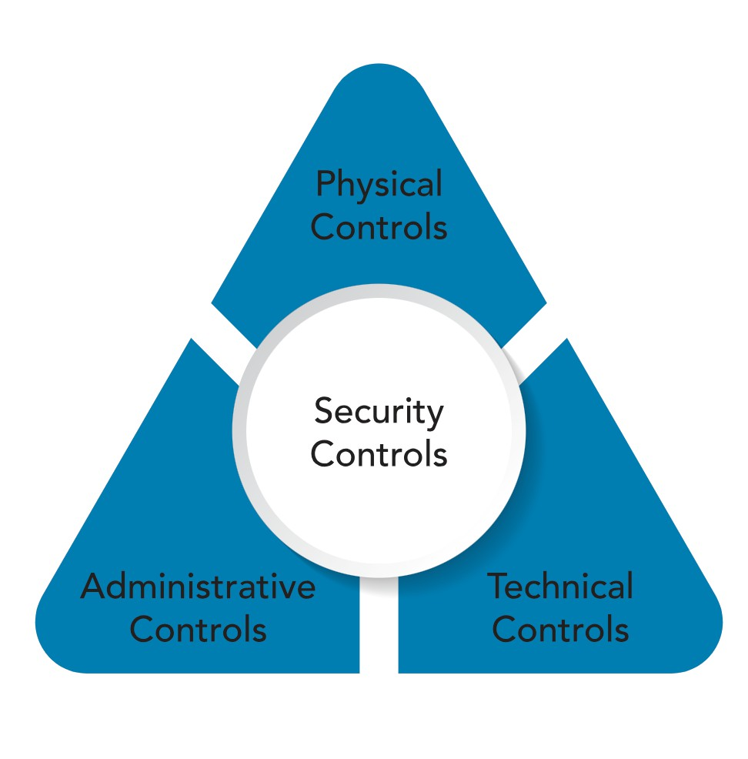
SECURITY CONTROL :
WHAT IS SECURITY CONTROL?
•
Security controls pertain to the
physical, technical and
administrative mechanisms that act as
safeguards or countermeasures
prescribed for an information system
to protect the confidentiality, integrity
and availability of the system and its information.
The implementation of controls should reduce risk, hopefully to an acceptable level.
•

Slide 18




SECURITY CONTROL : PHYSICAL CONTROL
Physical controls address process-based security needs using physical hardware devices, such as badge readers,
architectural features of buildings and facilities, and specific security actions to be taken by people.
Controlling, directing or preventing the movement of people and equipment throughout a specific physical
location
Protection and control over entry onto the land surrounding the buildings, parking lots or other areas that are
within the organization’s control
Physical controls are supported by technical controls as a means of incorporating them into an overall security
system.

Slide 19



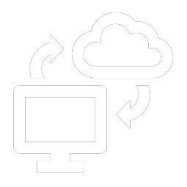
SECURITY CONTROL
:
TECHNICAL CONTROL
Security controls that
Provide automated
protection from
unauthorized access misuse.
computer systems
networks directly implement.
and
or
Support security
requirements for
applications and data.
Facilitate detection
security violations
of

Slide 20
Directives, guidelines or advisories
aimed at the people within the
organization
SECURITY
CONTROL :
ADMINISTRATIVE
CONTROL
Provide frameworks, constraints
standards for human behavior
and
Cover the entire scope of the
organization’s activities and its
interactions
• External parties
• Stakeholders

Slide 21

GOVERNANCE ELEMENTS
o REGULATIONS
§ commonly issued in the form of laws, usually from government (not to be confused with governance) and typically carry financial penalties for noncompliance.
o STANDARD
§ provide a framework to introduce policies and procedures in
support of
o POLICIES
regulations.
§ guidance in all activities to ensure that the organization
supports industry standards
o PROCEDURES
and
regulations.
§ detailed steps to complete a task that support departmental
or organizational policies.

Slide 22
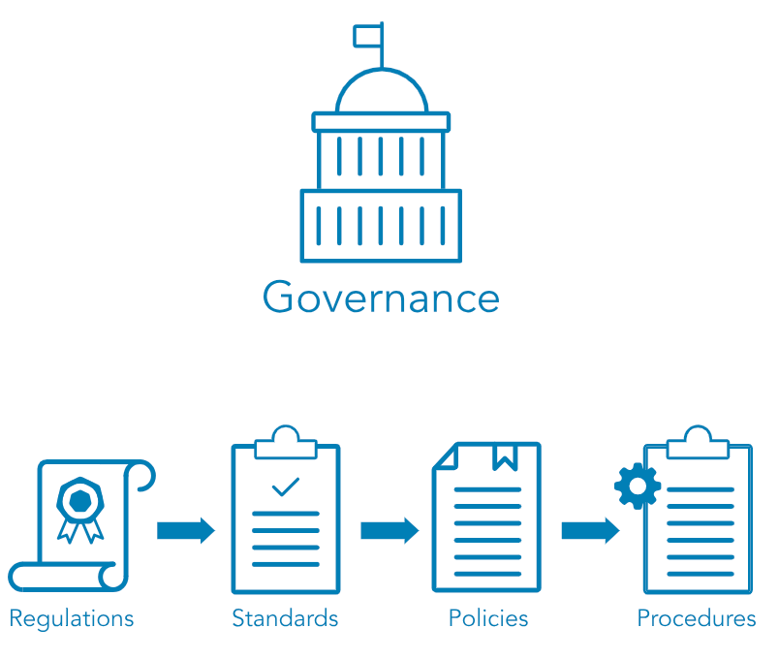
GOVERNANCE
PROCESS

Slide 23




STANDARDS
The International Organization for Standardization (ISO) develops and publishes international standards on a variety of technical
subjects, including information systems and information security, as well as encryption standards. ISO solicits input from the
international community of experts to provide input on its standards prior to publishing.
The National Institute of Standards and Technology (NIST) is a United States government agency under the Department of
Commerce and publishes a variety of technical standards in addition to information technology and information security
standards. Many of the standards issued by NIST are requirements for U.S. government agencies and are considered
recommended standards by industries worldwide.
From Internet Engineering Task Force (IETF), there are standards in communication protocols that ensure all computers can
connect with each other across borders, even when the operators do not speak the same language.
The Institute of Electrical and Electronics Engineers (IEEE) also sets standards for telecommunications, computer engineering and
similar disciplines.

