Slide 1
The Battle of Neighborhoods
Žiga Kljun

Slide 2

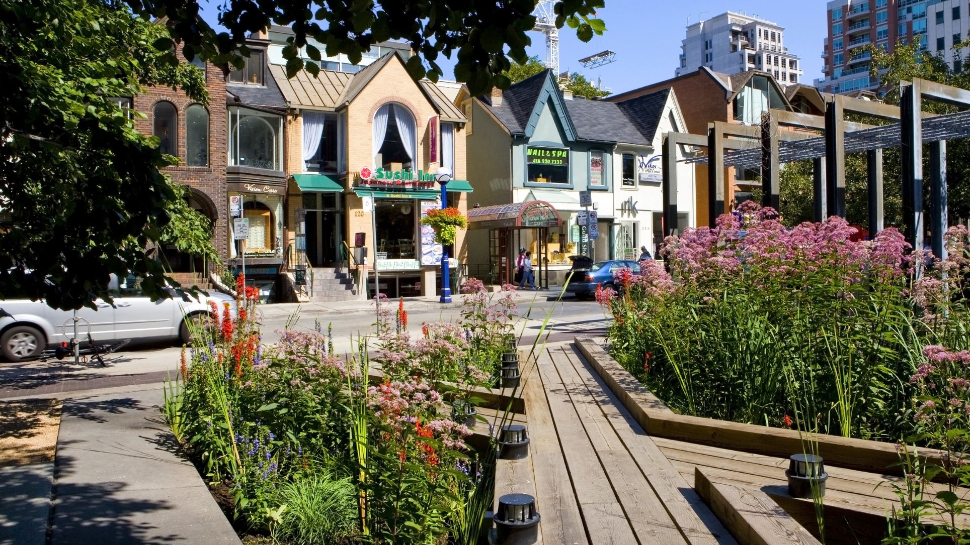


Problem
I am moving to Toronto from Yorkville (MH, NY)
Business problem is to find the area in Toronto, which is the most similar to Yorkville in terms of venues distribution and also a lot of gyms is a must, since I like to workout a lot and prefer a lot of options

Slide 3
Data
List of venues of Yorkville - Manhattan,
NYList of Boroughs and neighborhoods of Toronto with their geodata (latitud and longitud)
List of venues of Toronto neighbourhoods

Slide 4
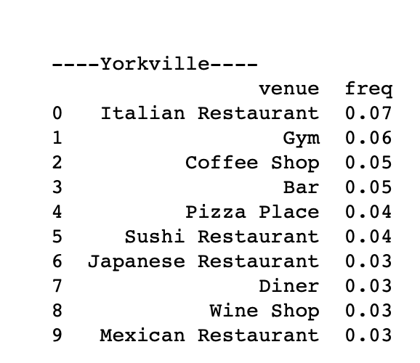
Methodology
Calculate the most common venues in Yorkville
Find out which boroughs and neighbourhoods are in Toronto
For each neighbourhood find out which are the most common venues
Compare venues distribution from all Toronto neighhbourhoods with venues distribution in Yorkville

Slide 5
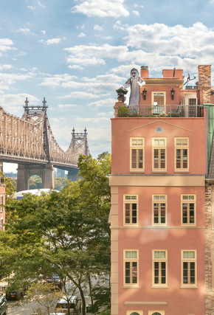
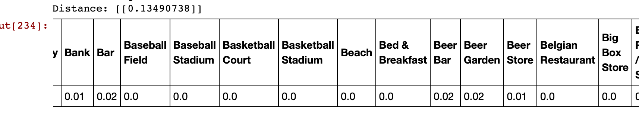
Results
Best match: Sutton Plac
Euclid distance is 0.1

Slide 6
Discusion
straigth-forward process luckly
data was well prepared from the begining but we still had to do some manual exploration and transformations
would recommend this solution for anyone, who wants to see, which neighborhood is the most similar to one - for traveling, living or other purposes

Slide 7

Conclusion
happy with the results
achieve goals I set at the beginning
able to make decision where to move

