Slide 1

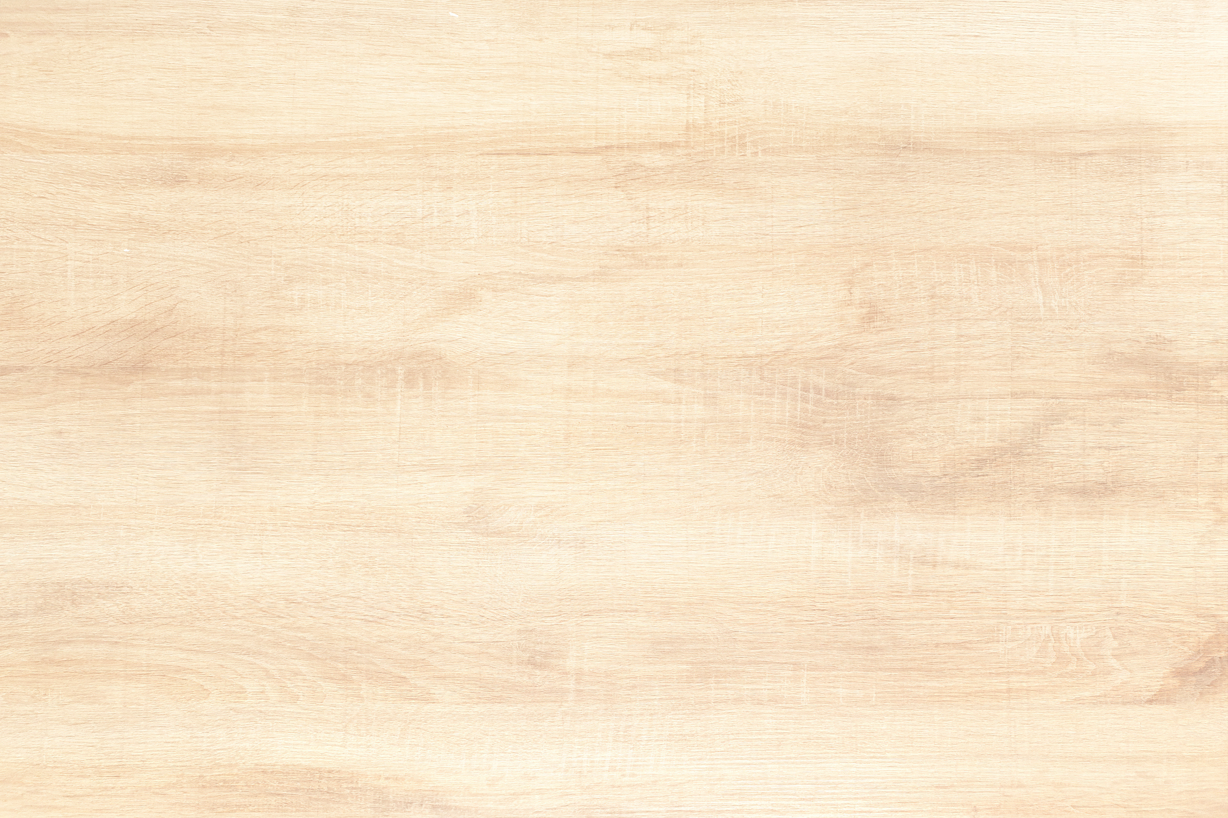





colors

Slide 2



warm-up
What is your favourite color?
What color is the sky?
What color are bananas?
What color is grass?
What color is the sun?

Slide 3






name colors
red
orange
yellow
blue
green
purple

Slide 4
red

Slide 5

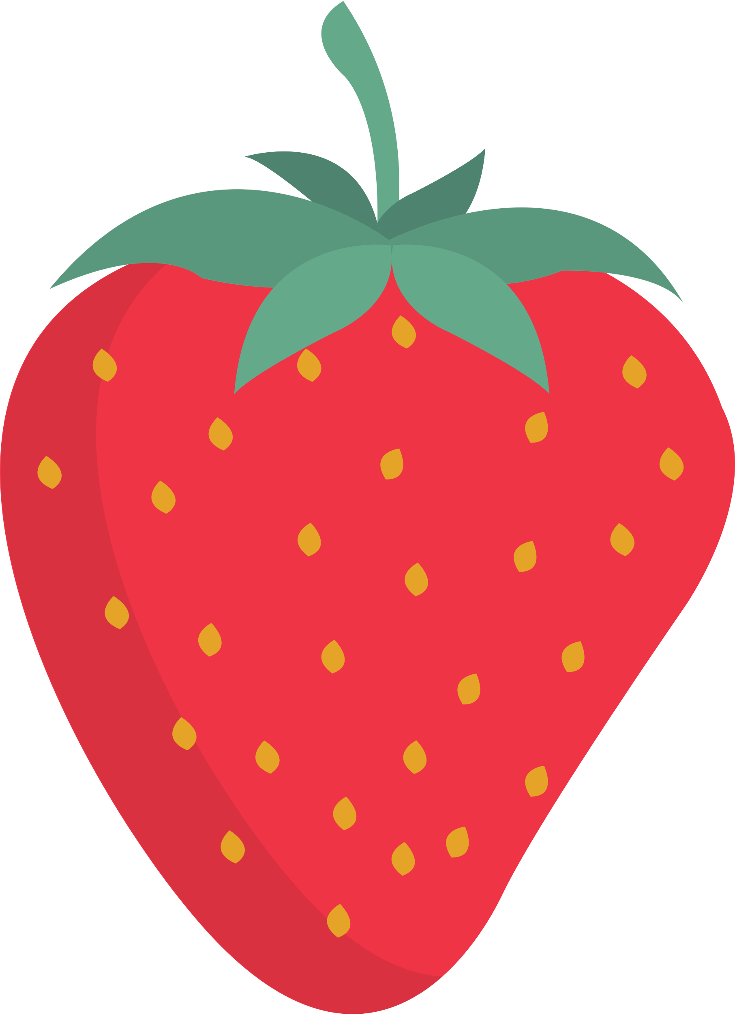

let's name objects that are color red
apple
strawberry
chili

Slide 6
orange

Slide 7
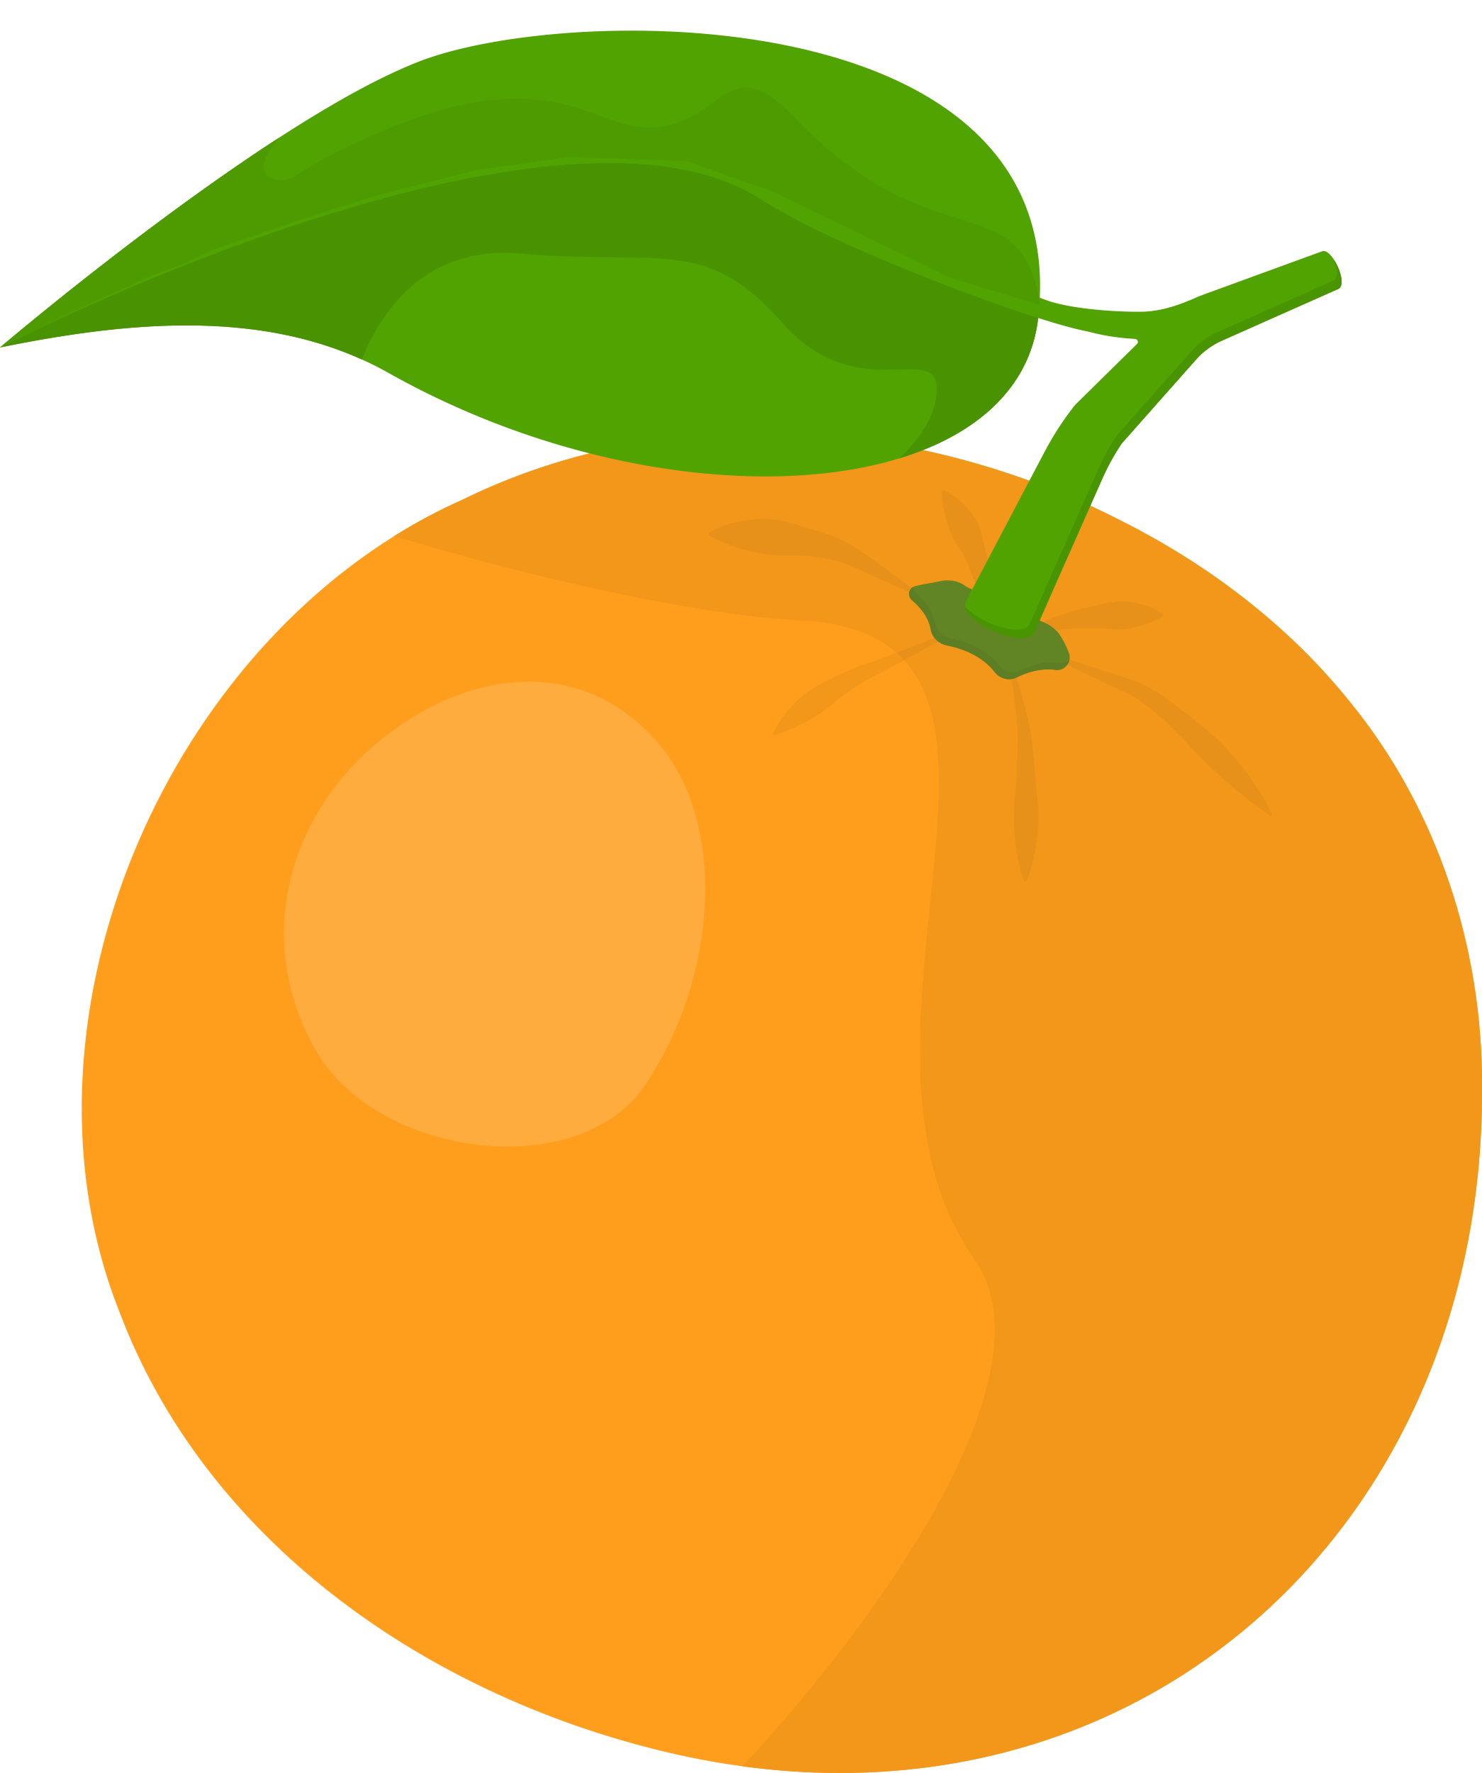


let's name objects that are color orange
orange
carrot
pumpkin

Slide 8
yellow

Slide 9



let's name objects that are color yellow
lemon
sun
sunflower

Slide 10
green

Slide 11
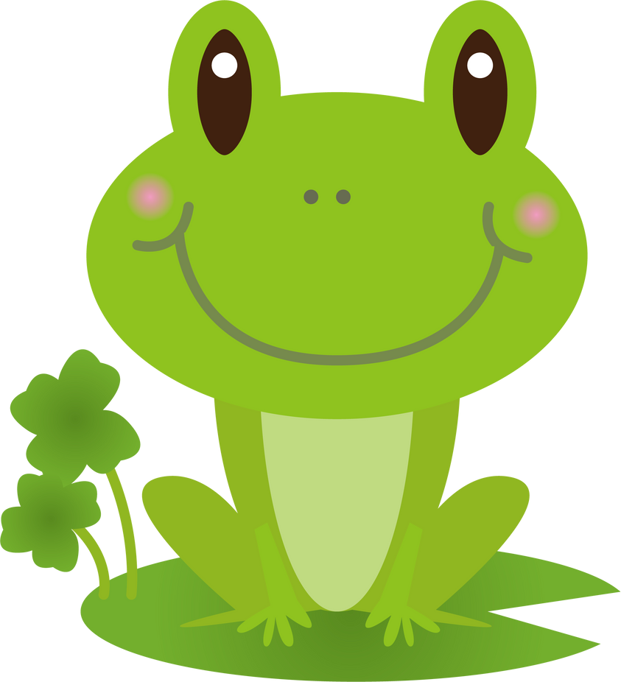

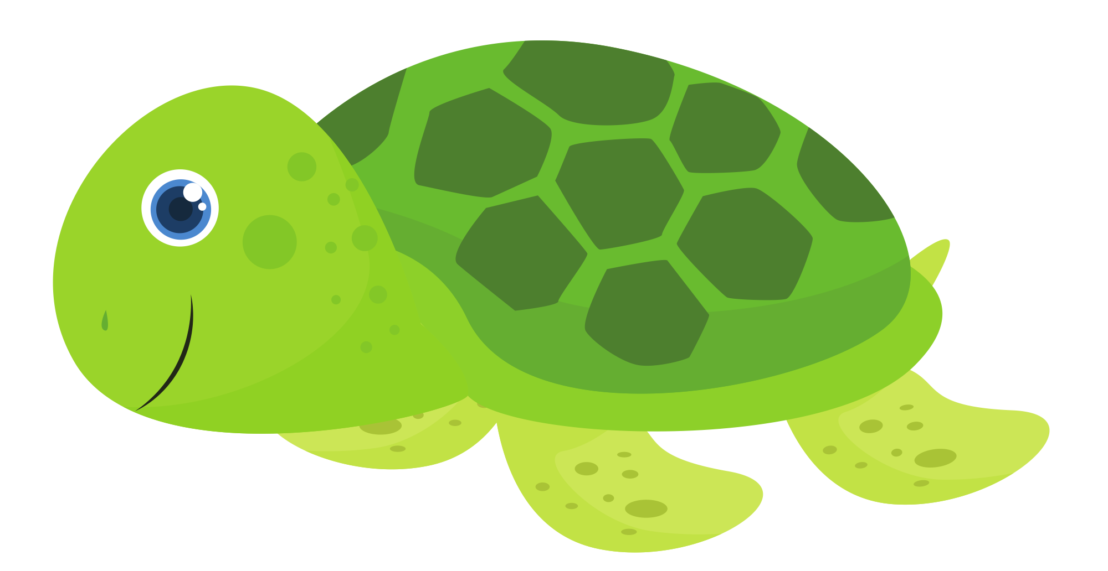
let's name objects that are color green
leaves
turtle
frog

Slide 12
blue

Slide 13


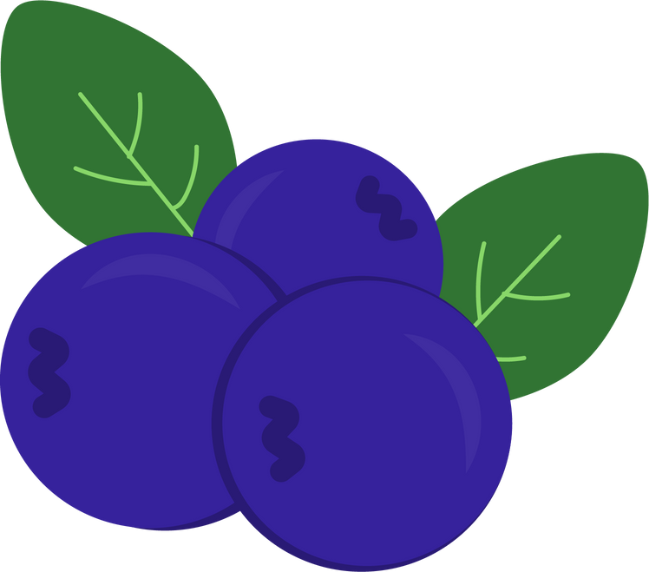
let's name objects that are color blue
whale
blueberry
pants

Slide 14
purple

Slide 15


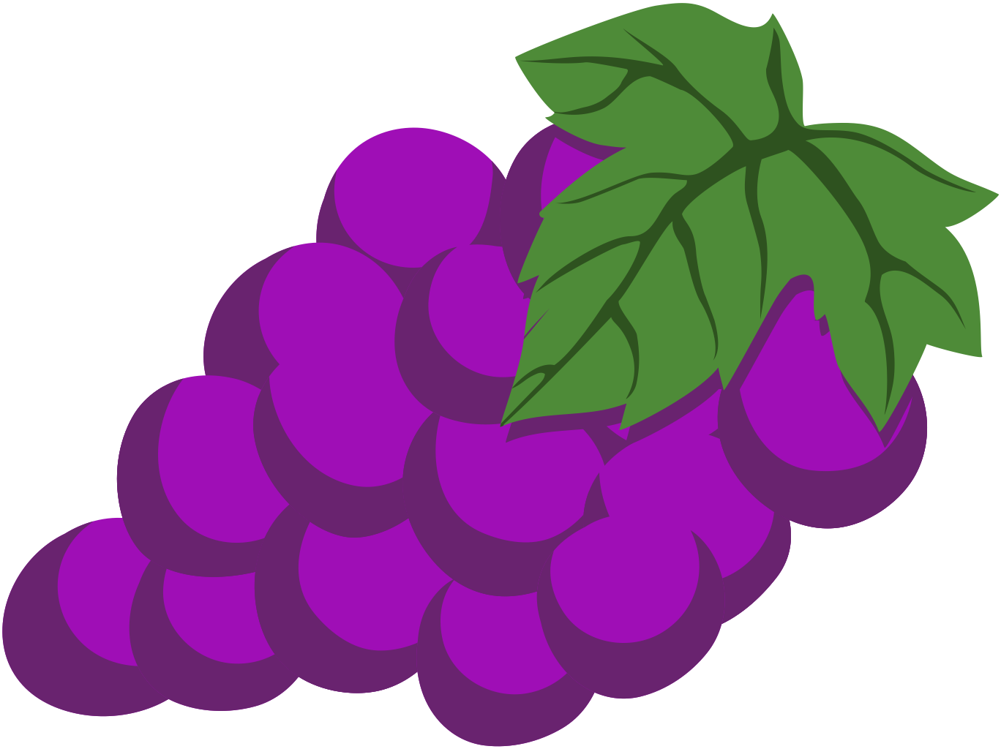
let's name objects that are color purple
eggplant
grapes
flower

Slide 16
What's missing?

Slide 17
What's missing?

Slide 18
What's missing?

Slide 19


What colour is it?

Slide 20
What colour is it?

