Slide 1



count == 0
…
v30
v29
v2
v1
v0
voltage[9:0]
+
$$a_{2}$$
x
.
.
.
+
+
$$a_{1}$$
x
intermediateFiltered
+
$$a_{0}$$
x

Slide 2
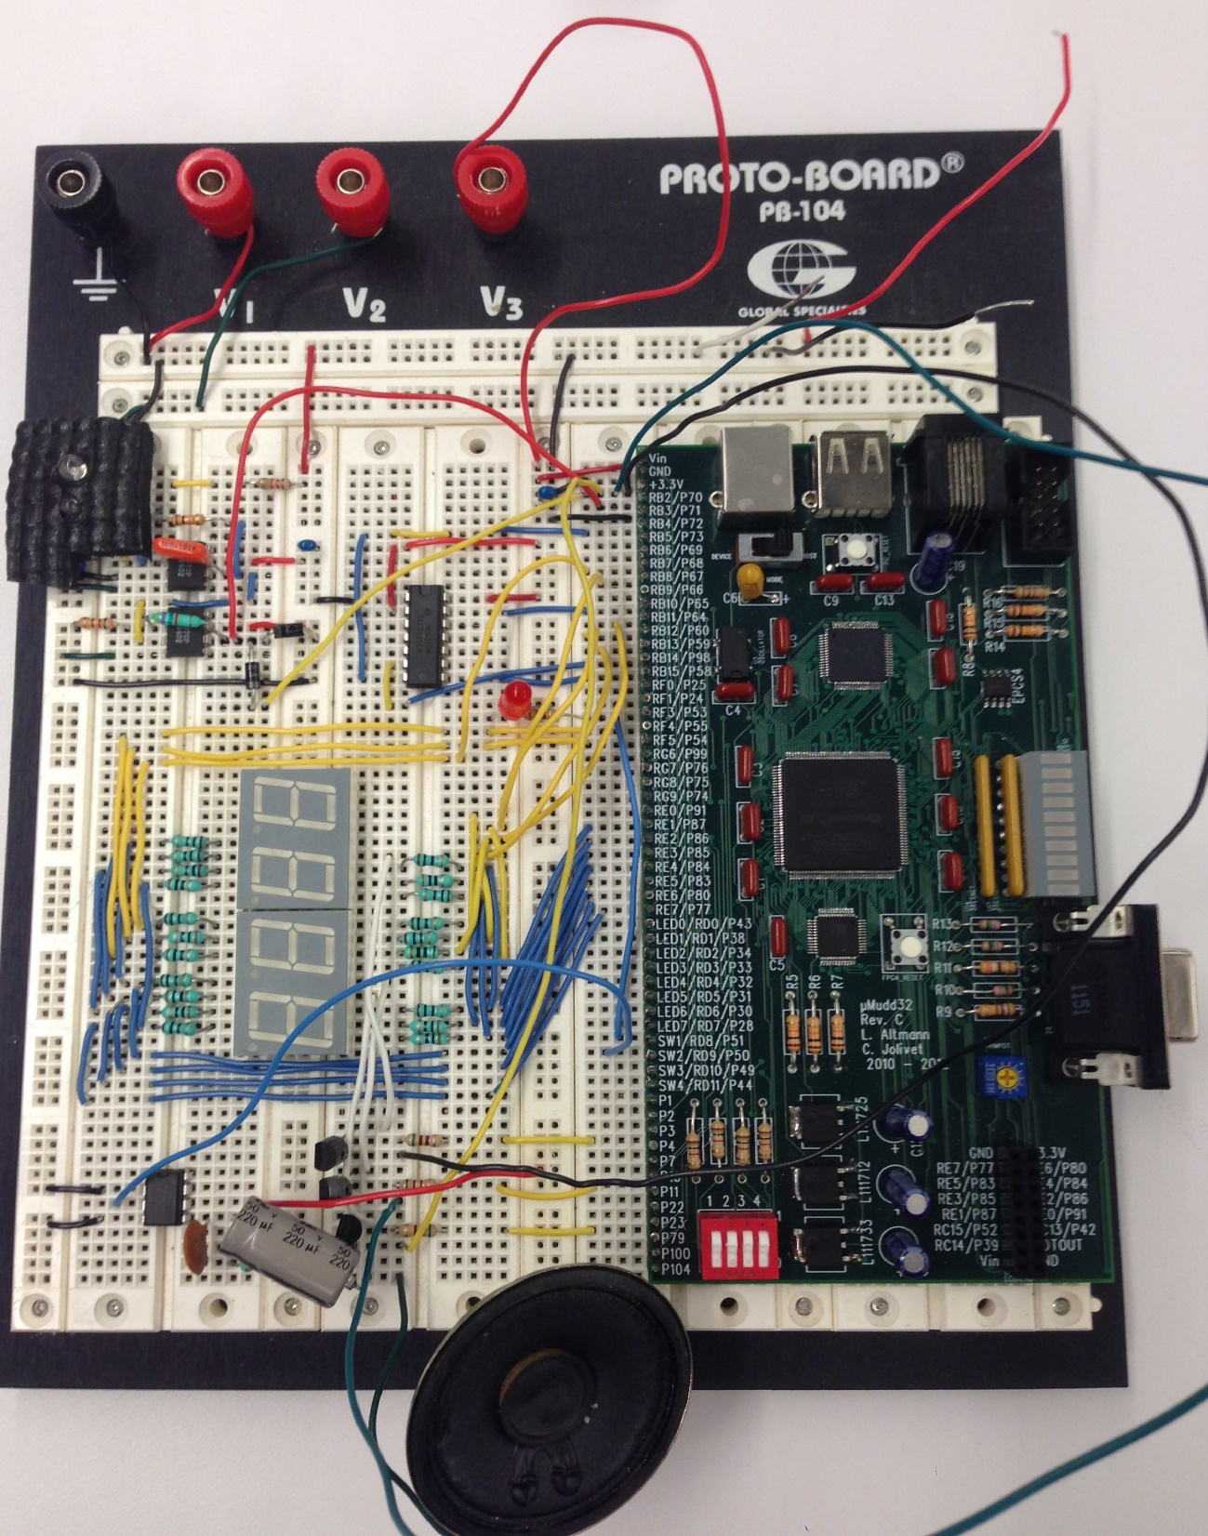
DAC
IR LED
photodiode
amplifier
circuit
digit3
digit2
digit1
speaker

