Slide 1
Outline
Data, Big Data and Challenges
Data Science
Introduction
Why Data Science
Data Scientists
What do they do?

Slide 2




Data All Around
Lots of data is being collected and warehoused
Web data, e-commerce
Financial transactions, bank/credit transactions
Online trading and purchasing
Social Network

Slide 3
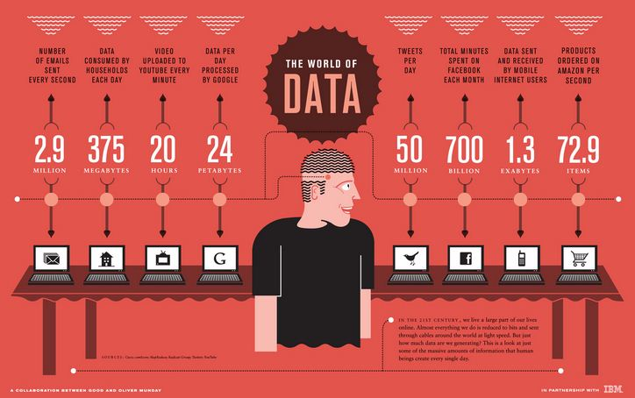
How Much Data Do We have?
Google processes 20 PB a day (2008)
Facebook has 60 TB of daily logs
eBay has 6.5 PB of user data + 50 TB/day (5/2009)
1000 genomes project: 200 TB
Cost of 1 TB of disk: $35
Time to read 1 TB disk: 3 hrs
(100 MB/s)

Slide 4
Big Data
Big Data is any data that is expensive to manage and hard to extract value from
Volume
The size of the data
Velocity
The latency of data processing relative to the growing demand for interactivity
Variety and Complexity
the diversity of sources, formats, quality, structures.

Slide 5
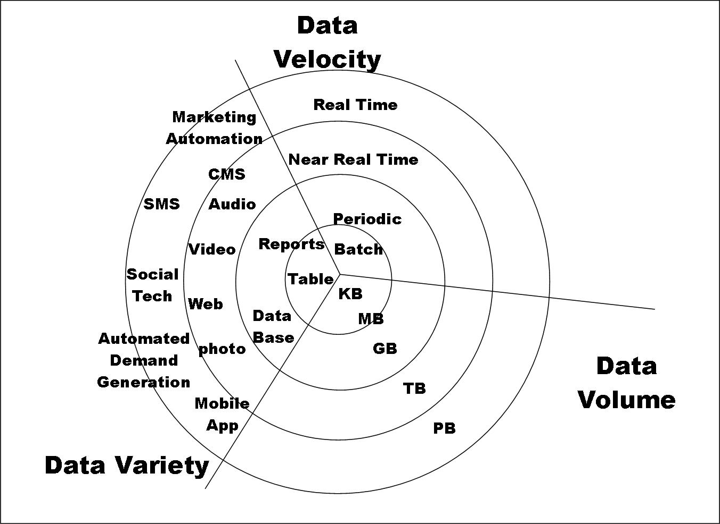
Big Data

Slide 6
Types of Data We Have
Relational Data (Tables/Transaction/Legacy Data)
Text Data (Web)
Semi-structured Data (XML)
Graph Data
Social Network, Semantic Web (RDF), …
Streaming Data
You can afford to scan the data once

Slide 7
What To Do With These Data?
Aggregation and Statistics
Data warehousing and OLAP
Indexing, Searching, and Querying
Keyword based search
Pattern matching (XML/RDF)
Knowledge discovery
Data Mining
Statistical Modeling

Slide 8
What is Data Science?
An area that manages, manipulates, extracts, and interprets knowledge from tremendous amount of data
Data science (DS) is a multidisciplinary field of study with goal to address the challenges in big data
Data science principles apply to all data – big and small

Slide 9
What is Data Science?
Theories and techniques from many fields and disciplines are used to investigate and analyze a large amount of data to help decision makers in many industries such as science, engineering, economics, politics, finance, and education
Computer Science
Pattern recognition, visualization, data warehousing, High performance computing, Databases, AI
Mathematics
Mathematical Modeling
Statistics
Statistical and Stochastic modeling, Probability.

Slide 10
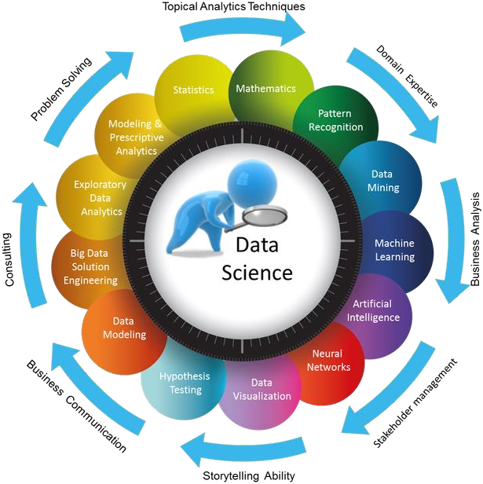
What is Data Science

Slide 11
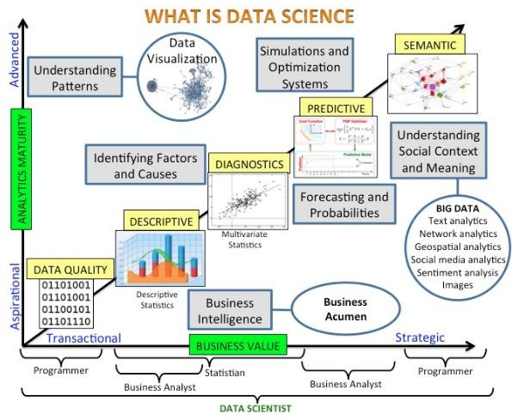

Slide 12

Data Scientists
Data Scientist
They find stories, extract knowledge. They are not reporters

Slide 13

Data Scientists
Data scientists are the key to realizing the opportunities presented by big data. They bring structure to it, find compelling patterns in it, and advise executives on the implications for products, processes, and decisions

Slide 14
What do Data Scientists do?
National Security
Cyber Security
Business Analytics
Engineering
Healthcare
And more ….

Slide 15
Concentration in Data Science
Mathematics and Applied Mathematics
Applied Statistics/Data Analysis
Solid Programming Skills (R, Python, Julia, SQL)
Data Mining
Data Base Storage and Management
Machine Learning and discovery

Slide 16
Introduction to R

Slide 17

Introduction to
R is data analysis software: data scientists, statisticians, analysts, quarts, and others who need to make sense of data use R for statistical analysis, data visualization, and predictive modeling.
R is a programming language: you do data analysis in R by writing scripts and functions in the R programming language.
R is a complete, interactive, object-oriented language: designed by
statisticians, for statisticians.

Slide 18
Introduction to
What is R Programming?
R is a programming language and software environment for statistical analysis, graphics representation and reporting.
R was created by Ross Ihaka and Robert Gentleman at the University of Auckland, New Zealand, and is currently developed by the R Development Core Team.
The core of R is an interpreted computer language which allows
branching and looping as well as modular programming using functions.
R allows integration with the procedures written in the C, C++, .Net, Python or FORTRAN languages for efficiency.

Slide 19
Introduction to
What is R Programming?
R is freely available under the GNU General Public License, and pre- compiled binary versions are provided for various operating systems like Linux, Windows and Mac.
R is free software distributed under a GNU-style copy left, and an official part of the GNU project called GNU S.

Slide 20
Introduction to
What is R Programming?
The language provides objects, operators and functions that make the process of exploring, modeling, and visualizing data a natural one.
Complete data analyses can often be represented in just a few lines of code.
R was created by RossIhaka and Robert Gentleman at the University of Auckland, New Zealand.

Slide 21
Introduction to
What is R Programming?
R is an environment for statistical analysis: Available in the R language are functions for virtually every data manipulation, statistical model, or chart that the data analyst could ever need.
Not only are all the “standard” methods available, but because most cutting-edge research in statistics and predictive modeling is done in R, the latest techniques are usually available first in the R system.

Slide 22
Introduction to
What is R Programming?
R is a programming language and a software environment for graphics representations, statistical analysis, and reporting. R is freely available under the GNU General Public License.

Slide 23






Provides statistical and
graphical techniques
Open source Programming language
Runs on wide variety of platform
Provides well designed
quality posts
R is available as free software
What is

Slide 24
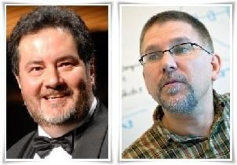
Introduction to
Ross Ihaka
Robert Gentleman

Slide 25
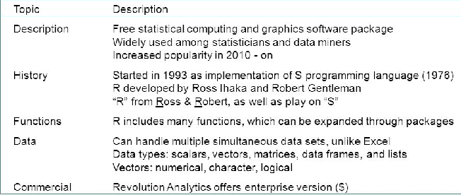
Introduction to

Slide 26
Installation of

Slide 27
Comprehensive R Archive Network (CRAN)
CRAN is a network of ftp and web servers around the world that store identical, up- to-date, versions of code and documentation for R.
Please use the CRAN mirror nearest to you to minimize network load.
https://cran.r-project.org ( Installation Link )
Download and Install R
Precompiled binary distributions of the base system and contributed packages, Windows and Mac users most likely want one of these versions of R:
Download R for Linux
Download R for (Mac) OS X
Download R for Windows
R is part of many Linux distributions, you should check with your
Linux package management system in addition to the link above.

Slide 28
R for Windows
Subdirectories:
base
Binaries for base distribution. This is what you want to install R for the
first time.
contrib
Binaries of contributed CRAN packages (for R >= 2.13.x; managed by Uwe Ligges). There is also information on third party software available for CRAN Windows services and corresponding environment and make variables.
old contrib
Binaries of contributed CRAN packages for outdated versions of R (for R
< 2.13.x; managed by Uwe Ligges).
Rtools
Tools to build R and R packages. This is what you want to build your own packages on Windows, or to build R itself.
28

Slide 29
R for Windows
Subdirectories:
base ( Recommended Option )
Binaries for base distribution. This is what you want to install R for the
first time.
contrib
Binaries of contributed CRAN packages (for R >= 2.13.x; managed by Uwe Ligges). There is also information on third party software available for CRAN Windows services and corresponding environment and make variables.
old contrib
Binaries of contributed CRAN packages for outdated versions of R (for R
< 2.13.x; managed by Uwe Ligges).
Rtools
Tools to build R and R packages. This is what you want to build your own packages on Windows, or to build R itself.
29

Slide 30
R for Windows
R-3.4.4 for Windows (32/64 bit)
Download R 3.4.4 for Windows (62 megabytes, 32/64 bit) Installation and other instructions
New features in this version
If you want to double-check that the package you have downloaded matches the package distributed by CRAN, you can compare the md5sum of the .exe to the fingerprint on the master server.
You will need a version of md5sum for windows: both graphical and command line versions are available.

Slide 31
Benefits of
Data Scientists, analysts, statisticians, quants and all other make use of
R for statistical analysis, predictive modeling and data visualisation.
In the R language, some of the main functions available are for data manipulation, charts which the data analyst could need and statistical model. The R is also famous as in this most cutting edge research can be done in statistics and predictive modeling.
R is also an open source software project, this not only means that you can download and use the R language for free but its source code is also open for the modification and inspection to anyone whoever want to see the algorithms and methods.

Slide 32
Installation of RStudio
Having installed R, the next thing we will want to do is install RStudio, a
popular and useful interface for writing scripts and using R.
If you google “RStudio” you will get to this window:
https://www.rstudio.com/products/rstudio/download/
RStudio is a set of integrated tools designed to help you be more productive with R. It includes a console, syntax highlighting editor that supports direct code execution, and a variety of robust tools for plotting, viewing history, debugging and managing your workspace.
https://www.rstudio.com/products/rstudio/download/#download

Slide 33
Installation of RStudio
RStudio Desktop 1.1.442
RStudio requires R 3.0.1+. If you don't already have R, download it here.
Installers for Supported Platforms
RStudio 1.1.442 - Windows Vista/7/8/10 85.8 MB 2018-03-12
RStudio 1.1.442 - Mac OS X 10.6+ (64-bit) 74.5 MB 2018-03-12
RStudio 1.1.442 - Ubuntu 12.04-15.10/Debian 8 (32-bit) 89.3 MB 2018-03-12
RStudio 1.1.442 - Ubuntu 12.04-15.10/Debian 8 (64-bit) 97.4 MB 2018-03-12

Slide 34
Benefits of
As like other open source, systems R also has open interfaces, which means that it readily integrates with all the other systems and applications.
So R is unique as it provides a developer power to do 3 things data manipulation, data analysis, and data visualization in a single tool.
R is world’s most widely used programming language. It is the first choice of most of the data scientists and is also supported by a talented and vibrant community of the contributors.
26

Slide 35



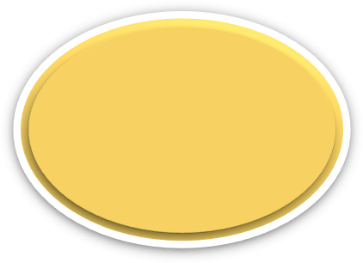
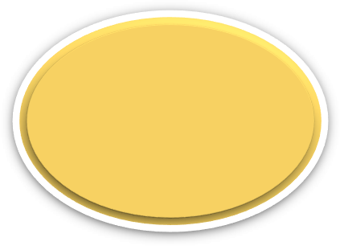








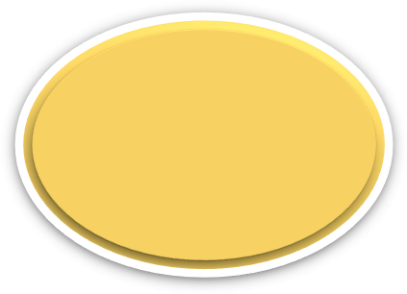



Benefits of
R IS OPEN SOURCE
WANT THE COOLEST JOB
CROSS- PLATFORM COMPATIBLE
LEARNING R IS FUN AND EASY
COMPLETE STATISTICAL LANGUAGE
R HAS A VAST COMMUNITY
2000+ FREE LIBRARIES
OUTSTANDING GRAPHICAL OUTPUTS
27

Slide 36
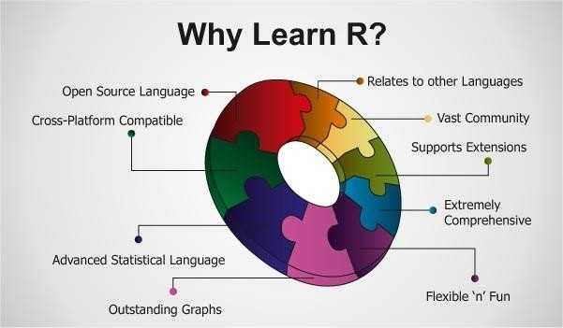
Importance of Learning

Slide 37
Companies Using
Thousands of companies are using R for data science applications. According to the data,
Google uses R to calculate the ROI on advertising campaigns.
Ford uses R to improve the design of its vehicles.
Twitter uses R to monitor user experience.
US National Weather Service uses R to predict severe flooding.
Rockefeller Institute of Government uses R to develop models for simulating the finances of public pension funds.
Human Rights Data Analysis Group uses R to quantify the impact of war.
R is used frequently by The New York Times to create infographics and
interactive data journalism applications.

