Slide 1
ALGORITHMS AND FLOWCHARTS
Lecture 1: Problem Analysis
By: Ashutosh Mishra

Slide 2
ALGORITHMS AND FLOWCHARTS
A typical programming task can be divided into two phases:
Problem solving phase
produce an ordered sequence of steps that describe solution of problem
this sequence of steps is called an algorithm
Implementation phase
implement the program in some programming language

Slide 3
Steps in Problem Solving
First produce a general algorithm (one can use pseudocode)
Refine the algorithm successively to get step by step detailed algorithm that is very close to a computer language.
Pseudocode is an artificial and informal language that helps programmers develop algorithms. Pseudocode is very similar to everyday English.

Slide 4
Pseudocode & Algorithm
Example 1: Write an algorithm to determine a student’s final grade and indicate whether it is passing or failing. The final grade is calculated as the average of four marks.

Slide 5
Pseudocode & Algorithm
Pseudocode:
Input a set of 4 marks
Calculate their average by summing and dividing by 4
if average is below 50
Print “FAIL”
else
Print “PASS”

Slide 6
Pseudocode & Algorithm
Detailed Algorithm
Step 1: Input M1,M2,M3,M4
Step 2: GRADE ← (M1+M2+M3+M4)/4
Step 3: if (GRADE < 50) then
Print “FAIL”
else
Print “PASS”
endif

Slide 7
The Flowchart
(Dictionary) A schematic representation of a sequence of operations, as in a manufacturing process or computer program.
(Technical) A graphical representation of the sequence of operations in an information system or program.
Information system flowcharts show how data flows from source documents through the computer to final distribution to users.
Program flowcharts show the sequence of instructions in a single program or subroutine. Different symbols are used to draw each type of flowchart.

Slide 8
The Flowchart
A Flowchart
shows logic of an algorithm
emphasizes individual steps and their interconnections
e.g. control flow from one action to the next

Slide 9
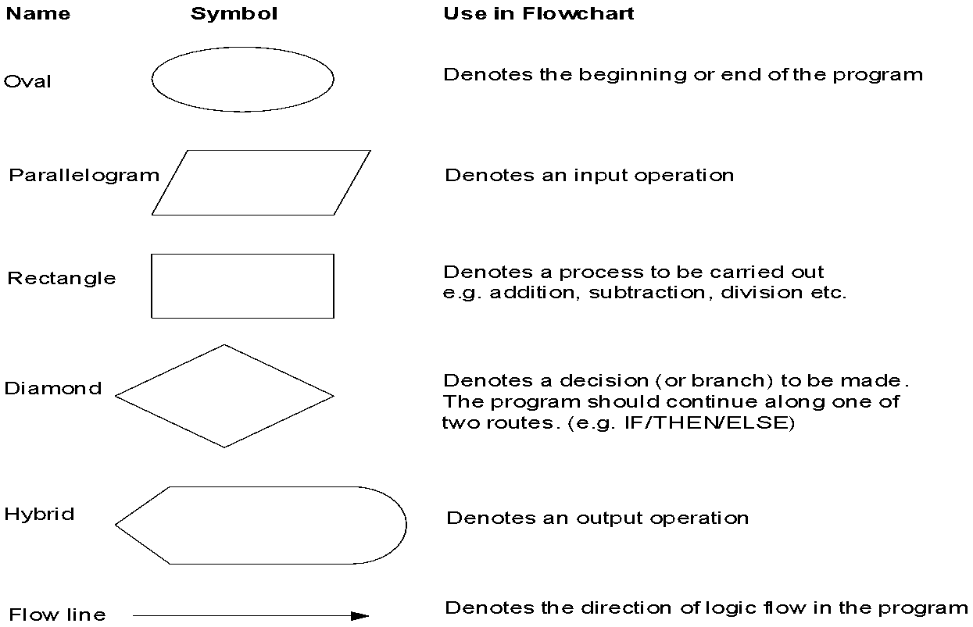
Flowchart Symbols
Basic

Slide 10
Example
START
Step 1: Input M1,M2,M3,M4
Step 2: GRADE ← (M1+M2+M3+M4)/4
Step 3: if (GRADE <50) then
Print “FAIL”
else
Print “PASS”
endif
Input
M1,M2,M3,M4
GRADE←(M1+M2+M3+M4)/4
IS
GRADE<50
N
Y
PRINT
“PASS”
PRINT
“FAIL”
STOP

Slide 11
Example 2
Write an algorithm and draw a flowchart to convert the length in feet to centimeter.
Pseudocode:
Input the length in feet (Lft)
Calculate the length in cm (Lcm) by multiplying LFT with 30
Print length in cm (LCM)

Slide 12
Example 2
Flowchart
Algorithm
Step 1: Input Lft
Step 2: Lcm ← Lft x 30
Step 3: Print Lcm
START
Input
Lft
Lcm ← Lft x 30
Print
Lcm
STOP

Slide 13
Example 3
Write an algorithm and draw a flowchart that will read the two sides of a rectangle and calculate its area.
Pseudocode
Input the width (W) and Length (L) of a rectangle
Calculate the area (A) by multiplying L with W
Print A

Slide 14
Example 3
Algorithm
Step 1: Input W,L
Step 2: A ← L x W
Step 3: Print A
START
Input
W, L
A ← L x W
Print
A
STOP

Slide 15
Flowcharts
Flowcharts is a graph used to depict or show a step by step solution using symbols which represent a task.
The symbols used consist of geometrical shapes that are connected by flow lines.
It is an alternative to pseudocoding; whereas a pseudocode description is verbal, a flowchart is graphical in nature.
Principles of Programming - NI July 2005
15

Slide 16
Flowchart Symbols
Terminal symbol - indicates the beginning and
end points of an algorithm.
Process symbol - shows an instruction other than
input, output or selection.
Input-output symbol - shows an input or an output
operation.
Disk storage I/O symbol - indicates input from or output to disk storage.
Printer output symbol - shows hardcopy printer
output.
Principles of Programming - NI July 2005
16

Slide 17
Flowchart Symbols cont…
Selection symbol - shows a selection process
for two-way selection.
Off-page connector - provides continuation of a logical path on another page.
On-page connector - provides continuation
of logical path at another point in the same
page.
Flow lines - indicate the logical sequence of
execution steps in the algorithm.
Principles of Programming - NI July 2005
17

Slide 18
Flowchart – sequence control structure
Statement 1
Statement 2
Statement 3
:
Principles of Programming - NI July 2005
18

Slide 19
Flowchart – selection control structure
No
Yes
Condition
else-
statement(s)
then-
statement(s)
Principles of Programming - NI July 2005
19

Slide 20
Flowchart – repetition control structure
yes
Loop
Statement(s)
Condition
no
Principles of Programming - NI July 2005
20

Slide 21
Flowchart – example 1
Begin
Read birth date
Calculate
Age = current year – birth date
Display
age
End
Principles of Programming - NI July 2005
21

Slide 22
Flowchart – example 2
Begin
Read age
YES
Age > 55?
NO
print “Pencen”
print “Kerja lagi”
End
Principles of Programming - NI July 2005
22

Slide 23
Flowchart – example 5
Begin
sum = 0
current_number = 1
NO
current_number <= 10?
print sum
YES
sum = sum + current_number
current_number = current_number + 1
End
Principles of Programming - NI July 2005
23

Slide 24
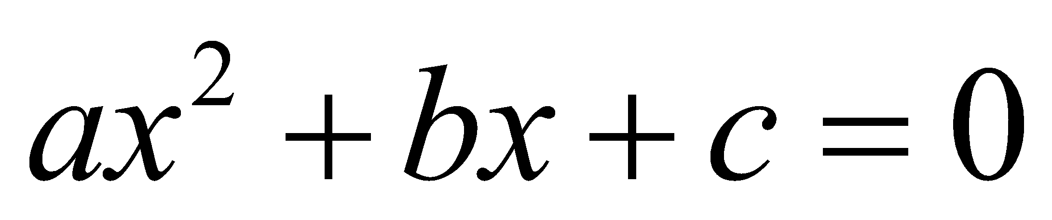
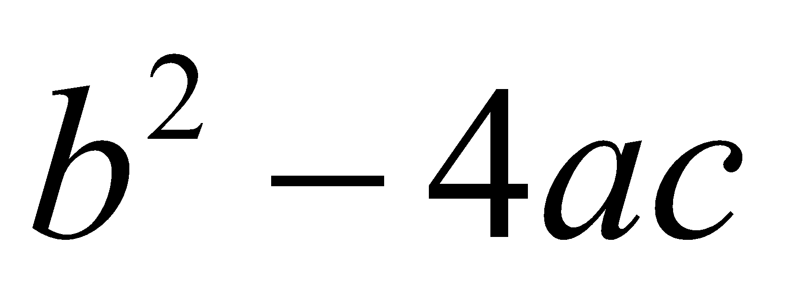
Example 4
Write an algorithm and draw a flowchart that will calculate the roots of a quadratic equation
Hint: d = sqrt ( ), and the roots are: x1 = (–b + d)/2a and x2 = (–b – d)/2a

Slide 25
Exercises: Algorithm & Flowchart
1.) Create an algorithm and a flowchart that will accept/read two numbers and then display the bigger number.

Slide 26
Exercises: Algorithm & Flowchart
2.) Create an algorithm and a flowchart that will compute the area of a circle.

Slide 27
Exercises: Algorithm & Flowchart
3.) Create an algorithm and a flowchart that will compute the sum of two numbers. If the sum is below or equal to twenty, two numbers will be entered again. If the sum is above 20, it will display the sum.

Slide 28
Lab Activity: Algorithm & Flowchart
4) Create an algorithm and a flowchart that will output the largest number among the three numbers.

Slide 29
Assignment 1
Create an algorithm and a flowchart that will output for g.c.d.
Create an algorithm and a flowchart that will output the factorial of a given number.
Create an algorithm and a flowchart that will output the Fibonacci series up to a given number.
Create an algorithm and a flowchart that will output all the prime numbers between 2 numbers.

