Slide 1
Chapter 2
Introduction to the C Language
Objectives
❏ To understand the structure of a C-language program.
❏ To write your first C program.
❏ To introduce the include preprocessor command.
❏ To be able to create good identifiers for objects in a program.
❏ To be able to list, describe, and use the C basic data types.
❏ To be able to create and use variables and constants.
❏ To understand input and output concepts.
❏ To be able to use simple input and output statements.
Computer Science: A Structured Programming Approach Using C
1
Notes:
1

Slide 2
2-1 Background
C is a structured programming language. It is considered a high-level language because it allows the programmer to concentrate on the problem at hand and not worry about the machine that the program will be using. That is another reason why it is used by software developers whose applications have to run on many different hardware platforms.
Computer Science: A Structured Programming Approach Using C
2
Notes:
Developed early 1970’s
2

Slide 3
2-2 C Programs
It's time to write your first C program.
Topics discussed in this section:
Structure of a C Program
Your First C Program
Comments
The Greeting Program
Computer Science: A Structured Programming Approach Using C
3
Notes:
3

Slide 4
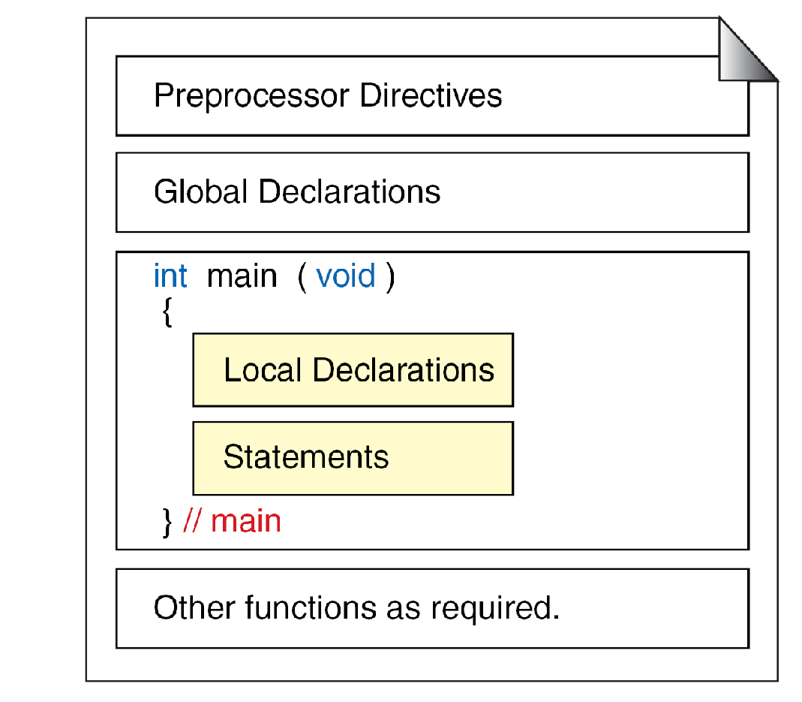
FIGURE 2-2 Structure of a C Program
Computer Science: A Structured Programming Approach Using C
4
Notes:
4

Slide 5
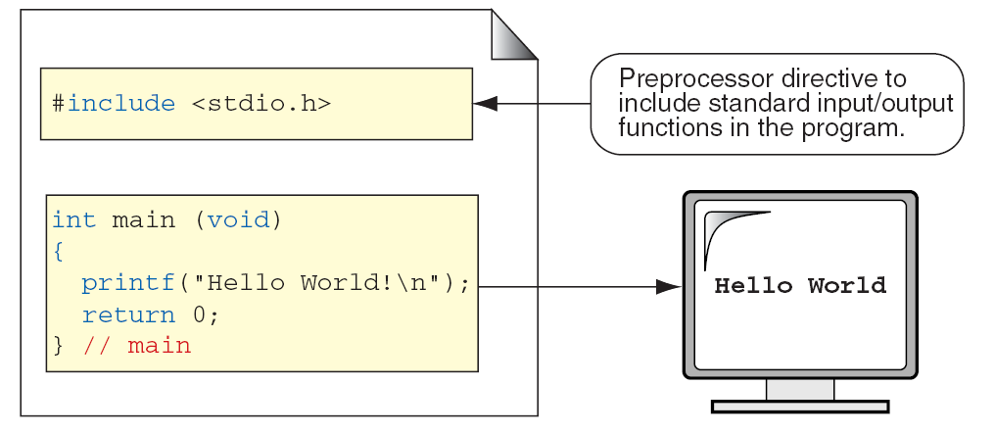
FIGURE 2-3 The Greeting Program
Computer Science: A Structured Programming Approach Using C
5
Notes:
5

Slide 6
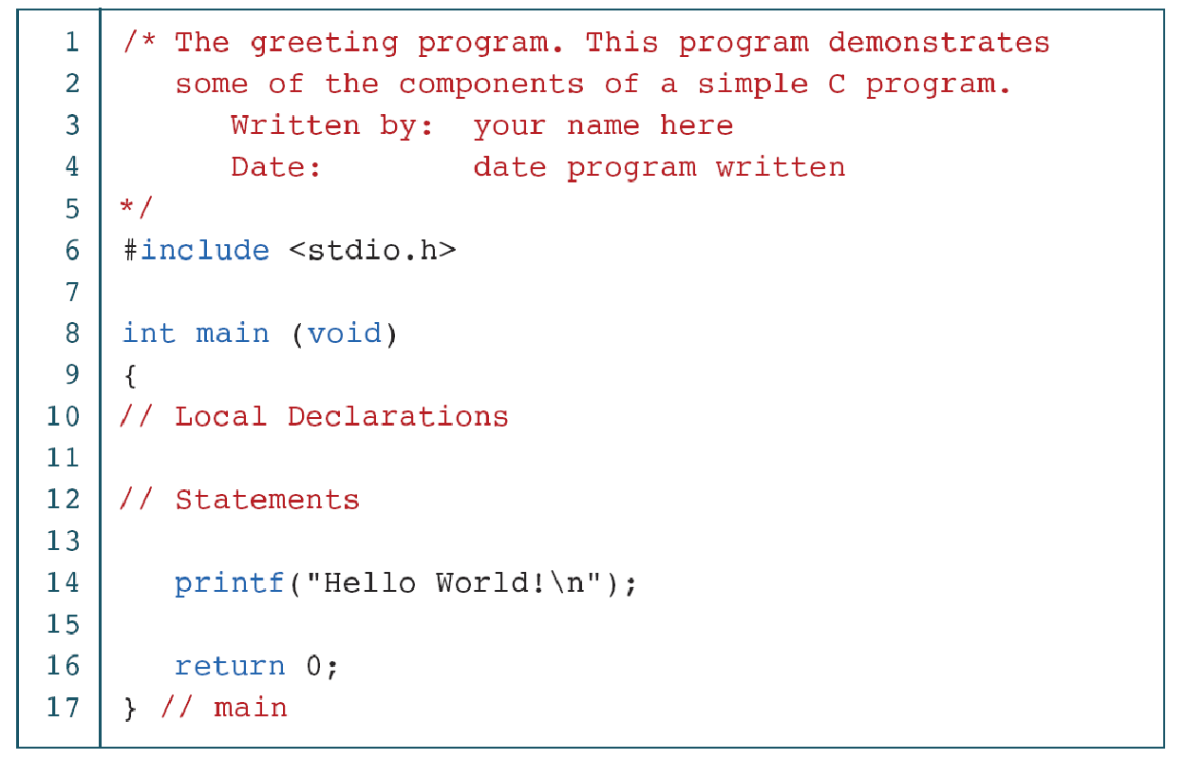
PROGRAM 2-1
The Greeting Program
Computer Science: A Structured Programming Approach Using C
6
Notes:
6

Slide 7
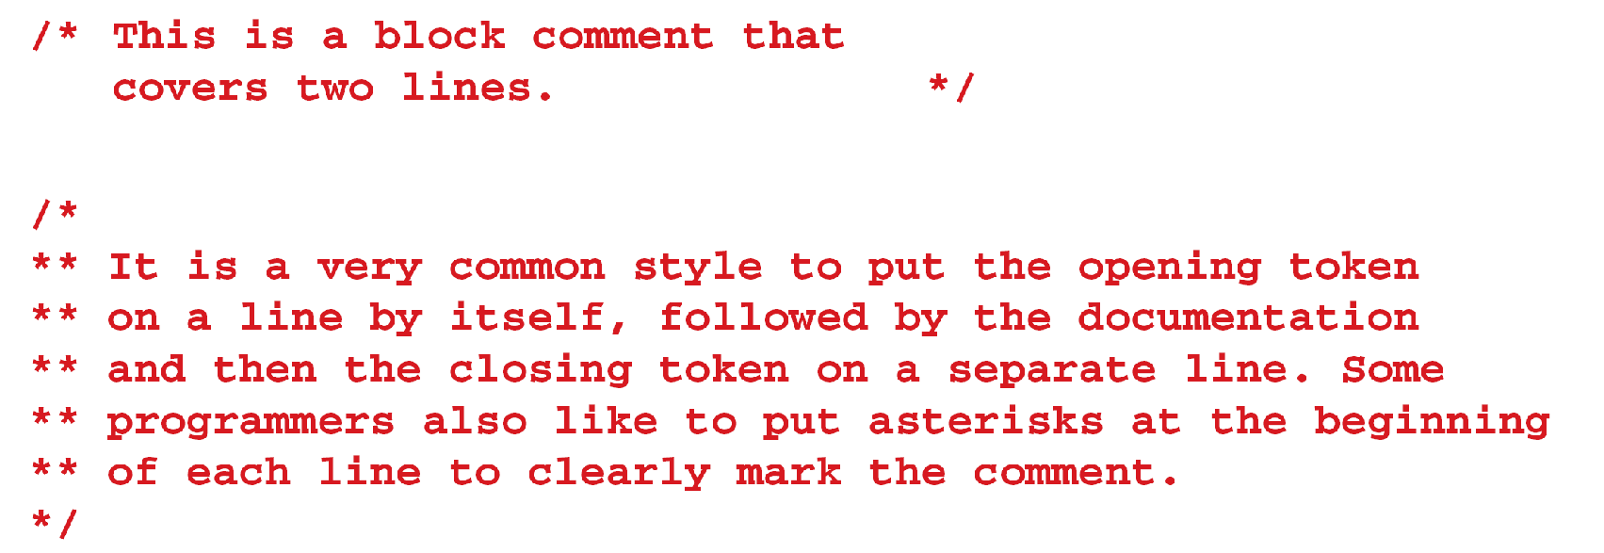
FIGURE 2-4 Examples of Block Comments
Computer Science: A Structured Programming Approach Using C
7
Notes:
7

Slide 8
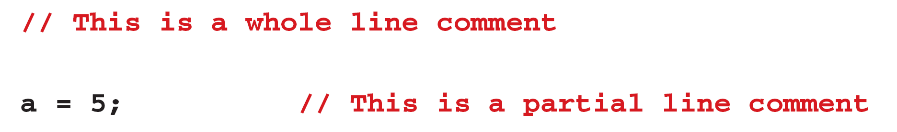
FIGURE 2-5 Examples of Line Comments
Computer Science: A Structured Programming Approach Using C
8
Notes:
8

Slide 9
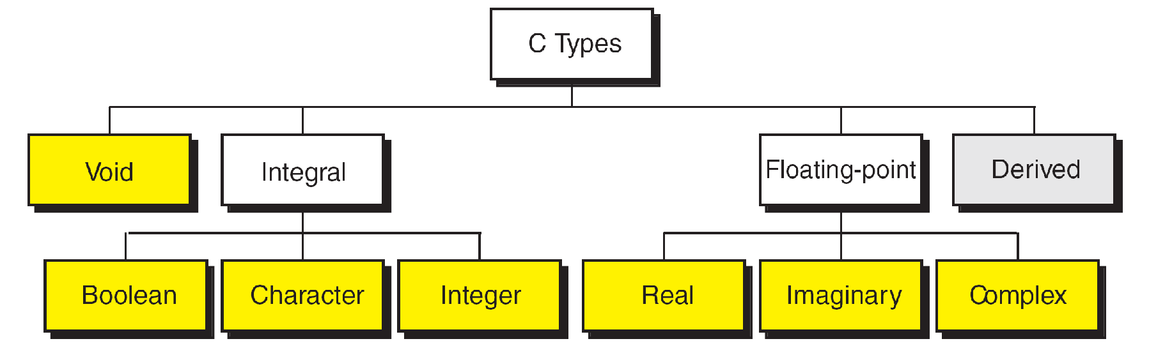
FIGURE 2-6 Nested Block Comments Are Invalid
Computer Science: A Structured Programming Approach Using C
9
Notes:
9

Slide 10
2-3 Identifiers
One feature present in all computer languages is the identifier. Identifiers allow us to name data and other objects in the program. Each identified object in the computer is stored at a unique address.
Computer Science: A Structured Programming Approach Using C
10
Notes:
10

Slide 11
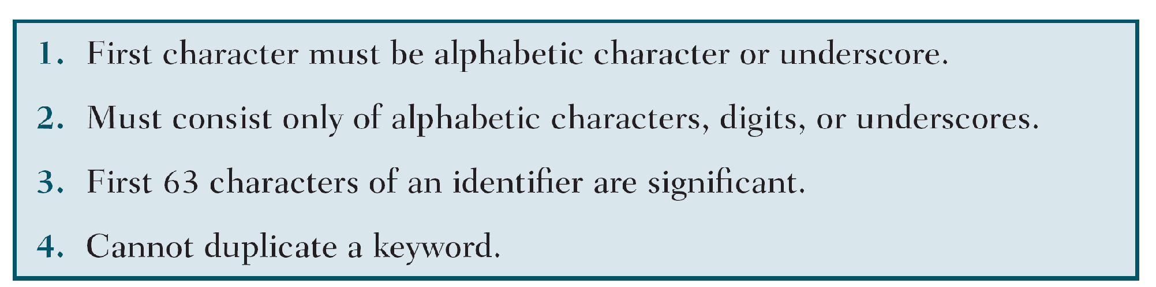
Table 2-1
Rules for Identifiers
Computer Science: A Structured Programming Approach Using C
11
Notes:
11

Slide 12
Note
An identifier must start with a letter or underscore: it may not have a space or a hyphen.
Computer Science: A Structured Programming Approach Using C
12
Notes:
12

Slide 13
Note
C is a case-sensitive language.
Computer Science: A Structured Programming Approach Using C
13
Notes:
13

Slide 14
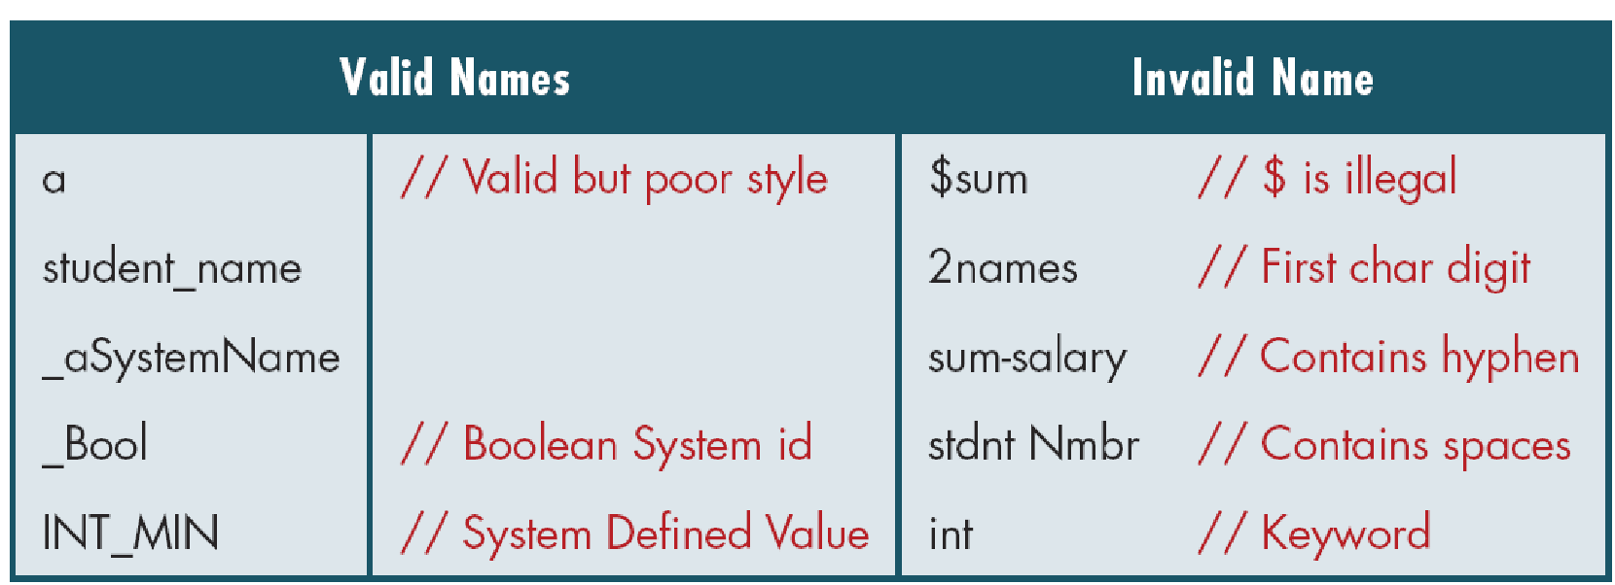
Table 2-2
Examples of Valid and Invalid Names
Computer Science: A Structured Programming Approach Using C
14
Notes:
14

Slide 15
2-4 Types
A type defines a set of values and a set of operations that can be applied on those values.
Topics discussed in this section:
Void Type
Integral Type
Floating-Point Types
Computer Science: A Structured Programming Approach Using C
15
Notes:
15

Slide 16
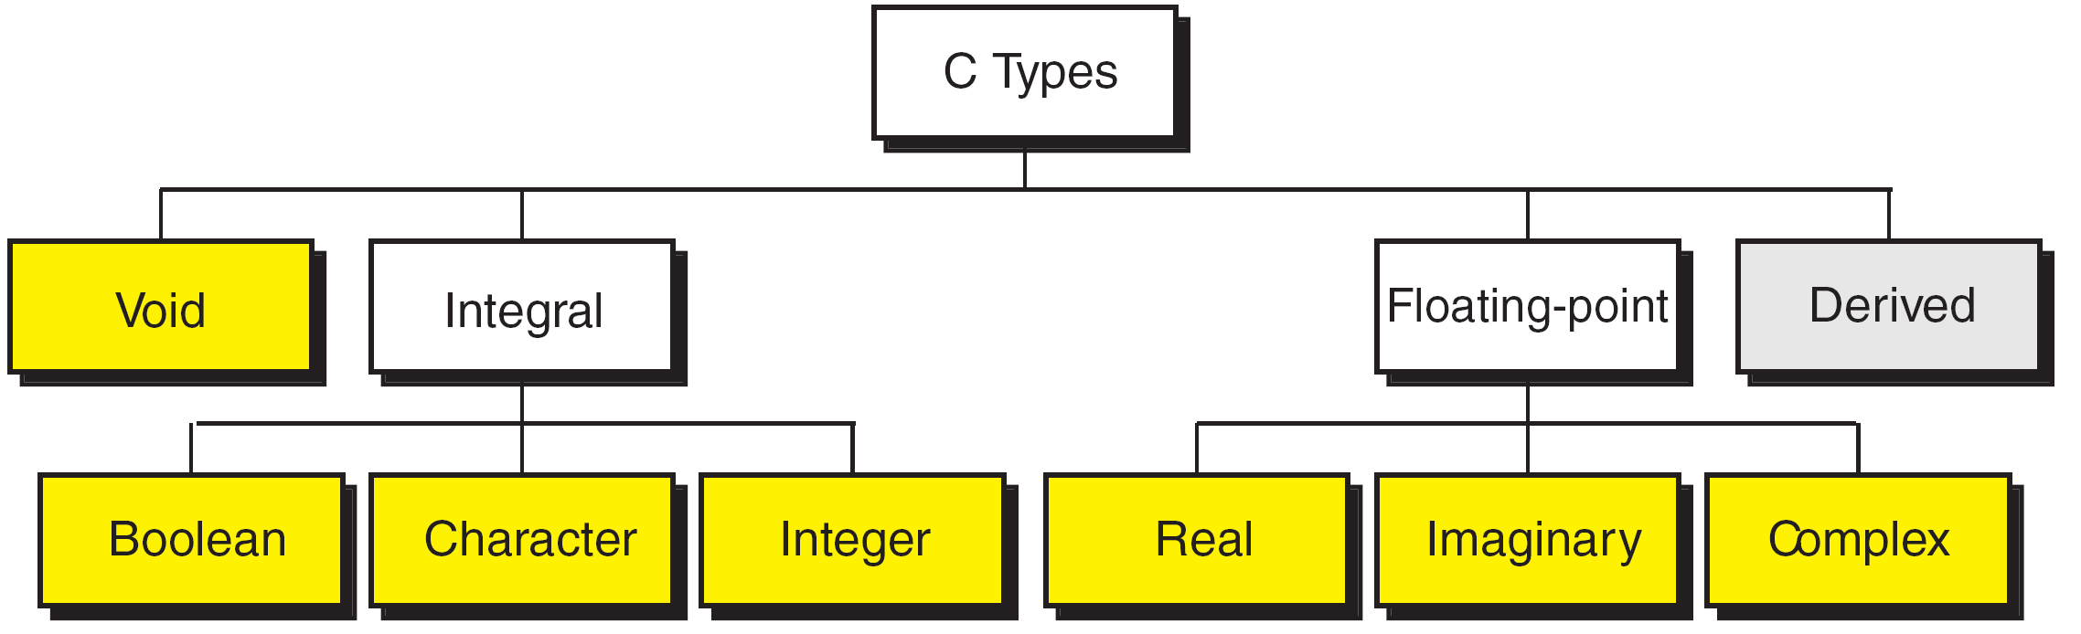
FIGURE 2-7 Data Types
Computer Science: A Structured Programming Approach Using C
16
Notes:
16

Slide 17
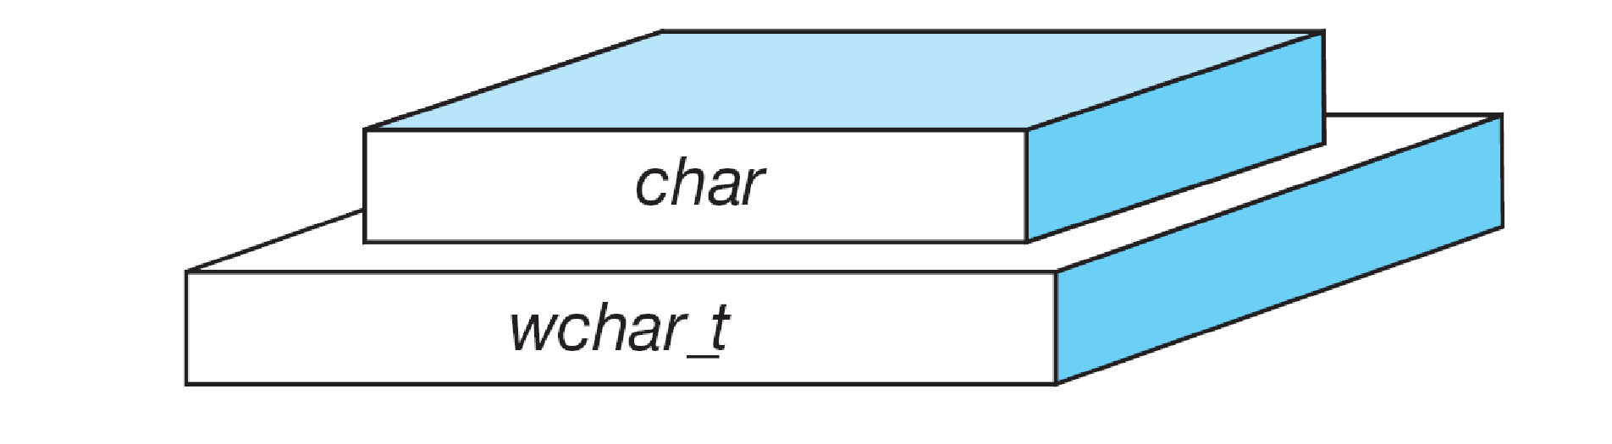
FIGURE 2-8 Character Types
Computer Science: A Structured Programming Approach Using C
17
Notes:
wchar_t is a wide character: The increased datatype size allows for the use of larger coded character sets. Width is compiler specific (not portable).
17

Slide 18
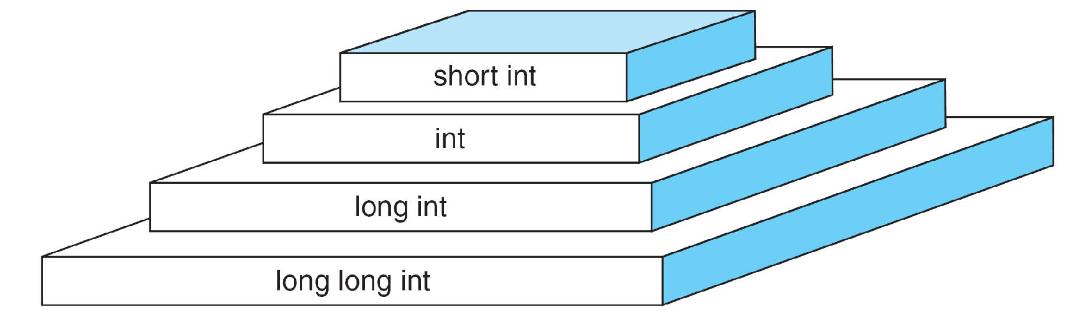
FIGURE 2-9 Integer Types
Computer Science: A Structured Programming Approach Using C
18
Notes:
18

Slide 19
Note
sizeof (short) ≤ sizeof (int) ≤ sizeof (long) ≤ sizeof (long long)
Computer Science: A Structured Programming Approach Using C
19
Notes:
19

Slide 20
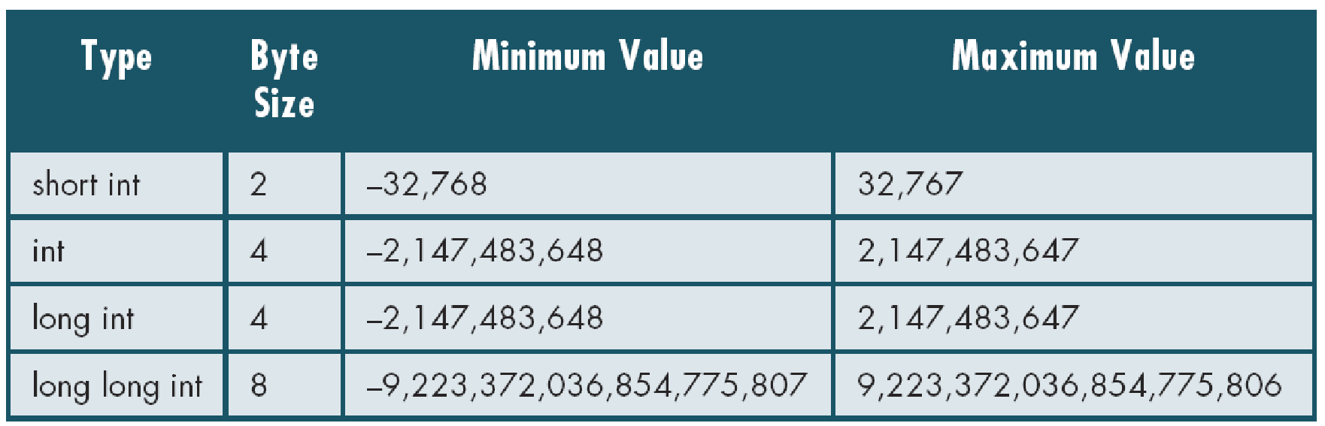
Table 2-3
Typical Integer Sizes and Values for Signed Integers
Computer Science: A Structured Programming Approach Using C
20
Notes:
20

Slide 21
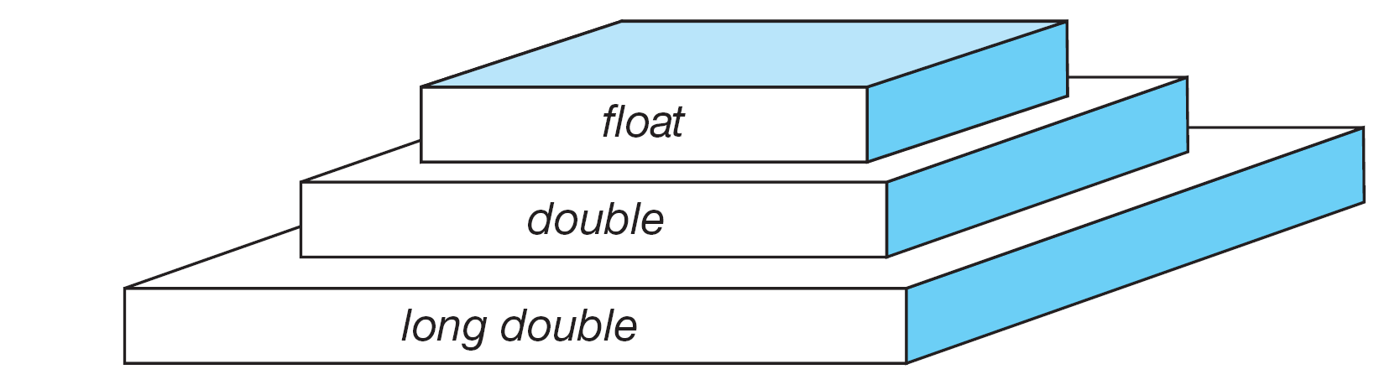
FIGURE 2-10 Floating-point Types
Computer Science: A Structured Programming Approach Using C
21
Notes:
21

Slide 22
Note
sizeof (float) ≤ sizeof (double) ≤ sizeof (long double)
Computer Science: A Structured Programming Approach Using C
22
Notes:
22

Slide 23
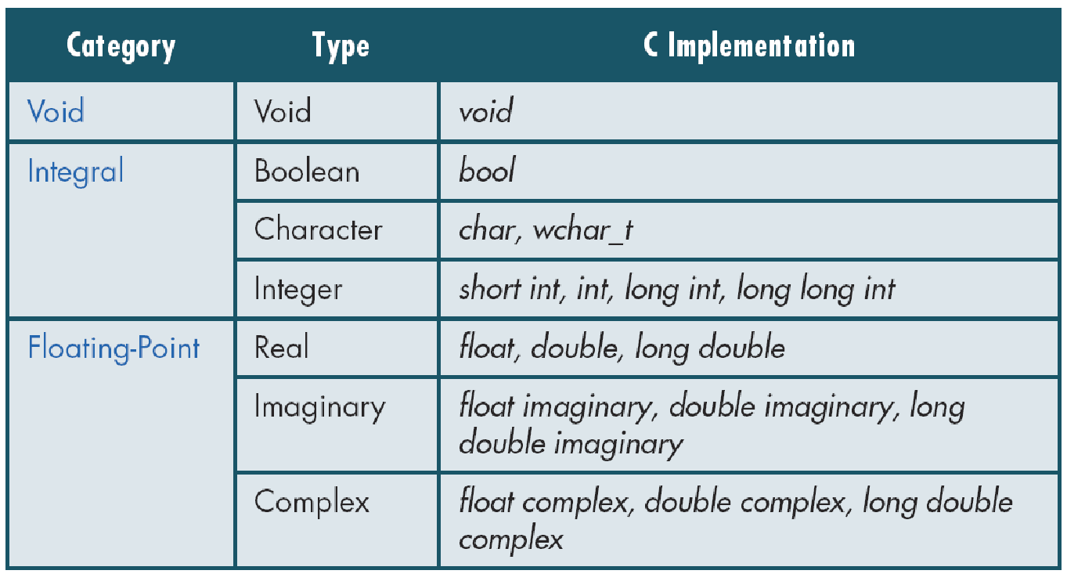
Table 2-4
Type Summary
Computer Science: A Structured Programming Approach Using C
23
Notes:
23

Slide 24
2-5 Variables
Variables are named memory locations that have a type, such as integer or character, which is inherited from their type. The type determines the values that a variable may contain and the operations that may be used with its values.
Topics discussed in this section:
Variable Declaration
Variable Initialization
Computer Science: A Structured Programming Approach Using C
24
Notes:
24

Slide 25
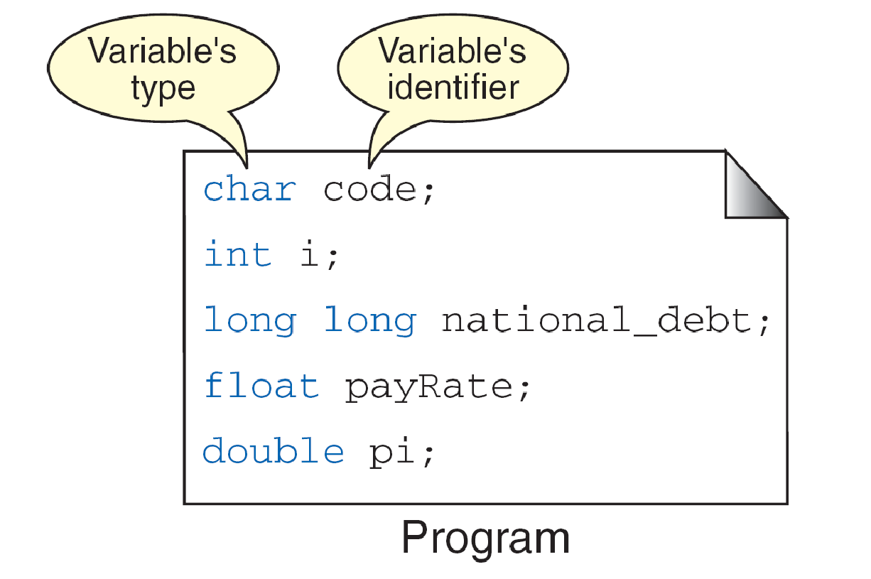
FIGURE 2-11 Variables
Computer Science: A Structured Programming Approach Using C
25
Notes:
25

Slide 26
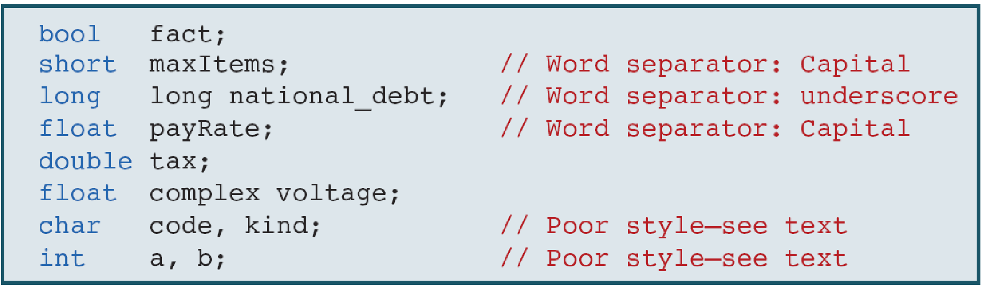
Table 2-5
Examples of Variable Declarations and Definitions
Computer Science: A Structured Programming Approach Using C
26
Notes:
26

Slide 27
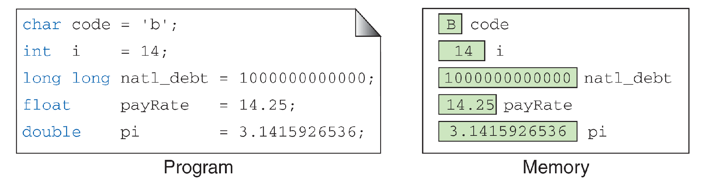
‘B’
FIGURE 2-12 Variable Initialization
Computer Science: A Structured Programming Approach Using C
27
Notes:
27

Slide 28
Note
When a variable is defined, it is not initialized. We must initialize any variable requiring prescribed data when the function starts.
Computer Science: A Structured Programming Approach Using C
28
Notes:
28

Slide 29
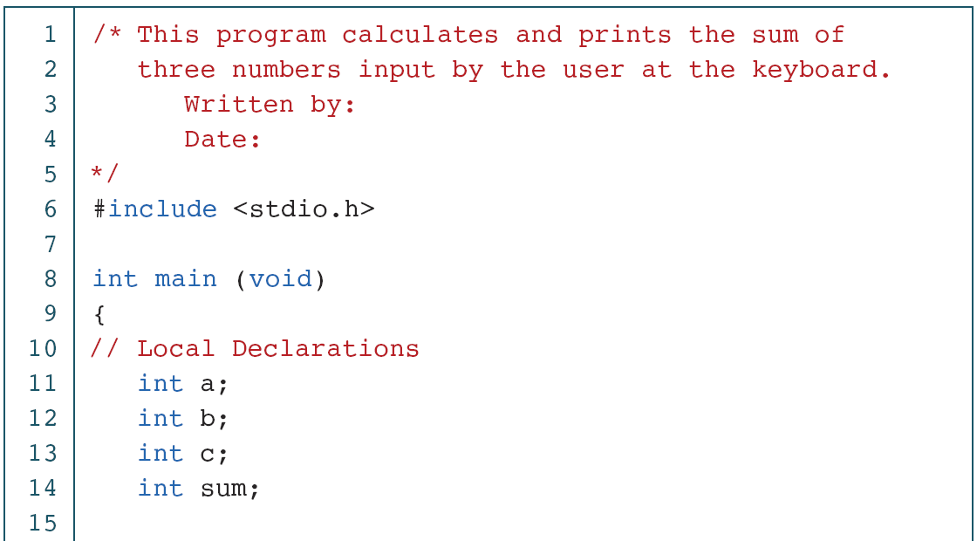
PROGRAM 2-2
Print Sum of Three Numbers
Computer Science: A Structured Programming Approach Using C
29
Notes:
29

Slide 30
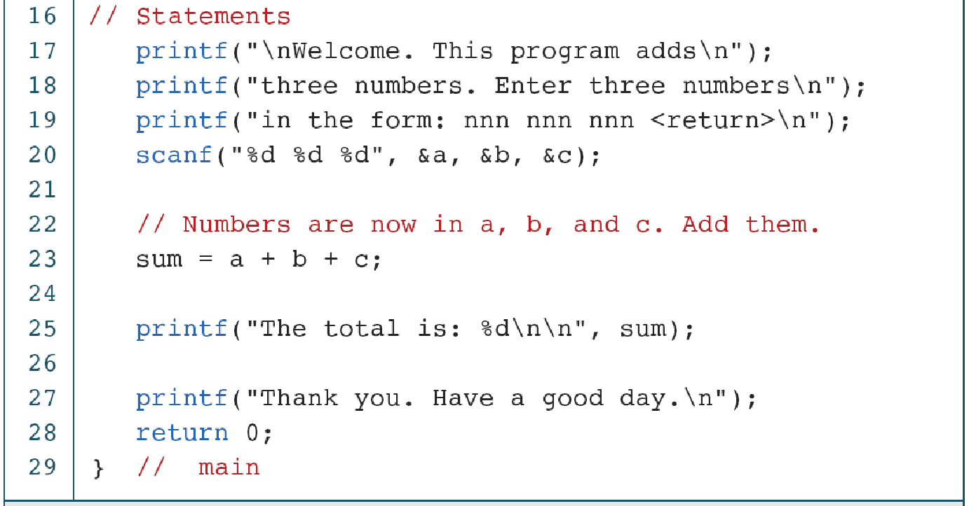
PROGRAM 2-2
Print Sum of Three Numbers (continued)
Computer Science: A Structured Programming Approach Using C
30
Notes:
30

Slide 31
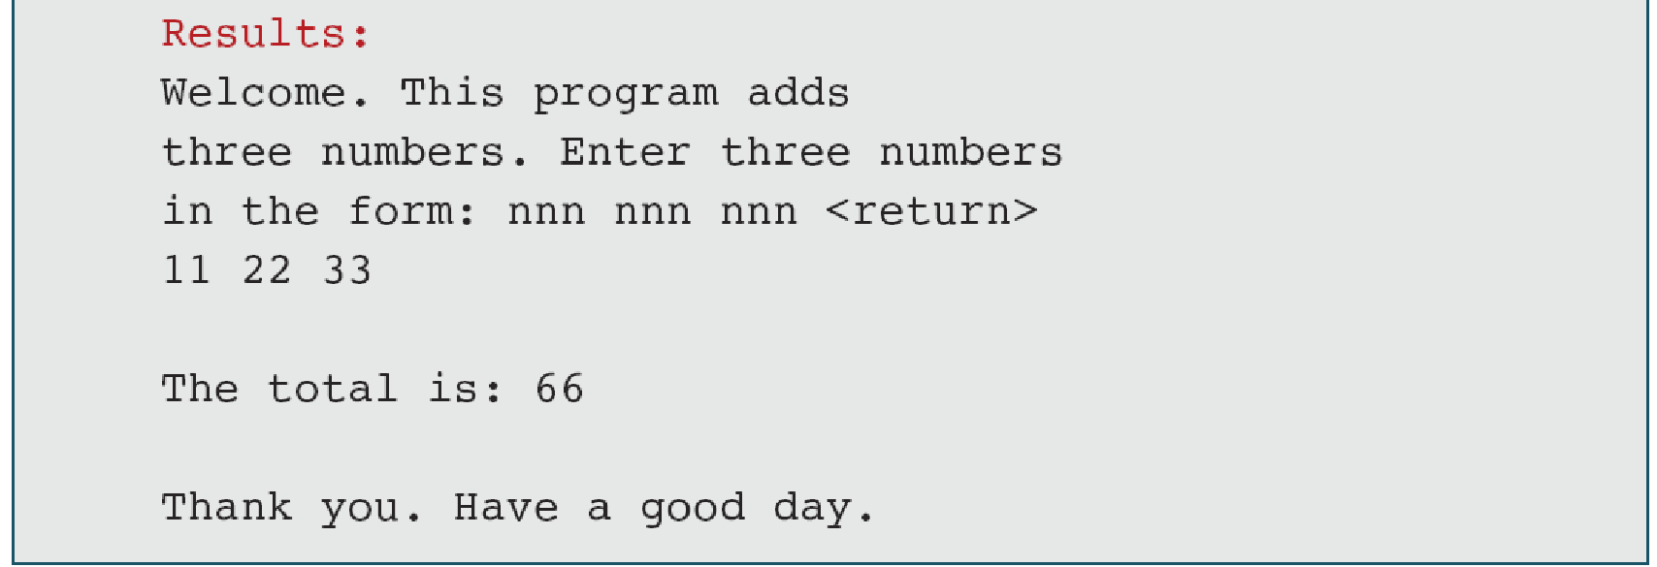
PROGRAM 2-2
Print Sum of Three Numbers (continued)
Computer Science: A Structured Programming Approach Using C
31
Notes:
31

Slide 32
2-6 Constants
Constants are data values that cannot be changed during the execution of a program. Like variables, constants have a type. In this section, we discuss Boolean, character, integer, real, complex, and string constants.
Topics discussed in this section:
Constant Representation
Coding Constants
Computer Science: A Structured Programming Approach Using C
32
Notes:
32

Slide 33
Note
A character constant is enclosed in single quotes.
Computer Science: A Structured Programming Approach Using C
33
Notes:
33

Slide 34
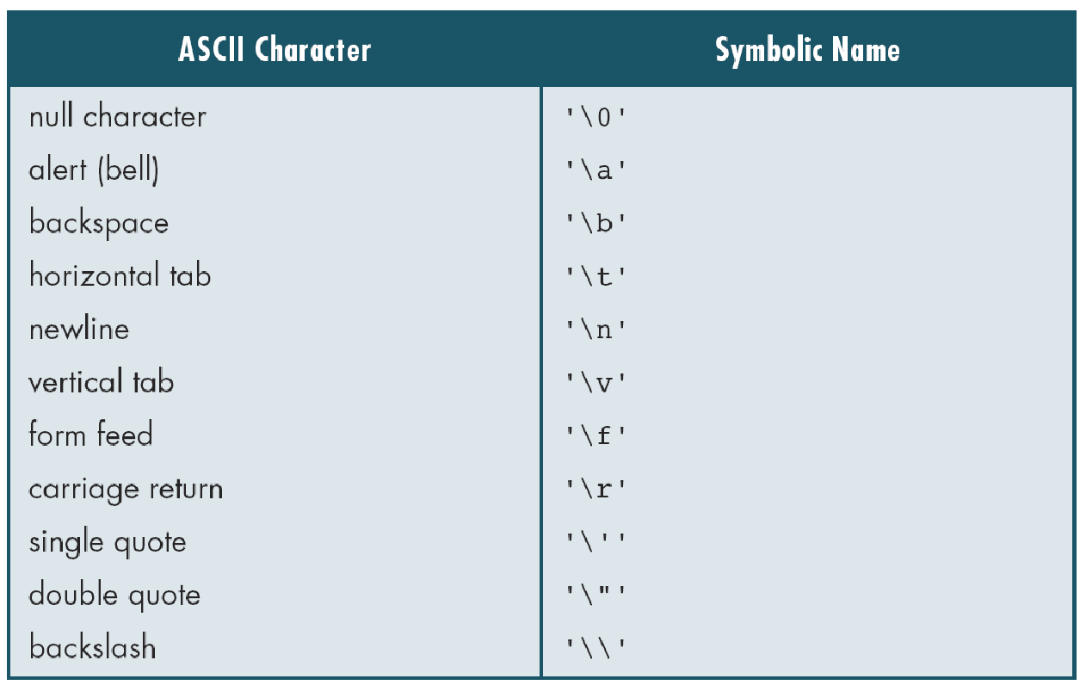
Table 2-6
Symbolic Names for Control Characters
Computer Science: A Structured Programming Approach Using C
34
Notes:
34

Slide 35
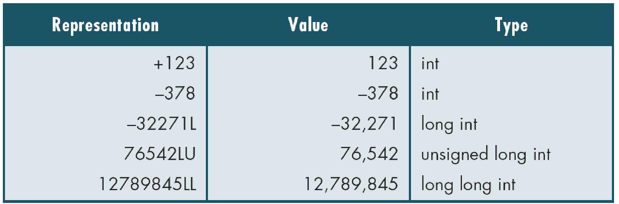
Table 2-7
Examples of Integer Constants
Computer Science: A Structured Programming Approach Using C
35
Notes:
35

Slide 36
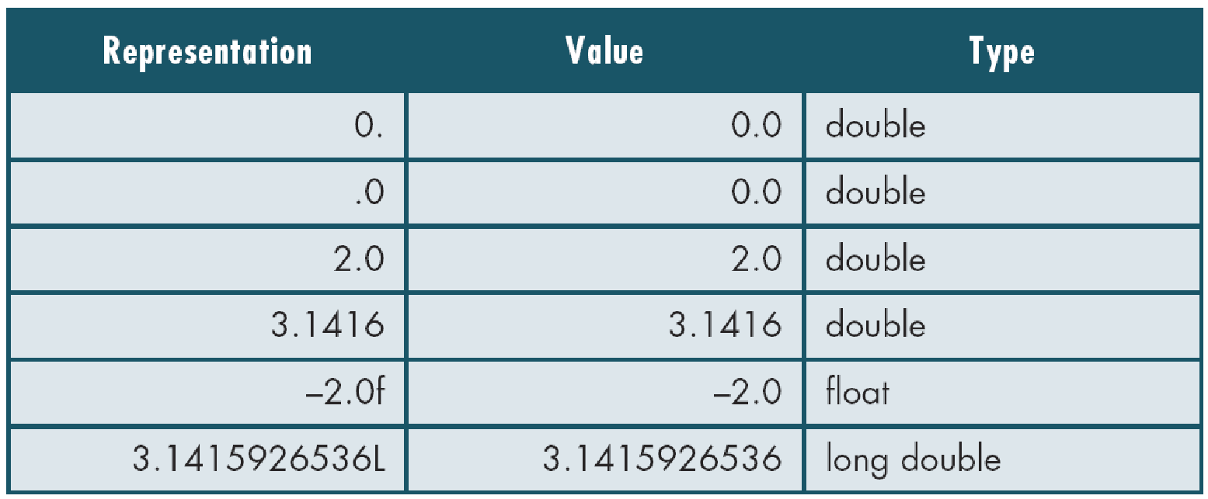
Table 2-8
Examples of Real Constants
Computer Science: A Structured Programming Approach Using C
36
Notes:
36

Slide 37
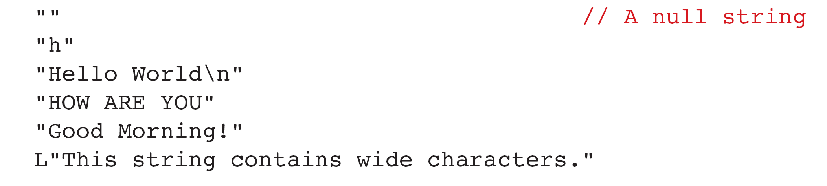
FIGURE 2-13 Some Strings
Computer Science: A Structured Programming Approach Using C
37
Notes:
37

Slide 38

FIGURE 2-14 Null Characters and Null Strings
Computer Science: A Structured Programming Approach Using C
38
Notes:
38

Slide 39
Note
Use single quotes for character constants. Use double quotes for string constants.
Computer Science: A Structured Programming Approach Using C
39
Notes:
39

Slide 40
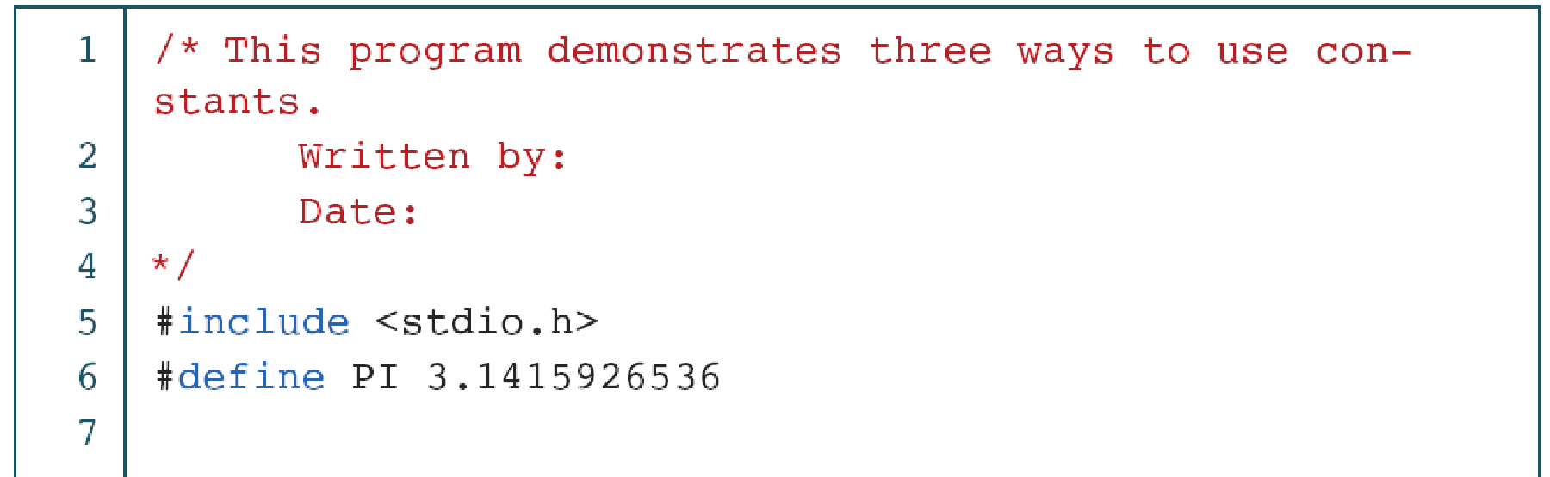
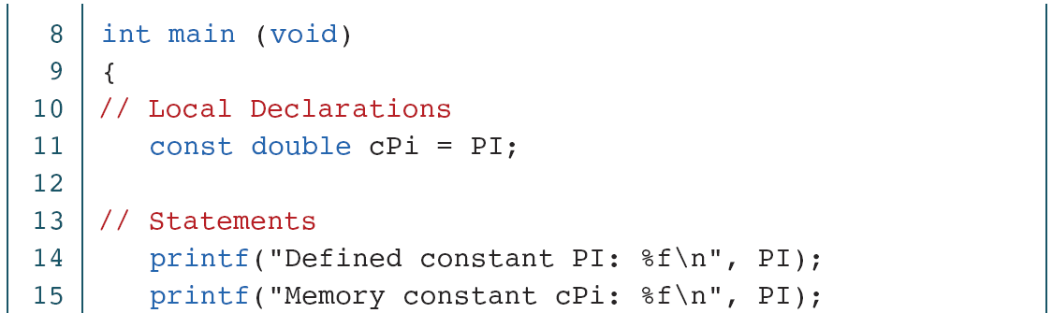
PROGRAM 2-3
Memory Constants
Computer Science: A Structured Programming Approach Using C
40
Notes:
40

Slide 41
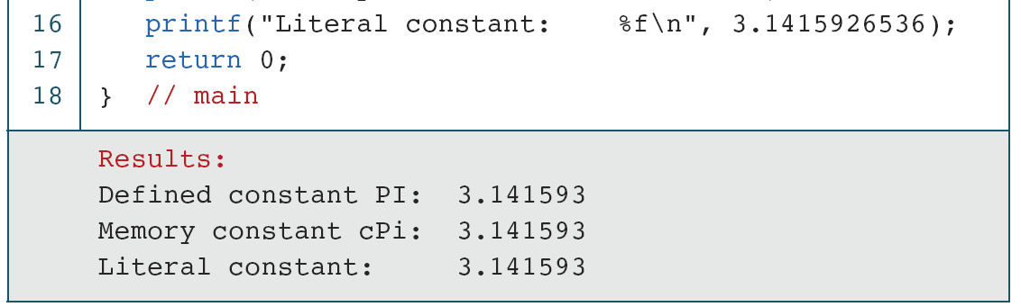
PROGRAM 2-3
Memory Constants (continued)
Computer Science: A Structured Programming Approach Using C
41
Notes:
41

