Slide 1
History and Features Of C

Slide 2
History of C Language
C programming language was developed in 1972 by Dennis Ritchie at bell laboratories of AT&T (American Telephone & Telegraph), located in the U.S.A.
Dennis Ritchie is known as the founder of the c language.
It was developed to overcome the problems of previous languages such as B, BCPL, etc.
Initially, C language was developed to be used in UNIX operating system. It inherits many features of previous languages such as B and BCPL.

Slide 3
Language | Year | Developed By
Algol | 1960 | International Group
BCPL | 1967 | Martin Richard
B | 1970 | Ken Thompson
Traditional C | 1972 | Dennis Ritchie
K & R C | 1978 | Kernighan & Dennis Ritchie
ANSI C | 1989 | ANSI Committee
ANSI/ISO C | 1990 | ISO Committee
C99 | 1999 | Standardization Committee

Slide 4
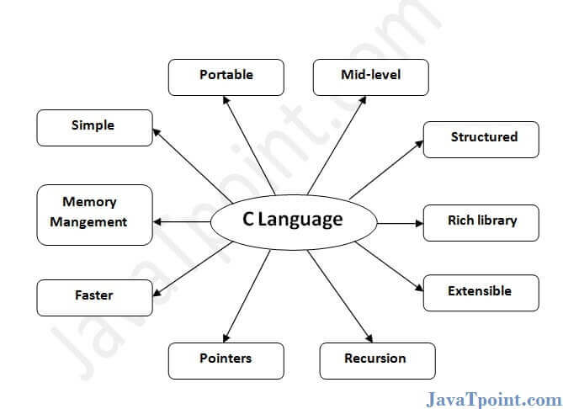
Features of C Language

Slide 5
1) Simple
C is a simple language in the sense that it provides a structured approach (to break the problem into parts), the rich set of library functions, data types, etc.
2) Machine Independent or Portable
Unlike assembly language, c programs can be executed on different machines with some machine specific changes. Therefore, C is a machine independent language.
3) Mid-level programming language
Although, C is intended to do low-level programming. It is used to develop system applications such as kernel, driver, etc. It also supports the features of a high-level language. That is why it is known as mid-level language.

Slide 6
4) Structured programming language
C is a structured programming language in the sense that we can break the program into parts using functions. So, it is easy to understand and modify. Functions also provide code reusability.
5) Rich Library
C provides a lot of inbuilt functions that make the development fast.
6) Memory Management
It supports the feature of dynamic memory allocation. In C language, we can free the allocated memory at any time by calling the free() function.

Slide 7
7) Speed
The compilation and execution time of C language is fast since there are lesser inbuilt functions and hence the lesser overhead.
8) Pointer
C provides the feature of pointers. We can directly interact with the memory by using the pointers. We can use pointers for memory, structures, functions, array, etc.
9) Recursion
In C, we can call the function within the function. It provides code reusability for every function. Recursion enables us to use the approach of backtracking.
10) Extensible
C language is extensible because it can easily adopt new features.

Slide 8
How to install C
There are many compilers available for c and c++. You need to download any one. Here, we are going to use Turbo C++. It will work for both C and C++. To install the Turbo C software, you need to follow following steps.
Download Turbo C++
Create turboc directory inside c drive and extract the tc3.zip inside c:\turboc
Double click on install.exe file
Click on the tc application file located inside c:\TC\BIN to write the c program
1) Download Turbo C++ software
You can download turbo c++ from many sites. download Turbo c++
2) Create turboc directory in c drive and extract the tc3.zip
Now, you need to create a new directory turboc inside the c: drive. Now extract the tc3.zip file in c:\truboc directory.
3) Double click on the install.exe file and follow steps
Now, click on the install icon located inside the c:\turboc

Slide 9
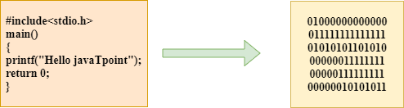
What is a compilation?
The compilation is a process of converting the source code into object code. It is done with the help of the compiler.
The compiler checks the source code for the syntactical or structural errors, and if the source code is error-free, then it generates the object code.

Slide 10
The c compilation process converts the source code taken as input into the object code or machine code. The compilation process can be divided into four steps, i.e., Pre-processing, Compiling, Assembling, and Linking.
The preprocessor takes the source code as an input, and it removes all the comments from the source code. The preprocessor takes the preprocessor directive and interprets it.
For example, if <stdio.h>, the directive is available in the program, then the preprocessor interprets the directive and replace this directive with the content of the 'stdio.h' file.

Slide 11
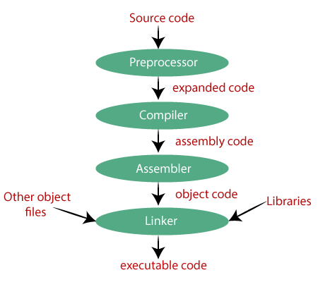
The following are the phases through which our program passes before being transformed into an executable form

