Slide 1
Introduction to Programming Language
CS105
Notes:
1

Slide 2
Programming Language
First-generation: Machine language
Second-generation: Assembly language
Third-generation: High-level language
Fourth-generation
(Fifth-generation)
Notes:
2

Slide 3
1GL: Machine language
A set of primitive instructions built into every computer
The instructions are in the form of binary code
1101101010011010
Notes:
3

Slide 4
2GL: Assembly language
Low-level programming language to represent machine-language instructions
E.g.: ADDF3 R1, R2, R3
Assembly code need to be converted into machine code by using an assembler
Assembly program
is platform dependent
Combination of mnemonic and machine instruction
Notes:
4

Slide 5
3GL: High-level language
English-like and easy to learn and program.
E.g.:
Area = 5 * 5 * 3.1415;
COBOL, FORTRAN, BASIC, Pascal, Ada, C, Visual Basic, Delphi, C++, C#, Java
Source program is compiled into machine code by a compiler and linked to supporting library code by a linker to form an executable file.
Notes:
5

Slide 6
4GL / 5GL
3GL offered greater power to the programmer, while 4GL open up the development environment to a wider population. (Applications Development Without Programmers)
Database query languages: SQL…
Data manipulation, analysis, and reporting languages: MATLAB, SPSS…
Notes:
6

Slide 7
Category (3GL)
Windows Application
C, C++, Java, Visual Basic, C#
Web Application
Server Side
PHP, JSP (Java), ASP.NET (Visual Basic, C#), …
Client Side
JaveScript, VBScript
Notes:
7

Slide 8
The Binary Machine
A modern computer can run programs written in JavaScript, Pascal, Visual Basic, Visual C++, etc.
However, computers can only understand one language: the machine language it is not easy to use.
The machine language of a Sun workstation is different from a PC (or other platform), however, they can run the same C++ program.
Notes:
8

Slide 9
Two types of Translators (3GL to 1GL)
Interpreter:
translate and run the source code one line at a time. Easy to write and easy to find the errors in the program, but running very slow.
JavaScript, VBScript, PHP, …
Compiler:
translates the source code once and for all, producing a complete machine language program. Very fast, but when the program fails, difficult to show the programmer where are the errors.
C, C++, Java, C#, and so on.
Notes:
9

Slide 10
Implement a Language
Generally, the action of any translating program can be divided into three phases
Scanning
Parsing
Code generation
Notes:
10

Slide 11
Implement a Language - Scanning
Scanning process: a long string of characters is broken into tokens.
Example: sum = a + b is broken into 5 tokens sum, =, a, +, b
A token is the smallest meaningful unit of information.
Notes:
11

Slide 12
Implement a Language - Parsing
Parsing: the string of tokens is transformed into a syntactic structure.
What happens in a compiler or interpreter is that the list of tokens is converted to a parse tree in memory via a complicated algorithm.
=
sum
+
a
b
Notes:
12

Slide 13
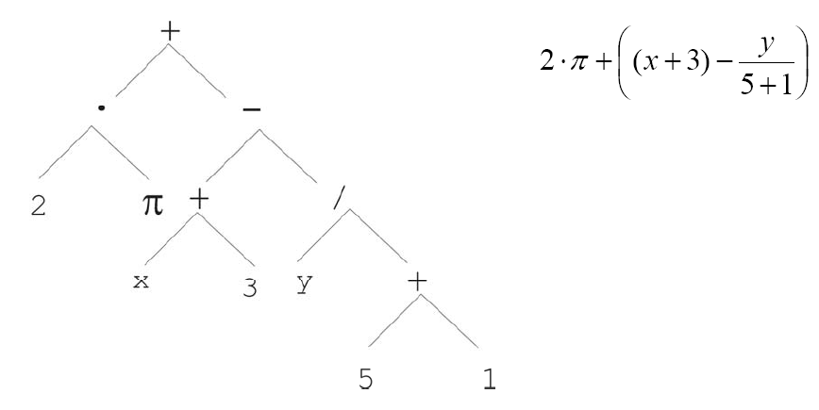
Parsing a complicated equation
Notes:
13

Slide 14
Parsing a complicated equation
Notes:
14

