Slide 1
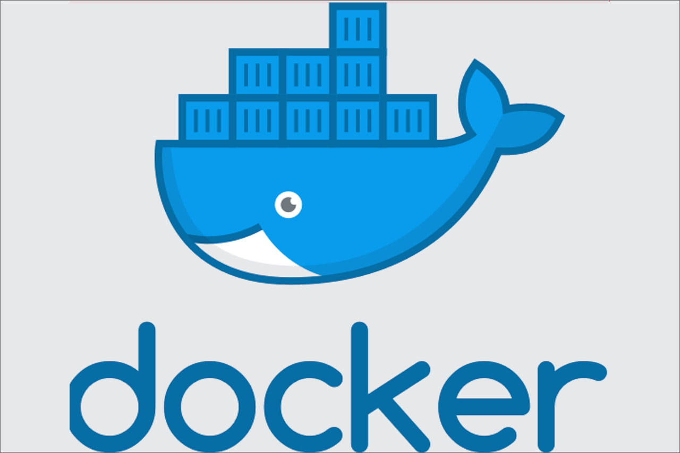

Docker to OPENSHIFT
Deep Dive into what is behind the scenes
from a developer’s perspective

Slide 2

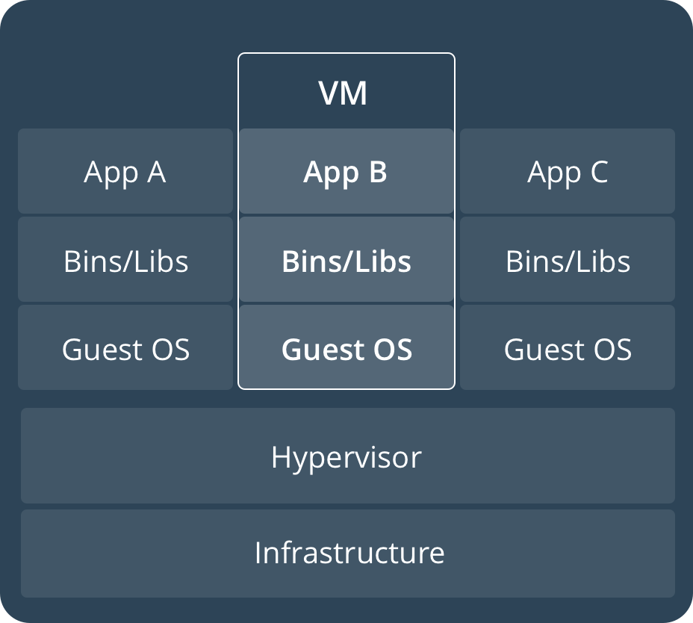
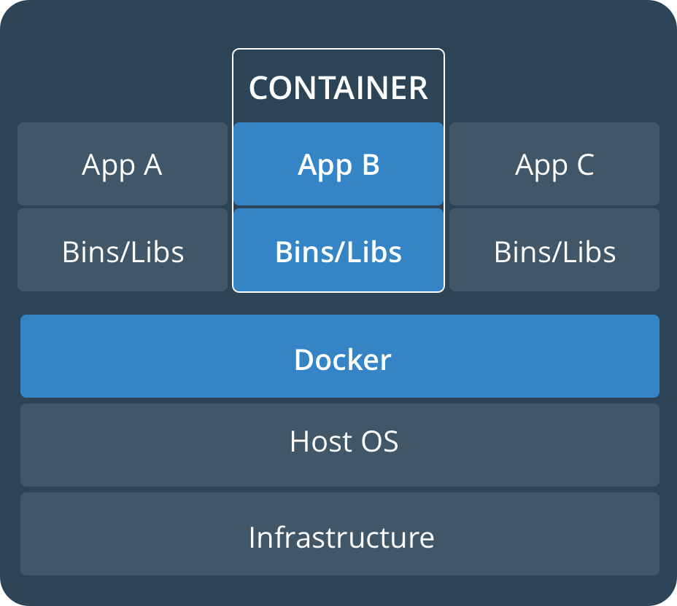
Docker Introduction
https://docs.docker.com/get-started/
  Part 1 / Docker Concepts only
Containerization
  Makes more use of H/W than virtualization
An image is a template that becomes a running container
Image consists of layers
  Built up using a sort of inheritance
Containers are isolated from each other
  Process isolation
  Resource isolation

Slide 3
Docker Introduction (cont.)
https://docs.docker.com/engine/docker-overview/
  Docker is a company - https://www.docker.com/company
  Docker is a platform – tools, deployment model
    Client tool, registries, images, containers
  The docker engine – daemon process that manages the system
  Docker is an API – docker engine, machine, compose, etc.

Slide 4
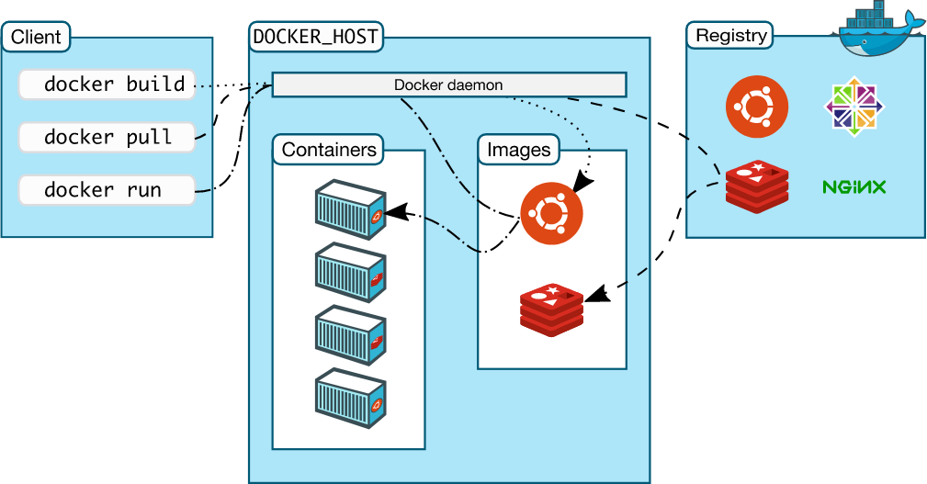
Docker Introduction (cont.)
Architecture

Slide 5
Docker Introduction (cont.)
Underlying Linux Technology
  Namespaces – provides isolation for containers
  Control groups – allows for H/W sharing with isolation
  Union File Systems (coming next)
    AUFS, btrfs, vfs, Device Mapper, etc.
  Container – composed of all of these things

Slide 6
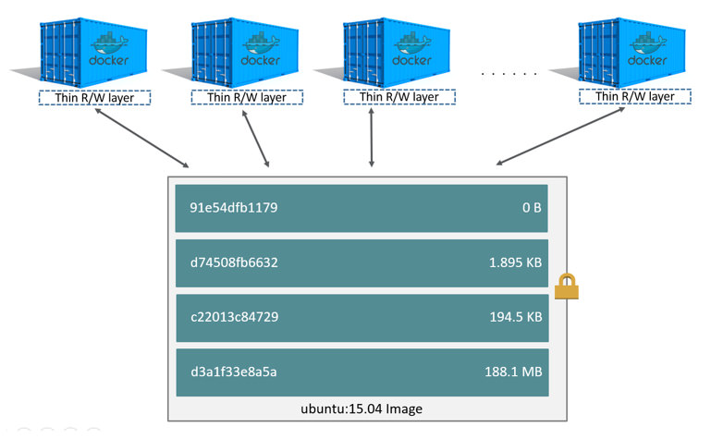
Docker Introduction (cont.)
https://docs.docker.com/storage/storagedriver/
Layered for efficiency
Reuses layers already in the system
Most layers are immutable
Containers have thin R/W layer

Slide 7
Docker Introduction (cont.)
https://docs.docker.com/install/linux/docker-ce/debian/
docker info | grep '^Docker Root'
  /var/lib/docker
docker – without params lists commands
docker help <command> - shows help for that command
docker image ls – shows local images
docker container ls – shows local running containers
docker inspect <container> - shows details of running container
docker run hello-world
docker run -it –name=alpine alpine sh
CTRL-p CTRL-q
docker exec -it alpine sh
docker stop alpine
docker system prune – answer y at the prompt

Slide 8
Docker Introduction (cont.)
Run a Docker image
  Lab - https://github.com/docker/labs/tree/master/beginner/
  Dockerfile - https://docs.docker.com/engine/reference/builder/
docker run nginx
  Blocks terminal; generates name for container; hit CTRL-c
docker container ls -a – shows all containers even exited
docker run -d nginx – starts in background (d for daemon mode)
  Still binds to port 80 which is not possible for unprivileged user
docker stop <container> - will stop the container in 10 secs
docker run -d --name nginx -p 8080:80 nginx
  Now has the name we give – nginx
  Binds internal port 80 to port 8080 on host
docker container ls – to see the result
Open browser and go to http://localhost:8080/

Slide 9
Docker Introduction (cont.)
Create a Docker image
  Dockerfile - https://docs.docker.com/engine/reference/builder/
mkdir src – create a dir to hold work; name is not important
Create index.html: <h1>It works!</h1><p>my custom page</p>
Create Dockerfile:
  FROM nginx
  COPY index.html /usr/share/nginx/html
Build image:
  docker build -t mynginx .
Run it:
  docker run -d --name mynginx -p 8080:80 mynginx
Open browser and go to http://localhost:8080/
Use docker inspect to compare nginx and mynginx

Slide 11
OpenShift Introduction
Kubernetes - https://kubernetes.io/
Okd - https://www.okd.io/
Minishift - https://www.okd.io/minishift/

