Slide 1

Do you like Yoga?
But you need a coach to start with it?

Slide 2
Then don’t worry!
I have something for you :)

Slide 3
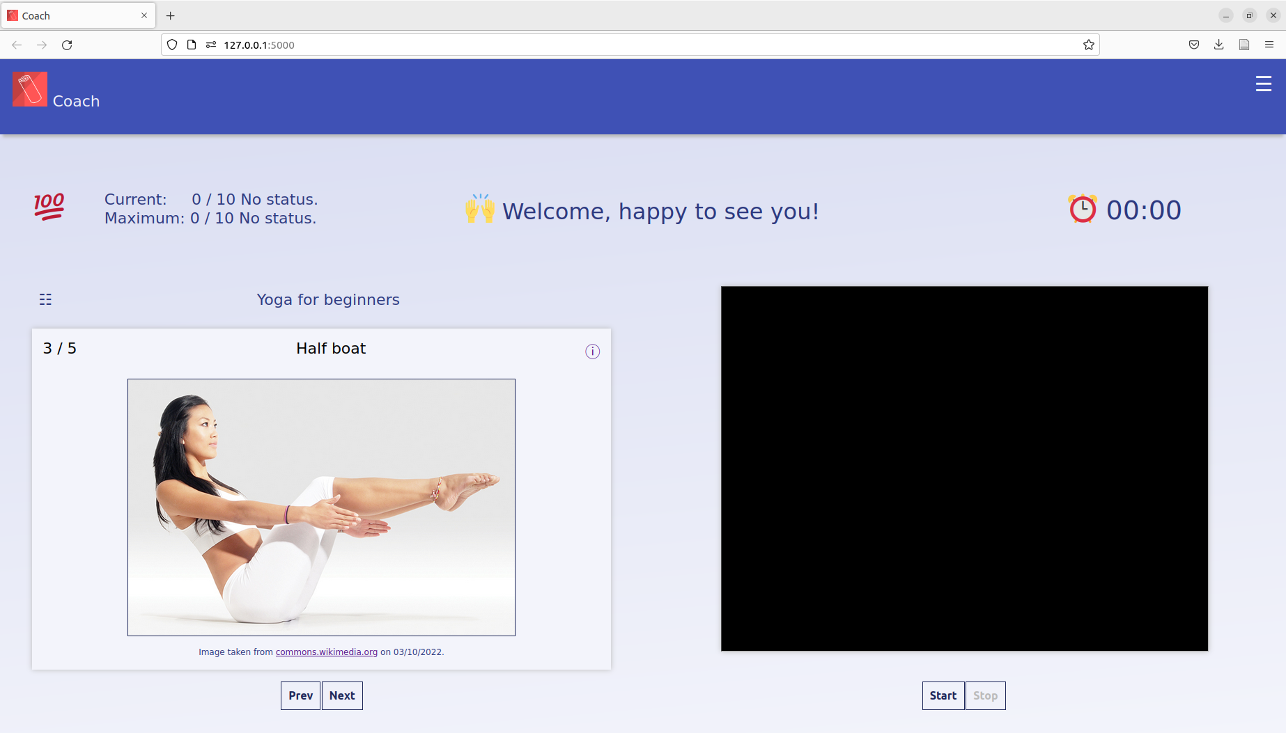
I created a computer vision based yoga coach web app

Slide 4
Functionality
Suggests you exercises from a certain category
Runs in your browser using your 2D webcam
Predicts your body pose in 3D on the server
Starts a timer when you are ready (visible)
Gives you feedback acustically

Slide 5
Technical background
Flask webframework
MediaPipe Pose library to predict the 33 landmarks
Relations between key landmarks and joints are known allowing to calculate angles
To create angle templates, Wikipedia images are used
Angles of correct template and current are compared per video frame
Feedback is based on the resulting differences
Feedback to audio with Google Translate's text-to-speech API (gTTS)

Slide 6

You want to know more about it?
Then check out the Github repository
It’s open-source :)
And give it a start ⭐ ;)
https://github.com/klmhsb42/yoga_coach_web

Slide 7
Credits
all people from Spiced Academy
Bundesagentur für Arbeit
Background for presentation taken from LibreOffice Impress templates
MediaPipe Pose
commons.wikimedia.org
And others (see Github repository)

