Slide 1

Kelemen Balázs János Bata Dániel Tamás Pidl Ádám

Slide 2
Aim of our project
Making the process of renting a vehicle smooth
Ensuring a secure and user-friendly experience
Efficient booking and management
Scalable and future proof architecture

Slide 3

Functions
User management
Car browsing & booking
Admin dashboard & control
User & rental approvals
Security
Driver’s license verification
Admin authorization
Notifications

Slide 4
Frontend
Stack:
Angular 18
TypeScript
Sassy CSS (SCSS)
Design:
Figma
Features:
Responsive UI
Smooth state management
Dynamic and interactive components via Angular
RxJS

Slide 5
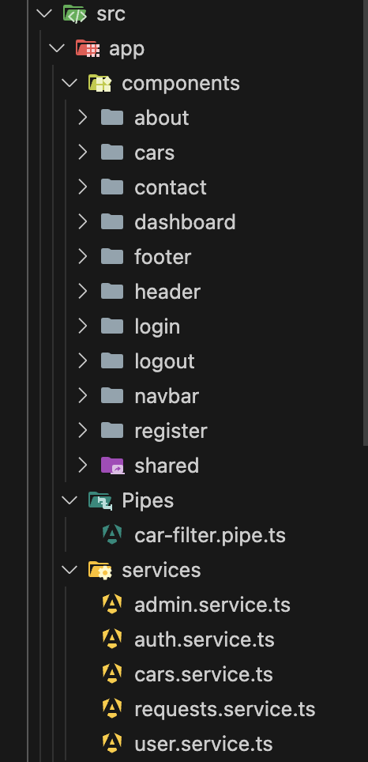
Frontend
Components
UI and user interactions
Pipes
Data transformations, such as filtering cars
Services
Handle API communication

Slide 6
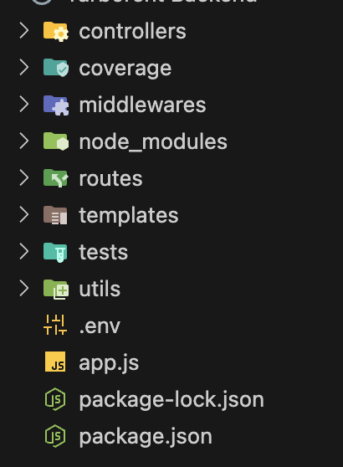
Backend
Stack:
NodeJS w/ Express
Features:
JWT (jsonwebtoken)
w/ refresh tokens & forgotten password tokens!
Full-fledged authentication system
Database connection via MySQL
MVC (model, view, controller)

Slide 7
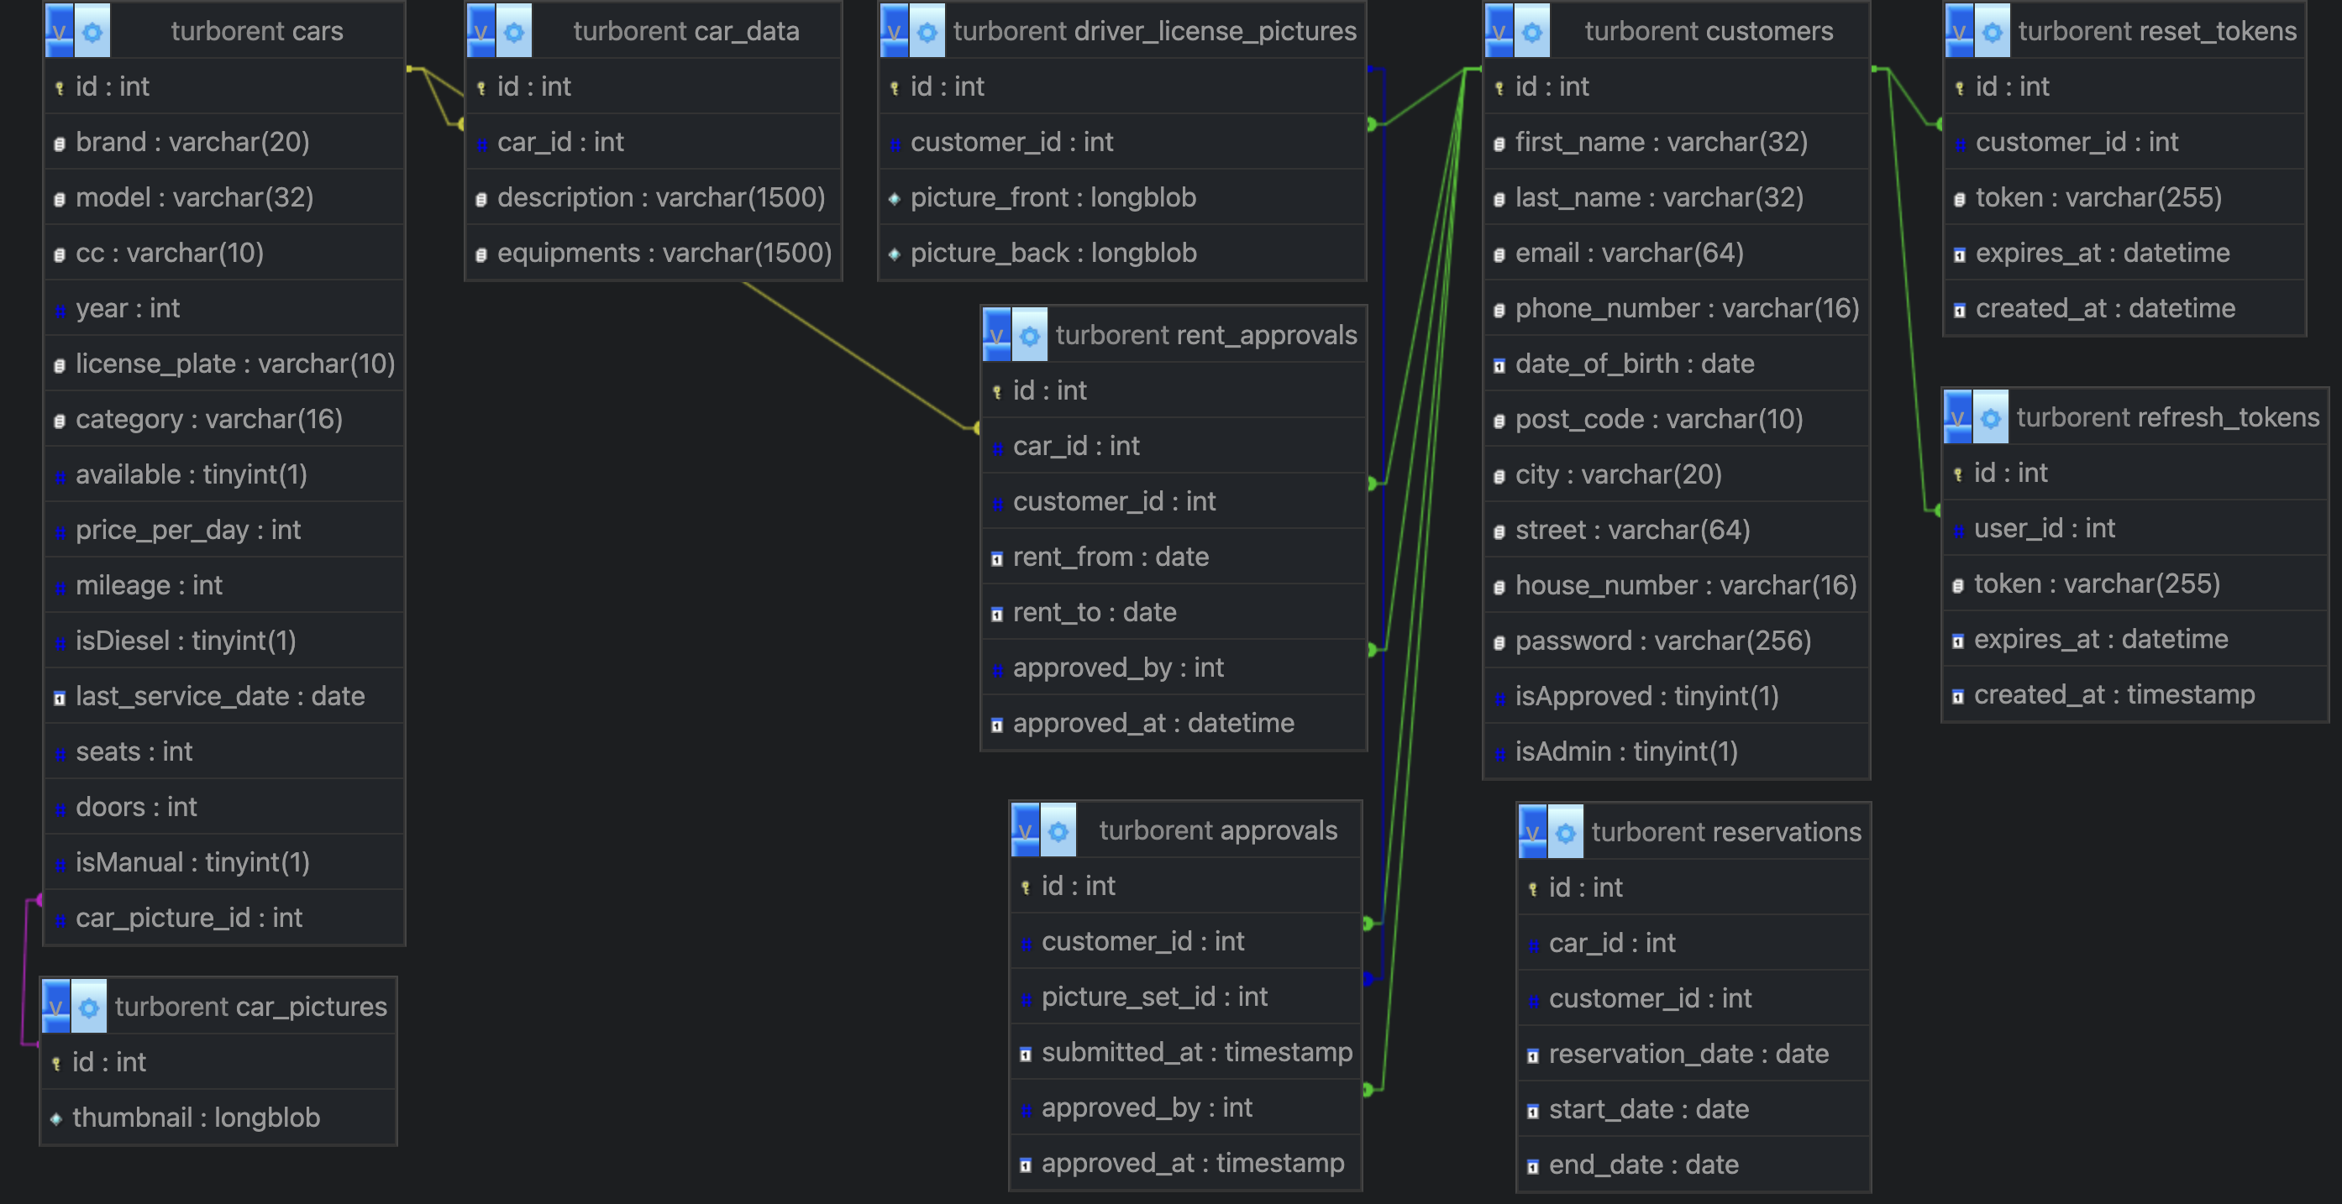
Database - MySQL
September 3, 20XX

Slide 8
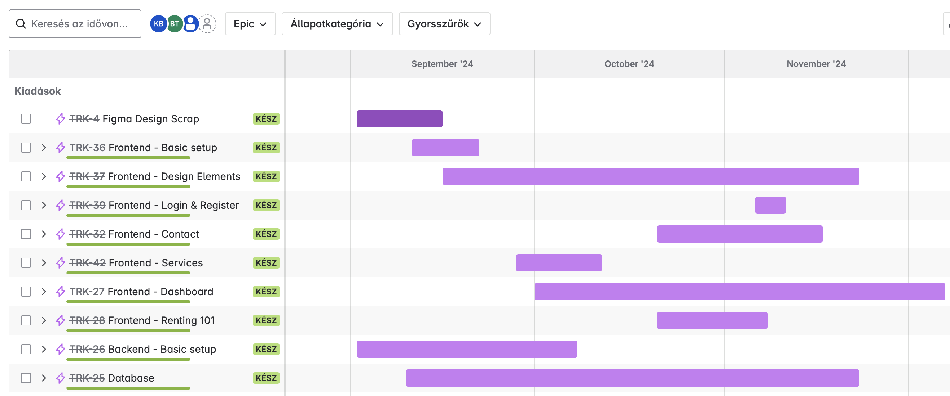
Jira
Kanban
Workflow management
Time tracking
w/ Clockwork
Task organization

Slide 9
GitHub
Branches
Production
Front-end
Back-end
Repository management
Commit history
Collaboration & workflow

Slide 10
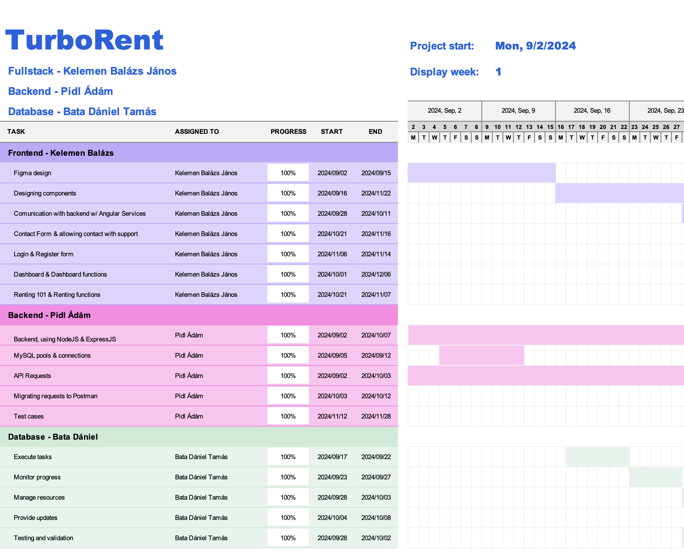
Gantt Diagram
Task scheduling
Progress monitoring
Task assigning
Adaptability
Easily adjustable

Slide 11

Why us?
Wide range of cars w/ affordable rates
Flexible rental periods
Easy online booking
Quick and efficient customer service
Secure and reliable

Slide 12
“
Future plans
Implementing online purchases w/ Stripe
Ticket system
Detailed logging system
SSO (Single sign-on)

Slide 13

Thank you
Thank you for taking the time to listen to our presentation.
We truly appreciate your attention and interest in our project.
team
made w/ passion & ❤️

